Slide 1
Revamp Software Quality for Android Robots through Advanced Development and Deployment Methodologies
SOFTWARE
QUALITY
CONFERENCE
PACIFIC NW
THEODORE GUO, MONICA BAO, SOPHIA LEE, KYLE ZHOU and Bo Li
[October 9-11, 2023]
PNSQC ™

Slide 2
Key Points and Overview of Content
SOFTWARE
QUALITY
CONFERENCE
PACIFIC NW
Introduction
For Inspiration and Recognition of Science and Technology (FIRST) Tech Challenge (FTC) and FTC robots: a brief summary.
Advanced Development and Deployment Methodologies to Revamp Hardware/Software Integration
Case Study: Robotic Claw Optimization
Case Study: Software Improvement through External Sensors
Utilizing TensorFlow ML for autonomous movement
Github and CI/CD software deployment methods to accelerate software improvements.
Conclusion & Acknowledgements
PNSQC ™

Slide 3
Introduction
SOFTWARE
QUALITY
CONFERENCE
PACIFIC NW
Robotics software quality is crucial to control robot hardware while interacting with the physical world
Software development and deployment methodologies are employed to revamp software quality and detail case studies are provided
Shared the experiences of FIRST Tech Challenge (FTC) robotics team to revamp software quality
PNSQC ™

Slide 4
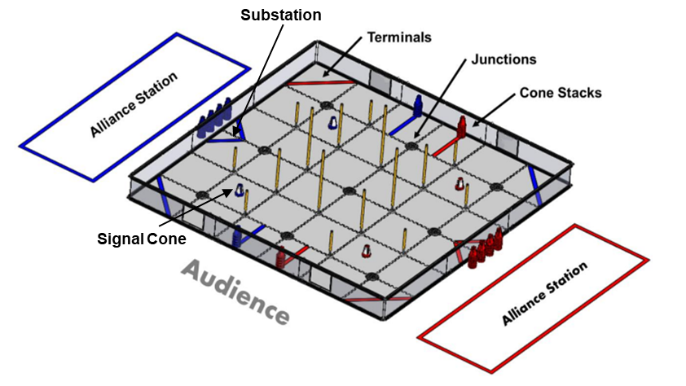
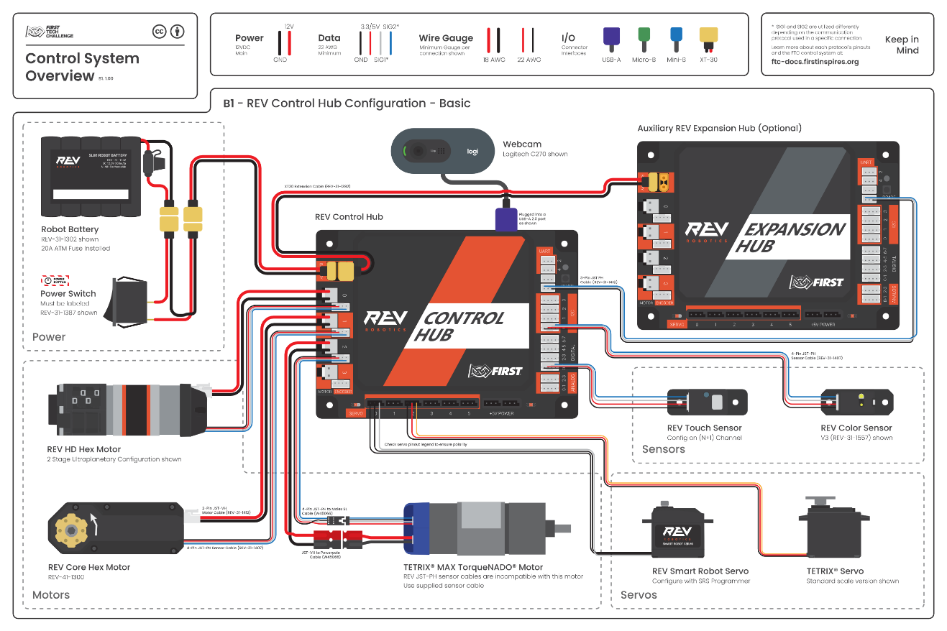
Introduction to FIRST Tech Challenge (FTC)
SOFTWARE
QUALITY
CONFERENCE
PACIFIC NW
FTC competition field: 12’ by 12’
Each alliance has 2 robots
Match Time duration
  30 second autonomous phase
  2 minute tele-operated phase
Score cones for points
Specially designed control system
PNSQC ™

Slide 5

FIRST Tech Challenge Game Video
SOFTWARE
QUALITY
CONFERENCE
PACIFIC NW
PNSQC ™

Slide 6
Challenges for Software Quality in a Physical World
SOFTWARE
QUALITY
CONFERENCE
PACIFIC NW
Hardware/Software integration is a key aspect of robotics, and is also crucial in the real world.
Hardware/Software integration challenges:
  Ensure that the software changes can be adapted rapidly with high quality.
  Ensure that the robot can utilize machine learning software to minimize the effect of the constantly changing physical world and make the right decision in different situations.
PNSQC ™

Slide 7
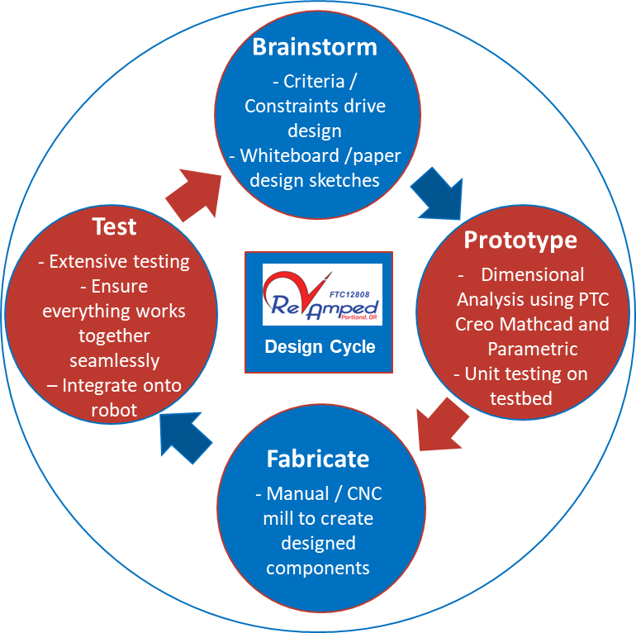
Advanced Development and Deployment Methodologies to Revamp Hardware/Software Integration
SOFTWARE
QUALITY
CONFERENCE
PACIFIC NW
RevAmped Industry-Adapted Design Cycle.
SWOT (Strengths, Weaknesses, Opportunities, Threats) Analysis and Weighted Metrics.
These methods allow for the acceleration of hardware mechanism development and superior hardware/software integration.
PNSQC ™

Slide 8
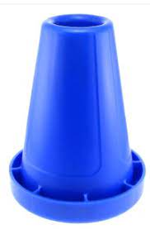
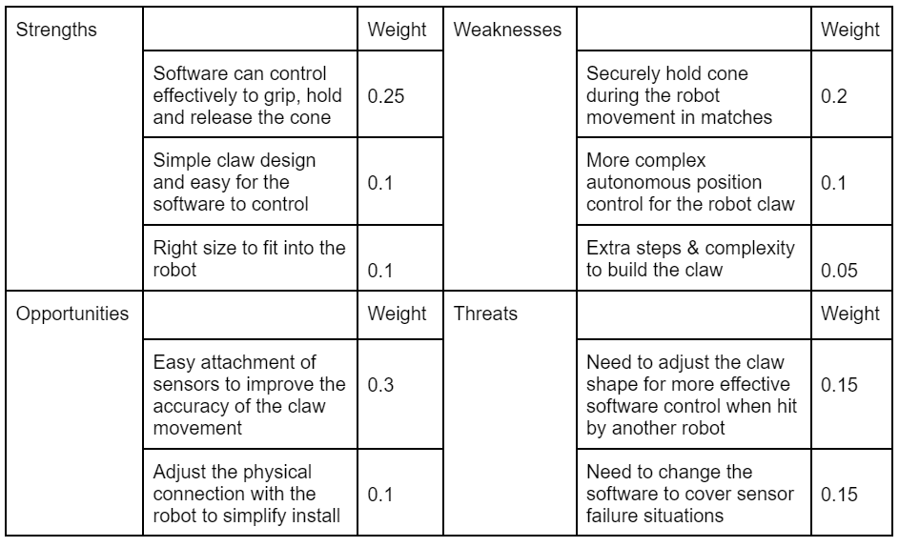
Case Study #1: Robotic Claw Optimization
SOFTWARE
QUALITY
CONFERENCE
PACIFIC NW
Recall that the season required moving cones to score points.
Being able to securely hold the cone became one of the highest weighted criteria in our initial evaluations.
During our design phase, we combined SWOT analysis and weighted metrics to achieve preliminary prototypes.
PNSQC ™

Slide 9
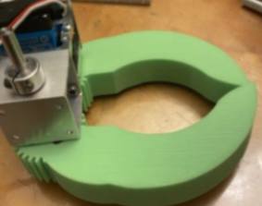
Case Study #1: Robotic Claw Optimization (cont.)
SOFTWARE
QUALITY
CONFERENCE
PACIFIC NW
Our initial design (with modifications) checked only a few of the boxes in the previous table.
Crucially, during testing the claw was unable to securely hold the cone.
Combined with threats exposed during analysis and other weaknesses, this led us to use our design cycle to improve our claw.
PNSQC ™

Slide 10
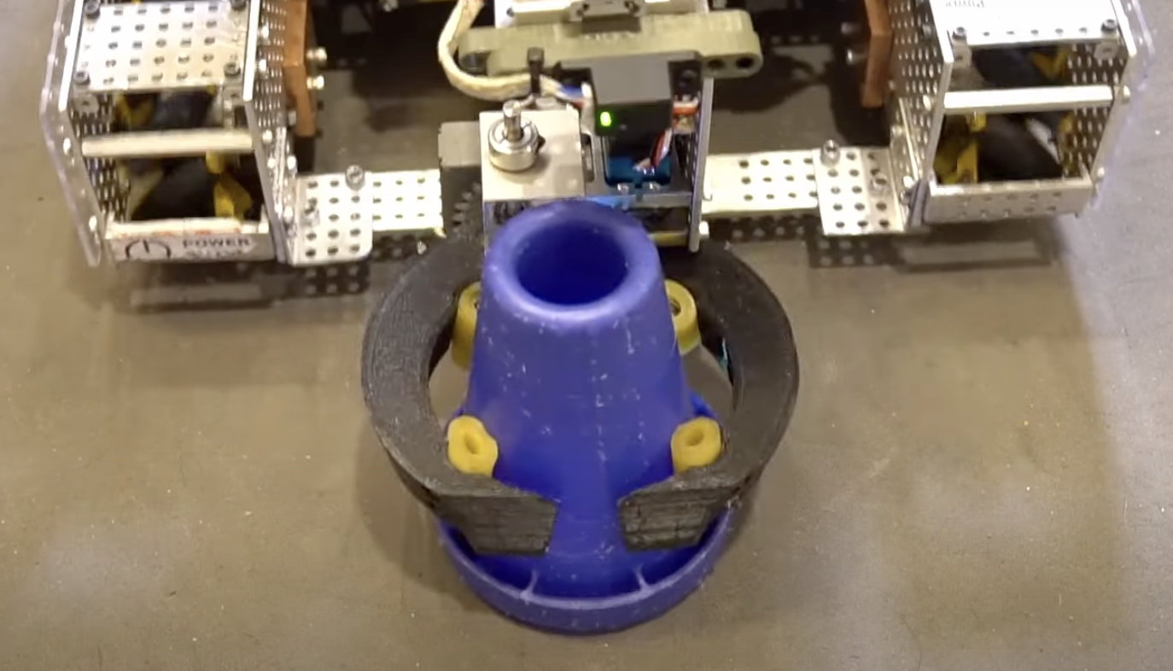
Case Study #1: Robotic Claw Optimization (cont.)
SOFTWARE
QUALITY
CONFERENCE
PACIFIC NW
After several iterations, we arrived at our final design.
Our newer claw was designed by iterating on the previous design with our industry design cycle.
Furthermore, the design team worked closely with the programming team to achieve the desired hardware/software integration.
PNSQC ™

Slide 11
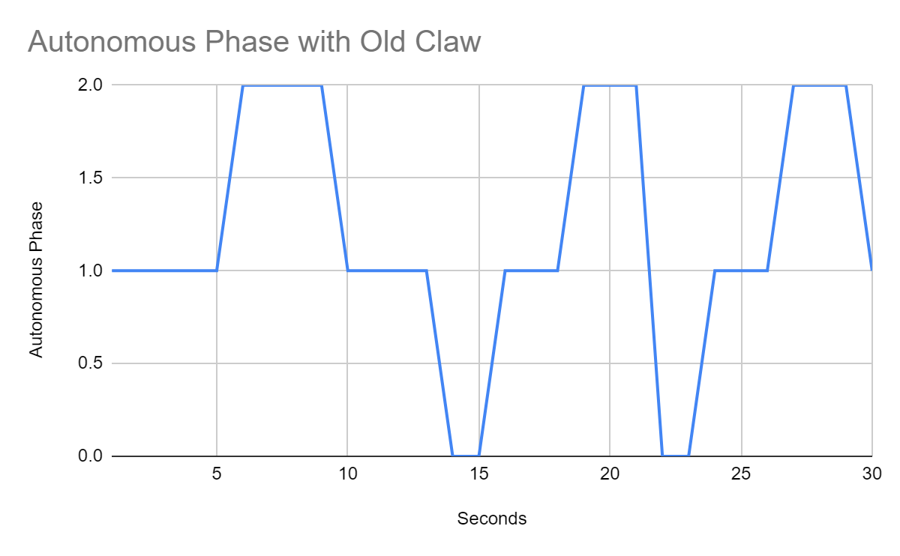
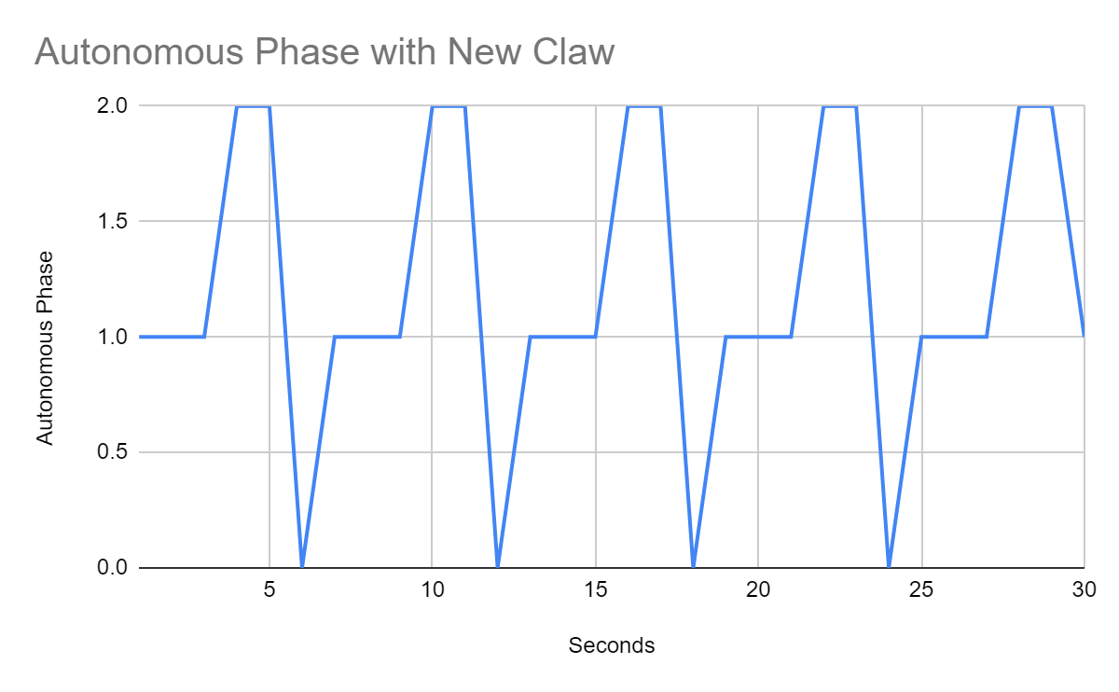
Case Study #1: Robotic Claw Optimization (cont.)
SOFTWARE
QUALITY
CONFERENCE
PACIFIC NW
Scoring
Scoring
Scoring
Scoring
Positioning
Positioning
Moving
Moving
Intaking
Intaking
Intaking
Intaking
PNSQC ™

Slide 12
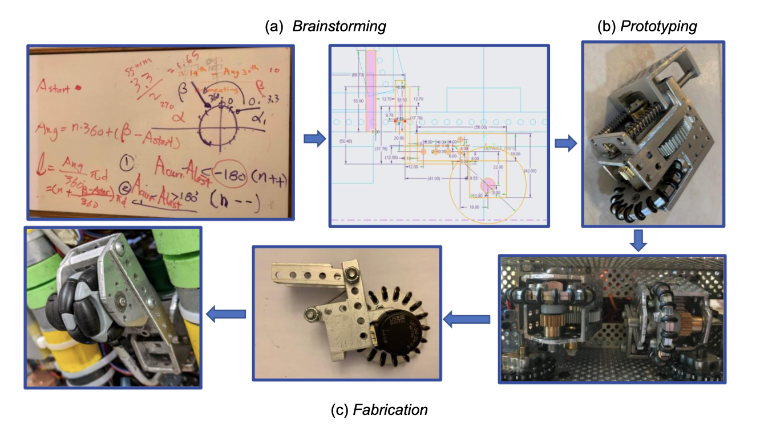
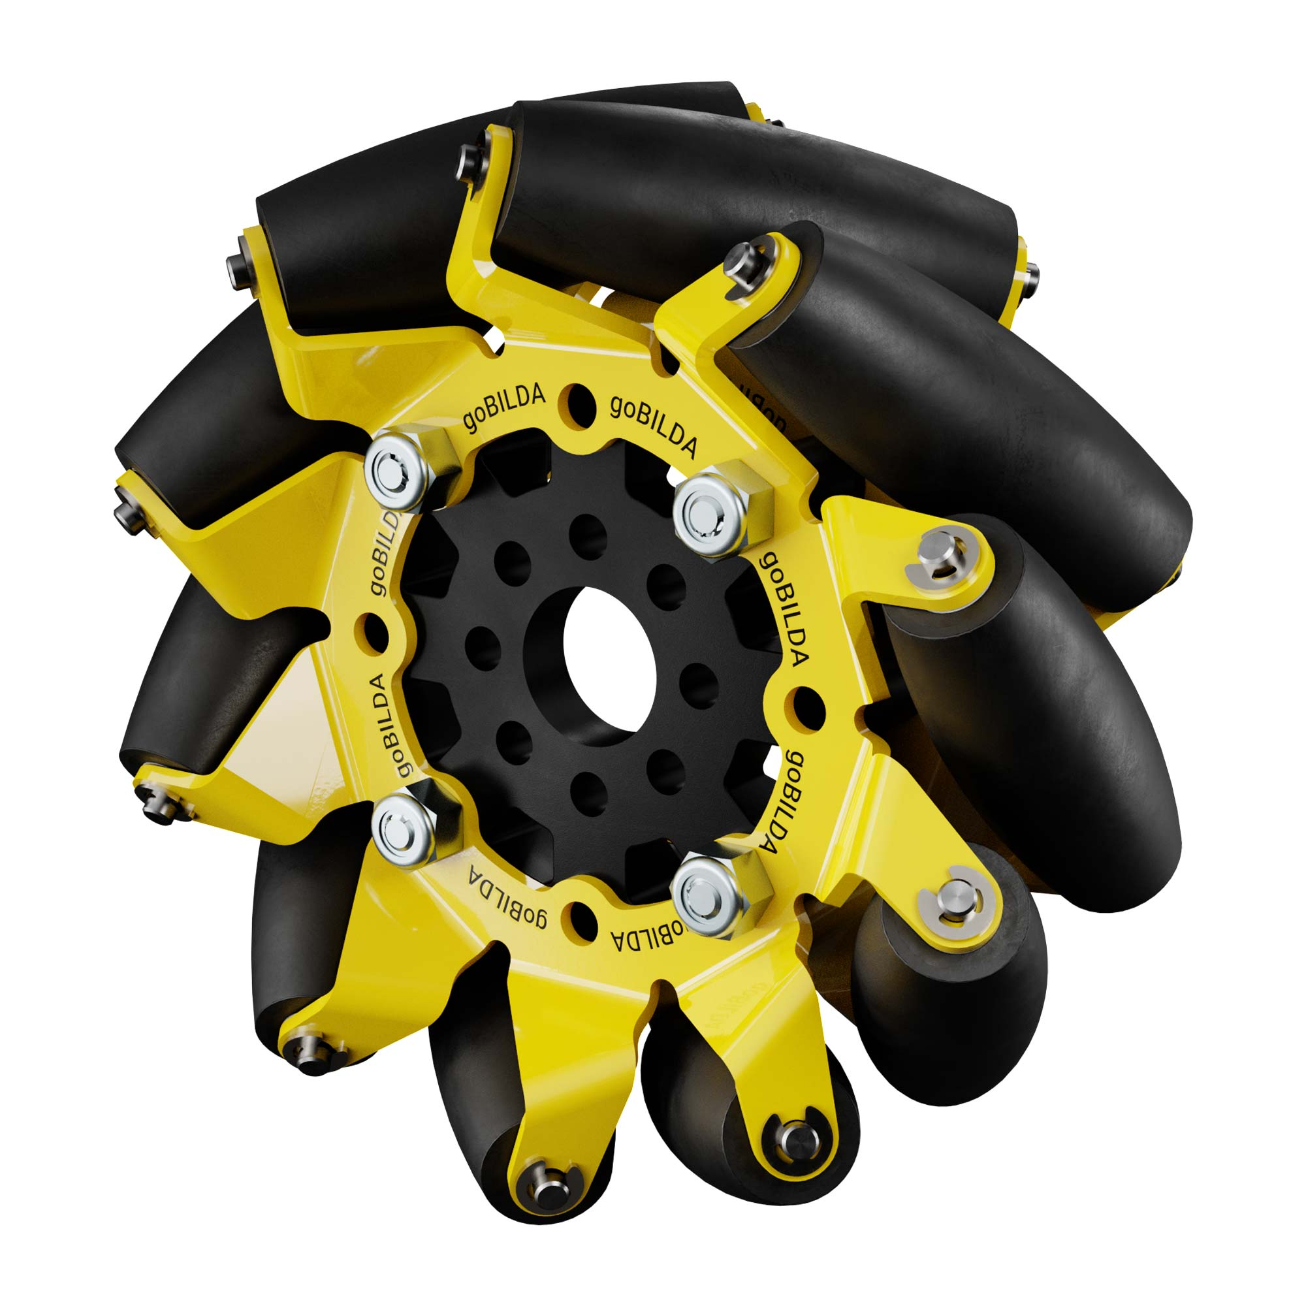
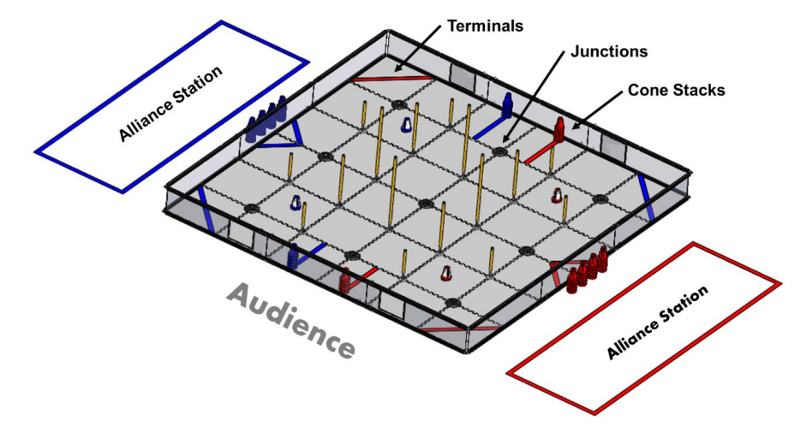
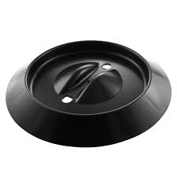
Case Study #2: Odometry Pod Improvement – Brainstorming
SOFTWARE
QUALITY
CONFERENCE
PACIFIC NW
What are odometry pods?
Problem Statement: The 45 degree rollers that allow our robot to strafe allow for slight margin of error between desired and actual distance traveled.
Overcoming field obstacles
45 degree rollers
Power Play Field
Ground Junctions
PNSQC ™

Slide 13
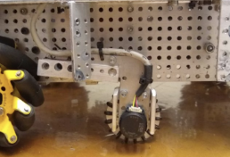
SOFTWARE
QUALITY
CONFERENCE
Case Study #2: Odometry Pod Improvement - Prototyping and Fabrication
PACIFIC NW
Determining distance and direction of the odometry pod travel
CAD-ing odometry pod design
Spring contact
PNSQC ™

Slide 14
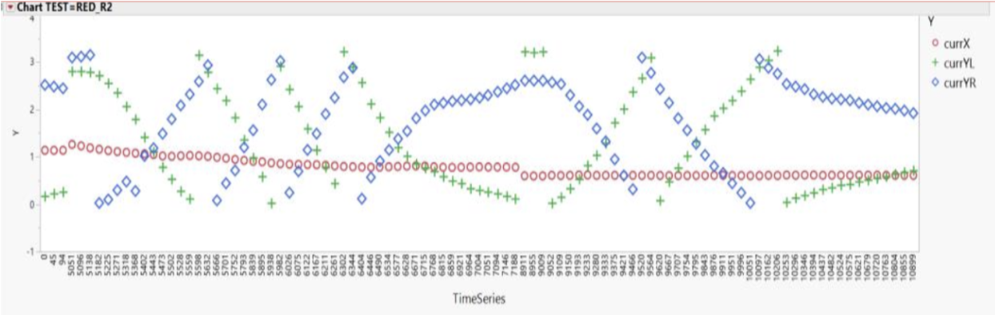
Case Study #2: Odometry Pod Improvement - Testing
SOFTWARE
QUALITY
CONFERENCE
Accurate positioning for the PI controller
By logging the voltage over time of our encoders we were able to identify discrepancies.
PACIFIC NW
PNSQC ™

Slide 15
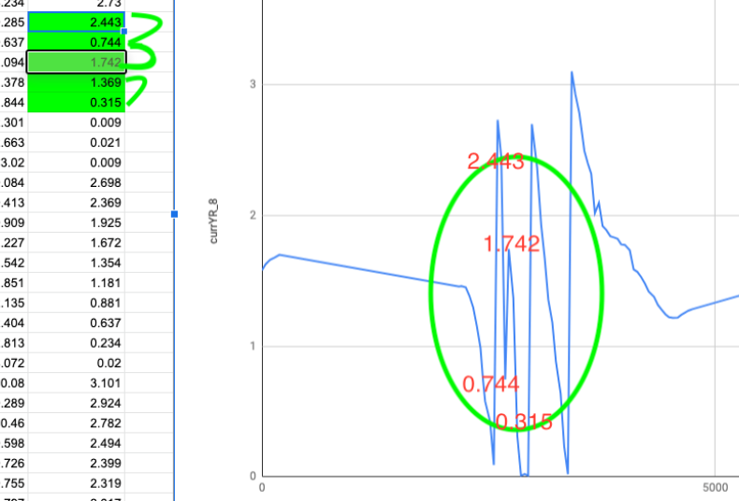
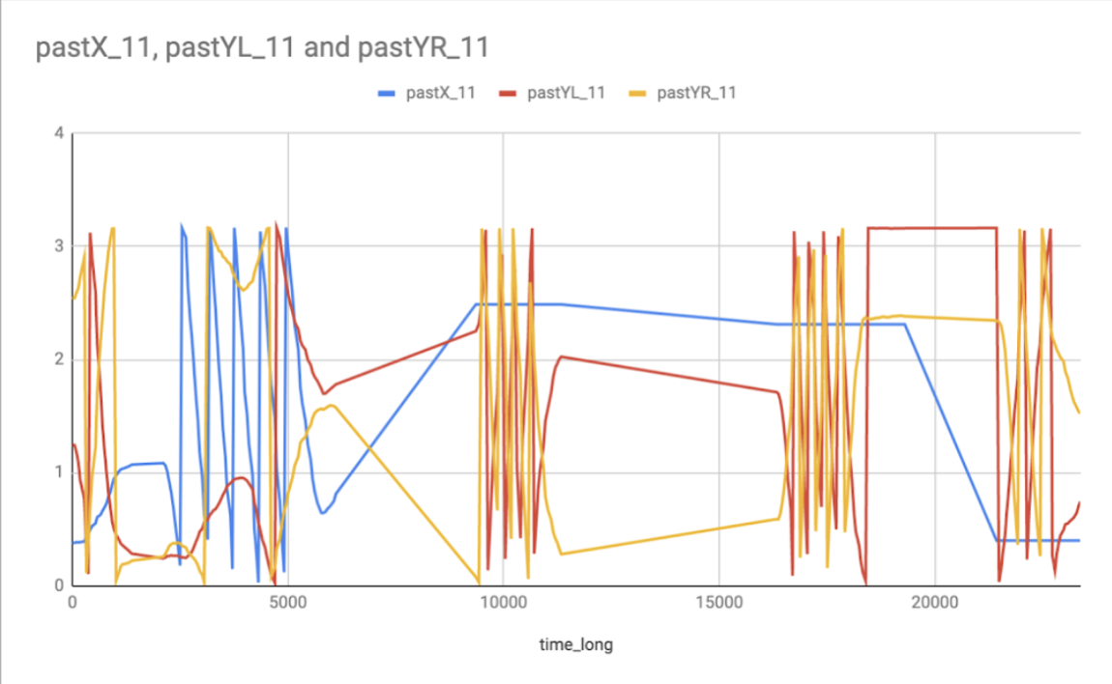
Case Study #2: Odometry Pod Improvement - Testing
SOFTWARE
QUALITY
CONFERENCE
PACIFIC NW
Gave the team reasoning to switch from MA3 encoder to E4T
By plotting multiple sets of data
Smooth run compared to run with voltage jumps identified
Potential factors were field friction/variation
PNSQC ™

Slide 16
TensorFlow Machine Learning for Autonomous Phases
SOFTWARE
QUALITY
CONFERENCE
PACIFIC NW
Why TensorFlow (and not OpenCV)?
  TensorFlow is used to detect pattern on signal cone
  Used OpenCV a few seasons ago
  OpenCV worked worse in dim lighting
  TensorFlow works well in any lighting
PNSQC ™
Notes:
Moving on, I’m going to explain why we use TensorFlow, what TensorFlow is and how we use it, and our autonomous path in general. First, why do we use TensorFLow? Well, during the autonomous period, our robot has to park in a specific zone based off of a pattern on a signal cone in front of the robot. To detect such pattern, we use TensorFlow which can quickly detect the pattern and zone the robot has to go to. Last season, we used OpenCV to detect game elements in the autonomous period, but it heavily relied on the lighting in the room, which meant that we could never know for sure if we’d get a consistent autonomous every game. To improve consistency we decided to use TensorFlow which didn’t depend on lighting at all, this meant our autonomous would be more consistent throughout every game despite bad lighting.

Slide 17
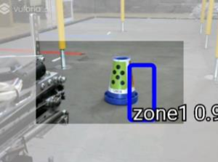
How TensorFlow works on Our Robot
SOFTWARE
QUALITY
CONFERENCE
PACIFIC NW
TensorFlow is a machine learning program
Recognizes the pattern on the cone in autonomous
Parks in the correct zone
Every recognized pattern is added to the data cloud
PNSQC ™
Notes:
So how exactly does tensorflow work on a robot well first tensorflow is a machine learning program which means that after you give it enough pictures of something it'll start recognizing it without you telling it what it is so what we did was we gave tensorflow multiple images of each pattern on the cone at many angles and tensorflow was soon able to recognize the patterns and what they were for without us having to tell it.
On the field, when autonomous starts the robot’s camera takes a picture of the signal cone and activates image recognition, Vuforia, allowing TensorFlow to see the pattern on our signal cone and recognize the zone it has to park in. After reogonizing the sleeve, Tensorflow adds the image into its data cloud so future readings will be even more accurate.

Slide 18
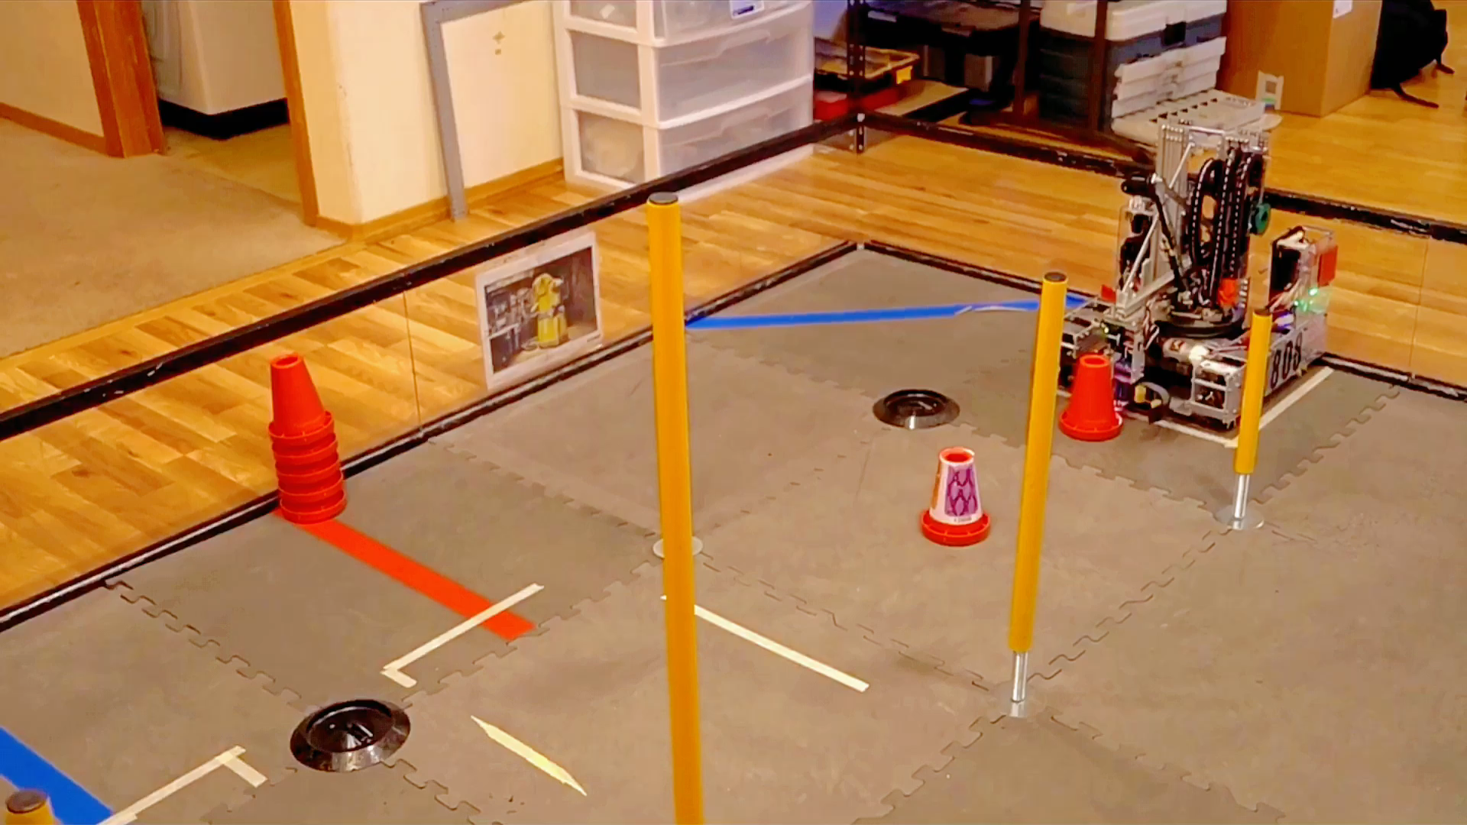
Our Autonomous in Action
SOFTWARE
QUALITY
CONFERENCE
PACIFIC NW
PNSQC ™
Notes:
So how exactly does tensorflow work on a robot well first tensorflow is a machine learning program which means that after you give it enough pictures of something it'll start recognizing it without you telling it what it is so what we did was we gave tensorflow multiple images of each pattern on the cone at many angles and tensorflow was soon able to recognize the patterns and what they were for without us having to tell it.
On the field, when autonomous starts the robot’s camera activates image recognition, Vuforia, allowing TensorFlow to see the pattern on our signal cone and recognize the zone it has to park in. After reogonizing the sleeve, Tensorflow adds the image into its data cloud so future readings will be even more accurate.

Slide 19
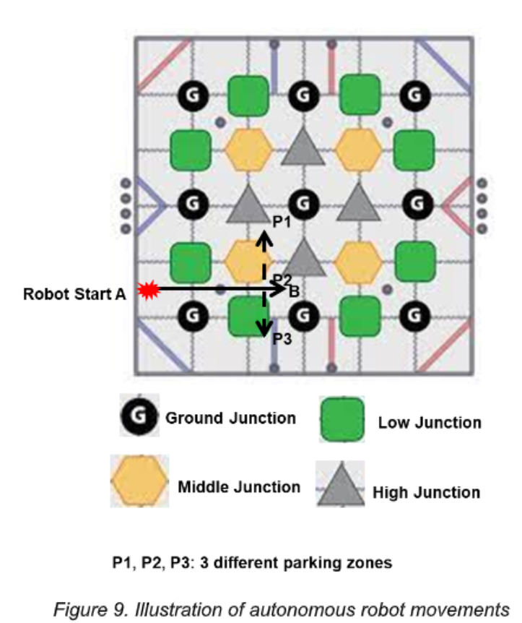
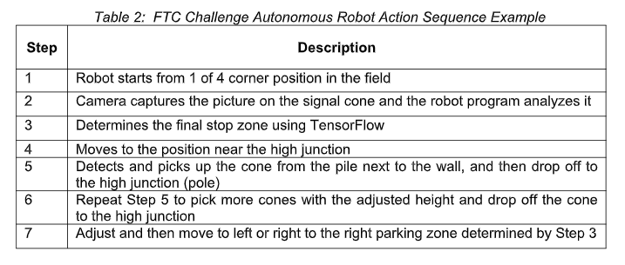
Our Robot’s Autonomous Path Make auto path more prominent
SOFTWARE
QUALITY
CONFERENCE
PACIFIC NW
Autonomous Program Steps
Autonomous Robot Path
PNSQC ™

Slide 20
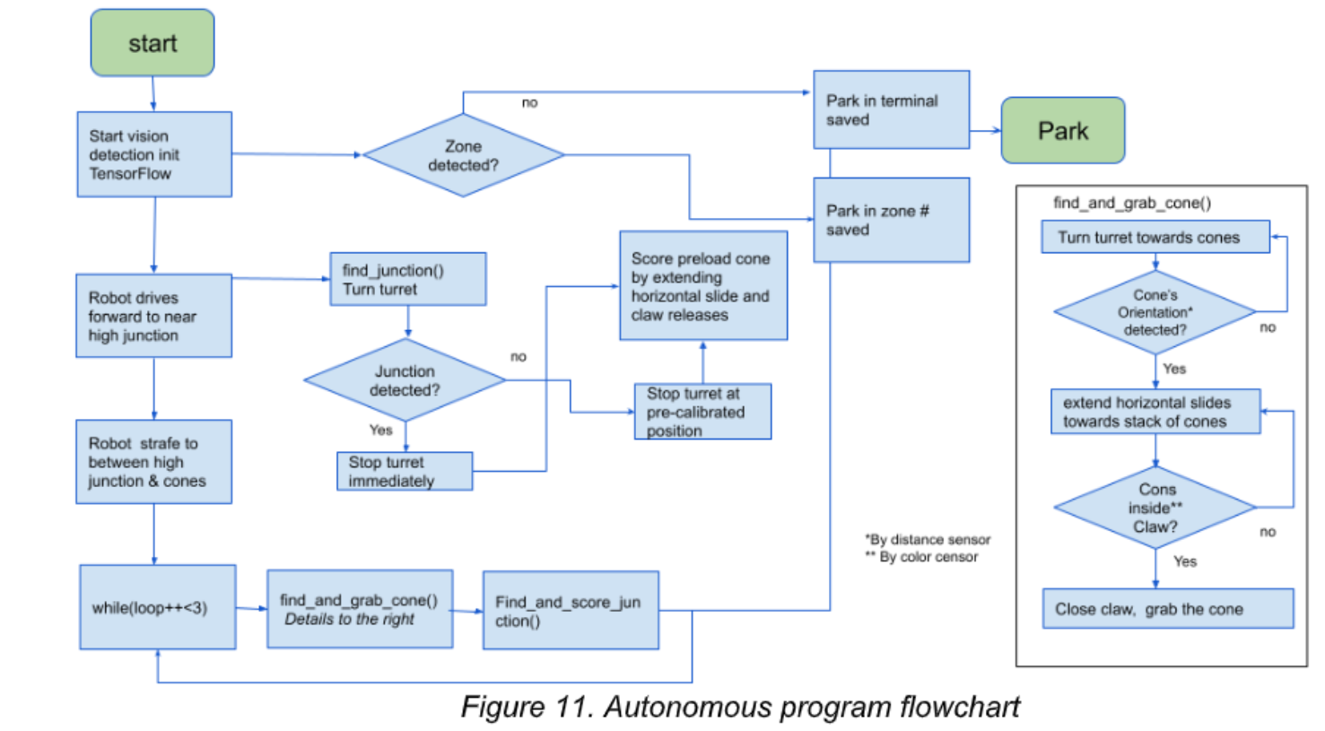
Autonomous Programing Flowchart
SOFTWARE
QUALITY
CONFERENCE
PACIFIC NW
PNSQC ™

Slide 21
Github and CI/CD Software Deployment Methodology
SOFTWARE
QUALITY
CONFERENCE
PACIFIC NW
Why Github and CI/CD?
Allows team members to collaborate on a project more effectively
Provides tools to manage changes
Track changes overtime
Repositories can also be shared to other teams (ex. Roadrunner a motion profiling library)
Allowing for greater knowledge sharing and advancement
PNSQC ™

Slide 22
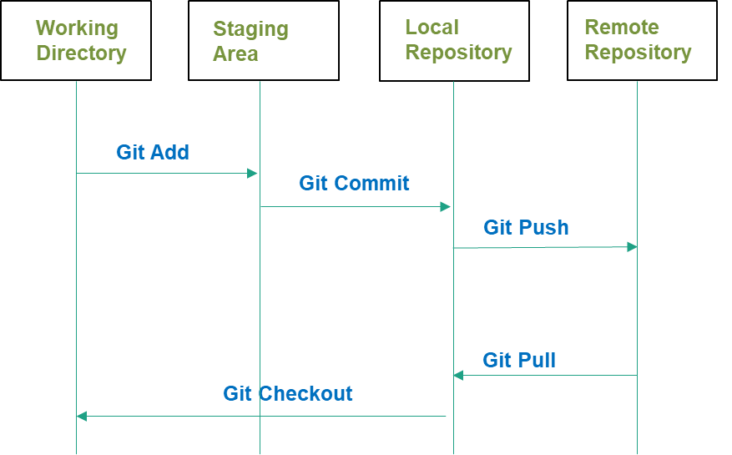
Flowchart for Github code storage and management
SOFTWARE
QUALITY
CONFERENCE
PACIFIC NW
PNSQC ™

Slide 23
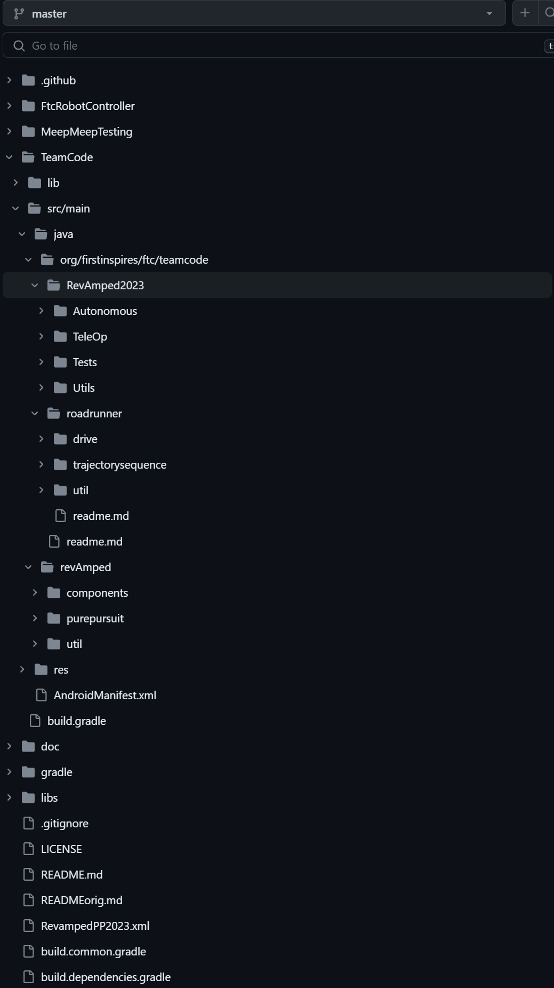
Revamped Robotics team GitHub code storage and management model screen shot
SOFTWARE
QUALITY
CONFERENCE
PACIFIC NW
PNSQC ™

Slide 24
Github and CI/CD Software Development and Deployment Acceleration
SOFTWARE
QUALITY
CONFERENCE
PACIFIC NW
Categories | Small Size Feature (Weeks) | Medium Size Feature (Weeks) | Large Size Feature (Weeks)
Legacy Deployment | 0.3 | 1 | 2
Github & CI/CD | 0.2 | 0.8 | 1.7
Acceleration | 33% | 20% | 15%
PNSQC ™

Slide 25
Conclusions
SOFTWARE
QUALITY
CONFERENCE
PACIFIC NW
"In summary..."
Shared FTC engineering experience to revamp software quality in Android robotic with software-hardware integrated solutions.
  Leveraged industry-adapted design cycle and employed SWOT Analysis and Weighted Metrics to improve the software quality.
  Utilized deep learning TensorFlow to minimize dependencies on the external physical sensor reading.
  Implemented Github storage management and CI/CD process to improve the quality and accelerate the process to design/build Android robots in FTC
PNSQC ™

Slide 26
Thank You!
SOFTWARE
QUALITY
CONFERENCE
PACIFIC NW
PNSQC committee
Reviewers: Cameron Kilgore and Nick Bonnichsen
RevAmped Robotics Team Coach: Zhunquin Wang
For Inspiration and Recognition of Science and Technology
(FIRST) Program
Oregon Robotics Tournament & Outreach Program (ORTOP)
FTC team coaches, mentors, and teammates
PNSQC ™

Slide 27
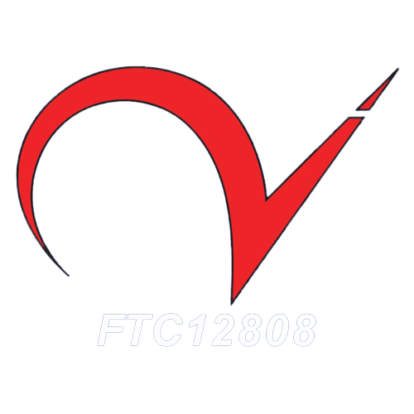
Further questions? Contact us at:
SOFTWARE
QUALITY
CONFERENCE
PACIFIC NW
Author email:
revampedrobotics@gmail.com
Author social media:
https://revampedrobotics.org/
PNSQC ™

