Slide 1
SPEAKER
NAME
TOPIC

Slide 2
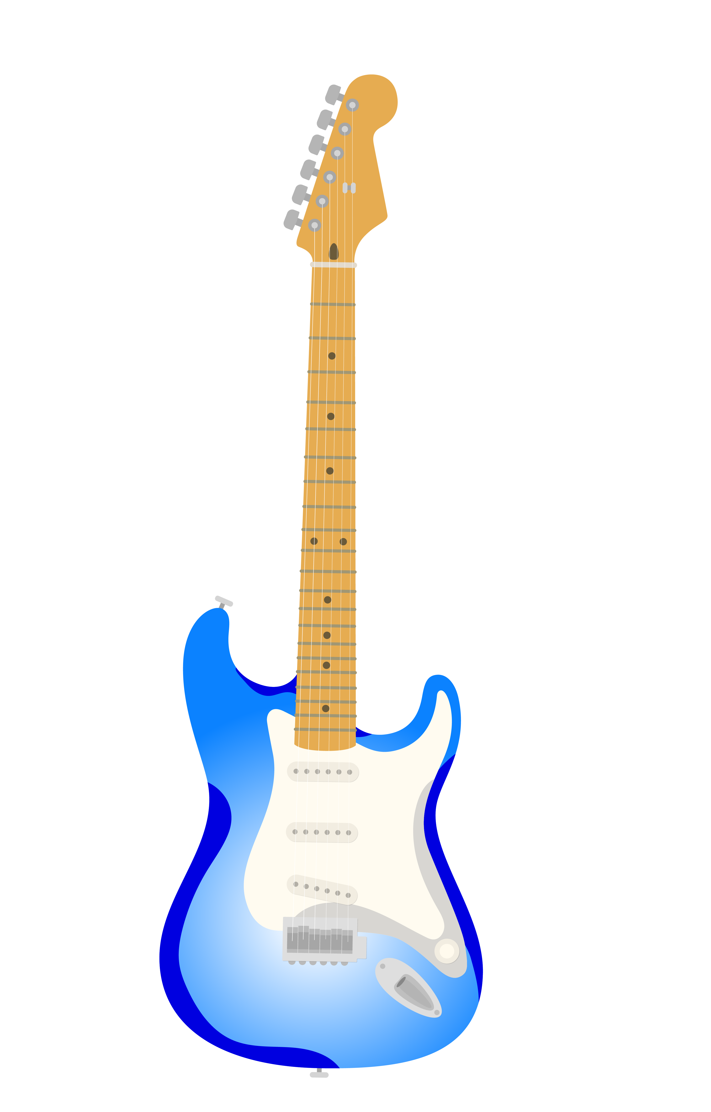
HEADING
Points of the speech
SPEAKER NAME
TOPIC

Slide 3
HEADING TWO
Points of the speech
SPEAKER NAME
TOPIC

Slide 4
HEADING TWO
Points of the graphic
SPEAKER NAME
TOPIC

Slide 5
THANK YOU
SPEAKER NAME
TOPIC

