Slide 1
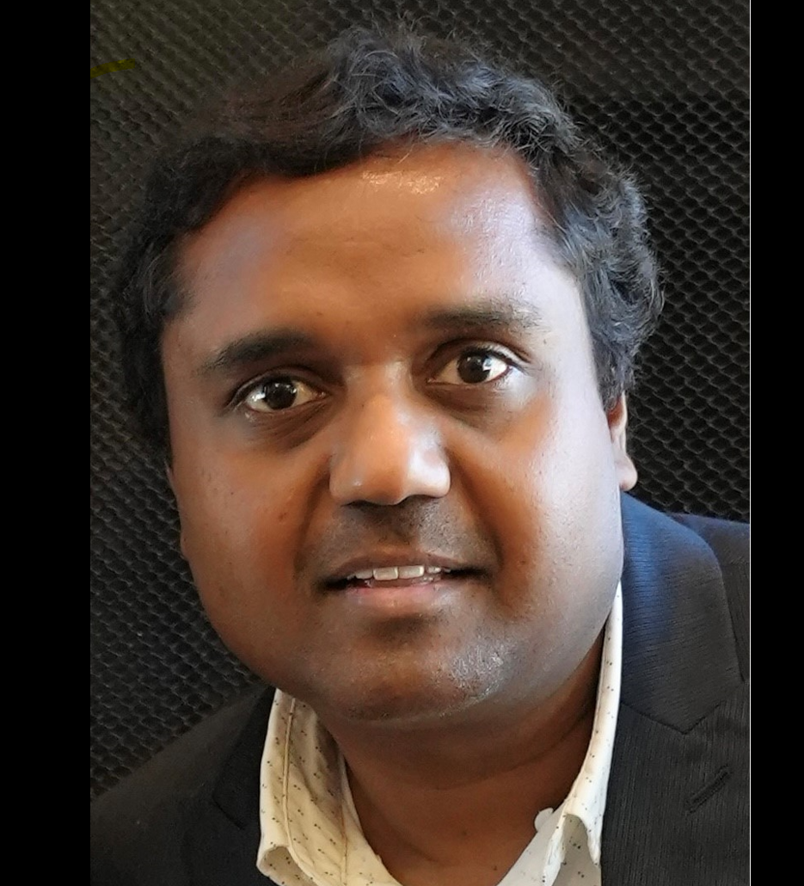
SPEAKER
Amith Pulla
Artificial Intelligence In Software Quality And Testing: Exploring Machine Learning and Large Language Models

Slide 2
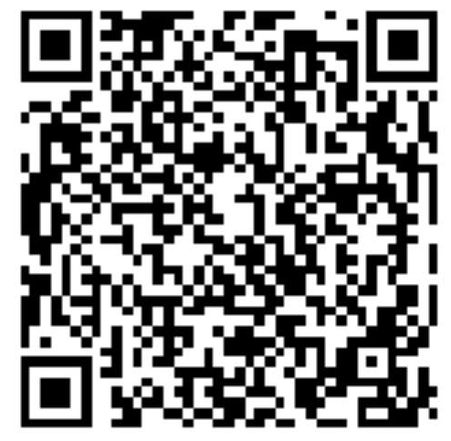
Bio:
Over 22 years of software experience, involved in software enabling, quality assurance, project and program management, testing strategies and processes.
Worked in several roles as a software engineer, QA analyst, ScrumMaster, QA manager and technical program manager.
Masters' degree in CIS from the New Jersey Institute of Technology and MBA from University of Illinois, Urbana Champaign.
CSTE, PMP and CSM certifications
DeveloperWeek advisory board member
https://www.linkedin.com/in/amith-david-pulla/
Twitter: @pamith
Amith Pulla
AI in Software Quality

Slide 3
Artificial Intelligence in Software Quality
Relevant Capabilities of AI
Machine Learning (ML)
Supervised (Training and Inference)
Deep Learning using Neural Networks
Unsupervised Learning (Clustering)
Reinforcement Learning
Natural Language Processing (NLP)
Speech Recognition, Speech to Text
Computer Vision
Visual Processing, Image Recognition
Generative AI
Generate content-text, images or code
Amith Pulla
AI in Software Quality

Slide 4
Adopting Machine Learning for QA
Efficiency by faster test case creation and automation
Accuracy by using ML algorithms
Autonomous testing
E2E testing without human intervention, less human bias
Adapts to change- offers flexibility
Scalability at speed- AI can handle large datasets and volume
Low Maintenance- Models can be retrained
Better bug reporting
Amith Pulla
AI in Software Quality

Slide 5
Machine Learning Use Cases
Test Planning
Automated Test Case and Test Data Creation
Defect prediction-analyzing historical defect data
Optimization- identify redundant or obsolete test cases
Debugging and bug fixes
Performance testing– Eg: benchmarking due to faster scaling
Decision making – How/When, release management, ROI, change control
Prioritizing test cases using ML algorithms – But Why?
Assists with:
Risk analysis
Bug analysis
Security testing
Requirements and specification summarization
Amith Pulla
AI in Software Quality

Slide 6
Popular Machine Learning Frameworks
TensorFlow- An end-to-end open-source machine learning platform
open-source software library
PyTorch- PyTorch is a machine learning framework based on the Torch library
OpenCV – Computer Vision Library
scikit-image - collection of algorithms for image processing
XGBoost – Library for gradient boosting framework
Hugging Face –Auto Train for Summarization, Text Regression, Text Classification
Amazon/AWS SageMaker and Bedrock (Gen AI)
Amith Pulla
AI in Software Quality

Slide 7
Test Automation Trends
Source: Infosys

Slide 8
Autonomous QA using ML
E2E Testing without human intervention
Code reviews
Predicting bugs before the release
Code coverage analysis
Automated test case creation
Exposing blind spots
Enterprise level learning - across several development teams
Intelligent self-healing of test cases
Test coverage metrics
Removing dead code/refactoring
Quality Metrics
AI for performance optimization and tuning
QAOps – QA + DevOps (framework and process integration)
Amith Pulla
AI in Software Quality

Slide 9
Low Code/No Code (LCNC) for Testing
Zero to minimal coding, no test scripts
Can be AI enabled with ML
Anyone can build tests, minimal coding knowledge
Drag-and-drop interface for faster test development
Easy to build and change
Model based testing and codeless design
Test Automation Landscape
TestResults.io, mabl
ACCELQ, Subject7, Testsigma, Opkey, Parasoft
BrowserStack-Record/Playback and Self-healing
Amith Pulla
AI in Software Quality

Slide 10
ML in Action
Hexaware Autonomous Test Orchestration Platform (ATOP)
End-to-end Autonomous Software Testing
Utilizes AI, machine learning, deep learning algorithms and NLP
Trains the models at all stages of development
Makes decisions using inference
Meta’s Sapienz: Intelligent automated software testing at scale
Automatically designs and runs thousands of test cases everyday
75 percent of Sapienz reports are actionable
Facebook Android app has seen around 70 percent improvement in failure rate
Microsoft's DeepCode
Uses machine learning to analyze source code
Identifies potential security vulnerabilities and defects
Amith Pulla
AI in Software Quality

Slide 11
AI Adoption Challenges
AI models can be difficult to train
Data management, policies, and governance
Prone To Bias
Initial investment, ROI and cost
Bugs in AI software
Hallucinations -“AI starts to make up stuff” Eg: Google’s BARD
Security
Copyright issues, privacy and consent
Balancing hype vs. opportunity
Probabilistic vs. deterministic mindset
Sustainability
Amith Pulla
AI in Software Quality

Slide 12
Generative AI and Large Language Models
Generative AI -Artificial intelligence models that can generate content. Text, code, images, video, and music etc.
Large Language Models used in Generative AI that are trained on textual content. Can generate text and code.
GPT: Generative pre-trained transformers (foundation model for ChatGPT)
BERT: The Bidirectional Encoder Representations from Transformers
LLaMA: Large Language Model Meta AI
PaLM: Pathways Language Model by Google (foundation model for BARD)
LLMs are designed to assist humans, not replace them, and domain-specific knowledge remains essential for achieving optimal results.
More of a productivity booster for QA Teams
Amith Pulla
AI in Software Quality

Slide 13
Source: Gartner

Slide 14
Large Language Models for Quality
Requirements Analysis
Identify the testing objectives, scope, and criteria
Test case generation
Test data generation
Program repair
Debug assistance
Test reporting
Workaround suggestions for code and user flows
Amith Pulla
AI in Software Quality

Slide 15
LLMs in Action in Quality Landscape
TestGPT by CodiumAI
IDE integration
Test suggestions as you code
Test generation
TestRigor (demo)
Test generation, automation and reporting
Code-generation models: Replit’s Ghostwriter and GitHub Copilot
ChatGPT for writing comments and unit tests
BLOOM for language and localization testing
Amith Pulla
AI in Software Quality

Slide 16
testRigor Example: Test Case Options ebay Homepage
Amith Pulla
AI in Software Quality

Slide 17
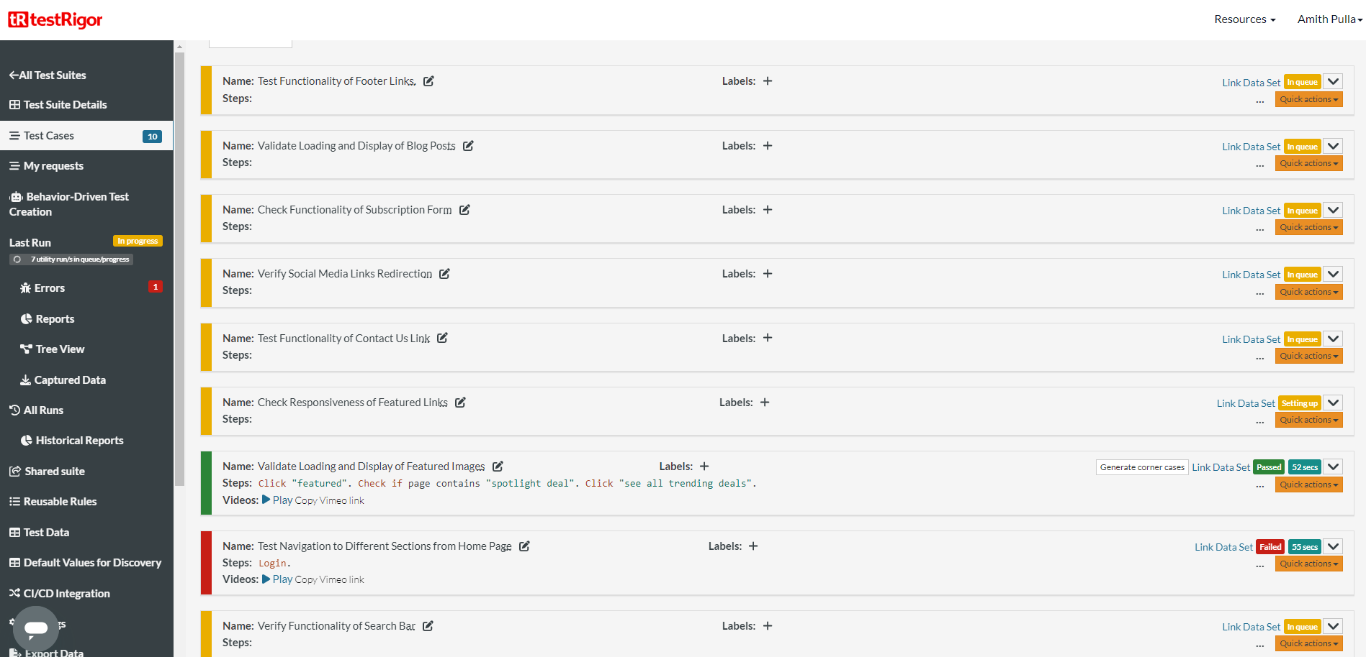
testRigor Example: Test Case Flows
Amith Pulla
AI in Software Quality

Slide 18
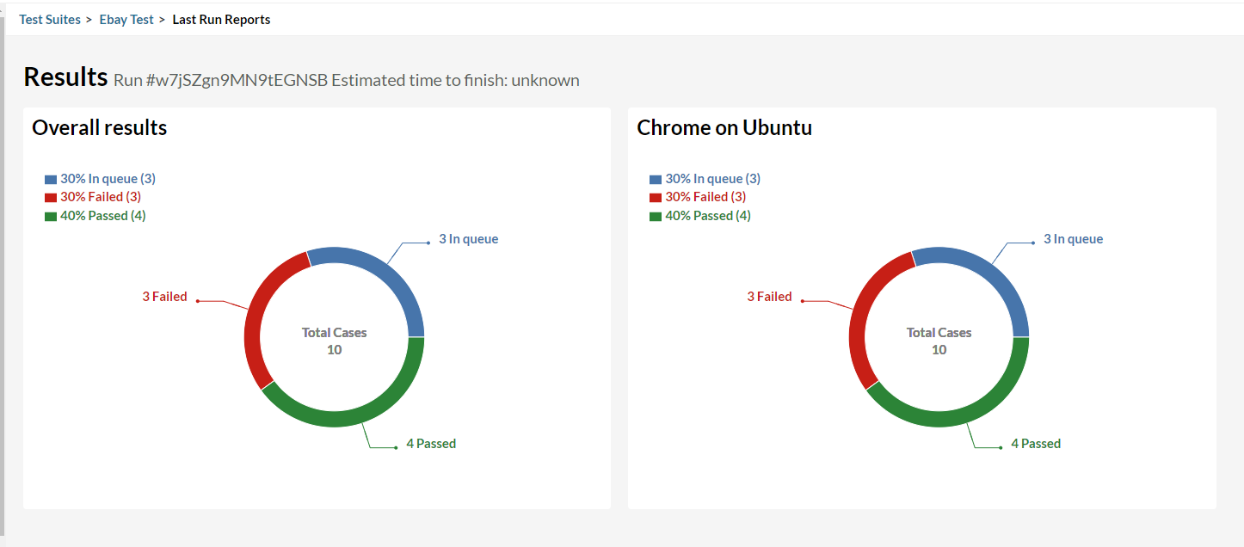
testRigor Example: Results Dashboard

Slide 19
Generative AI Best Practices for QA
Composite AI
Leverage enterprise AI strategy and data management
Integrate quality frameworks and tools into existing AI infrastructure
Start with “80-20” rule
80% AI based testing and 20% existing frameworks/tools
Build the AI and toolset strategy upfront
Start with requirements analysis with AI
Be aware of data security and privacy, start with in-house models
Invest in fine-tuning Gen AI models with human feedback
Use ROUGE Metrics (Recall-Oriented Understudy for Gisting Evaluation)
Compares generated content with standard human generated content
QA role may become more of a Quality architect or strategist
Amith Pulla
AI in Software Quality

Slide 20
References:
Gartner Hype Cycle for AI
https://www.gartner.com/en/articles/what-s-new-in-artificial-intelligence-from-the-2023-gartner-hype-cycle
Leveraging AI in Quality Assurance-Rajneesh Malviya (Infosys)
https://www.infosys.com/insights/ai-automation/quality-assurance.html
TestRigor - https://testrigor.com/
Software Testing with Large Language Model: Survey, Landscape, and Vision-Junjie Wang, Yuchao Huang, Chunyang Chen, Zhe Liu, Song Wang, Qing Wang
What is a large language model (LLM)?
https://www.elastic.co/what-is/large-language-models
How AI Is Changing Automation Testing In Quality Assurance
https://www.forbes.com/sites/forbestechcouncil/2023/05/25/how-ai-is-changing-automation-testing-in-quality-assurance/
AI In Software Testing
https://theqalead.com/ai-ml/ai-in-software-testing/
Amith Pulla
AI in Software Quality

Slide 21
THANK YOU
SPEAKER Amith Pulla

