Slide 1
Nick Bonnichsen
Measuring Data Quality and Data Stewardship

Slide 2
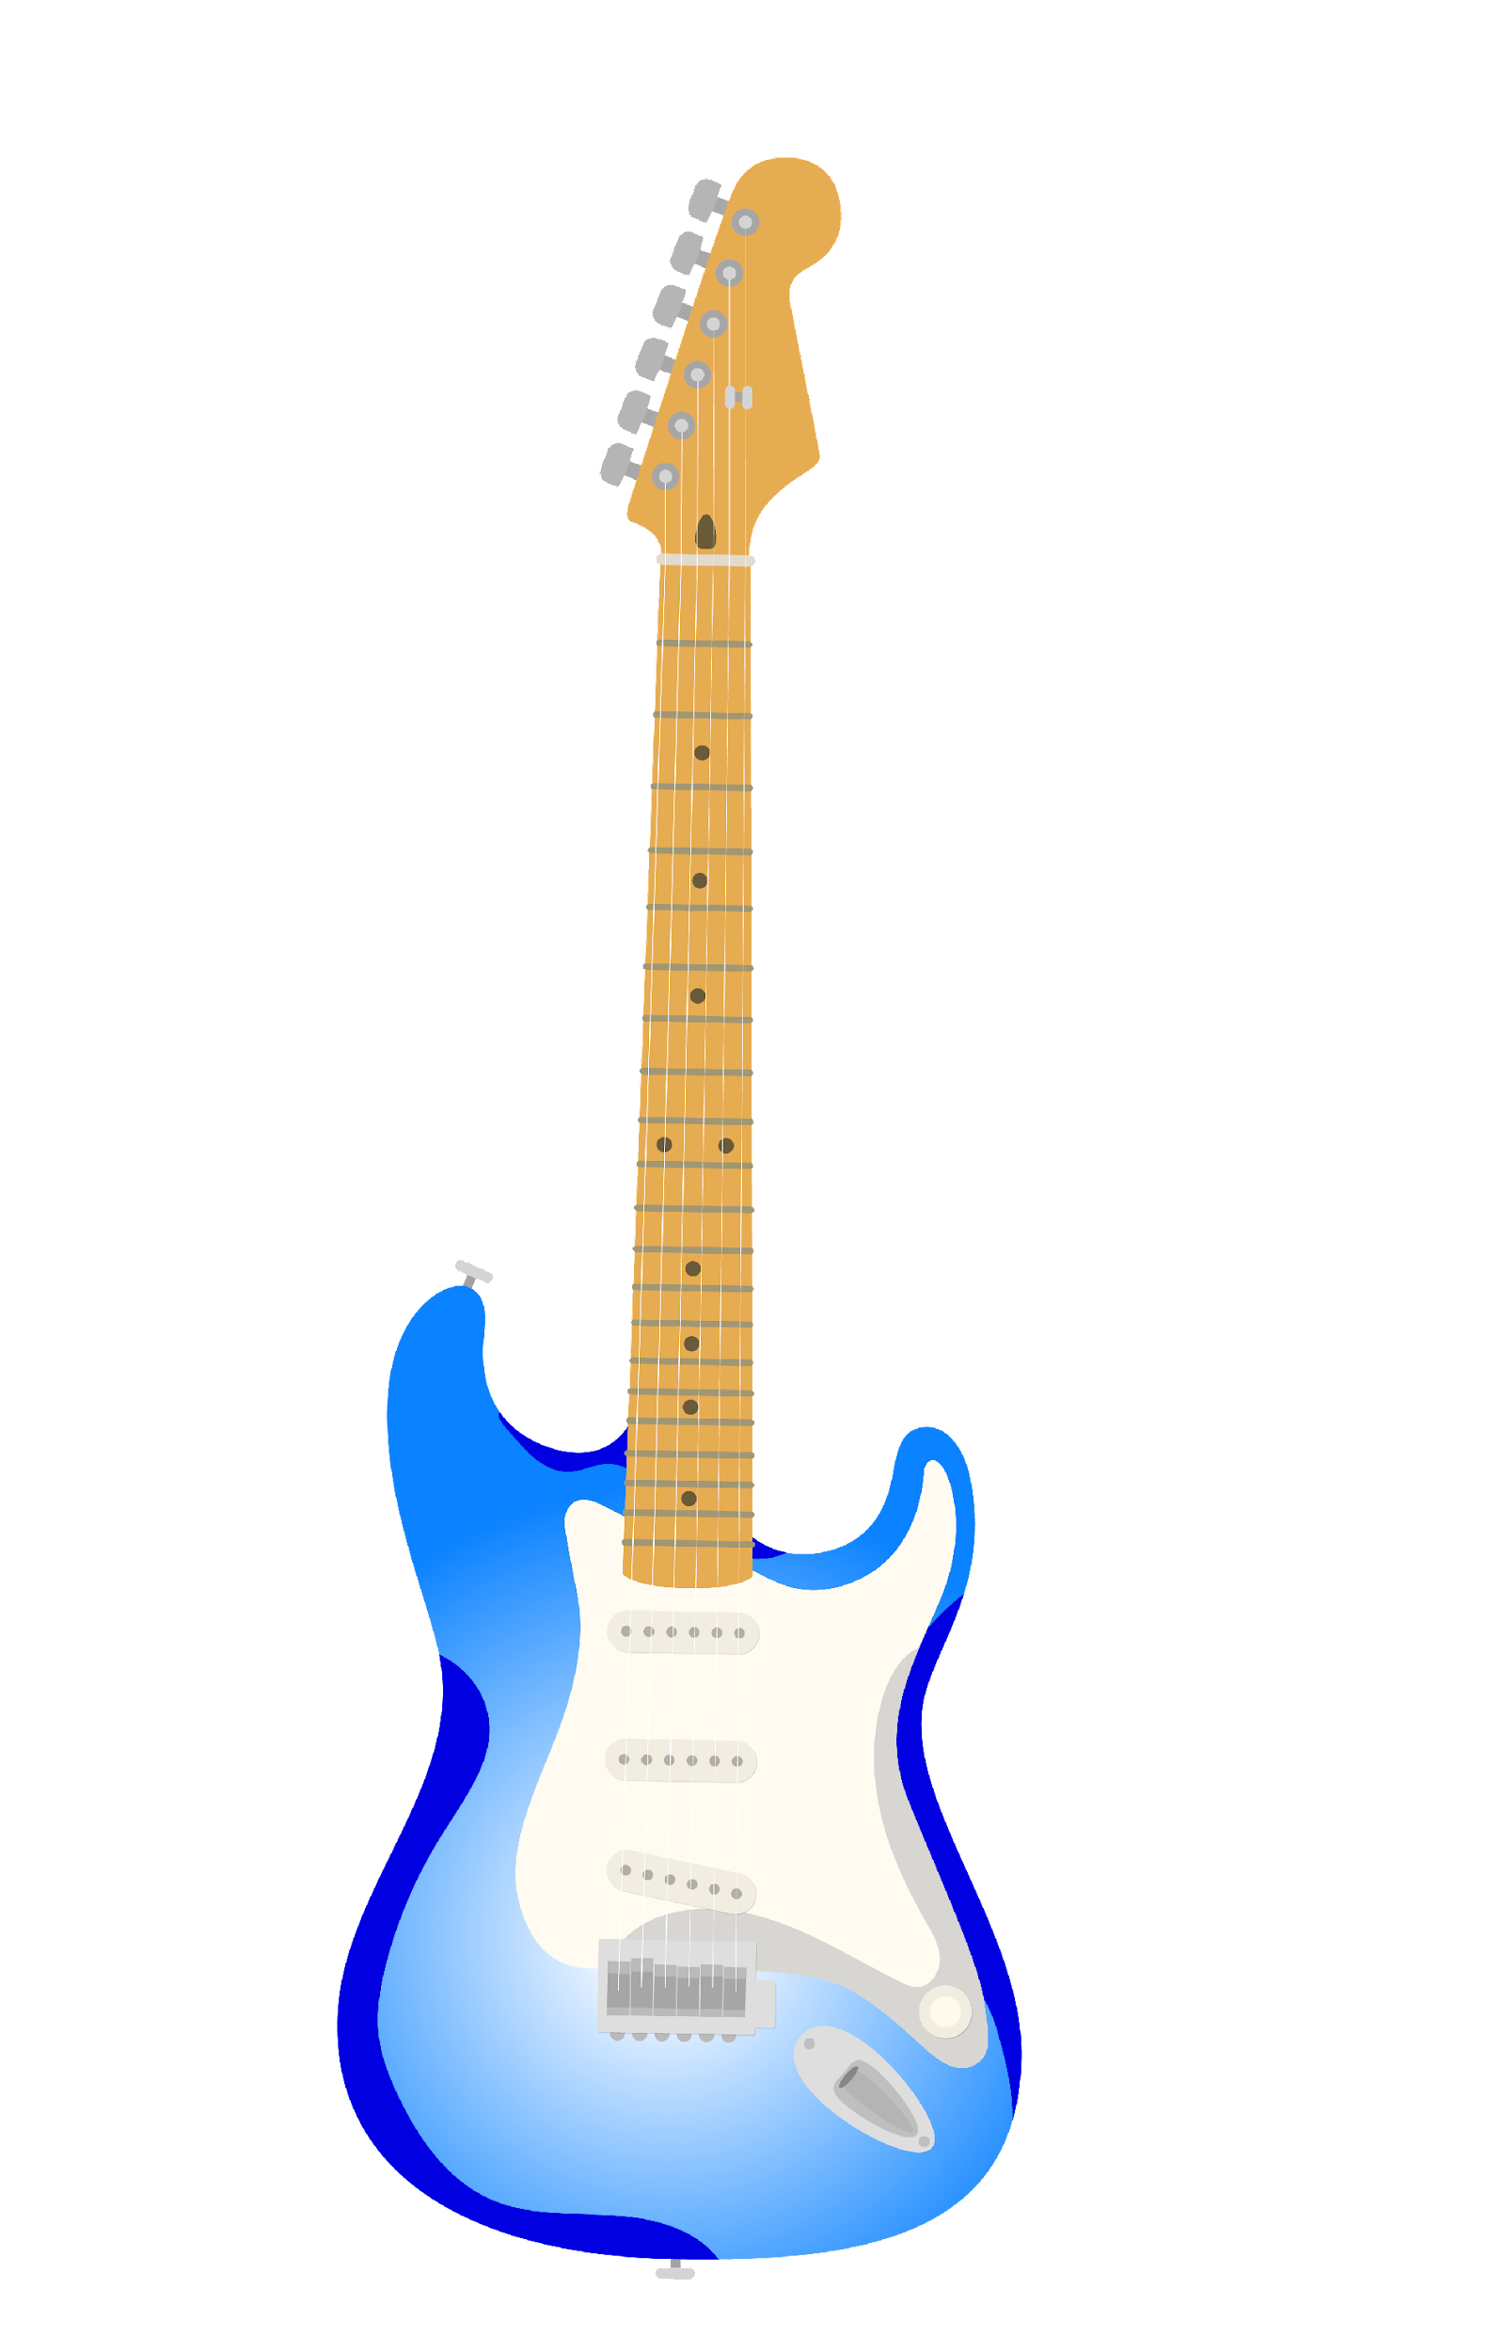
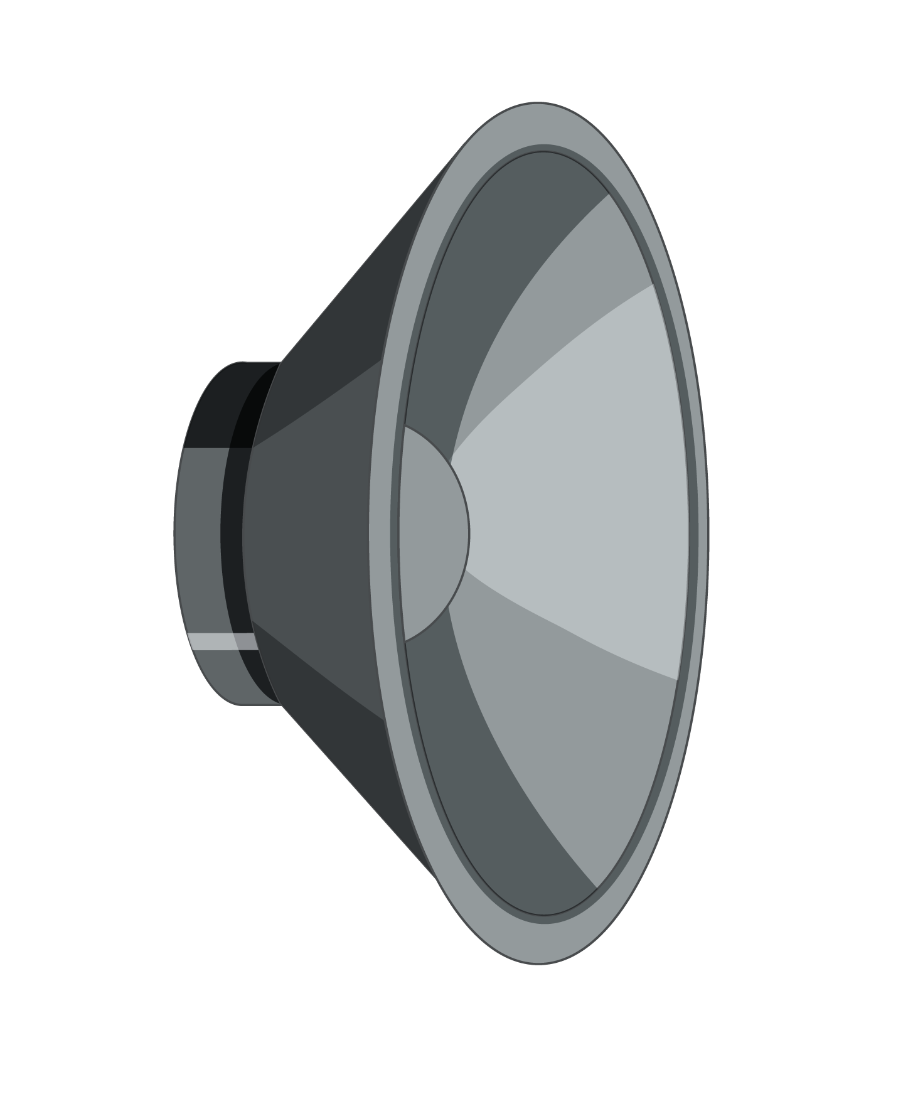
Cast your mind…
It’s a wet February morning.
Nick Bonnichsen
Measuring Data Quality and Data Stewardship

Slide 3
Portland, we have a problem
Missing data in customer serving APIs
Data in customer reports not matching other reports
Contractual penalties for data issues
How do you “improve data quality”?
Nick Bonnichsen
Measuring Data Quality and Data Stewardship

Slide 4
All purpose Plan A
Find something to measure connected to quality
No “Qualitons”, please
Measure a baseline
Make some changes
Measure more and compare to baseline
Nick Bonnichsen
Measuring Data Quality and Data Stewardship

Slide 5
Defining Data Quality
“No one complaining about your data”
“Meets or exceeds customer expectations”
“Fit for intended uses in operations, decision making, and planning”
“You know it when you see it”
Nick Bonnichsen
Measuring Data Quality and Data Stewardship

Slide 6
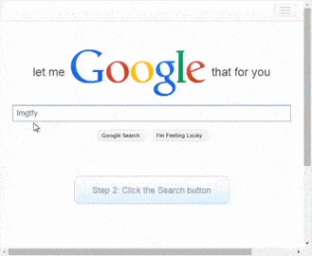
LMGTFY
Many many tools
Informatica, Talend, Tableau, etc
Academic Data Quality frameworks
Stanford Data Governance Model
Multiple Dimensions
Not the fun multiverse kind
Slim on concrete ways to measure the kind of data we had
Nick Bonnichsen
Measuring Data Quality and Data Stewardship

Slide 7
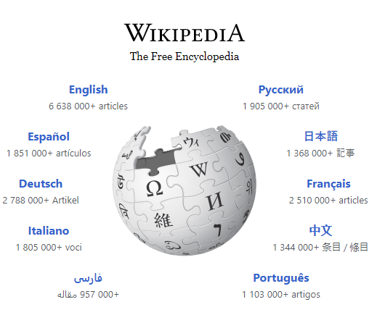
When all else fails: Wikipedia
“Data quality refers to the state of qualitative or quantitative pieces of information…Data is generally considered high quality if it is ‘fit for [its] intended uses in operations, decision making and planning’. …People's views on data quality can often be in disagreement, even when discussing the same set of data used for the same purpose.”
Nick Bonnichsen
Measuring Data Quality and Data Stewardship

Slide 8
But what can we actually measure?
Data Quality is some measurement or distillation of how fit for purpose a particular data set is.
Data Quality is no one complaining that the data on a report doesn't match the data they think should be on it.
Data is generally considered high quality if it is "fit for [its] intended uses in operations, decision making and planning".
High Quality data is that which meets or exceeds customer expectations.
Quality requires comparison
Nick Bonnichsen
Measuring Data Quality and Data Stewardship

Slide 9
Data Quality is a comparison of the actual state of a data set to a desired state
Nick Bonnichsen
Measuring Data Quality and Data Stewardship

Slide 10
Measuring Data Quality
Data Profiling: Comparing data between datasets
Two flavors:
Data Fidelity - comares source and target
Intrinsic Data Quality - compares real to ideal
Different ways to measure are Dimensions
Nick Bonnichsen
Measuring Data Quality and Data Stewardship

Slide 11
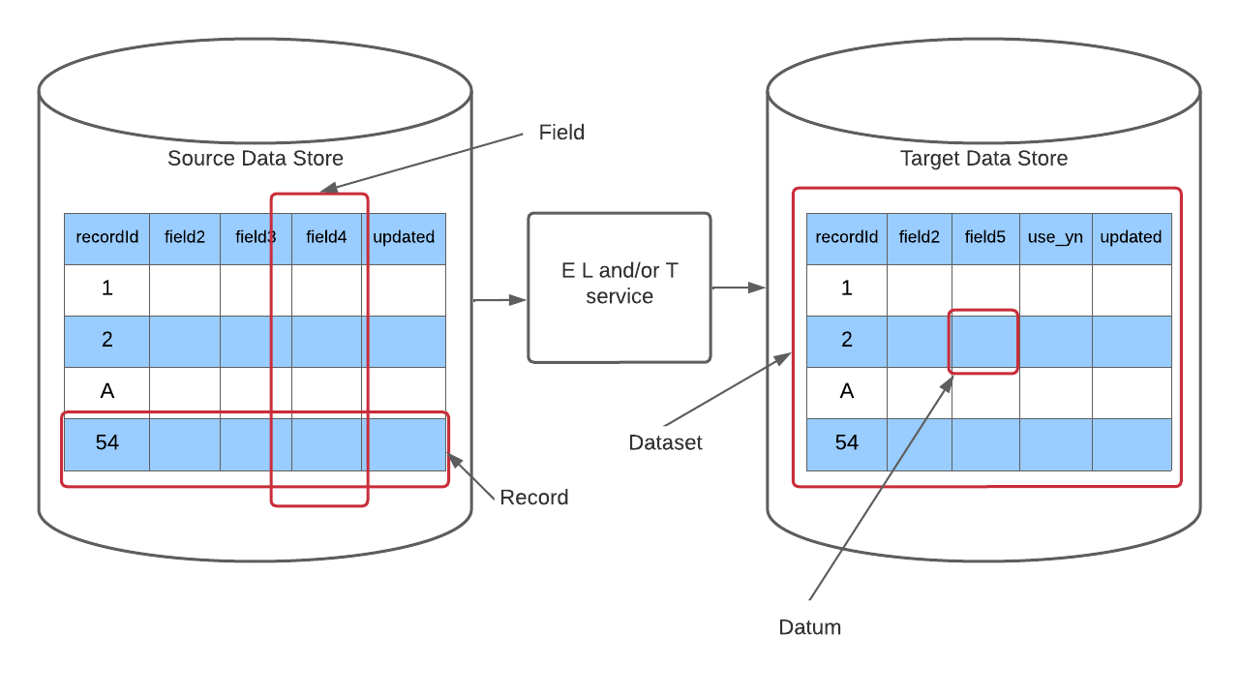
Some quick terms
Datum: one important thing
Data: bunch of datum
Record: related data about one thing
Field: Same datum over records
Dataset: A collection of records
Data store: Many datasets
Nick Bonnichsen
Measuring Data Quality and Data Stewardship

Slide 12
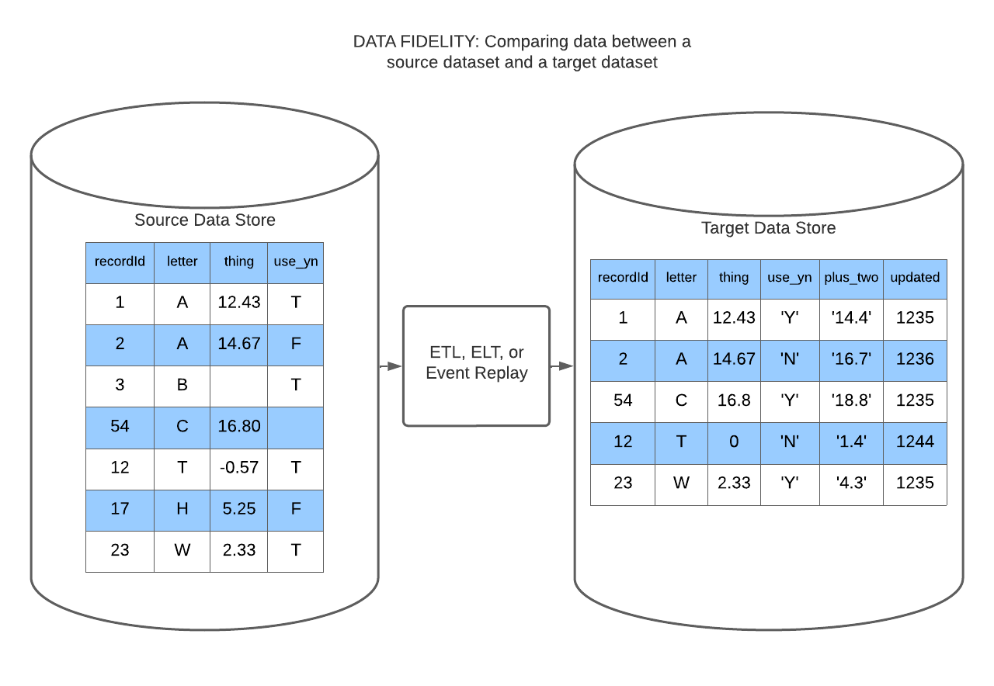
Data Fidelity
Compares target data with source data
Source data is considered “right”
Compensate for transformations
Essential when Target and Source are in different data stores
Nick Bonnichsen
Measuring Data Quality and Data Stewardship

Slide 13
Measures of Data Fidelity
Set-Completeness: A Target data set is set-complete if it contains all the records in the source data set.
Count of records in target dataset/count of records in source dataset
Consistency: Data or Records between two data sets are consistent if the Target data matches the Source data exactly.
Count of consistent records/count of all records
Validity/Precision: Data is Valid in a target data set if it matches the precision, data type, and format of the source or of source data transformed.
Nick Bonnichsen
Measuring Data Quality and Data Stewardship

Slide 14
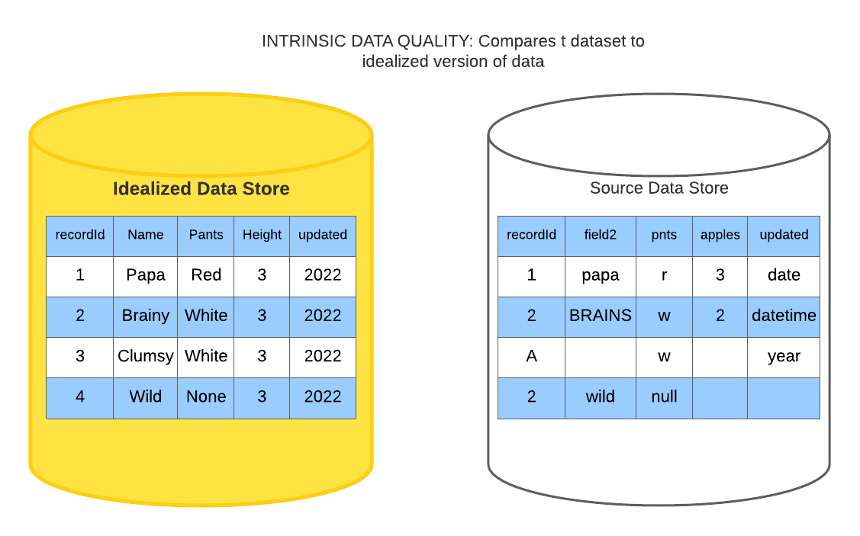
Intrinsic Data Quality
Compares a real dataset with an Ideal dataset
Idealized dataset defined by business rules and data convention
Tests “Fit for Purpose”
Nick Bonnichsen
Measuring Data Quality and Data Stewardship

Slide 15
Measure of Intrinsic Data Quality
Completeness: Values available for all records
For each field: count records missing data/overall count of records
Missing records are not necessarily bad
Uniqueness: Fields that should be unique across the data set are identified and not duplicated
Orderliness: Data is “orderly” if is conforms to the required structure for the data
Validity: Data correct data type, format, value range, and precision
Nick Bonnichsen
Measuring Data Quality and Data Stewardship

Slide 16
Harder to Measure Dimension
Timeliness: How recent is your data? When was it last updated
Name Correctness (Aptronymity): Does data define what the field, dataset, or data store name says it does
Cross data connections: Data dependent on other data
Accuracy: Data that is Accurate exactly reflects the real world thing that it is meant to describe
Auditability and Legacy: Meta-data of where your data came from and what or who touched it.
Nick Bonnichsen
Measuring Data Quality and Data Stewardship

Slide 17
Data Quality Practices
I’ve got Measurements, now what?
Going Back to the Defects
Many of the problems found could be traced to
Poor understanding of the data
Not my service, not my problem
Only doing testing before deployments
Not profiling production data
Nick Bonnichsen
Measuring Data Quality and Data Stewardship

Slide 18
High quality data comes from high quality data practices
And poor quality data from bad practices
Nick Bonnichsen
Measuring Data Quality and Data Stewardship

Slide 19
Better Practices
Maintain a Data Dictionary
Defines the Idealized data set
Has all the business rules
Has all the names
Agreed upon definitions, uses, types, etc.
Track Data Defects
Tag or mark them separately from software defects
Create separate defects for software that caused problems
Data Quality belongs to everyone
Nick Bonnichsen
Measuring Data Quality and Data Stewardship

Slide 20
Better Practices
Include a unique identifier per record that is not data store dependent
Preferably UUID
Implement Quality checks within data pipelines
Check that the data you got was the data sent
Manifests
Profile you data
Create a baseline of measures
Pick some measures from above
Where you paying attention?
See how they change over time
Proudly display your data on data quality
Execs love a pretty dashboard and graphs
Nick Bonnichsen
Measuring Data Quality and Data Stewardship

Slide 21
Things not to do
Don’t implement multiple tools to move same data
Like a separate daily ETL tool and a “one time” initial loader
Don’t copy partial data sets between data stores
Seems to always bite back
Easier to filter data out than go fetch it
ELT over ETL
Don’t continue to use outdated field names
As business terminology evolves change the names in the data
Don’t just keep using the same thing
It just makes everyone nuts
Nick Bonnichsen
Measuring Data Quality and Data Stewardship

Slide 22
Data Stewardship
Know how you get data and how it’s used
Understand your data’s meaning and purpose
Measure your relevant data quality dimensions
Keep your data dictionary up to data
Keep teams focused on data quality
Nick Bonnichsen
Measuring Data Quality and Data Stewardship

Slide 23
Data Quality
You know it when you see it,
But you can’t see it till you measure.
Quality is not an act, it is a practice.
– Aristotle
Nick Bonnichsen
Measuring Data Quality and Data Stewardship

Slide 24
THANK YOU
Nick Bonnichsen
Measuring Data Quality and Data Stewardship

Slide 25
To the chorus of “The Gambler”
You gotta know where it comes for, know where it’s going to,
Know how it changes ‘round, and know what it means
You have to measure Dimension and update your dictionaries,
The job of data stewardship belongs on every team
Nick Bonnichsen
Measuring Data Quality and Data Stewardship

