Slide 1
SPEAKER
Evan Masters
Reducing Ambiguity in Requirements Through Multi-Modal Communication

Slide 2
About Evan
Based in Spokane, WA
Been in SQA with Critical Logic since 2010
Began as SQA Analyst, specializing in MBT
Customer Success Manager & Product Owner
BS Physics, MBA, CSM, SAFe certified
Adjunct professor of Business Ethics
SPEAKER NAME
TOPIC

Slide 3
Agenda
I will talk
We will talk
SPEAKER NAME
TOPIC

Slide 4
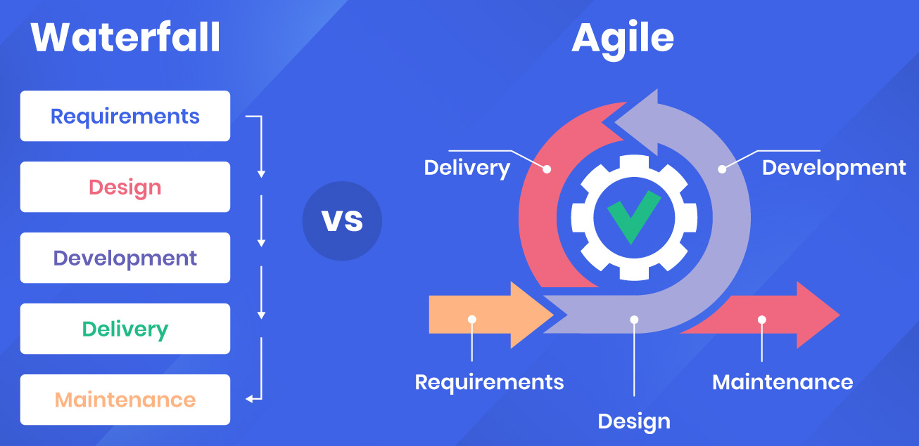
Overview of the current landscape of software development
Two ends of the development methodology spectrum:
Most organizations fall somewhere along the spectrum
SPEAKER Evan Masters
Reducing Ambiguity in Requirements Through Multi-Modal Communication
Notes:
Image credit: https://apifuse.io/blog/agile-vs-waterfall-methodology/
Regardless of where you fall on this spectrum, the expectation for high quality software is ever present. In Agile environments, this comes with the extra burden of needing to achieve high quality at a velocity that matches the rest of the definition and development cycle.
It’s to your benefit to use every tool at your disposal to reach this goal.

Slide 5
Challenges in effectively conveying requirements to development
Organizational structure (e.g., silos)
Lack of full understanding
Not experienced conveying at the right level
SPEAKER Evan Masters
Reducing Ambiguity in Requirements Through Multi-Modal Communication
Notes:
Organization structure challenges (i.e., silos): It is not at all uncommon for business organizations to be functionally segregated. Sometimes there are good business reasons for this. One downside to such an organizational structure is that it prevents the people on these segregated (i.e., siloed) teams from seeing the bigger picture. Therefore, when one of them attempts to describe a business need, they can’t see the full impact of how the solution will affect the organization as a whole.
Lack of a full understanding of the need: Another common shortcoming that business stakeholders face when attempting to describe a business need is that they don’t fully understand it. This isn’t meant as a slight or criticism about these stakeholders. On the contrary, I have personally found myself in this situation numerous times. Rather, it’s an acceptance of the fact that business stakeholders often find themselves faced with a problem of finite resources. The resources could be time, accessibility to Subject Matter Experts (SME’s), technical expertise, overwhelming amounts of context around the need, just to name a few.
Not experienced with conveying the business need to technical resources: Even the best-intentioned business stakeholders may have a hard time conveying their need in ways that a development team could take and turn into something deliverable. While this does get easier with experience, additional complications to this can arise for even experienced authors. Complications such as offshore teams, infrastructure considerations and constraints, and complex system interactions. Each of these complications adds a layer of difficulty the business stakeholder will have to contend with to convey their need.

Slide 6
Consequences of ambiguous requirements
Feedback loops – lots of them!
Rework
Opportunity costs
Missed deadlines
Technical debt
Erosion of trust and consequences
SPEAKER Evan Masters
Reducing Ambiguity in Requirements Through Multi-Modal Communication

Slide 7
Multi-Modal communication as an approach to rqmt communication
What is multi-modal communication?
Using more than one ‘mode’ of communicating
Most requirements are conveyed via text and text alone
Specs, User Stories, unstructured descriptions of an idea
Multi-Modal Communication is used to:
Common Understanding of Requirements (CURe)
Reduce/eliminate ambiguity
Make requirements more accessible
SPEAKER Evan Masters
Reducing Ambiguity in Requirements Through Multi-Modal Communication

Slide 8
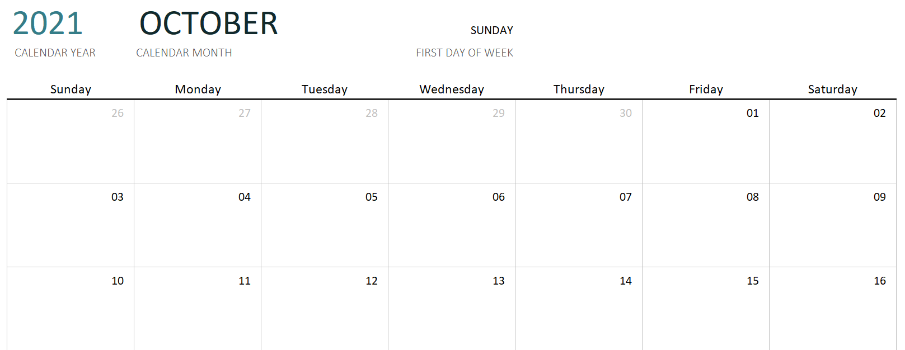
Ensure clarity, reduce ambiguity, and create a common understanding of the requirements
My favorite example: Next Thursday
What I said (and meant!) vs what my boss interpreted
Thursday, October 14th, 2021
SPEAKER Evan Masters
Reducing Ambiguity in Requirements Through Multi-Modal Communication

Slide 9
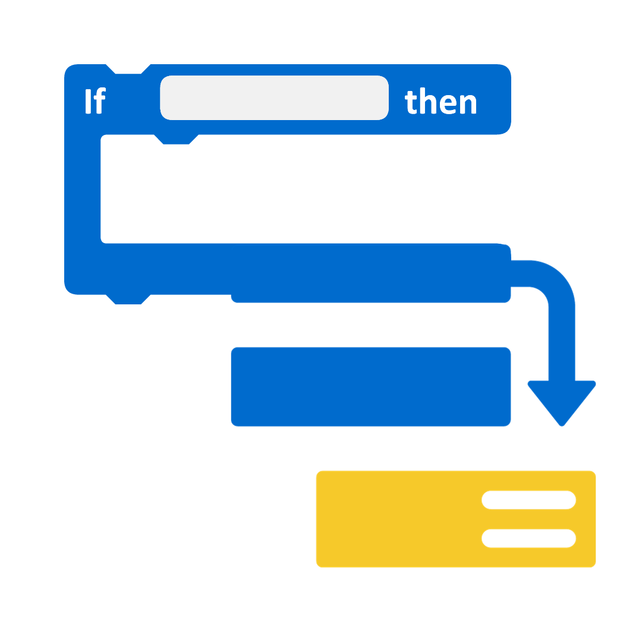
Ensure clarity, reduce ambiguity, and create a common understanding of the requirements
Increase accessibility of requirements
Broader audience
Different consumption styles
SPEAKER Evan Masters
Reducing Ambiguity in Requirements Through Multi-Modal Communication
Notes:
A requirements document can include:
A written description of the requirements.
Diagrams or illustrations of the requirements.
Use cases or scenarios that illustrate how the requirements will be used.
Screen mockups or prototypes of the user interface.
Requirements can be gathered through interviews, workshops, or focus groups, and these sessions can be recorded and transcribed to capture the different ways that stakeholders communicate about the requirements.
Requirements can be modeled using UML or other modeling languages, which can help to visualize the requirements and identify potential ambiguities.
Requirements can be tested using a variety of techniques, such as user testing or acceptance testing, to ensure that they are understood and can be implemented correctly.

Slide 10
Success: Some Case Studies
Department of Defense Contractor
Finance sector
Start up working with Dept of Veteran’s Affairs
SPEAKER Evan Masters
Reducing Ambiguity in Requirements Through Multi-Modal Communication

Slide 11
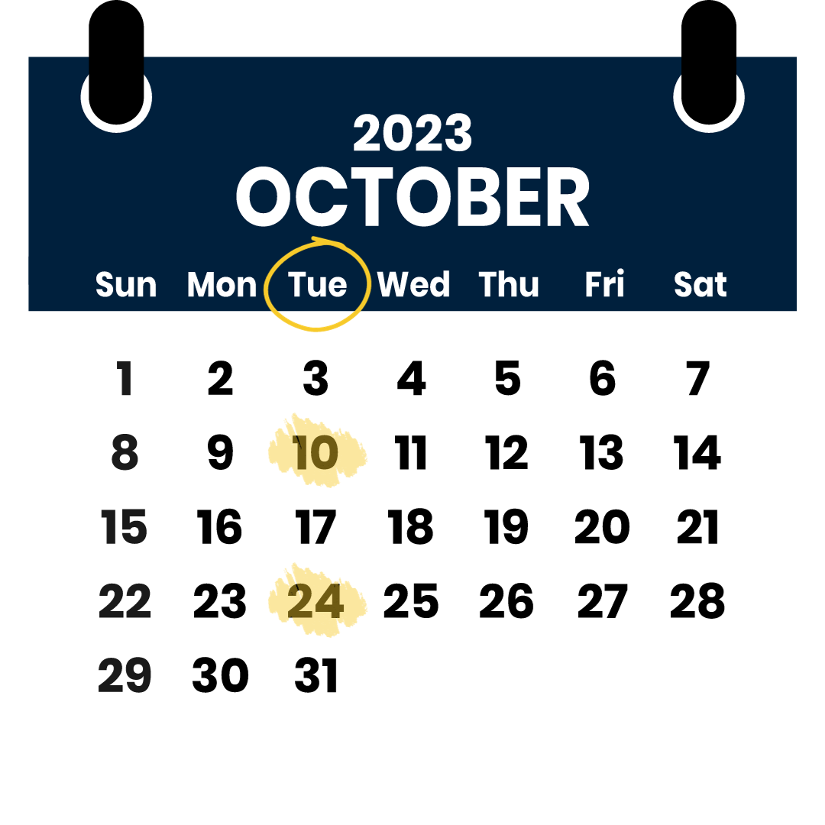
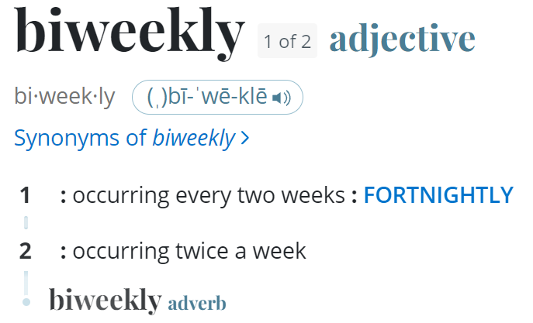
Multi-Modal vs. Traditional Methods
Some specs rely heavily on written documentation
Ambiguities – such as the word ‘biweekly’
SPEAKER Evan Masters
Reducing Ambiguity in Requirements Through Multi-Modal Communication

Slide 12
Resetting the standard of communication
Ensuring that all stakeholders have a common understanding of the requirements (CURe)
Facilitating communication between stakeholders with different language skills or learning styles
Making the requirements more accessible to stakeholders with disabilities
Improving the efficiency and effectiveness of the requirement development and communication process
SPEAKER Evan Masters
Reducing Ambiguity in Requirements Through Multi-Modal Communication
Notes:
During the requirements gathering phase
Stakeholder interviews can be recorded and transcribed to capture the different ways that stakeholders communicate about the requirements.
Requirements workshops can be used to facilitate communication between stakeholders and to get feedback on the requirements.
Use cases or scenarios can be used to illustrate how the requirements will be used.
Diagrams can be created based on Use Cases and/or Scenarios that augment the information contained in the Use Case/Scenario.
During the requirements analysis phase:
Requirements can be modeled using UML or other modeling languages to visualize the requirements and identify potential ambiguities.
Requirements can be modeled using a variety of techniques, and then shared back with the stakeholders who originated the requirements to ensure that they are understood and can be implemented correctly.
During the requirements validation phase:
The requirements can be presented to stakeholders in multiple formats, such as written documents, diagrams, or prototypes, to ensure that they are understood.
Stakeholders can be asked to provide feedback on the requirements in multiple formats.
Tests can be developed from the visualized requirements and included in the validation assets so stakeholders know how their requirements will be validated.

Slide 13
Accuracy, Speed, and High-Quality
If a picture is worth 1,000 words, how many are a video worth?
Mockups and prototypes!
Less rework and nipping tech debt in the bud
SPEAKER Evan Masters
Reducing Ambiguity in Requirements Through Multi-Modal Communication
Notes:
Images and diagrams can be a helpful way to illustrate requirements and to make them more understandable. For example, a diagram can be used to show the flow of information through a system. Another type of diagram can be used to show, for the same system, how data elements of a system relate to each other.
Video can be a helpful way to demonstrate how requirements will be used in practice. For example, a video can be used to show a user interacting with a system or to demonstrate how a process will be carried out. Videos can include everything from stakeholder interviews to a demonstration of how an app will function based on a series of mockups.
Prototypes can be used to test requirements and to get feedback from stakeholders. For example, a prototype of a user interface can be used to get feedback on the usability of the interface. Prototypes are also effective for validating accessibility considerations before development.
By using multimodal communication, you can help to ensure that the requirements are clear, unambiguous, and understood by all stakeholders. This can help to avoid costly rework and delays in the development process. It can also lead to higher quality business systems that meet the needs of the stakeholders.

Slide 14
Best Practices and Guidance
Identify the stakeholders
Understand the needs of stakeholders
Choose the right communication methods
Use multiple communication methods
Be flexible and reactive
Get feedback
Continuously improve
SPEAKER Evan Masters
Reducing Ambiguity in Requirements Through Multi-Modal Communication
Notes:
Identify the stakeholders
The first step is to identify the different stakeholders who will be involved in the project. This includes the users of the system, the business owners, the developers, and the testers.
This seems obvious but I’ve seen many projects fail because key resources have failed to identify critical stakeholders.
Understand the needs of the stakeholders
Once you have identified the stakeholders, you need to understand their needs and expectations. This includes their understanding of the requirements, their preferred communication methods, and their level of technical expertise.
Choose the right communication methods
Once you understand the needs of the stakeholders, you can choose the right communication methods. This may include written documents, diagrams, videos, prototypes, or even face-to-face meetings.
Remember to keep in mind that you may need different communication modes to convey the same message to different stakeholders
Use multiple communication methods
It is important to use multiple communication methods to ensure that all stakeholders can understand the requirements. This is especially important for stakeholders with different learning styles or who are not native speakers of the language in which the requirements are written.
Again, multiple modes may need to be implemented.
Be flexible and reactive
It is important to be flexible in your approach to multimodal communication. The best communication method for one stakeholder may not be the best method for another. Be willing to adapt your approach based on the needs of the stakeholders.
Get feedback
It is important to get feedback from the stakeholders throughout the process. This will help you to ensure that the communication is effective and that the requirements are understood.
Continuously improve
The process of multimodal communication is an ongoing process. As you learn more about the stakeholders and their needs, you may need to adjust your approach. Be willing to continuously improve your communication methods to ensure that the requirements are communicated effectively.

Slide 15
Conclusions
Don’t let PROCESS get in the way of quality
Take the time to take a step back (often!)
You’re all on the same team
What are YOUR experiences?
SPEAKER Evan Masters
Reducing Ambiguity in Requirements Through Multi-Modal Communication

Slide 16
THANK YOU
SPEAKER Evan Masters
Reducing Ambiguity in Requirements Through Multi-Modal Communication

