Slide 1
Achieving Software Quality:
Prioritizing Intended Behavior
Bob Johnston
ACHIEVING SOFTWARE QUALITY:
PRIORITIZING INTENDED BEHAVIOR

Slide 2
ACHIEVING SOFTWARE QUALITY:
PRIORITIZING INTENDED BEHAVIOR
Development
Intended Behavior
SDLC
VerificationXXXXXX

Slide 3
Intended Behavior
User Stories
Security
Requirements
Data Models
Business
Needs
Use Cases
Development
UX Standards
Interfaces
Legacy System

Slide 4
Development
Analyze and Interpret the Intended Behaviors
Code/Sprints/MVP
Unit and System Testing
(We are good at this)
Intended Behavior
Release to Test

Slide 5
Verification
Development Release
Test Planning
Test Design
Test Execution
Automate
Bug Tracking
Quality Assessment
Release Criteria
QA Team
Coverage
Release Decision
Technical Debt
Business System
Users
Intended Behaviors
Intended Behaviors

Slide 6
Software Quality Triangle
Not clear, complete or ambiguous
Development
Intended Behavior
SDLC
VerificationXXXXXX
Business System
Technical Debt
Risk

Slide 7
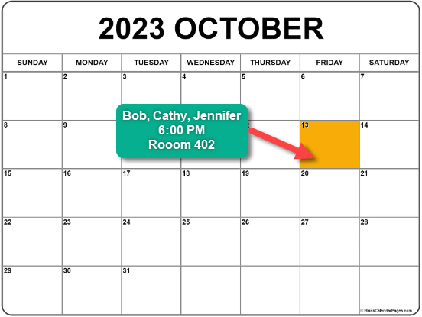
Workshop: Examples
Let’s meet next Friday
Let’s meet next Friday
Let’s meet Oct. 13
Let’s all meet Oct. 13
Bob, Cathy and Jennifer meet Oct.13
Bob, Cathy and Jennifer meet Oct.13 at 6:00
Bob, Cathy and Jennifer meet Oct.13 at 6:00 PM
Bob, Cathy and Jennifer meet Oct.13 at 6:00 PM here

Slide 8
Workshop: Examples
Customer Login

Slide 9
Problem: Testing Should Do vs. Does Do
Requirements Based Testing
Modeling
SME Authoring
Better Testing
Should Do
Does Do
Capture Playback
Data Driven Testing
AI generated Testing
Test Engineer Authoring
Code Coverage

Slide 10
Development
Clear, Complete and Unambiguous
Intended Behavior
SDLC
VerificationXXXXXX
Business System
Business System
Technical Debt
Risk

Slide 11
Keys to improving Software Quality
By focusing on ‘Intended Behavior’
Intended Behavior
Must be Clear, Complete and Unambigous
Must be Maintained
Must be Signed off by Stakeholders
Must by Source to Development AND Test
Single Agreed Upon Statement of
Intended Behavior
Development
Test
Modeling, Diagrams, Prototypes
Follow BABOK
Extend schedules for Requirements
Apply ‘Testability’ to designs
Measure Results and Coverage
Some Ideas

Slide 12
THANK YOU
Bob Johnston
ACHIEVING SOFTWARE QUALITY:
PRIORITIZING INTENDED BEHAVIOR

