Slide 1



Nate Smith, Ph.D.
Navigating Complex GraphQL Testing: Automating Integration Test Generation

Slide 2




ABOUT ME
Principal Software Engineer at Care.com
Been in the industry for about 15 years on and off
Former academic philosopher
NATE SMITH
Navigating Complex GraphQL Testing: Automating Integration Test Generation

Slide 3

WHAT THIS TALK IS
A case study on what we did and how well it worked
Some ‘how-to’ steps on how to do something similar in your own org
Some more general thoughts
NATE SMITH
Navigating Complex GraphQL Testing:
Automating Integration Test Generation

Slide 4
OUTLINE
Testing REST APIs
GraphQL Crash Course
Challenges of Testing GraphQL APIs
A Tale of the Project
Results
Technical Details & How To
Final Thoughts
NATE SMITH
Navigating Complex GraphQL Testing:
Automating Integration Test Generation

Slide 5

Testing a Simple REST API
GET user/{id}
NATE SMITH
Navigating Complex GraphQL Testing:
Automating Integration Test Generation

Slide 6
Testing a Simple REST API
Send valid Ids
Send invalid Ids
Send invalid payloads
Send invalid headers
Seed the API with test data, and then try:
  Users with lots of data
  Users with minimal data
NATE SMITH
Navigating Complex GraphQL Testing:
Automating Integration Test Generation
Notes:
While there are lots of tests we could write, it’s relatively to easy to conceive of a sensible space of inputs to test that would give us good coverage.

Slide 7
Testing a Simple REST API
If the response payload were complex (suppose many layers of nested objects), we might have some more complex to assertions to make.
But the basic structure of the input is still: send an id, get back an object.
NATE SMITH
Navigating Complex GraphQL Testing:
Automating Integration Test Generation

Slide 8
GraphQL Crash Course
Operation Types
Queries: retrieve data
Mutations: modify data
Subscriptions: get real-time updates on data.
There’s a single endpoint for all resources.
NATE SMITH
Navigating Complex GraphQL Testing:
Automating Integration Test Generation
Notes:
The project I’m describing here is limited to queries, so from here on out we’ll just talk about those. Mutations add additional complexity but can be tested with this approach as well.

Slide 9
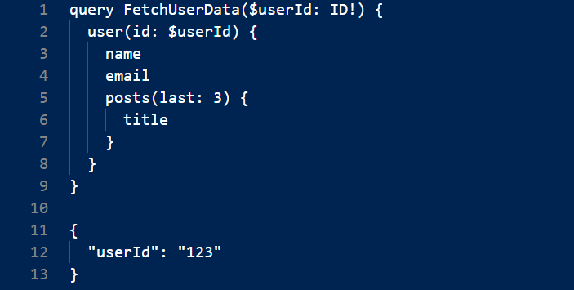
GraphQL Crash Course
When we make a GraphQL query, we send a query string.
NATE SMITH
Navigating Complex GraphQL Testing:
Automating Integration Test Generation

Slide 10
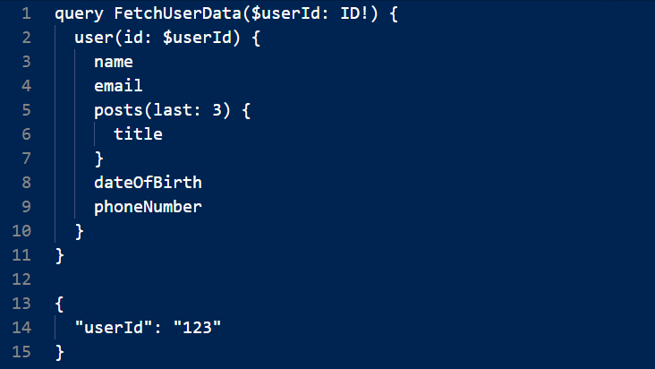
GraphQL Crash Course
We can add additional fields in our request:
NATE SMITH
Navigating Complex GraphQL Testing:
Automating Integration Test Generation

Slide 11
GraphQL Crash Course
Why is this called GraphQL?
The endpoint and the data it supports is indeed a graph.
For a given resource, there are there 0 or more possible entities that belong to it.
A blogging platform:
A user has an email address.
A post has an author (user).
NATE SMITH
Navigating Complex GraphQL Testing:
Automating Integration Test Generation

Slide 12
Testing GraphQL
Ok, so now we want to test a GraphQL endpoint. How might we proceed?
1. List all the queries.
2. Come up with some query strings for each (i.e. select the fields we want to request). Perhaps driven by business context?
3. Create input variables as applicable. Perhaps some combination of business scenarios and edge case tests?
The catch: we had to do some version of 1 and 3 with REST, but not we’ve got another dimension to our requests. The bad news is that the list of possibilities here is approximately way too many.
NATE SMITH
Navigating Complex GraphQL Testing:
Automating Integration Test Generation

Slide 13
Enterprise Graphs
Hundreds or thousands operations in the schema.
Query strings that can reach hundreds of lines in some cases, and the graph has cycles.
In other words, you can create a valid request of infinite length.
What do we do? How do we test hundreds of operations with an infinite number of possible query strings in addition to all the normal complexity of testing various API inputs?
NATE SMITH
Navigating Complex GraphQL Testing:
Automating Integration Test Generation

Slide 14
A Tale
“Nate, we should test this new GraphQL API.”
NATE SMITH
Navigating Complex GraphQL Testing:
Automating Integration Test Generation
Notes:
Nate has never written automated tests for a GraphQL API before and wonders how people tackle this.
Nate spends a few hours standing up basic tests for a single query and starts worrying a lot about the complexity problem.
Nate searches the internet to see how people solve this.

Slide 15
A Tale
Nate spends a few hours writing tests for a single operation.
NATE SMITH
Navigating Complex GraphQL Testing:
Automating Integration Test Generation

Slide 16
A Tale
He starts worrying a lot about the complexity problem because his company’s graph has over 500 operations.
NATE SMITH
Navigating Complex GraphQL Testing:
Automating Integration Test Generation

Slide 17
Prior Efforts
“Automatic Property-testing of GraphQL APIs” published in 2020 by Karlsson, Čaušević, and Sundmark.
It’s possible to automatically generate queries from a schema that will detect most, but not all, bugs introduced into a graph.
NATE SMITH
Navigating Complex GraphQL Testing:
Automating Integration Test Generation

Slide 18
Exploring the Idea
Prototype from paper is in Clojure.
Build a proof-of-concept in Care.com’s GraphQL stack (TypeScript).
See if we can get it to work for some simple operations.
NATE SMITH
Navigating Complex GraphQL Testing:
Automating Integration Test Generation

Slide 19
Initial Results
Initial version:
  query name
  scalar fields only, no objects
  hardcoded inputs
We found bugs immediately.
NATE SMITH
Navigating Complex GraphQL Testing:
Automating Integration Test Generation

Slide 20
Finishing
Next steps were:
Add support for object fields
Generated inputs
Fine-tuning input generators
Adding ‘known issue’ handlers
NATE SMITH
Navigating Complex GraphQL Testing:
Automating Integration Test Generation

Slide 21
Components
To run tests in this framework we need:
Get the schema
Generate a list of queries to test
Load configuration
Authenticate
Generate GQL string
Generate input object
Iterate on input values
Assert on response
NATE SMITH
Navigating Complex GraphQL Testing:
Automating Integration Test Generation

Slide 22
1 - Get the schema
We want a JSON representation of the schema so we can work with it in Typescript. (GQL introspection schema)
Can get this via Graph introspection if it’s enabled on the graph.
Otherwise (this is what we did):
Use Apollo CLI (rover) to retrieve schema file from the graph (.graphql format)
Use graphql-codegen to encode this as JSON.
Note that if you do this, you get an up-to-date representation of the graph.
NATE SMITH
Navigating Complex GraphQL Testing:
Automating Integration Test Generation

Slide 23
2 – List Queries
The JSON schema contains an object with the name “Query”, that has each possible query as a field.
We can get a list of all the field names in this object.
NATE SMITH
Navigating Complex GraphQL Testing:
Automating Integration Test Generation

Slide 24
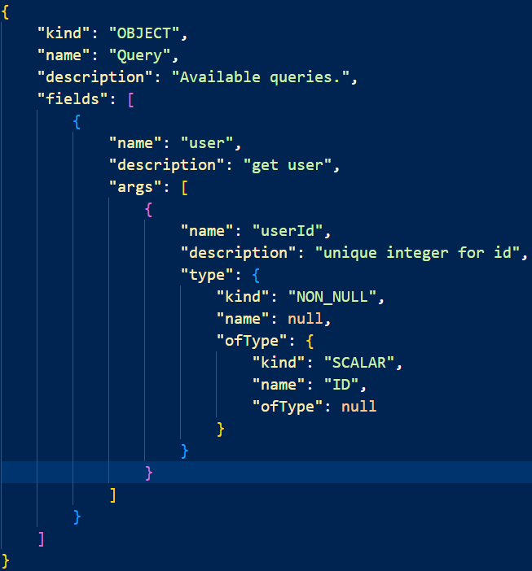

2 – List Queries
The JSON schema contains an object with the name “Query”, that has each possible query as a field.
We can get a list of all the field names in this object.
NATE SMITH
Navigating Complex GraphQL Testing:
Automating Integration Test Generation

Slide 25
3 – Load Configuration
We’ll need some configuration for refining how we run the tests.
NATE SMITH
Navigating Complex GraphQL Testing:
Automating Integration Test Generation

Slide 26
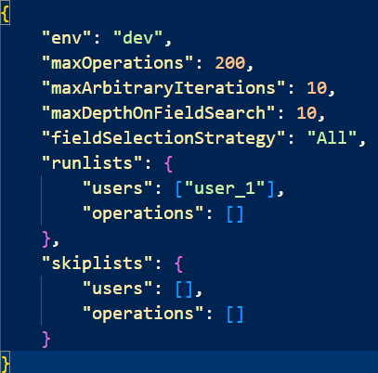

3 – Load Configuration
NATE SMITH
Navigating Complex GraphQL Testing:
Automating Integration Test Generation

Slide 27
4 – Authenticate
If your graph requires authentication, this step will depend on your identity management architecture.
Ours was complex, but solvable with open-source JS/TS tooling.
NATE SMITH
Navigating Complex GraphQL Testing:
Automating Integration Test Generation

Slide 28
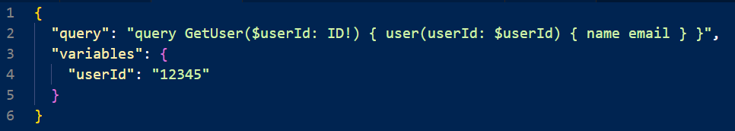
5 – Generate GQL String
Simple Case:
How do we generate a query like this from our JSON schema?
NATE SMITH
Navigating Complex GraphQL Testing:
Automating Integration Test Generation

Slide 29
5 – Generate GQL String
We need to traverse the graph.
Get the node with the named query.
Add its name to the string
Go to the next node (its first ‘field’).
Add its name to the string.
Rinse and repeat.
This is a depth-first search algorithm.
NATE SMITH
Navigating Complex GraphQL Testing:
Automating Integration Test Generation

Slide 30
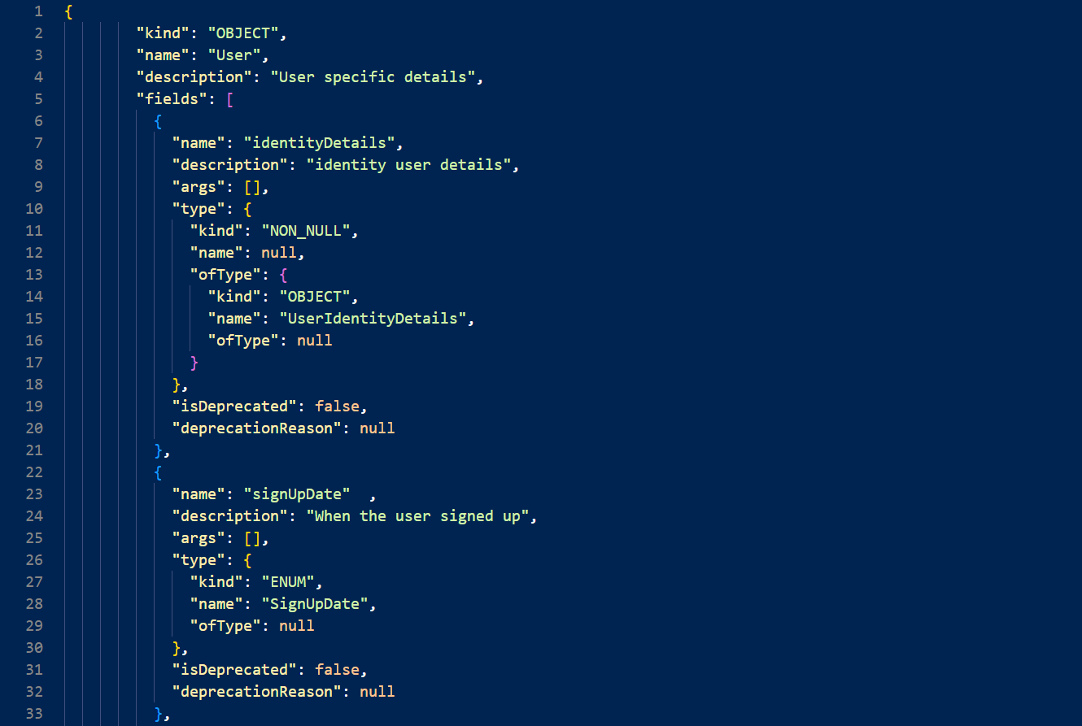

5 – Generate GQL String
We need to traverse the graph.
Get the node with the named query.
Add its name to the string
Go to the next node (its first ‘field’).
Add its name to the string.
Rinse and repeat.
This is a depth-first graph traversal algorithm.
NATE SMITH
Navigating Complex GraphQL Testing:
Automating Integration Test Generation

Slide 31


5 – Generate GQL String

Slide 32
6 – Generate Input Object
Inputs are already serialized as JSON, so this is easier.
Find the object in the schema and traverse the input object and build the object.
There’s some nuance to this, but that’s the basic idea.
NATE SMITH
Navigating Complex GraphQL Testing:
Automating Integration Test Generation

Slide 33
7 – Iterate on Input Values
Property Tests:
Given a range of inputs R, the response must have property P.
For example:
Given a zip code input of a five-character string containing only numbers, the response must be one of:
1. NOT_FOUND response object
2. A state abbreviation object.
NATE SMITH
Navigating Complex GraphQL Testing:
Automating Integration Test Generation

Slide 34
7 – Iterate on Input Values
We can use a property testing library to:
Generate and iterate on the values
‘Shrink’ ranges when unexpected results are found.
We used fast-check.
NATE SMITH
Navigating Complex GraphQL Testing:
Automating Integration Test Generation

Slide 35
8 – Assert on Response
A simple version of the property test:
All requests must do one of the following:
Respond with a 200 and return an object.
Respond with a known acceptable error message
NATE SMITH
Navigating Complex GraphQL Testing:
Automating Integration Test Generation

Slide 36
Components
Get the schema
Generate a list of queries to test
Load configuration
Authenticate
Generate GQL string
Generate input object
Iterate on input values
Assert on response
NATE SMITH
Navigating Complex GraphQL Testing:
Automating Integration Test Generation

Slide 37
Things We Learned
Our graph had bugs.
Tended to be:
Edge / boundary conditions
Poorly seeded test data
Non-functional operations
NATE SMITH
Navigating Complex GraphQL Testing:
Automating Integration Test Generation

Slide 38
Things We Learned
Our graph has lots of operations.
NATE SMITH
Navigating Complex GraphQL Testing:
Automating Integration Test Generation

Slide 39
Things We Learned
Operations can be very complex.
The tests generated query strings of 1500+ lines
NATE SMITH
Navigating Complex GraphQL Testing:
Automating Integration Test Generation

Slide 40
Things We Learned
Our graph didn’t handle error conditions consistently.
NATE SMITH
Navigating Complex GraphQL Testing:
Automating Integration Test Generation

Slide 41
Things We Learned
Our graph had unused operations.
NATE SMITH
Navigating Complex GraphQL Testing:
Automating Integration Test Generation

Slide 42
Things We Learned
Operations weren’t named consistently.
NATE SMITH
Navigating Complex GraphQL Testing:
Automating Integration Test Generation

Slide 43
Today
They run twice per day.
Testing hundreds queries with hundreds of input iterations each.
Entire test run takes about two minutes.
They automatically test operations that are newly introduced.
They do require some maintenance, mostly handling with new known issues.
NATE SMITH
Navigating Complex GraphQL Testing:
Automating Integration Test Generation

Slide 44
Automated Automated Tests
Note that we never wrote a single test ourselves.
This was a delightful situation to be in.
NATE SMITH
Navigating Complex GraphQL Testing:
Automating Integration Test Generation

Slide 45
Acknowledgements
Care.com Engineering
Emmanuel Pamintuan Jr.
Karlsson, S., Čaušević, A., and Sundmark, D. 2020 “Automatic Property-based Testing of GraphQL APIs” https://arxiv.org/abs/2012.07380, (submitted December 14, 2020).
NATE SMITH
Navigating Complex GraphQL Testing:
Automating Integration Test Generation

Slide 46
Thank you!
Nate Smith
nate@natesmith.io
https://natesmith.io
NATE SMITH
Navigating Complex GraphQL Testing:
Automating Integration Test Generation

