Slide 1
Zenzi Ali
Nimble Not Agile

Slide 2
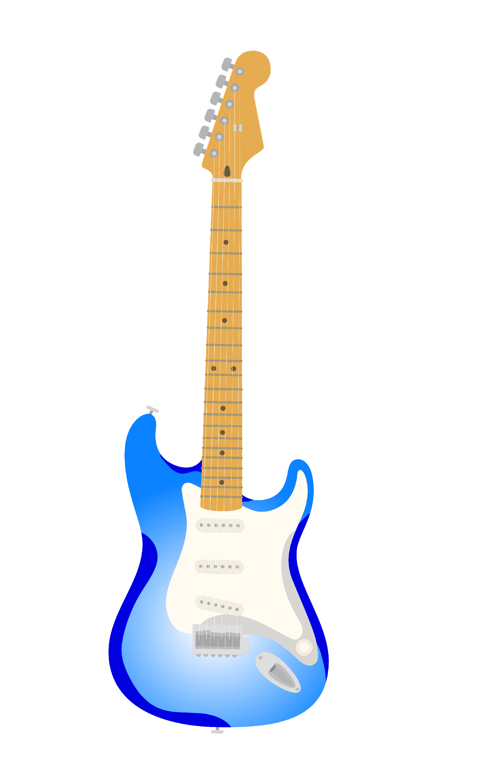
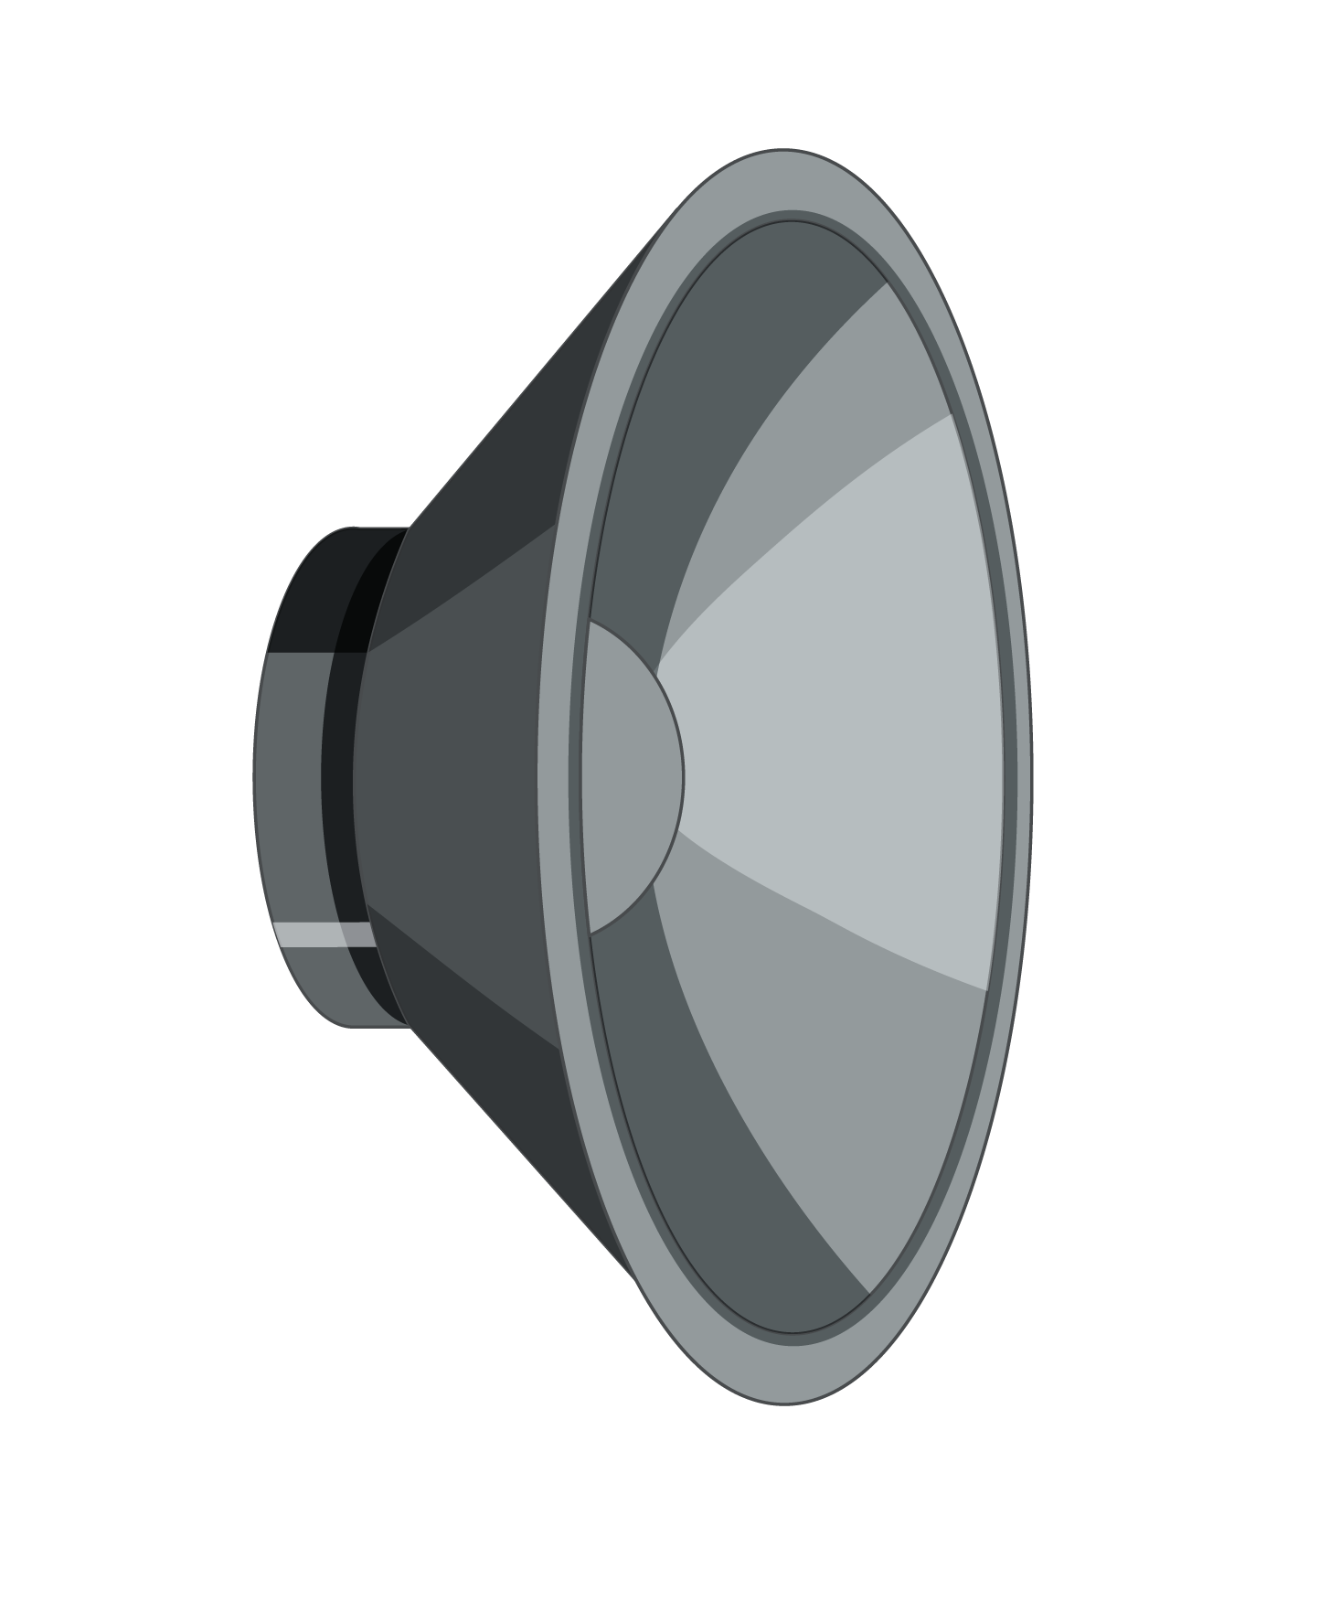
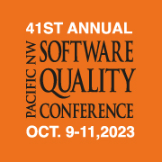
Objectives
Define framework
Explore my process for creating a framework
Show how to create a system that withstands the challenges of unorthodox workflows
Discuss iteration and resilience as a QA professional
Zenzi Ali
Nimble Not Agile
Notes:
Define Terms – activities and processes are called different things in different orgs 2. Our positions are in constant flux
For unorthodox teams–aren’t satisfied with their current workflow

Slide 3
About Me
Career Changer
Love systems
Thrive in a purpose driven environment
Community focused
Zenzi Ali
Nimble Not Agile
Notes:
Puzzles and birdwatching
Best/Worst Quality is that I pick things apart

Slide 4
About Clarity Innovations
Consulting
EdTech (K-12) Focus
Product Strategy and Development Specialists
Core Values include Collaboration, Creativity and Productivity
Zenzi Ali
Nimble Not Agile
Notes:
I’d like to explain what I do there, what my focus is as a QA professional and how we’re changing the way we work
SHARE WHAT MAKES US UNORTHODOX
Now that you know who I am and where I work, let’s talk Frameworks! What are they? How do we build our own?

Slide 5
What’s a Framework?
A basic structure underlying a system, concept, or text.
Zenzi Ali
Nimble Not Agile
Notes:
We often associate frameworks with programming languages, Angular or Django.
In this context, the system is the SDLC and the structure are a blend of habits, activities and principles defining you and your team’s Quality Management Practice
When you have a system you don’t need to panic!
What are your pain points working for an unorthodox team?

Slide 6
Common SDLC Models
Zenzi Ali
Nimble Not Agile
Notes:
What is our framework supporting? How are we working together to build?
My organization like many works differently. We use Basecamps Shape Up model

Slide 7
What Type of Teams Benefit from Creating a Framework?
Solo testers or testers that are part of a small team.
Testers that work with teams that use an unorthodox software development lifecycle model.
Teams that build and ship fast.
Quickly expanding teams that have not had time to focus on Quality Control and quality management.
Testers that value flexibility in their tooling.
Teams that manage multiple products with varied contextual needs.
Zenzi Ali
Nimble Not Agile
Notes:
How does your team differ from the norm?
Discuss problems with current models.

Slide 8
Benefits of your Framework
Couples with the SDLC
Pairs each phase of development with one or more testing activities
Can include phases that fall outside of your teams SDLC
Activities are unique to your team and project context
Goals: Systematically shift testing left/QM integrated
Zenzi Ali
Nimble Not Agile
Notes:
The STLC is an essential part of a tester’s framework, but it isn’t the entire thing. It’s a less rigid approach that takes your team’s unique needs into account.

Slide 9
The Framework Creation Process
Zenzi Ali
Nimble Not Agile
Notes:
This, is how I designed my own framework.
These are the basic steps. I’ll show you how I use them after we discuss my teams The difference between my framework and the STLC

Slide 10
Step 1: Observe
Zenzi Ali
Nimble Not Agile
Notes:
Google Drive
Shaping Document
-Problem
-Appetite
-Solution
Slack
-Takes the place of email and face-to-face convo
-Huddles used for internal team and cross-functional Meetings
GitLab
-Used for MR and Test Scripts
-Holds team project onboarding documentation
Zoom
-Used for Formal Planning Meetings (Kick-Off, Retrospectives, External Stakeholders)

Slide 11
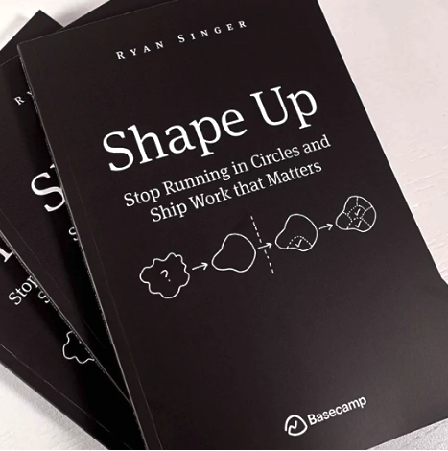
What’s Basecamp?
Start Up
Designs Project management software
Founded as a 3-person web design company
Zenzi Ali
Nimble Not Agile
Notes:
Understanding who they are as a company explains how their method developed
The Founder wrote shape up to explain how they were able to build high quality software quickly
focuses on strategic scoping and thoughtful problem-solving, there is little room or expectation for testing involved
LINK TO BASECAMP BOOK

Slide 12
The Shape Up Model
Source: Shape Up: Stop Running in Circle and Ship Work That Matters
Zenzi Ali
Nimble Not Agile
Notes:
Understanding who they are as a company explains how their method developed
The Founder wrote shape up to explain how they were able to build high quality software quickly
focuses on strategic scoping and thoughtful problem-solving, there is little room or expectation for testing involved
LINK TO BASECAMP BOOK
Nothing’s piecemeal
Whole solutions
Refinement is a new pitch
No Kanban or backlog (if it’s important, it’ll show up again)
Can you see any challenges for QA in this model?
Shape Up does not seem to leave space for quality. QA is shown to be nearly unnecessary in their process and used to explore edge cases only. Box checking and rubberstamping a finished product is not satisfying testing work

Slide 13
Step 2: Assessment
Zenzi Ali
Nimble Not Agile
Notes:
Strategic Planning Technique
Helps to assess factors that may affect project or goal success
SWOTs can be used throughout this process and they have use outside of business

Slide 14
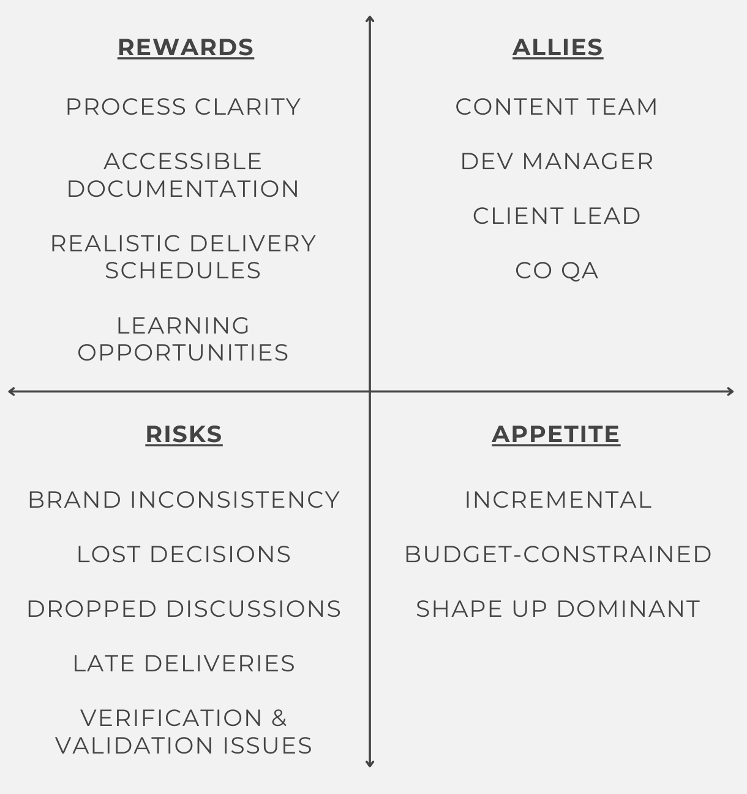
Assessment Cont.
Zenzi Ali
Nimble Not Agile
Notes:
-we’ve observed our environment
-we’ll assess risk via SWOT and experience in Quality Management
Validation is the process of checking whether the specification captures the customer's requirements, while verification is the process of checking that the software meets specifications.

Slide 15
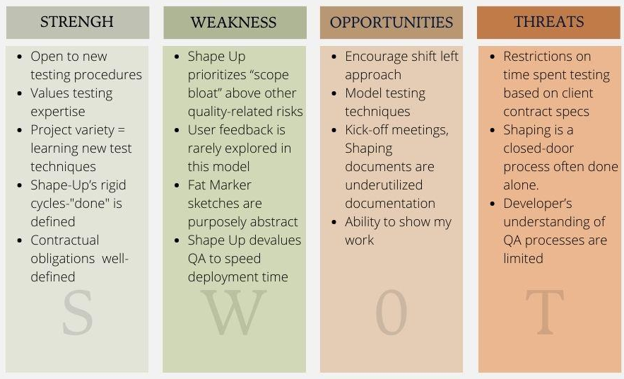
Dev Team SWOT
Zenzi Ali
Nimble Not Agile
Notes:
Here’s our team SWOT
From my perspective, but you can do this as a group or gather input from meetings
You can further dissect each item (what can you control? External v. internal? Immediate v. long-term)
Define scope bloat
Define Marker Sketches

Slide 16
Step 3: Design
Modular Components
Old and New Techniques
Address highest risks
Plan for the future
Zenzi Ali
Nimble Not Agile

Slide 17
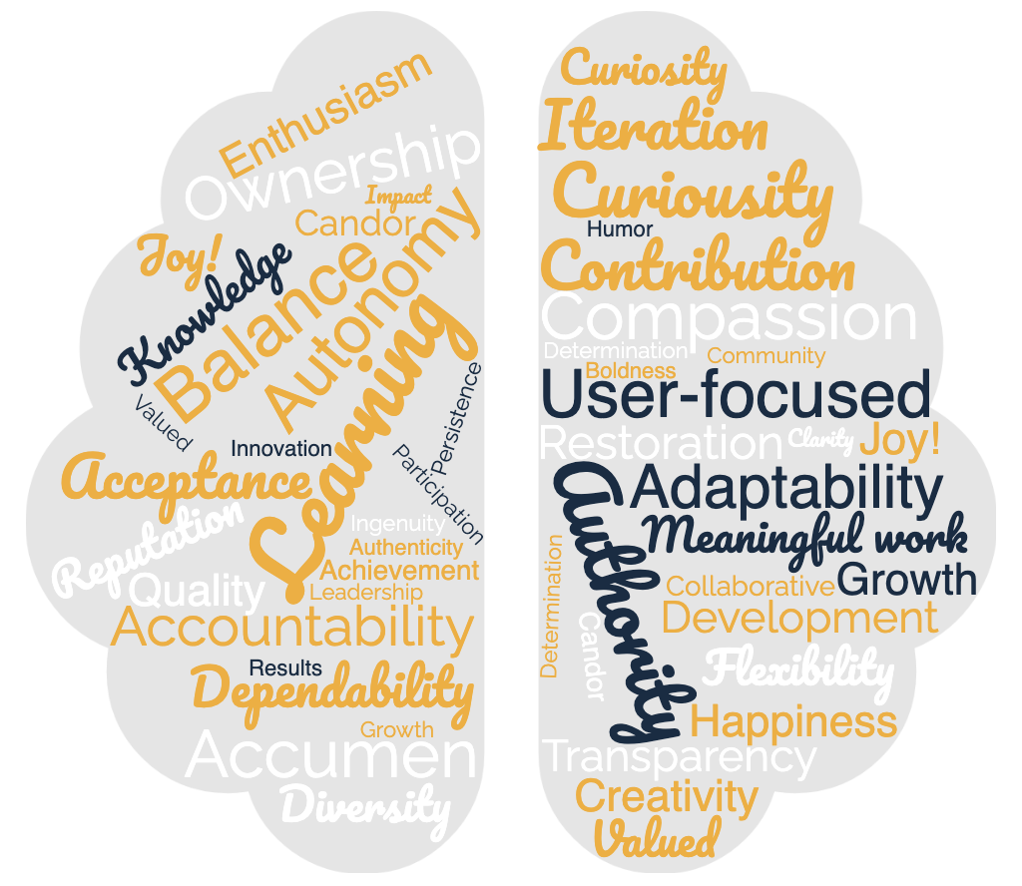
Let’s Talk – Professional Principles
Zenzi Ali
Nimble Not Agile
Notes:
Add to work connection when remote
Defines purpose of work

Slide 18
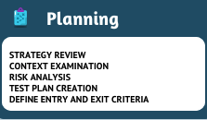
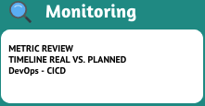
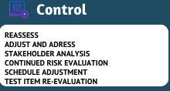
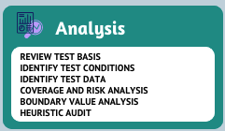
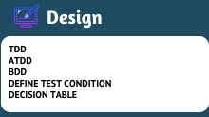
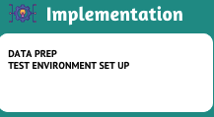
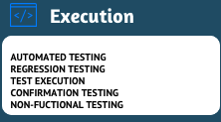
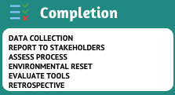
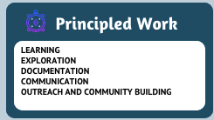
Modules
Zenzi Ali
Nimble Not Agile
Notes:
These are common activities that can be added to your framework. You may have different modules for different projects. I would suggest writing it down in the same way you’d write any important documentation. Some of this is part of a test plan, but principled work may go undiscussed or unmanaged. Can you think of other forms of principled work? Rest may be one/
Define principled work
Define Module
Find resources
State that this is commonly invisible work

Slide 19
Addressing the SWOT
Zenzi Ali
Nimble Not Agile
Notes:
Strengths: Team Curiosity and Openness

Slide 20
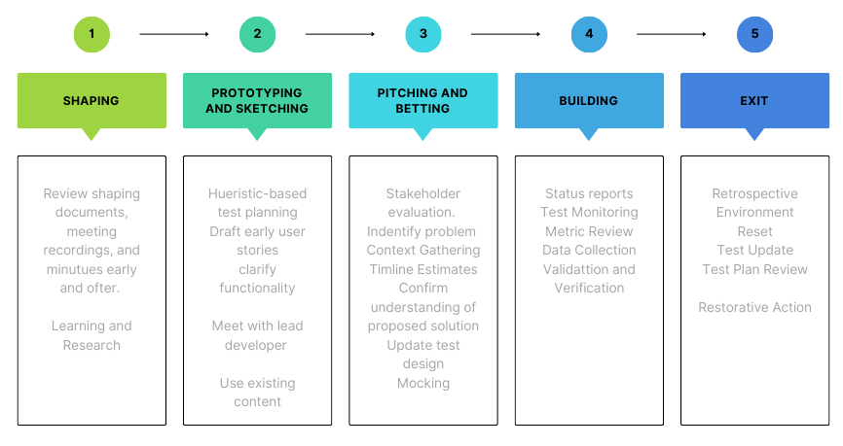
Shape Up Redesign
Zenzi Ali
Nimble Not Agile

Slide 21
Step 5: Iterate
What did you learn? | Focus on student use improved test cases
Where did you excel? | Communication
How can you improve? | Refine Deployment Calendar
Who can we gain support from? | Devs-Pair Programming
Zenzi Ali
Nimble Not Agile
Notes:
This essentially returns us to the Observation and Designing phases.
These questions can be used in place of formal metrics.
Do you find metrics to be useful?

Slide 22
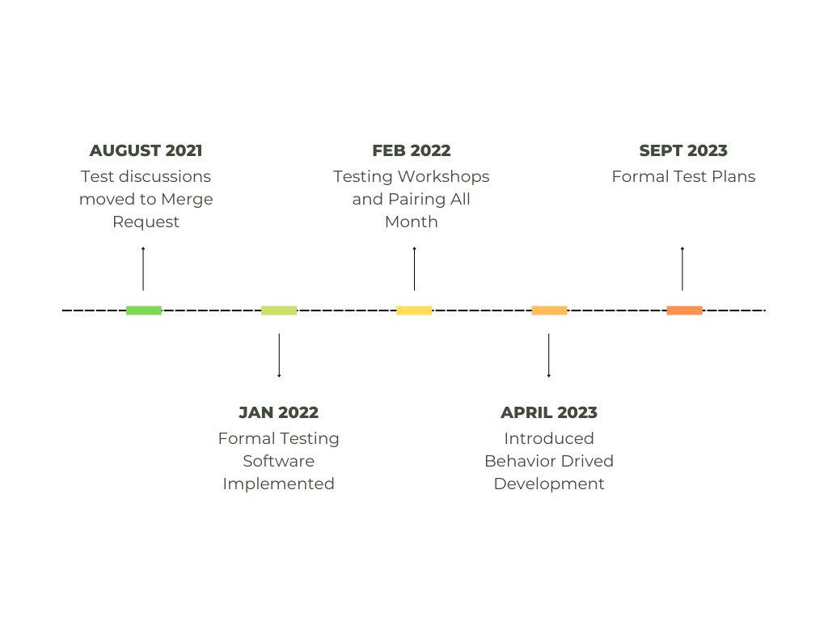
Implementation Timeline
Zenzi Ali
Nimble Not Agile
Notes:
This is a partial list of activities and benchmarks

Slide 23
Conclusion
A tailored framework can improve your workflow
Improved workflow = increased productivity
Quality Management is more that test processing
This 5 Step Process can be performed by any team member and implemented alongside current processes
Zenzi Ali
Nimble Not Agile

Slide 24
THANK YOU
SPEAKER NAME
TOPIC

