Slide 1
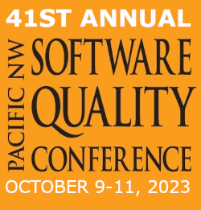
Optimize Your Testing Performance by Using Cypress.io
Ryan Song | Iterable

Slide 2
Ryan Song
Staff Software QA Engineer @Iterable
ryan.song@iterable.com
www.linkedin.com/in/ryan-song-tamu
Texas A&M ISEN Class 2015

Slide 3
Cognizant
UAT Test Analyst
Test Lead UAT
Test Lead UAT (Federal)
FabFitFun
QA Test Analyst
Senior QA Test Analyst
QA Automation Engineer (Mid)
Iterable
Senior Quality Assurance Engineer
Staff Quality Assurance Engineer

Slide 4
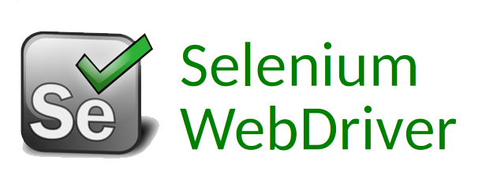
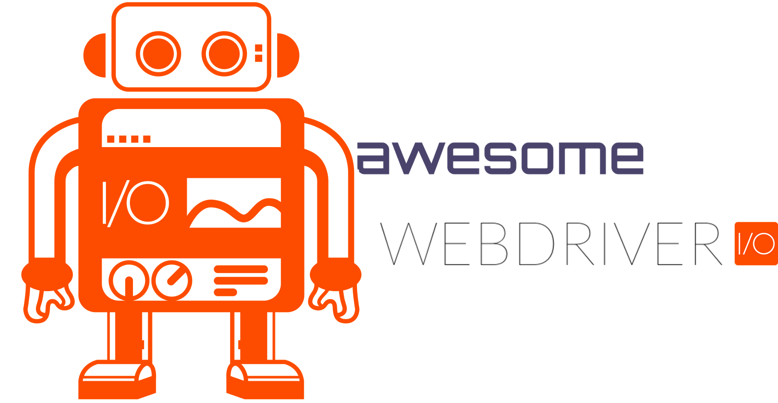
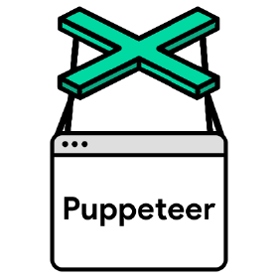
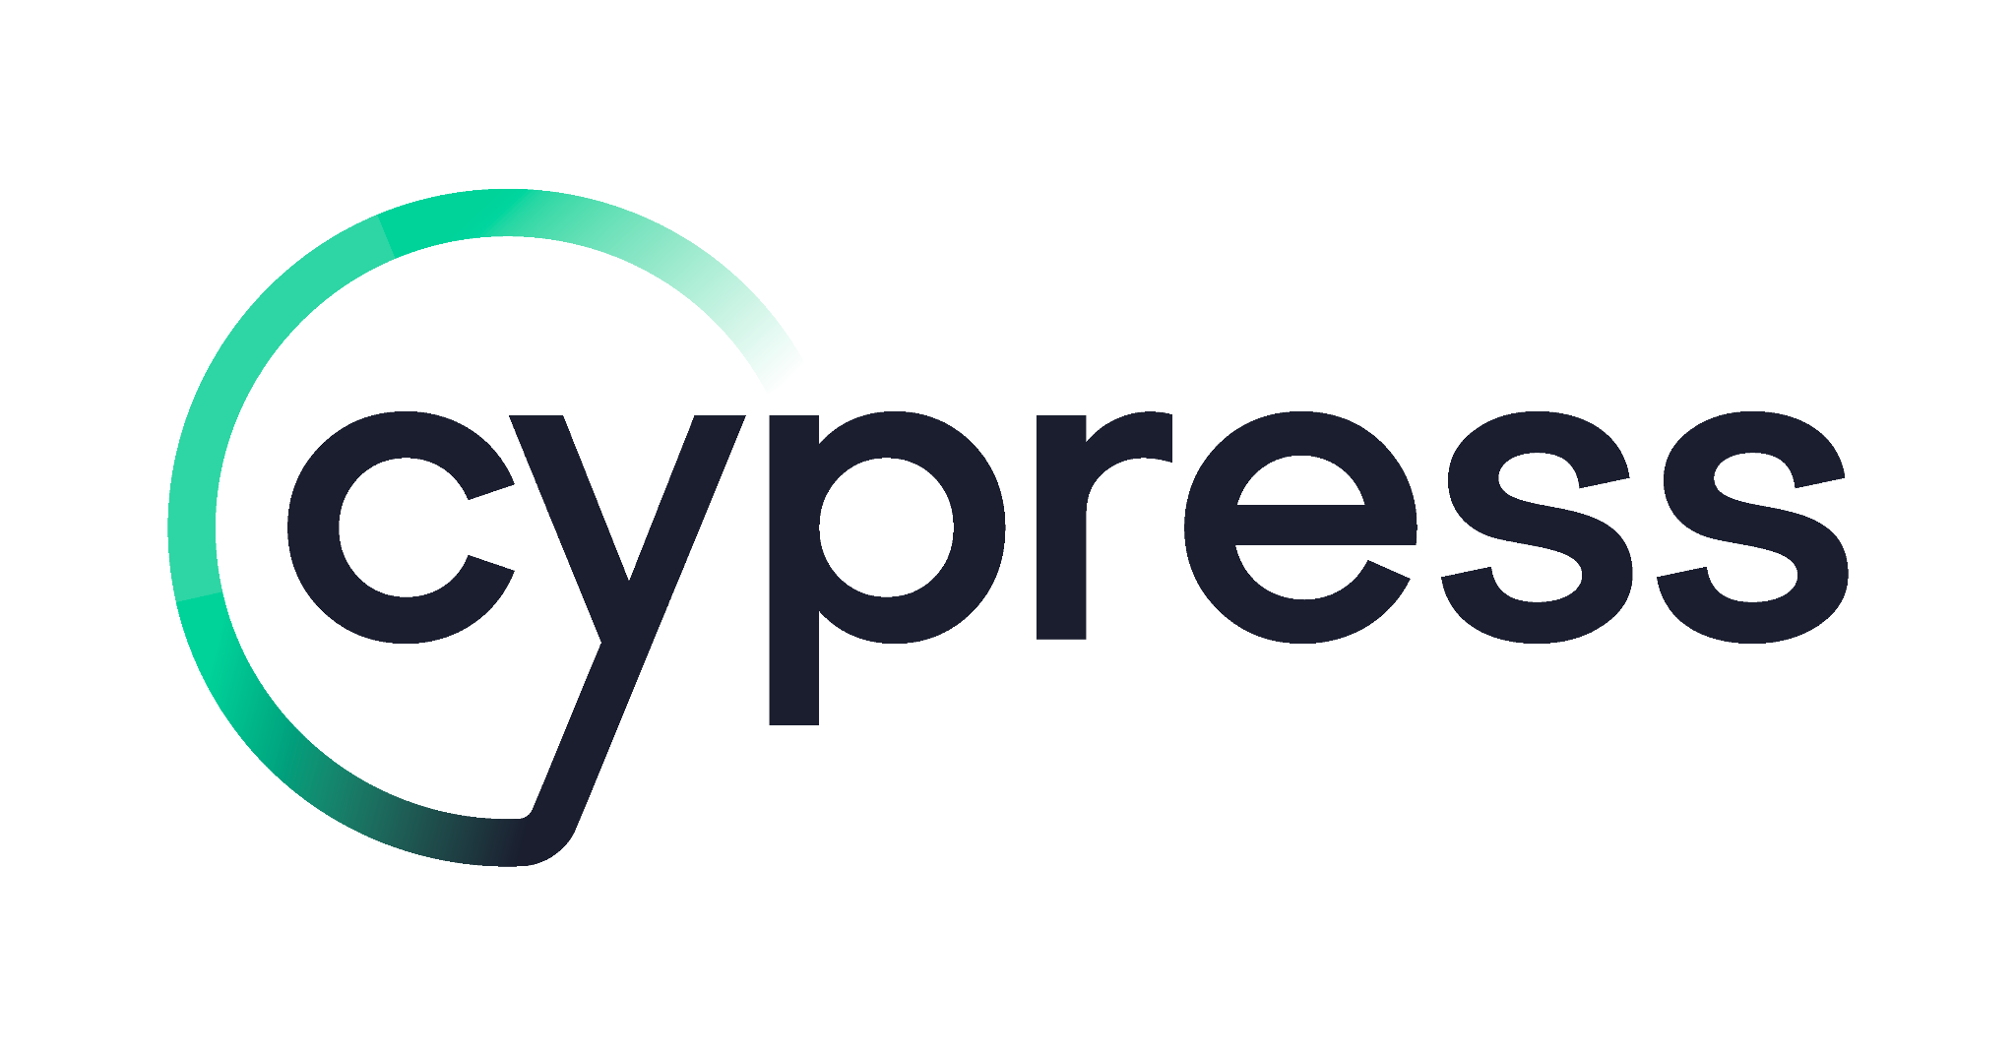
Notes:
Working on different tools in past 8 years

Slide 5
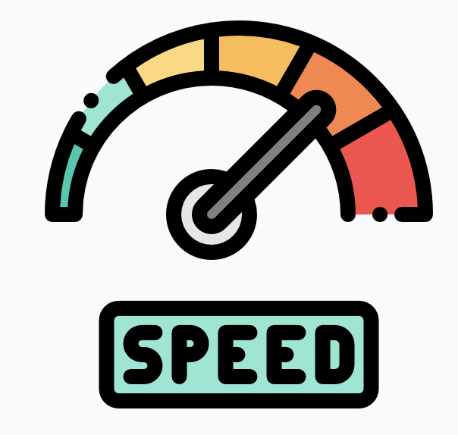
The Big Three Factors for Test Automation
Test Speed
Test Coverage
Test Stability

Slide 6
Test Speed
Running automation tests quickly enables developers to iterate faster, therefore they can promptly review test results and make necessary adjustments in a timely manner.
Test Coverage
Higher test coverage requires to create more test cases to test different test scenarios. This leads to fewer defects and work to do at later stages.
Test Stability
Higher test stability will reduce the number of flaky tests and improve the developer test experience.

Slide 7
Conflicts
The Struggle:
Running tests fast might require reduce the number of test runs.
Increasing test coverage might requires more update and maintain more tests.
Improve stability might require add more wait time or create fresh data for each test case and this will reduce the test run speed.
Notes:
If you want to run test faster, you might have to reduce the amount of of the to total tests. This will reduce the number of test coverages.
If you want to add more test coverage, you might need to update and maintain more tests.
If you want to improve test stability, you might need to add more wait time or create fresh data for each test run. This will potentially reduce the test speed

Slide 8
What if I want all?
Cypress.io offers:
Running tests in parallel.
Group test scenarios by using built-in test structure.
Ex: describe(), context() and it()
Test re-try, wait on mechanism and API calls.
Notes:
Using Cypress built-in features can help improve the test speed, test coverage and test stability.

Slide 9
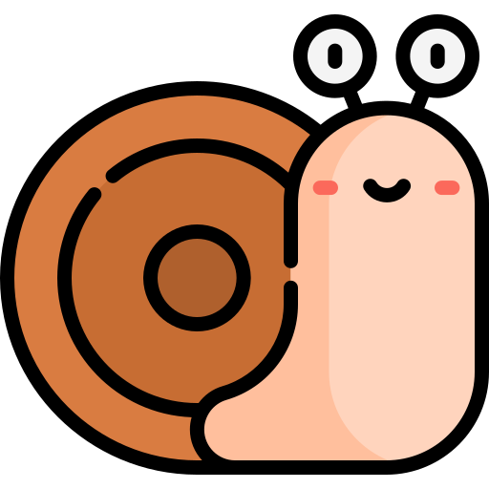
Test Speed
Test speed is always one of the major the bottleneck for software testing process.
WaterFall projects could take 4-6 weeks to complete the regression testing.
Many companies running all the tests during nightly batch and take hours to finish all the test runs.
Notes:
Truth is - engineering is fickle and you will probably have to revisit and try again.
Here is why generally I see I have to Iterate and how I approach these challenges.

Slide 10
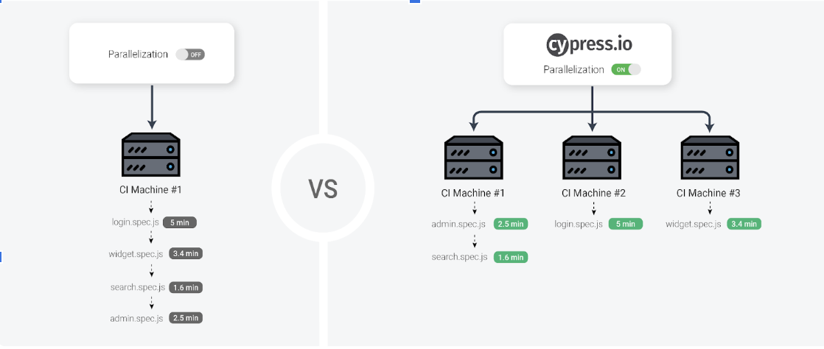
Test Speed
Running Tests in Parallel:
Cypress provide built-in feature to automatically split up test suites and running tests in parallel.
Running tests in many machines at the same time and evenly distributed tests to each machine.
This technique will empower developers to run tests in parallel and significantly reduce test run time.

Slide 11
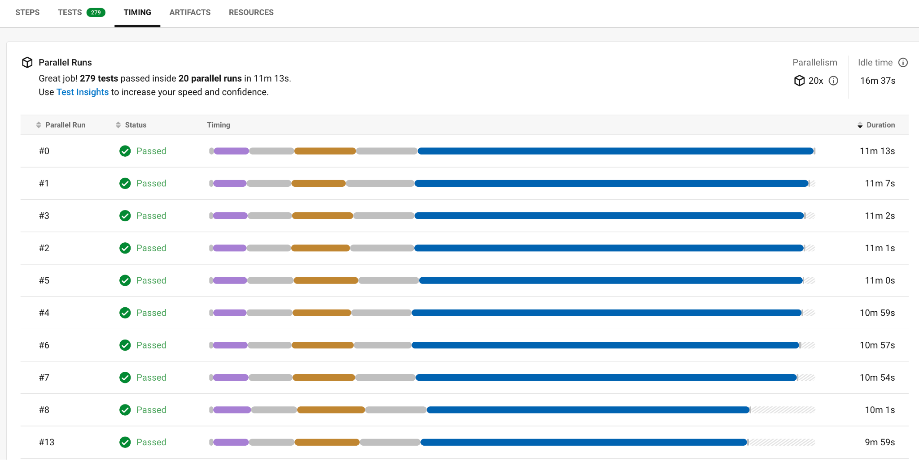
Test Speed
Running Tests in Parallel:
Currently at Iterable, we run almost 300 Cypress E2E tests in 20 parallel machines within CircleCI, and each round test run can be finished in less than 12 mins.
This strategy offers much faster feedback to the developers, a crucial aspect of our CI/CD pipeline, given the frequency of multiple deployments we conduct each day.
Developers are able to deploy code to production 10+ times per day.

Slide 12
Test Coverage: Code vs Business
Code Coverage
Testing the code logic
It is very expensive to have high test coverage
Consistently update and maintain all the tests when making code changes
High code coverage does not mean bug free
Business coverage
Testing the business logic
Less expensive to write tests based on business coverage
Less update and maintenance
Bugs on less frequently used feature means less business impacts
Notes:
Truth is - engineering is fickle and you will probably have to revisit and try again.
Here is why generally I see I have to Iterate and how I approach these challenges.

Slide 13
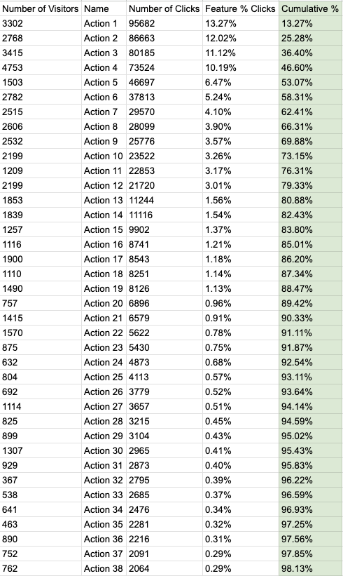
Test Coverage
Group test based on business coverage:
Many companies are using tools such as Segment to track customer usage.
QE team can utilize the data from those tools to design the E2E test scenarios.
The table below shows the example for one team’s feature usage.
The the Feature % Click is calculated based on the (number of clicks/total number of clicks)* 100.
The Cumulative % is calculated based on the (current Feature % Click + previous Feature % Click).

Slide 14
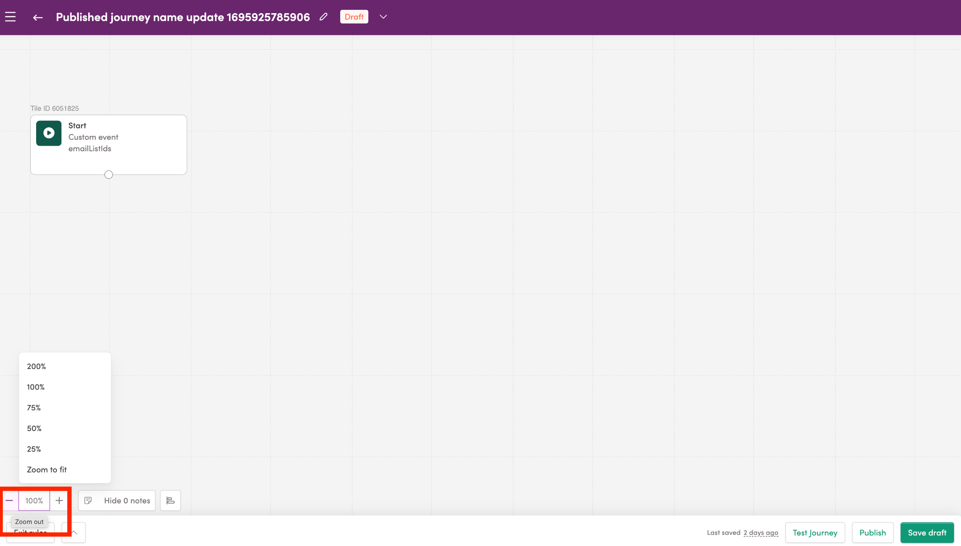
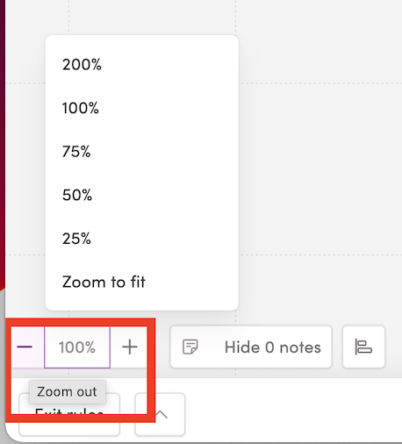
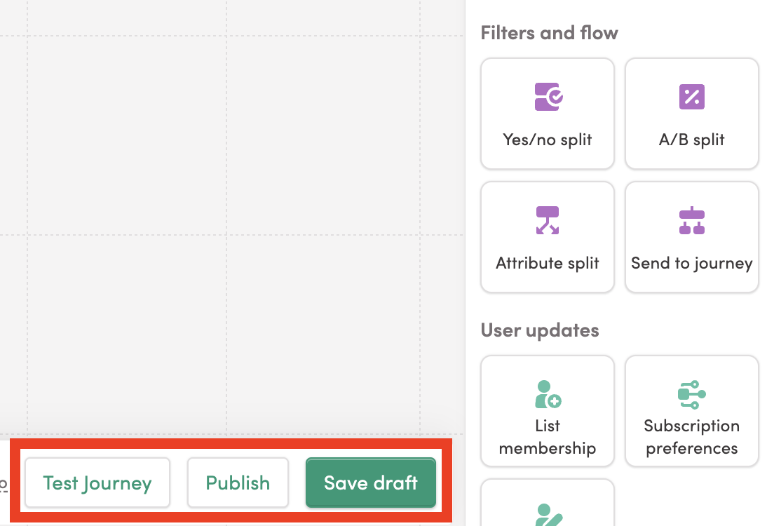
Test Coverage
Example:
Inside the Journey studio, all the user actions are recorded.
Based on the test data, only one user clicked on the zoom out button In the past 30 days.
This zoom out button has very low risk, because less users are using it.
“Test Journey”, “Publish” and “Save draft” are the top popular buttons on this page, therefore, those scenarios need to be covered.

Slide 15
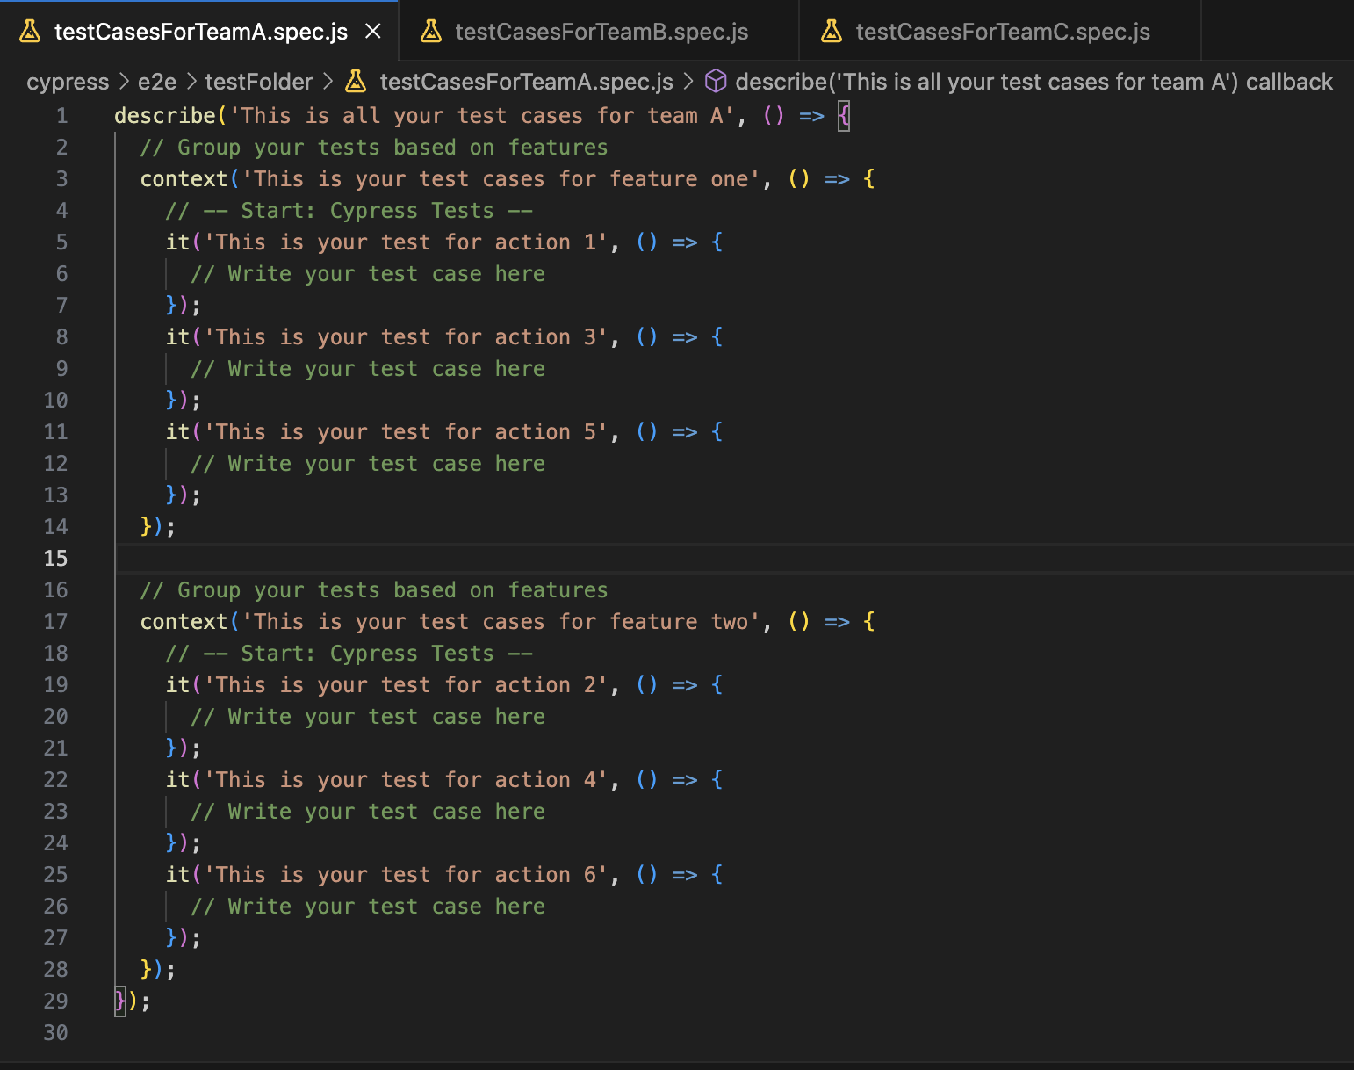
Test Coverage
Organize the tests in Cypress:
Each describe() covers for one team.
Each context() covers one feature.
Each it() covers a few actions.
QEs can set a goal to cover 90%+ of the user actions.

Slide 16
Test Stability
Flaky tests: Test that fails nondeterministically, and that the failure is unrelated to the change that initiated the test run.
Synchronization issues
External dependencies
Improper test design
and etc
Notes:
Truth is - engineering is fickle and you will probably have to revisit and try again.
Here is why generally I see I have to Iterate and how I approach these challenges.

Slide 17
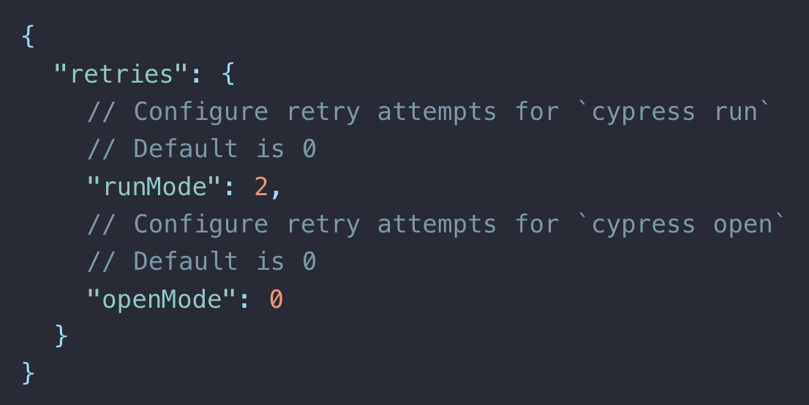
Test Stability
Stable the tests by using test retries:
Retry the failed tests a few times before failing the test.
The extra retries will improve the passing rates and save developer time and resources.

Slide 18
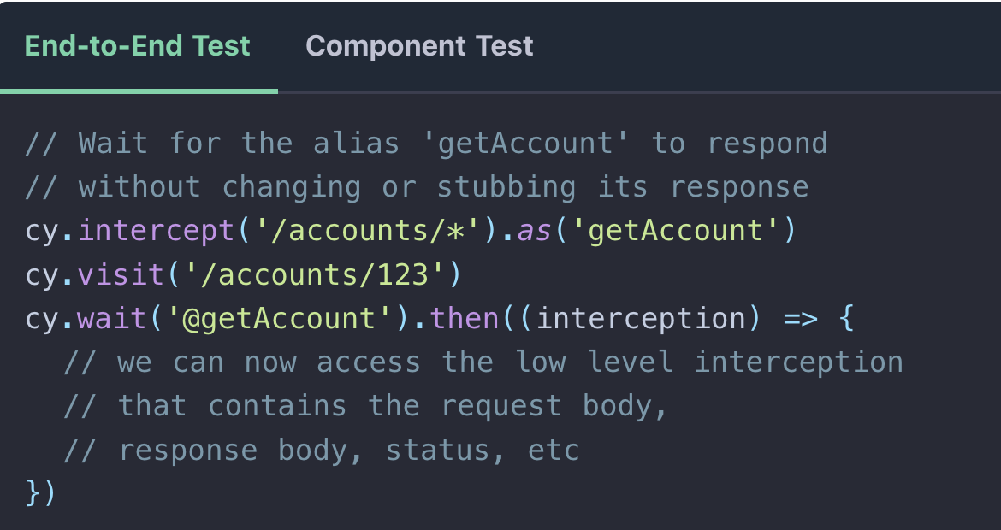
Test Stability
Stable the tests by using wait for alias:
Wait for network calls to complete before continuing the next step. For example, wait for specific request to respond before executing the next test step.
This feature significantly reduces the race condition that happens within test runs.

Slide 19
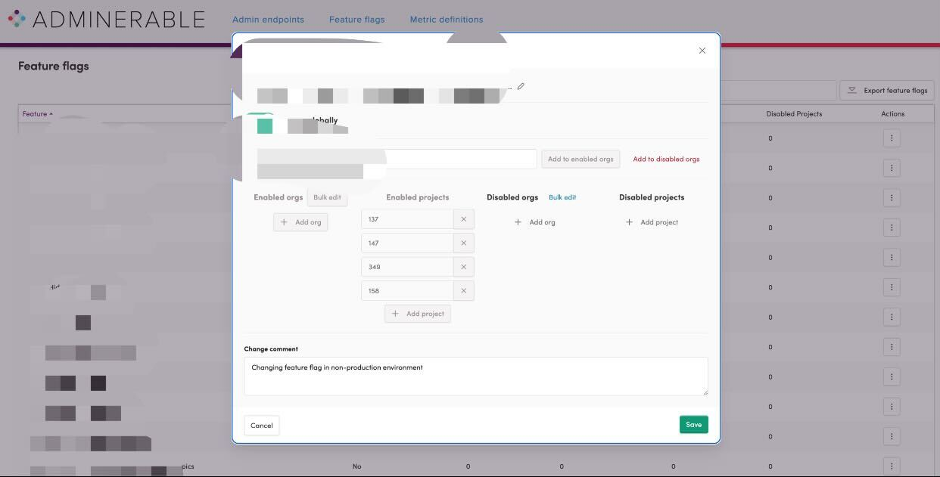
Test Stability
Stable the tests by using API calls for data prep:
Many tests will require turn on the feature flags before the test run.
Setting up feature flag by running through all the steps in UI will increase the risk of flaky tests and take long time.

Slide 20
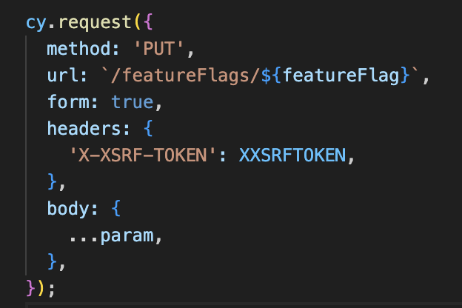
Test Stability
Stable the tests by using API calls for data prep:
API calls are more stable. Making API calls to set up test data will decrease the data perp time significantly.
Turn on the FFs will table 10s via UI, but only 3s if making API calls.

Slide 21
THANK YOU!

Slide 22
Credits
Images
unsplash: https://unsplash.com/photos/OiZZtfxYmmg
Colton Sturgeon: https://unsplash.com/photos/6KkYYqTEDwQ
flaticon: https://www.flaticon.com/free-icons/analytic
Miguel Bruna: https://unsplash.com/photos/TzVN0xQhWaQ
Cypress.io: https://docs.cypress.io/guides/overview/why-cypress
Selenium webdriver: https://www.selenium.dev/documentation/webdriver/
WebdriverIO: https://webdriver.io/
Puppeteer: https://pptr.dev/
UFT https://www.microfocus.com/en-us/products/uft-one/overview
Ranorex: https://www.ranorex.com/
TestCafe: https://testcafe.io/
https://en.wikipedia.org/wiki/Texas_A%26M_ring

