Slide 1
Sagar Aghera
Nikhil Yogesh Joshi
Amit Bhanushali
Quality Beyond Testing: Jenkins to GitHub Actions Migration for Optimized Processes and Quality Assurance

Slide 2
About Sagar
Sagar Aghera holds a master in computer science and a bachelor in electrical engineering from Florida Atlantic University, with over 10 years of experience in DevOps, CI/CD & test automation. He has worked at Motorola, Qualcomm, Gracenote, VMware, and currently excels as a Sr Staff Software Engineer at Netskope, focusing on testing frameworks, cloud infrastructure, and mentoring. His commitment to Testing and DevOps is evident throughout his career.
Sagar/Nikhil/Amit
Jenkins to GitHub Actions Migration

Slide 3
About Nikhil
Nikhil Yogesh Joshi, a Senior Manager in Software Engineering based in Cumming, Georgia, boasts over 18 years of experience leading high-performing teams and delivering complex projects. His career spans multiple industries, demonstrating his expertise in automation, cloud migration, and strategic leadership.
Sagar/Nikhil/Amit
Jenkins to GitHub Actions Migration

Slide 4
About Amit
Amit Bhanushali is a Manager, Software Quality Assurance at West Virginia University based in West Virginia, United States and have more than 20 years of experience in BFSI and Higher Ed Domains. He is a certified Scrum Master and holds a master’s degree in business data Analytics from West Virginia University in West Virginia, United States.
Sagar/Nikhil/Amit
Jenkins to GitHub Actions Migration

Slide 5
About Netskope
Netskope is a cloud security company that provides solutions for secure access and data protection across cloud services, private applications, endpoints and the web. It helps organizations safeguard sensitive data and prevent cyber threats with advanced visibility and control.
Sagar/Nikhil/Amit
Jenkins to GitHub Actions Migration

Slide 6
Understanding DevOps, Jenkins, and GitHub Actions
What is DevOps?
Definition
Set of practices combining Dev and Ops.
Objectives
Enhance collaboration, automate processes, improve deployment frequency.
Principles
CI, CD, Monitoring, Collaboration.
Sagar/Nikhil/Amit
Jenkins to GitHub Actions Migration

Slide 7
Understanding DevOps, Jenkins, and GitHub Actions
What are Jenkins and GitHub Actions for?
Jenkins
Open-source automation server.
Automates building, deploying, and other tasks.
Extensible with plugins.
GitHub Actions
CI/CD service integrated with GitHub.
Automates workflows using YAML files.
Built-in and custom actions.
Sagar/Nikhil/Amit
Jenkins to GitHub Actions Migration

Slide 8
Understanding DevOps, Jenkins, and GitHub Actions
Why are Jenkins and GitHub Actions Relevant to DevOps?
Relevance to DevOps
Support CI/CD principles.
Automate tasks, integrate tools, improve efficiency.
Enhance collaboration and flexibility.
Sagar/Nikhil/Amit
Jenkins to GitHub Actions Migration

Slide 9
Problem statement (Jenkins for CI/CD & Automation)
QA, Dev & DevOps usage of Jenkins differ
Test execution
Continuous integration
Continuous deployment
25+ of 3rd party plugins in use
Server maintenance with scaling operations
Security without compromising quality
Identity & Access Management
Sagar/Nikhil/Amit
Jenkins to GitHub Actions Migration

Slide 10
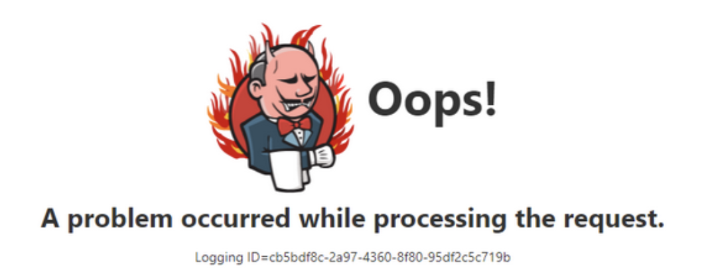
Understanding Pain points of Jenkins
Maintenance Overhead
Limited User Interface
Scalability Challenges
Security Concerns
Dependency on Plugins
Sagar/Nikhil/Amit
Jenkins to GitHub Actions Migration

Slide 11
Solution (GitHub Actions)
Tool/Framework must be,
Able to execute tests, and CI/CD
Seamless 3rd party tools integration
Scalable with growing features &/or tests
Secure
Streamlined Access Control
Sagar/Nikhil/Amit
Jenkins to GitHub Actions Migration

Slide 12
GitHub Actions Components
Events - Events trigger workflows to run
Workflows - A workflow is a customizable automated process made up of one or more jobs
Jobs - Jobs are individual tasks that run sequentially or concurrently within a workflow
Steps - Steps are the individual tasks within a job.
Action - Pre-defined functionality to execute. (Container image/JavaScript)
Runners - Environment to execute a Job (Container, Workstation, VM)
Sagar/Nikhil/Amit
Jenkins to GitHub Actions Migration

Slide 13
Events
Push event
Pull request event
Schedule Event
Deployment event
Workflow Dispatch Event
on:
schedule:
- cron: '0 0 * * *'
on:
push:
branches:
- main
on:
pull_request:
branches:
- main
on:
deployment:
types: [created, updated]
on:
workflow_dispatch:
inputs:
branch:
description: 'Build branch’
default: 'main'
Sagar/Nikhil/Amit
Jenkins to GitHub Actions Migration

Slide 14
Workflows
name: CI Workflow
on:
push:
branches:
- main
jobs:
build:
runs-on: ubuntu-latest
steps:
- name: Checkout code
uses: actions/checkout@v2
- name: Build
run: |
npm install
npm run build
on: Specifies the events that trigger the workflow.
jobs: Defines one or more jobs to be executed as part of the workflow.
Name: A descriptive name for the workflow.
Sagar/Nikhil/Amit
Jenkins to GitHub Actions Migration

Slide 15
Jobs
jobs:
build:
name: Build
runs-on: ["self-hosted","X64","Windows","node-1"]
steps:
- name: Checkout code
uses: actions/checkout@v2
- name: Build project
run: |
npm install
npm run build
name: A descriptive name for the job.
runs-on: Specifies the type of runner environment on which the job will execute (e.g., Ubuntu, macOS, Windows, Container).
steps: Defines a sequence of steps to be executed as part of the job.
Sagar/Nikhil/Amit
Jenkins to GitHub Actions Migration

Slide 16
Steps
jobs:
build_and_test:
name: Build and Test
runs-on: ubuntu-latest
steps:
- name: Checkout code
uses: actions/checkout@v2
- name: Set up Node.js
uses: actions/setup-node@v2
with:
node-version: '14'
- name: Install dependencies
run: npm install
- name: Run tests
run: npm test
- name: Build project
run: npm run build
- name: Deploy to staging
if: github.ref == 'refs/heads/main'
run: echo "Deploying to staging environment..."
Steps represent individual task
Steps can execute shell commands, run scripts, or invoke reusable actions.
Steps can be conditional
Sagar/Nikhil/Amit
Jenkins to GitHub Actions Migration

Slide 17
Actions
Built-in actions
Community actions
Custom actions
- name: Checkout code
uses: actions/checkout@v2
- name: Deploy to AWS Lambda
uses: actions/aws/lambda@48038c4d189536a0862a0ed832dc34bd1c8b2
with:
aws-access-key-id: ${{ secrets.AWS_ACCESS_KEY_ID }}
aws-secret-access-key: ${{ secrets.AWS_SECRET_ACCESS_KEY }}
function-name: my-lambda-function
- name: Run Custom Action
uses: ./custom-action
Sagar/Nikhil/Amit
Jenkins to GitHub Actions Migration

Slide 18
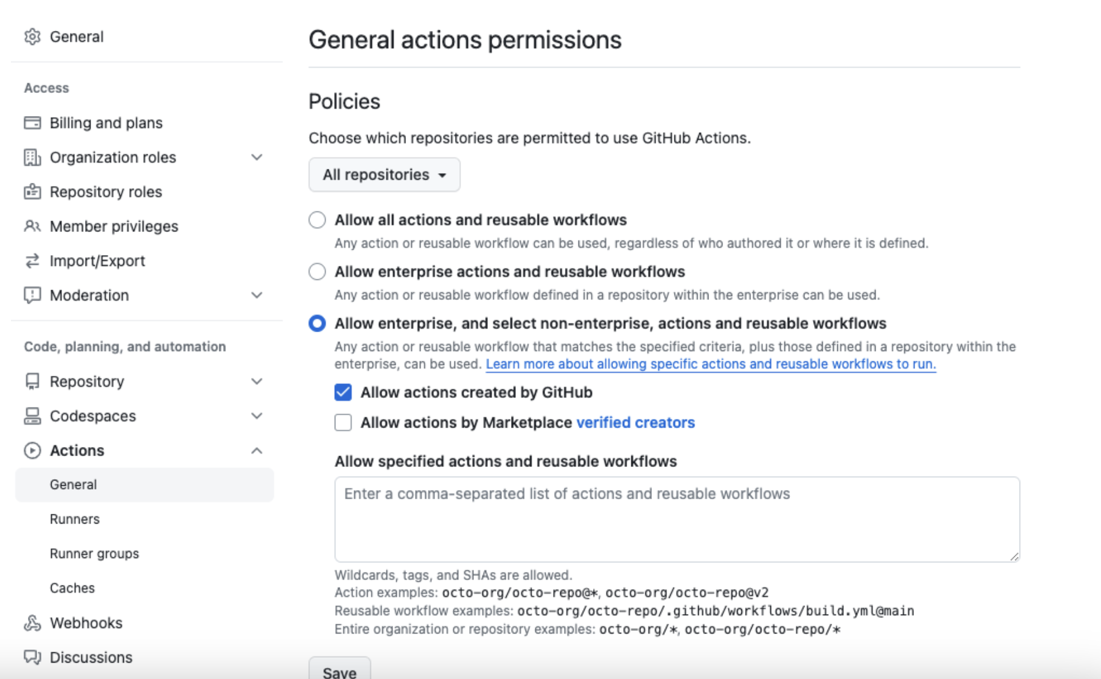
Enforcement of 3rd party actions
Sagar/Nikhil/Amit
Jenkins to GitHub Actions Migration

Slide 19
Runners
GitHub hosted runners
runs-on: ubuntu-latest
Self Hosted runners
runs-on: self hosted
Runner labels
runs-on: [self-hosted, x64, VS2022]
Runner groups
runs-on: [self-hosted, prod-group]
Sagar/Nikhil/Amit
Jenkins to GitHub Actions Migration

Slide 20
Built-in secrets management
Types of secrets
Repository secrets
Organization secrets
Environment secrets
Adding Secrets via GitHub UI:
Navigate to your repository on GitHub.
Go to "Settings" > "Secrets" > "New repository secret".
Enter the name and value of the secret and click "Add secret".
Referencing Secrets in Workflow:
Secrets can be referenced using the ${{ secrets.SECRET }} syntax
Sagar/Nikhil/Amit
Jenkins to GitHub Actions Migration

Slide 21
Case Studies
Nightly build pipeline for Netskope Endpoint DLP client which runs on Mac & Windows OS.
Sagar/Nikhil/Amit
Jenkins to GitHub Actions Migration

Slide 22
Jenkins implementation
Pipeline code in a separate repo
Groovy pipeline with steps
Build trigger
Source code checkout
Building client
Unit tests
Tagging build &/or release
BAT test
Artifactory upload
Email notification
Sagar/Nikhil/Amit
Jenkins to GitHub Actions Migration

Slide 23
GitHub Actions Implementation
Workflow defined in the same repo.
Workflow
Triggered on push event to main/release branch
Source code checkout using built-in action
Build client solution using powershell script
Run Unit test using powershell script
Tagged build & release using built-in action
BAT test run using windows cmd prompt
Artifactory upload using Jfrog 3rd party action
Email notification using 3rd party action - dawidd6/action-send-mail
Slack notification using 3rd party action - slackapi/slack-github-action
Sagar/Nikhil/Amit
Jenkins to GitHub Actions Migration

Slide 24
Case Studies
Automated Test execution of Netskope Endpoint DLP client tests.
Sagar/Nikhil/Amit
Jenkins to GitHub Actions Migration

Slide 25
Jenkins implementation
Jenkins freestyle project(s)
Plugins used
Built-in cronjob trigger
Test automation repo checkout using Git plugin
Running test using build shell plugin
Aggregate & parse test results using 3rd party plugin - Junit
Email notification using Email extension plugin
Slack notification using Slack plugin
Sagar/Nikhil/Amit
Jenkins to GitHub Actions Migration

Slide 26
GitHub Actions Implementation
Workflow defined in same repo.
Workflow
Triggered using built-in scheduled trigger
Self hosted runner on ubuntu Linux VM
Test automation repo checkout using built-in action
Run tests using shell script
Email notification using 3rd party action - dawidd6/action-send-mail
Slack notification using 3rd party action - slackapi/slack-github-action
Sagar/Nikhil/Amit
Jenkins to GitHub Actions Migration

Slide 27
Efficiency Gains from Migrating Jenkins to GitHub Actions
Categories | Results
Streamlined CI/CD Workflows | Integrated Platform Simplified Configuration Built-in Actions
Faster Execution Times | Optimized workflows
Enhanced Collaboration and Visibility | Unified Platform
Cost and Resource Savings | No Server Maintenance
Improved Reliability and Security | Managed Service Access Control Built-in secrets management
Sagar/Nikhil/Amit
Jenkins to GitHub Actions Migration

Slide 28
Increased Efficiency by 35%
Categories | Results
Time Savings | 10% less time on GitHub Actions due to faster runners and optimized workflows
Developer Productivity | Developer productivity increased by 10% due to better integration and less context switching
Operational costs | 15% reduction in operational costs due to less maintenance and infrastructure overhead
Sagar/Nikhil/Amit
Jenkins to GitHub Actions Migration

Slide 29
Conclusion
Self contained CI/CD pipeline within GitHub ecosystem
Reliable & stable test automation execution using GitHub Actions
Automated code linting, GitHub cleanup (stale branches & PRs) etc.
Lead to 35% increase in developer efficiency.
Sagar/Nikhil/Amit
Jenkins to GitHub Actions Migration

