Slide 1
Bartholomew Hsu, Jovan Araiza, Jeff Borg
IoT In The Matrix: Mocking External Dependencies For IoT Systems Using Physical Hardware

Slide 2
Preliminaries
Authors
  Bartholomew Hsu
  Jovan Araiza
  Jeff Borg
Disclaimers
  Opinions expressed are our own and do not represent those of any past or present employers
Acknowledgements
  Special thanks go to Impinj for supporting this presentation and permitting the use of their products in photos

Slide 3
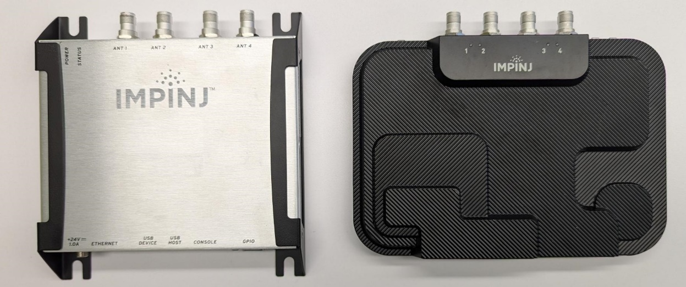
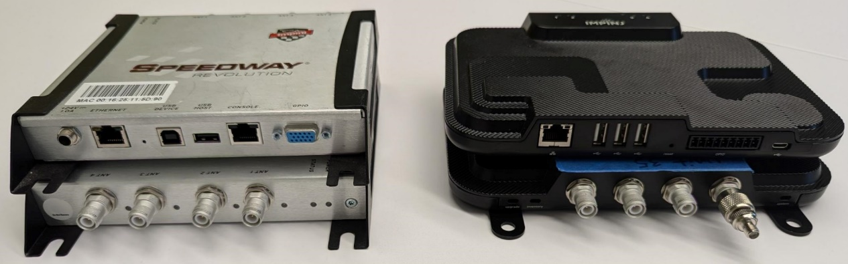
Testing Hardware Interfaces Can Be Tricky
IoT devices and embedded systems often have hardware interfaces to the real world and such interfaces often have complex internal behaviors
  Hard to mock well in software
  Conventional methods and tools used by specialists can be costly and require considerable expertise
These difficulties often leave testers unable to adequately replicate the behaviors of these subsystems, resulting in gaps in test coverage

Slide 4
Let’s get unconventional…
What if we look at a different approach?
  Proliferation of low-cost hobbyist / maker / HAM radio enthusiast hardware and tools
  Proliferation of software and libraries that make use of such HW
  Proliferation of online tutorials, forums, etc. about how to use both

Slide 5
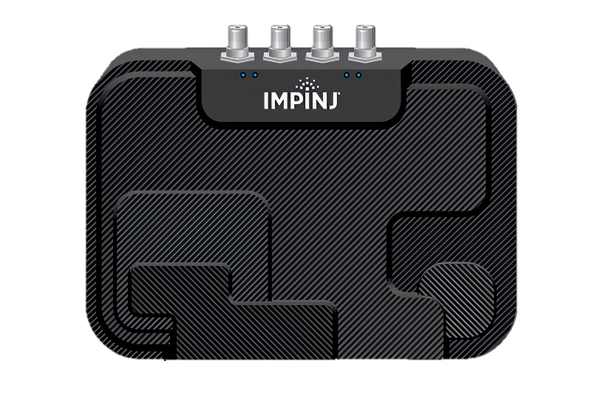
Going Straight To The Point
Simple electronics / RF concepts +
Hobbyist / low-cost hardware =
Mock hardware inputs…
…that ordinary testers are capable of building
Examples
  Wi-Fi
  GPS
  Battery
  Other interface types

Slide 6
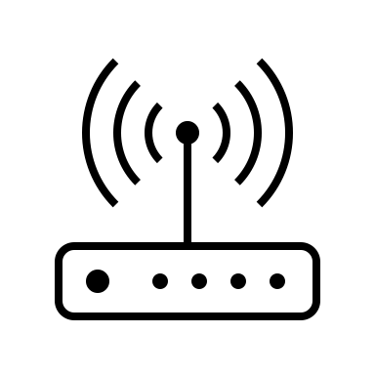
Wi-Fi

Slide 7
Wi-fi: The Conundrum
Many 802.11(b/g/n/ac/ax) configurations and settings to be tested means many wi-fi networks
Wi-fi traffic congestion concerns
Security concerns
An unconventional answer: Build your own reconfigurable wireless access point (WAP) directly cabled to the device under test (DUT)

Slide 8
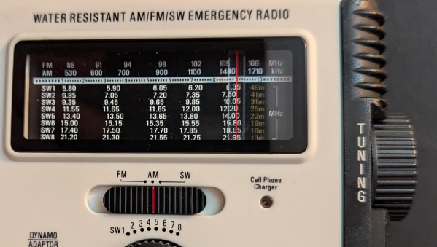
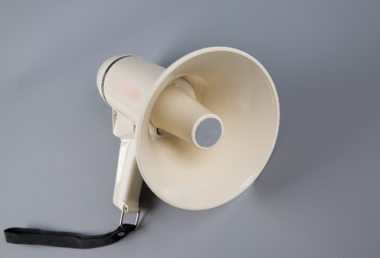

Sixty Seconds Of Background In RF
Frequency - analogous to tuning to a broadcast TV or radio station
Power - analogous to the loudness of a sound
Leakage - analogous to the penetrating power of bass sounds

Slide 9
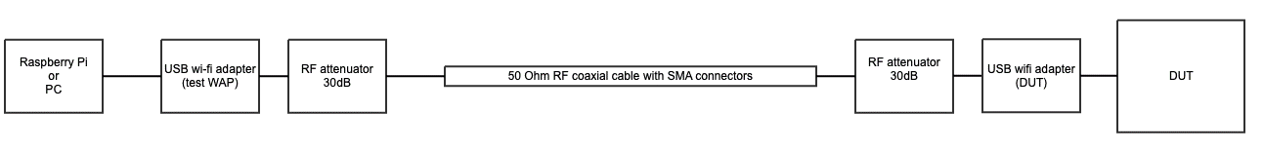
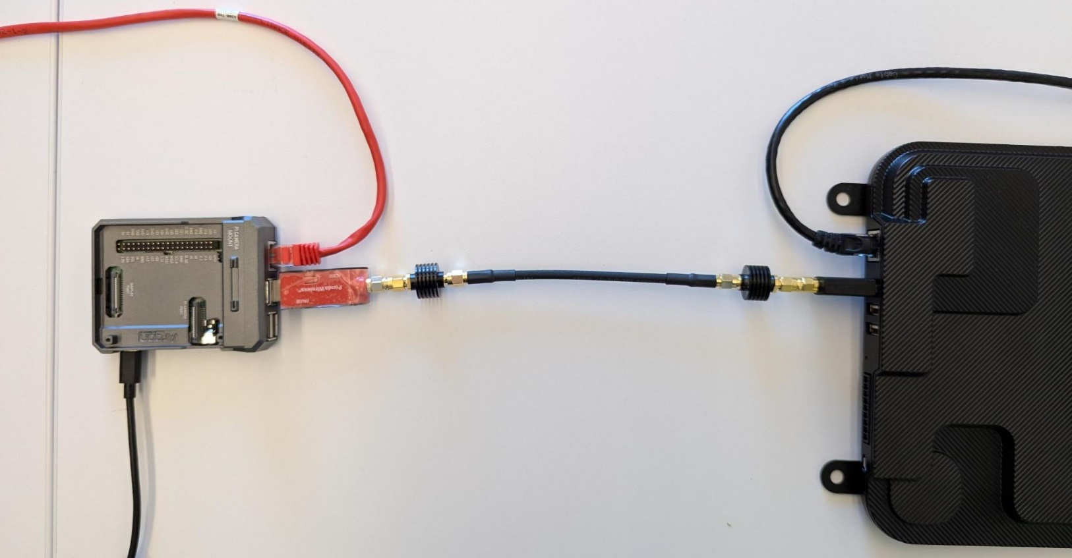
Designing The Hardware
Frequency range
  2.4-2.5 GHz and 5.1-5.9 GHz
  Make sure components are rated for 6 GHz or more
Power
  Max 1,000 mW output power
  Max input power is 0.001 (10⁻³) mW to 10⁻⁷ mW (‑30 to ‑70 dBm)
  Muffle the signal by factor of 10⁻⁶ to avoid damage = 2x 30 dB attenuators
Leakage -> Keep cables short
Cable adapters -> Convert from RP-SMA to SMA
USB wi-fi adapter with an antenna connector (check compatibility!)

Slide 10
Software
Standard Raspberry Pi 4B running Raspberry Pi OS
Wi-Fi access point software
  Network Manager – built-in but does WPA-PSK authentication only
  hostapd – highly configurable WAP software that does WPA-PSK and WPA-EAP authentication in various flavors
Network traffic shaping
  tc / Traffic Control: A Linux subsystem for controlling network traffic that allows simulation of latency, jitter, bandwidth limiting, and packet loss

Slide 11
Limitations
Requires a wi-fi connector on the test device or support for USB wi-fi adapter
Not suitable for high bandwidth testing

Slide 12


“GPS” (GNSS)
  Global Positioning System a.k.a. GPS (United States)
  Galileo (European Union)
  BeiDou (China)
  GLONASS (Russia)

Slide 13
GNSS: The Conundrum
Often referred to as “GPS” by the public, Global Navigation Satellite System (GNSS) is the technical nomenclature for the various navigation satellite constellations
Challenges
  Can’t get a GNSS signal inside many offices
  May need to simulate the DUT being at a position somewhere other than its current location
  May need to simulate movement
Conventional solutions
  Most facilities don’t have GNSS signal repeater
  GNSS signal emulators are are complex and costly
  Physically moving the DUT around is practical only under limited circumstances
An unconventional answer: Low cost (relatively speaking) SDR based GPS simulation as a mock for GNSS input

Slide 14
60 Seconds Of Background On Software Defined Radio
Radio systems use complicated and precise electronics to mathematically transform radio signals into usable information or, inversely, transform information into a radio signal
Software defined radio (SDR) simply digitizes an incoming radio signal as it is and relies on software to do the transformations to convert it to usable information and does the reverse to send a radio signal. This requires less hardware and is more flexible.

Slide 15
Software
gps-sdr-sim package (https://github.com/osqzss/gps-sdr-sim)
  Pre-calculates the RF signal for GPS based on ephemeris tables and the time range and location(s) to be simulated
  The resulting signal data file is played back through the SDR using tools specific to the model
Limitations
  GPS only – does not simulate other GNSS constellations
  Generate + playback system – not real-time and needs reset to cold start
  Simulating movement beyond the included sample data requires data gathering – still under investigation
  Preferable to select a SDR from the list ones known to work with it

Slide 16
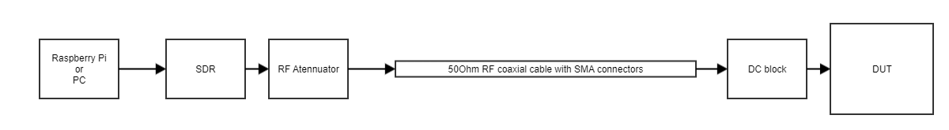
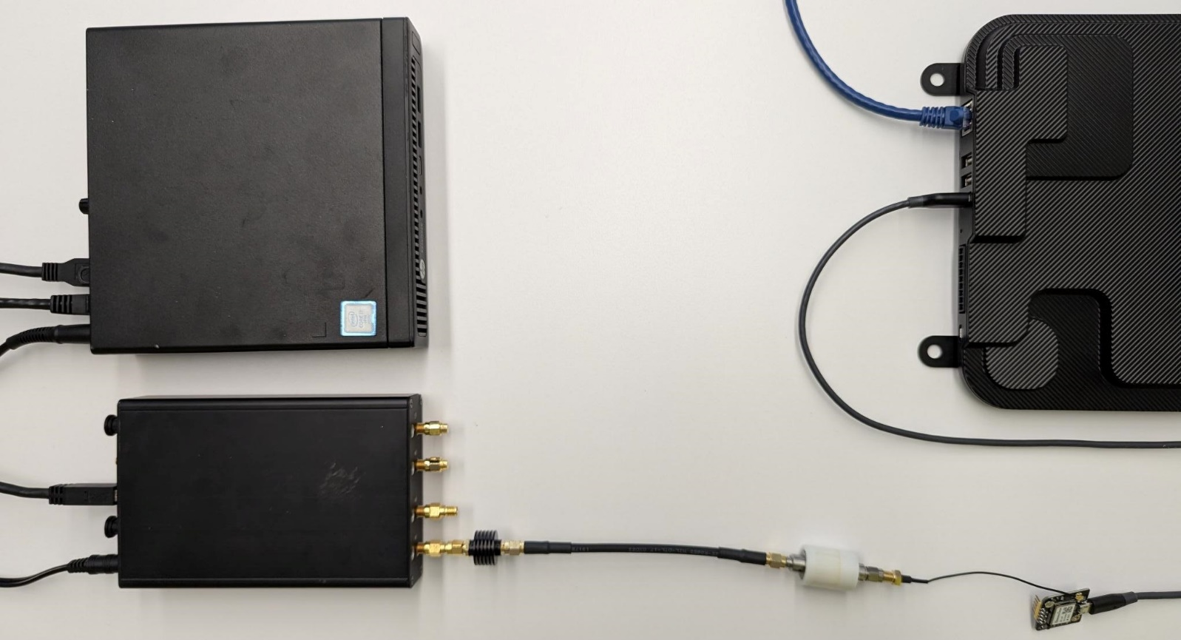
Designing The Hardware
SDR – Selected from compatibility list
Frequency range
  GPS L1 frequency = 1575.42 MHz
  Make sure components are rated for 1.6 GHz or more
Power
  Source signal strength from SDR is unknown; need to measure its default
  Target signal strength = 10^{-12.5} to
  10^{-15.5} mW = -125 to -155 dBm
Leakage - Signal strength too low to be an issue
DC voltage from GNSS receiver -> Add DC block to prevent damage to the SDR

Slide 17
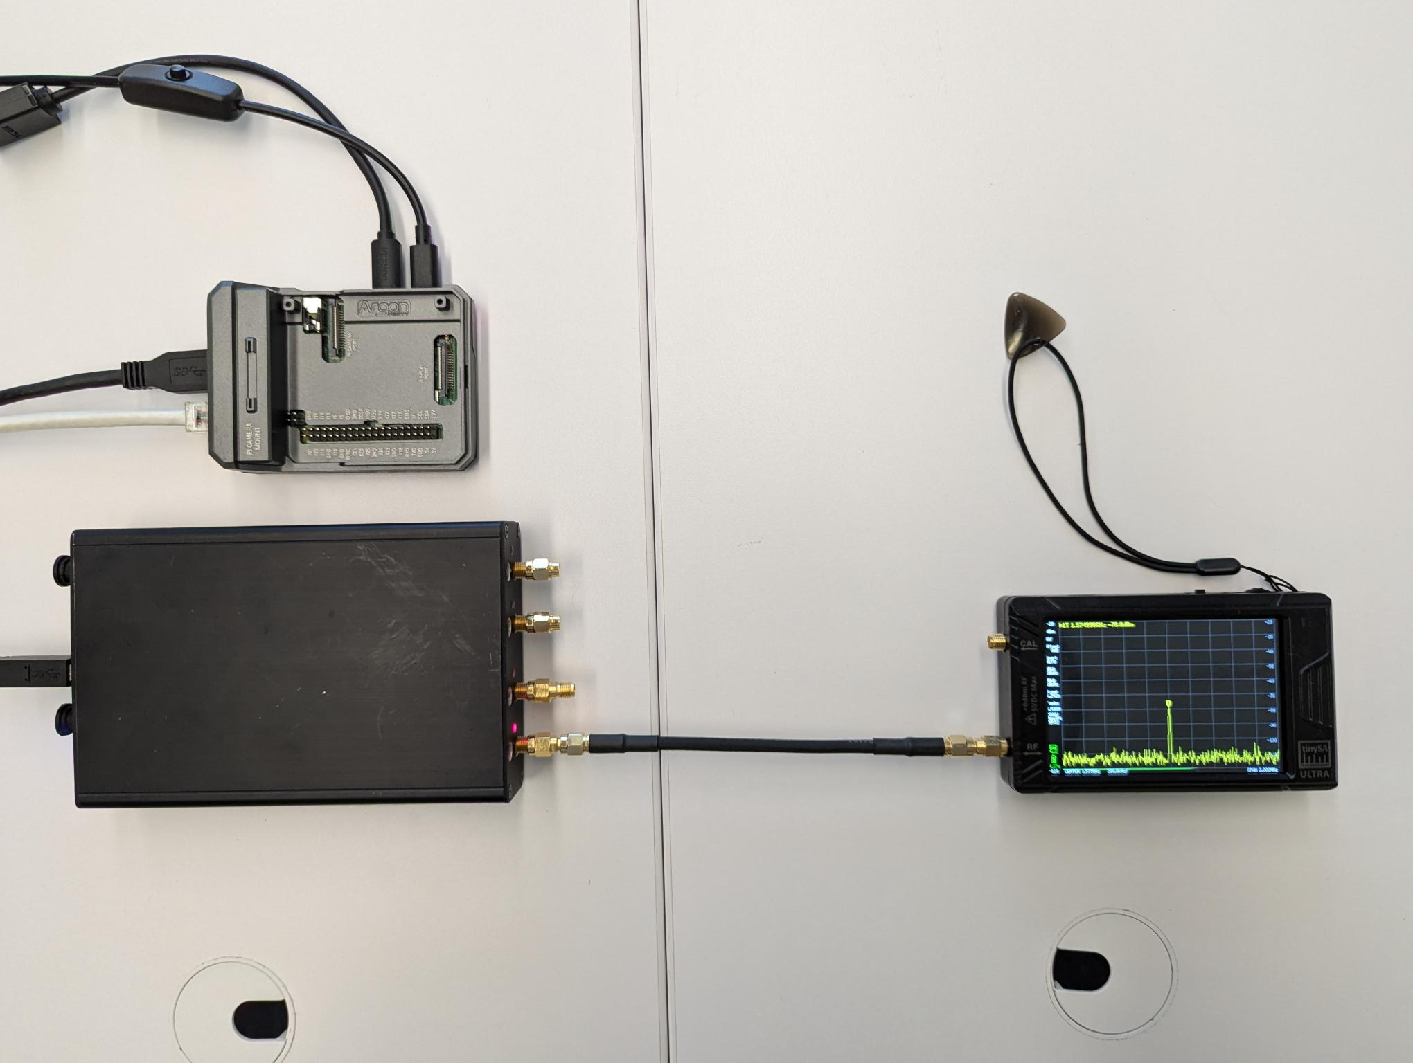
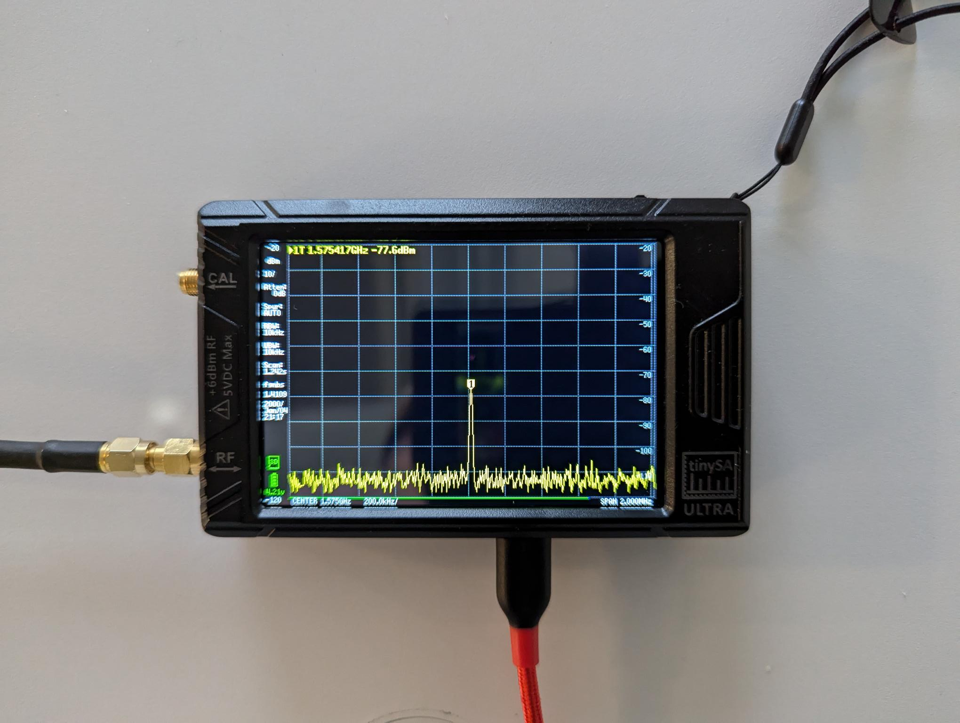
Measuring The SDR’s Default Power Level
Power measurement setup with SDR connected to SA
Close-up of spectrum analyzer showing -77 dBm reading

Slide 18

DO NOT USE AN ANTENNA ON YOUR SDR TO TRANSMIT UNLESS YOU KNOW WHAT YOU’RE DOING
Transmitting on most frequencies requires a permit / license
A little bit of RF signal can travel a long, long way and can also be traced back to you
Fines for unlicensed transmitting or RF interference can be very high
Always use a cabled connection!

Slide 19



Battery And Power Consumption

Slide 20
Battery And Power Consumption: The Conundrum
Battery life is just as crucial to mobile / handheld IoT devices and embedded systems as it is to mobile consumer devices
Modern mass-produced consumer devices have battery monitoring circuitry that a lower volume IoT device might not have
An unconventional approach: Substitute the battery with power measurement apparatus

Slide 21


Another 60 Seconds Of Electronics Background
Energy is measured in watt-hours (Wh)
Power = energy per unit time (Watts)
Energy (another way) = mAh @ V
  This is what is often seen on batteries
  Ohm’s Law – power = volts × amperes

Slide 22
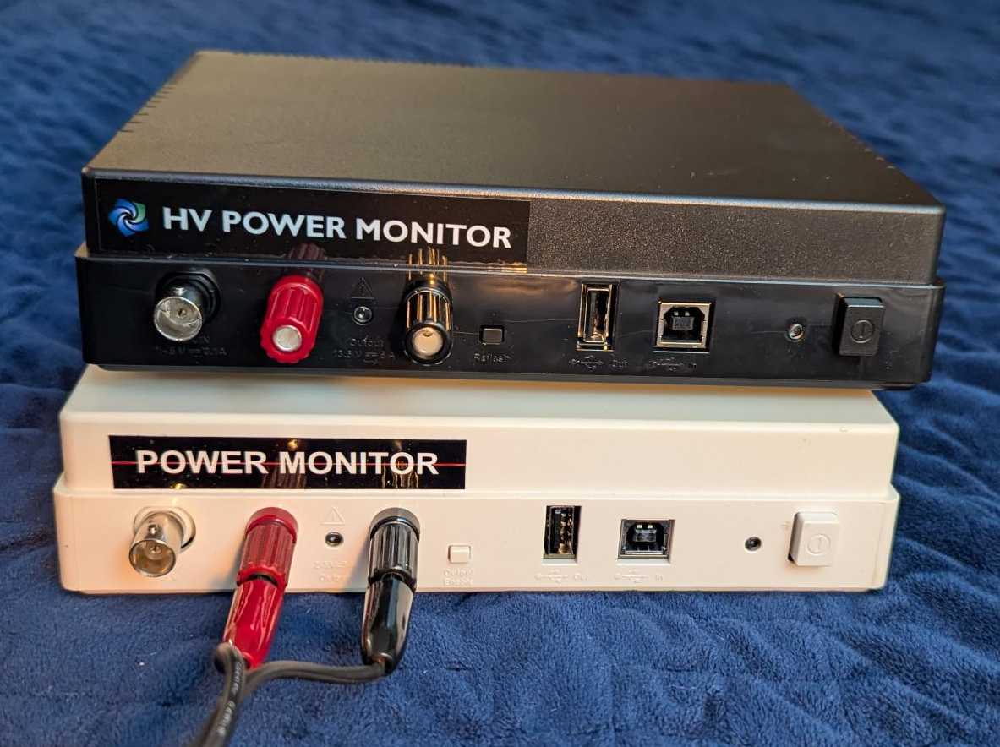
Measuring Power
Hardware
  Benchtop power supply with power measurement capabilities
  Precision power monitoring instruments
Workflow
  Generate clean baseline measurement of power consumption with the device in an idle state while minimizing extraneous activity and then verify repeatability
  Execute the test scenario while measuring power consumption, again minimizing extraneous activity, and then verify repeatability
Tips
  Taking a baseline measurement over a long duration smooths out unwanted transients
  When taking measurements during a scenario, repeating the action whose effect on power is to be measured can increase its effect enough to be measurable

Slide 23
Mocking For Other Physical Interfaces

Slide 24
Mocking Possibilities For Digital I/O
Conundrum
  Many IoT / embedded devices have switches or indicators
  For industrial applications, often IoT / embedded devices have general purpose I/O (GPIO) connections to accept input from or control nearby equipment
An unconventional solution: with minimal modifications to the device being tested, these I/O connections can be connected to the GPIO header on a Raspberry Pi
  Low cost
  Controllable through scripting languages like Python
  Usually fairly minimal modifications to the device
  Many I/O adapter boards available

Slide 25
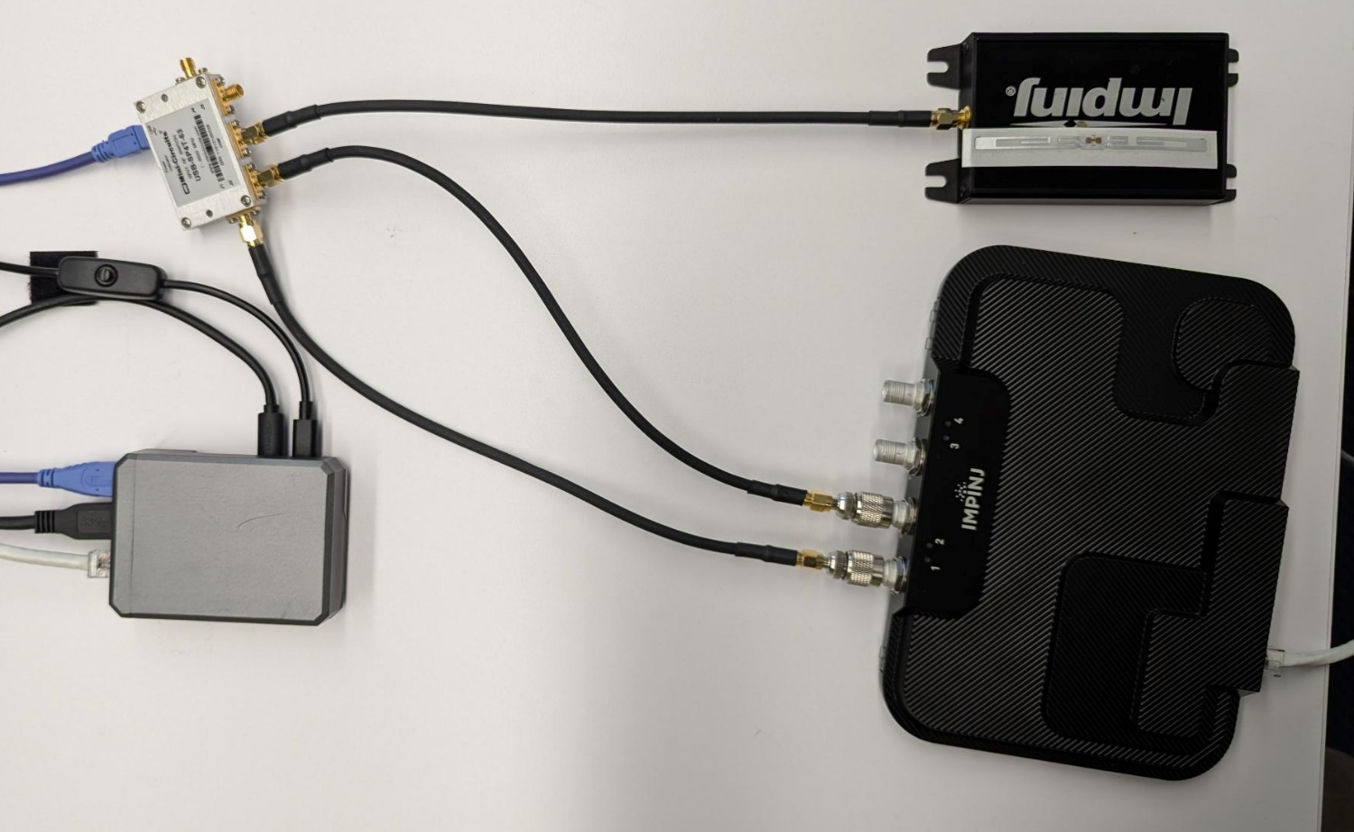
Mocking Possibilities for RF Signals
Conundrum
  Have an existing RF signal that you want to modify to accomplish a test scenario
Options
  Digital RF switch – USB or network controlled
  Digital RF attenuator – USB or network controlled

Slide 26
Putting It All Together

Slide 27
Management Service
Small web service exposing REST API
Python-based for easy maintenance
Tests invoke various endpoints to configure the mocks during test execution

Slide 28
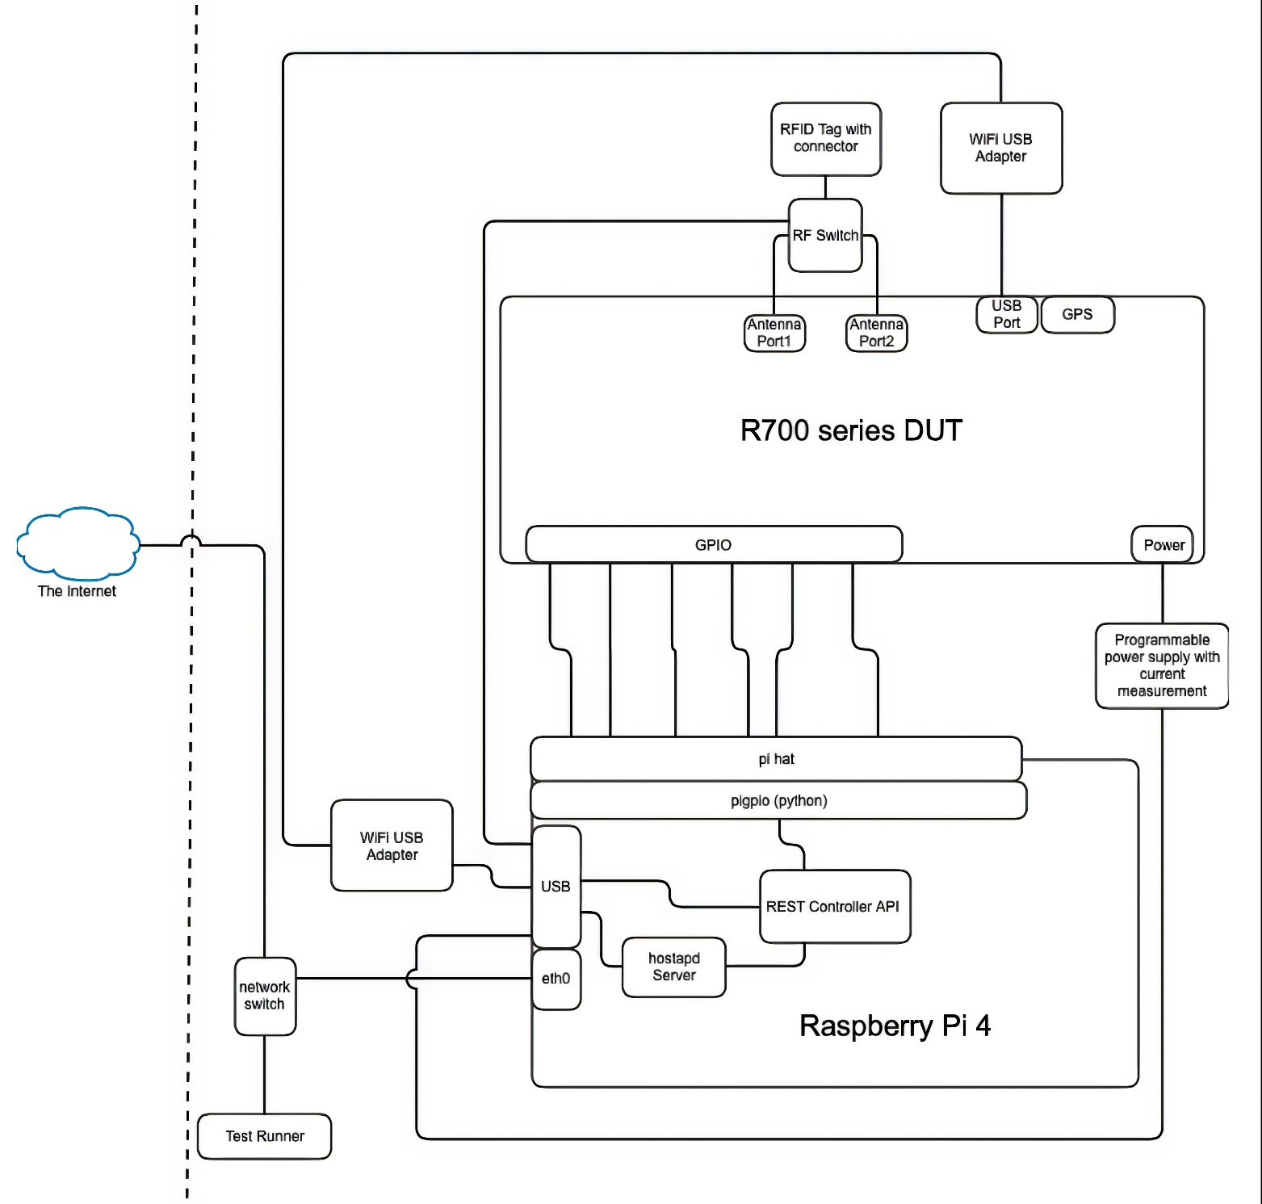
Overall System Diagram

Slide 29

CONCLUSION
Simple electronics / RF concepts +
  Examples: frequency, power, attenuation, energy, etc.
  Plentiful information and tutorials
Low-cost / hobbyist hardware
  With associated software + libraries
= Mock hardware inputs…
…that ordinary testers are capable of building
Your Device Here?
Bartholomew Hsu, Jovan Araiza, Jeff Borg

