Slide 1
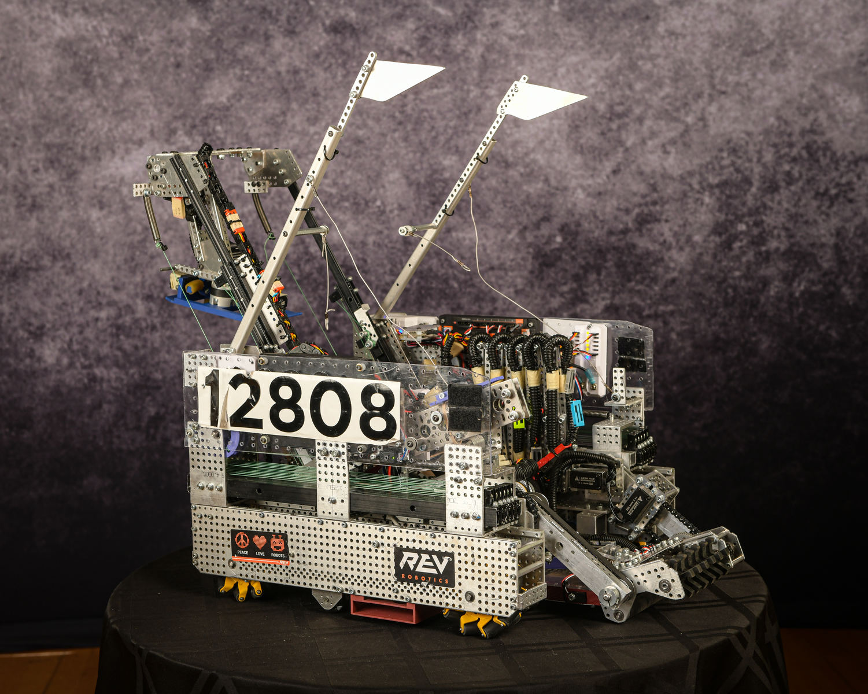

Achieving Software Quality Excellence Through Software-Hardware Co-Verification and Co-Design
By Monica Bao, Sophia Lee, Havish Sripada, Joanna Mei

Slide 2
Key Points and Overview of Content
Introduction
For Inspiration and Recognition of Science and Technology (FIRST) and FTC (FIRST Tech Challenge) Overview
Contributions of FTC
Software-Hardware Co-verification and Co-Design in FTC Robots
Case Study: Intake
Case Study: Automated Tester
Case Study: Software improvement through external sensors
Case Study: Robot Movement
Key Takeaways and Conclusion
Acknowledgements

Slide 3
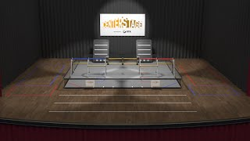
FTC At A Glance
12’ by 12’ competition field
2 Team Alliances
Match Time Duration
  30 Second Auto Period
  2 Minute Tele-Op Period
CenterStage Competition
  Pixels
  Scoring

Slide 4
Co-Design & Co-Verification
Co-design involves the simultaneous development of hardware and software, ensuring that both components are optimized to work seamlessly together. This process begins with defining the robot's requirements and partitioning tasks between hardware (such as motor control and signal processing) and software (such as decision-making algorithms and path planning).
Co-verification ensures that the integrated hardware and software function correctly, employing comprehensive test benches, integrated testing environments, and advanced debugging tools.
By addressing these challenges, hardware-software co-design and co-verification enable the development of high-performance, adaptable, and reliable robotic systems capable of performing complex tasks in diverse environments.

Slide 5
Challenges for Real World Implementation
Co-Design and Co-Verification integration is a key aspect of robotics and required for high software quality.​
Hardware/Software integration challenges:
Ensure that the software changes can be adapted rapidly with high quality ​
Hardware software changes should work in conjunction with one another
Early validation with tied integration between software and hardware

Slide 6
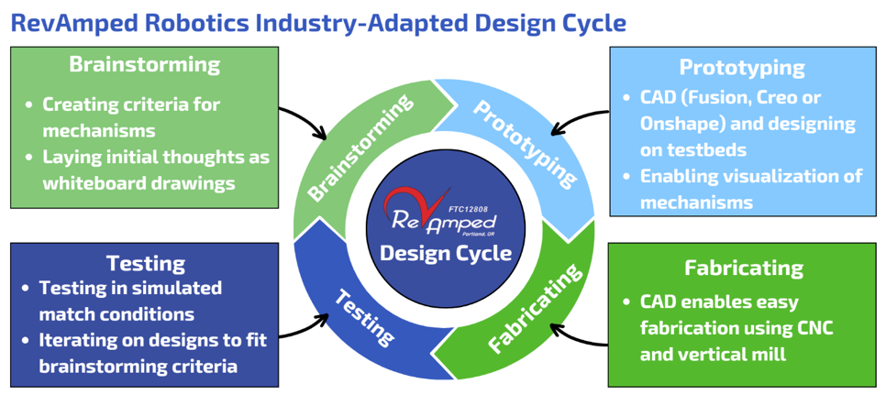
Design Cycle
SWOT Analysis

Slide 7
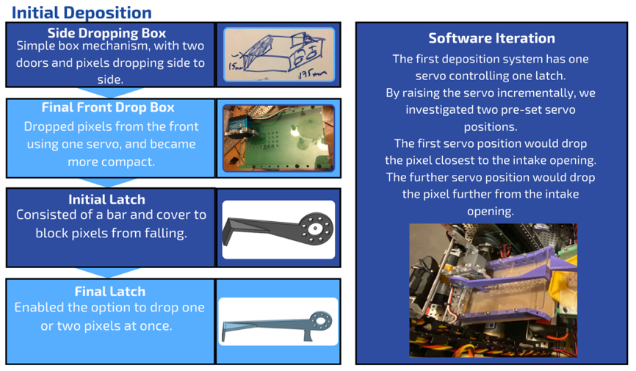
Deposition Examples

Slide 8
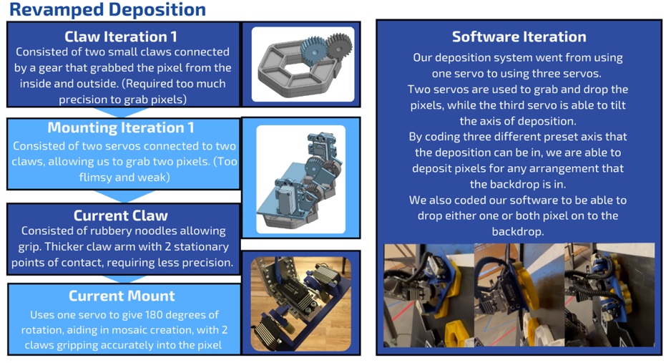
Deposition Examples

Slide 9
Automated Testing
Critical for fast turnaround between games, designing, and competition
Detect the core reason for any malfunction the robot is receiving.
Tests multiple components at once
  Cannot be done manually
Motors | Servos | Sensors
Drivetrain; Horizontal Slides; Vertical Slides; Intake Motor. | Intake Door; Door; Intake TwoBar; Drone; Droppers; Hang; Deposition TwoBar; Deposition Turner; Deposition Claws. | Ultrasonic Sensors; Voltage Sensors; Encoder Sensors; IR sensor; LED Panel.

Slide 10
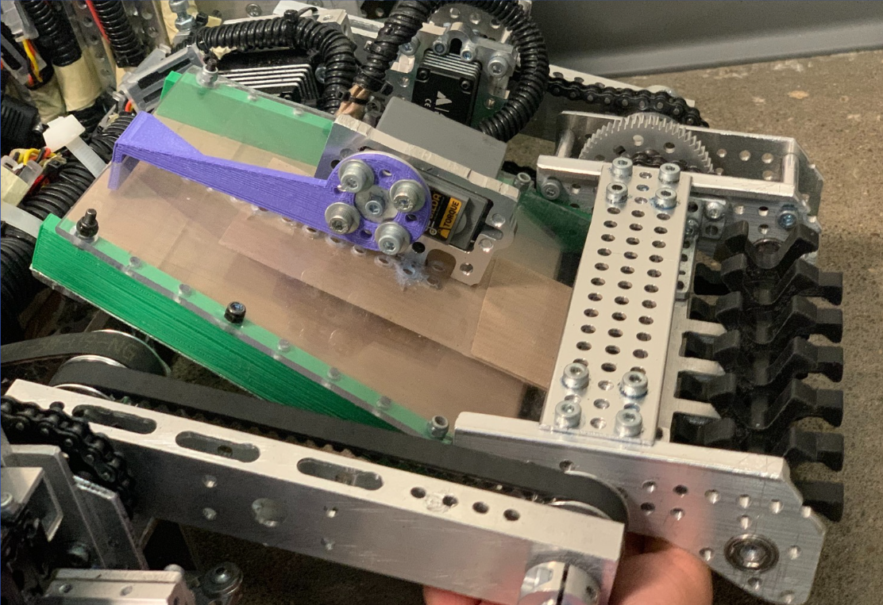
Case Study: Intake
Mechanical components are refined for high operability throughout the season
Intake originally had no sensors
Intake used a time-based system
The program was flawed and led to unreliable autonomous cycles

Slide 11
SWOT Analysis Table for Pre-Programmed Time Functions
Strengths
Weaknesses
Allows intake to collect two pixels
Doesn’t take up space in the robot
Functions aren’t always on time
Opportunities
Threats
No hardware maintenance
A lot of time spent on fine-tuning wait time
Losing points
Possibility of penalties

Slide 12
SWOT Analysis Table for IR Sensor
Strengths
Weaknesses
Detects number of pixels in our robot at all times
Very reliable
Simplifies the program
Increased power consumption
Depleted battery power quicker
Opportunities
Threats
Consistently collects two pixels every cycle
Efficient autonomous cycling
Maximize points
Not enough time to mount before the next competition

Slide 13
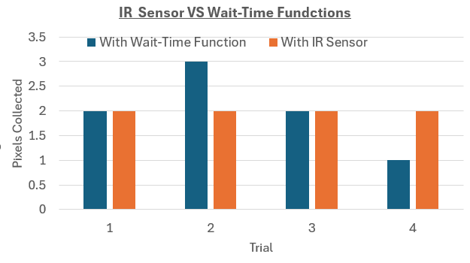
Time-Based System VS IR Sensor Graph

Slide 14
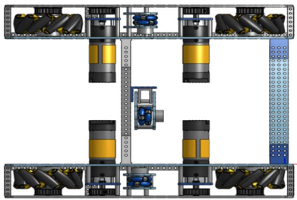
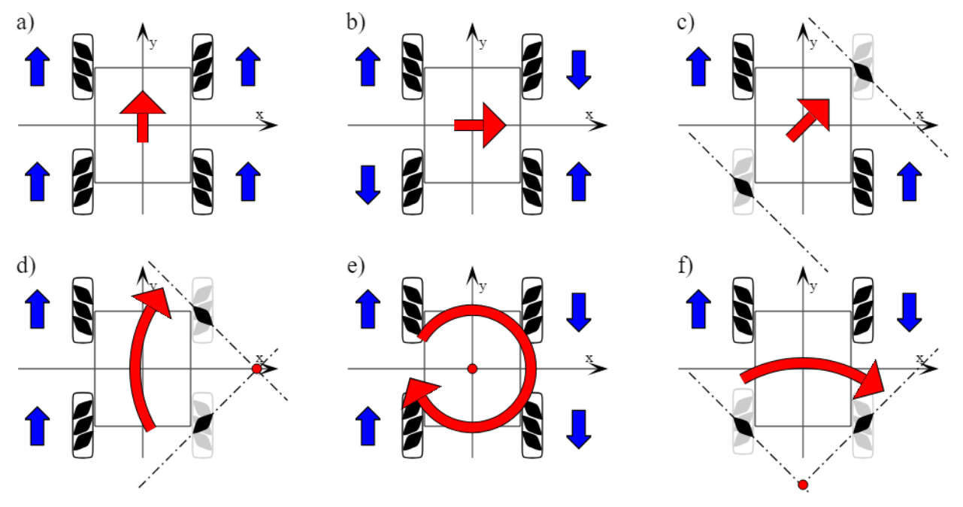
Mecanum Drivetrain

Slide 15
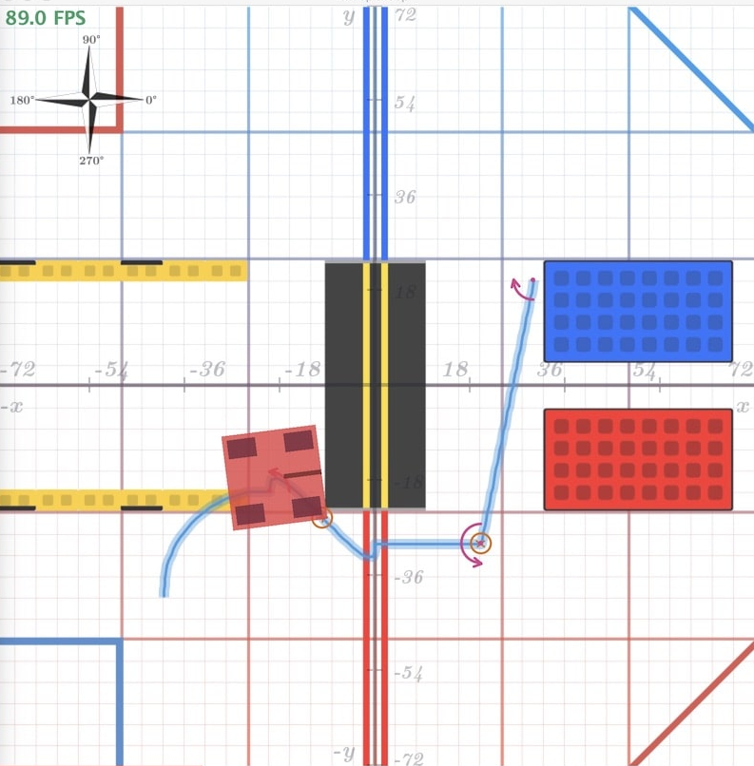
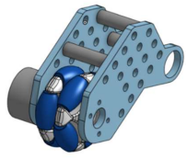
Odometry
What is Localization?
Dead Wheels

Slide 16
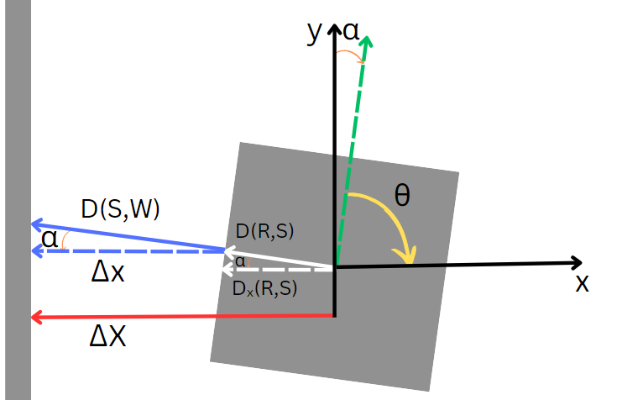


Distance Sensor Localization

Slide 17
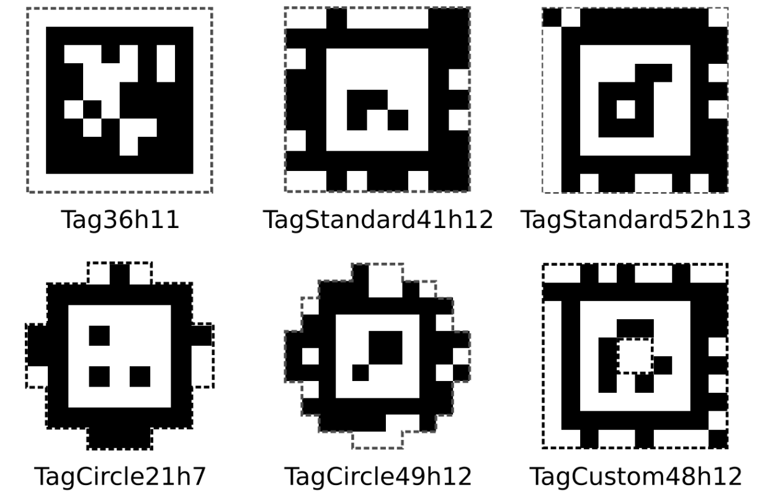
Image from ftc-docs
Introduction to AprilTags
Visual Fiducial System
Similar to QR Codes (Less Data Stored)
AprilTag Families

Slide 18
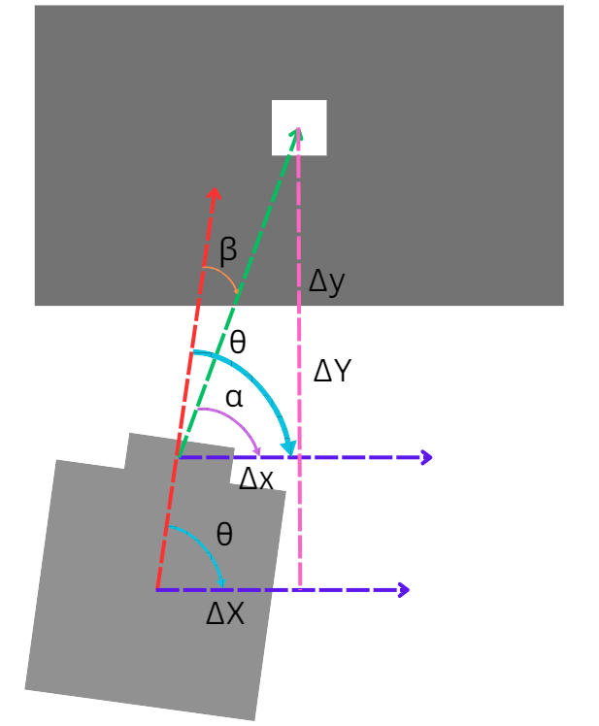


AprilTag Localization

Slide 19
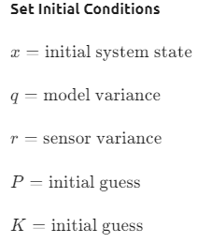
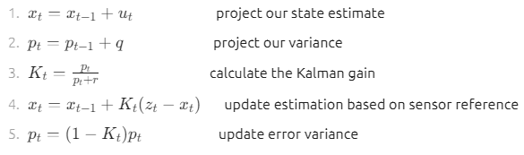
Images from CtrlAltFTC
Kalman Filter

Slide 20
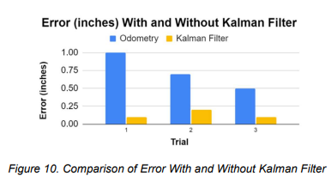
Kalman Filter Experimentation Results
Experiment Setup
Data Analysis

Slide 21
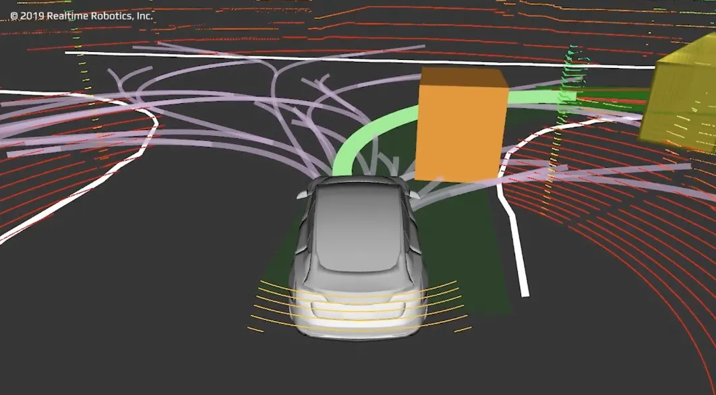
Case Study: Trajectory - Motion Profile Lib.
Libraries designed for movement manipulation
  Controlling motor sequences for systems motor-based axis
  Defines movement in series of steps
Consistent and smooth movement

Slide 22

Road Runner Overview
Motion profiling library for FTC
Designed for precise control over velocity and acceleration
  Can also create complex trajectories
Can be coupled with sensors
  Odometry pods help track the robots position and heading

Slide 23
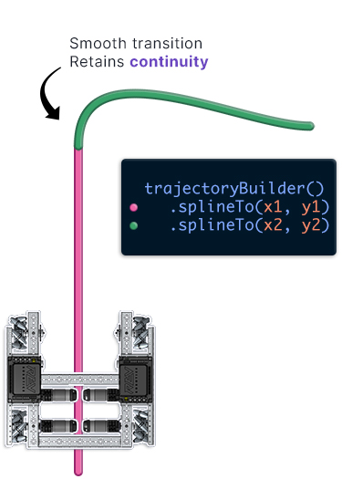
Road Runner Trajectory Logic
Odometry pods increase accuracy
Motion-based path follower
  Set of instructions, based on how long to run a certain magnitude of motor power
  Calculated for each path before robot begins follow trajectory

Slide 24
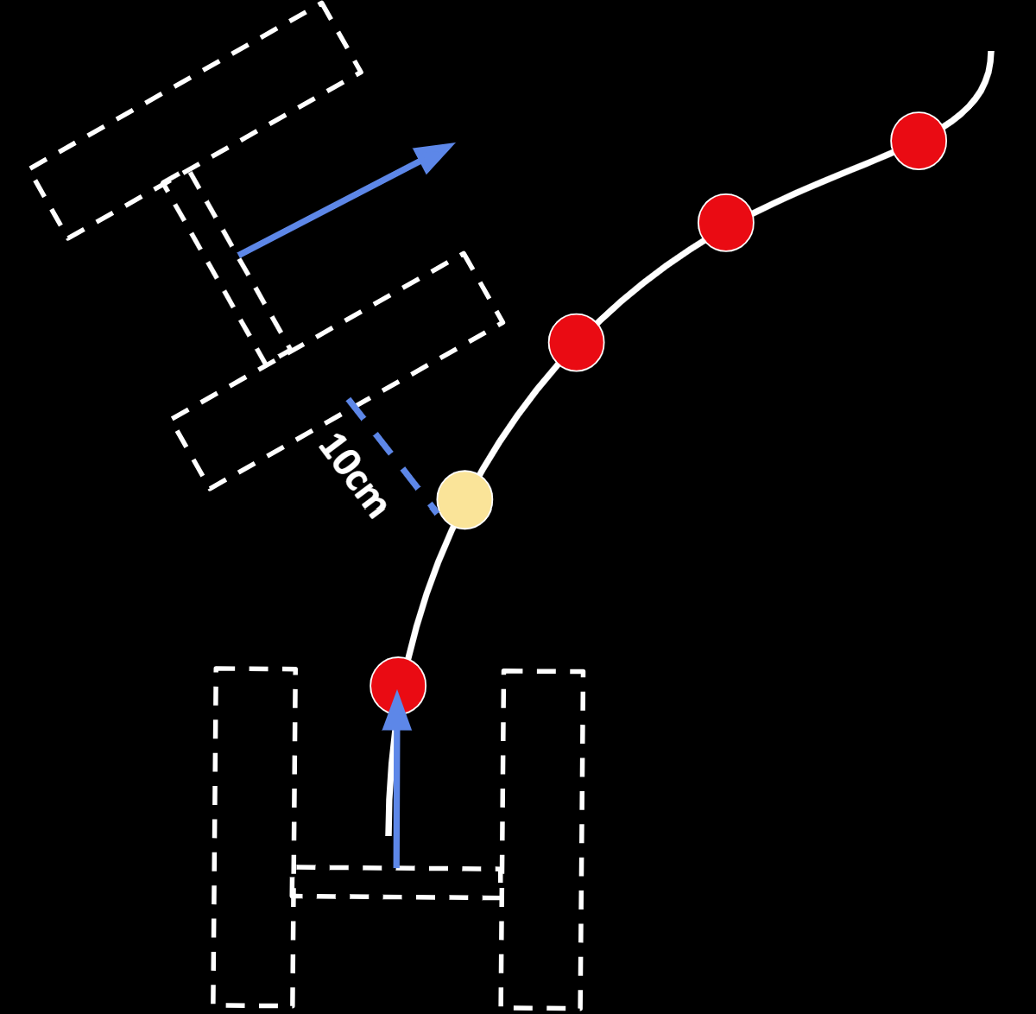
Road Runner Issues
Trajectory Point
Point of Collision
Localization
  Used to generate set of instructions
  Assumes robots position is correct by the end of motion profile
Unable to correct displacement off path until the end of motion profile
  Discrepancies after collision
  Imprecise movement
Continue to be that far off the path

Slide 25
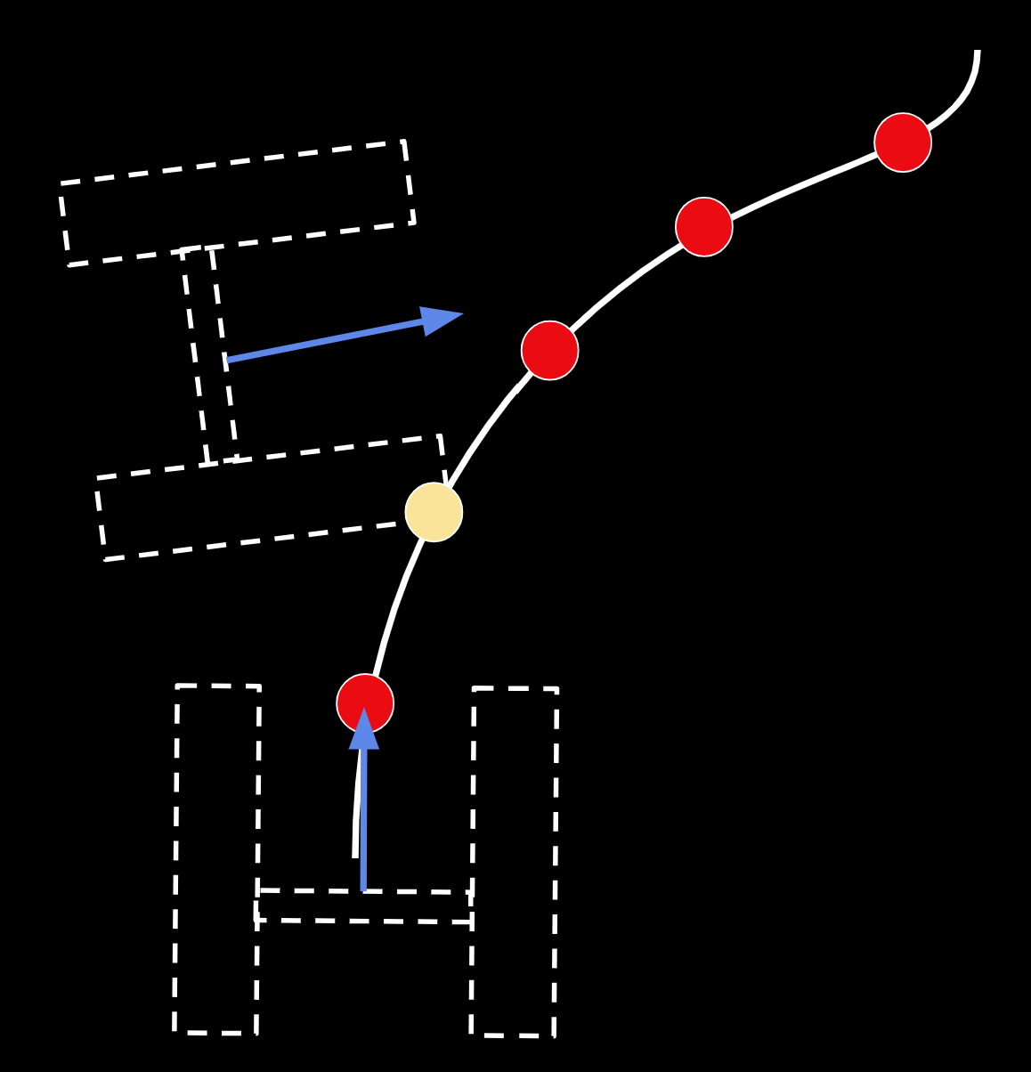
Pedro Pathing
More Complex path planning library
  Designed last year by FTC team Scott Bots
Vectors
  Dynamically Calculated
  Corrects robot movement to closest point on target curve
Enables robot to detect collisions and corrects error immediately
Trajectory Point
Point of Collision

Slide 26
Pedro Pathing VS Road Runner
Pedro Trajectory
Road Runner Trajectory
Calculates heading towards the next point and reevaluates vector
Corrects displacement after motion profile is done
Consistency
Consistency
Very consistent as it fixes the collision and displacement by each small point
Not very consistent as you will continue traveling in the displacement until end

Slide 27
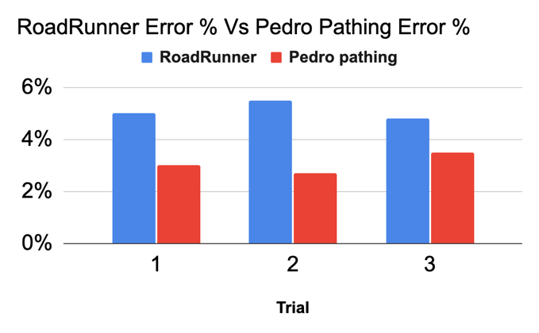
Error Yield Experiment Results
To test the error between both programs, a straight line test was ran

Slide 28
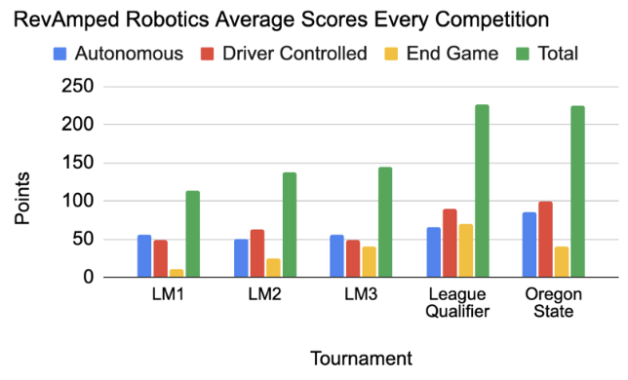
Competition Score Analysis in FTC
IR sensor to the intake after LM3
  Increase in Tele-Op Score
Pedro Pathing after League Qualifier
  Increase in Autonomous Score
Score analysis as feedback and validation

Slide 29
Acknowledgements
PNSQC committee​
Reviewers: Nancy Hou McCormack and Justin Wolf
RevAmped Robotics Team Coach: Zhunquin Wang​
For Inspiration and Recognition of Science and Technology​
(FIRST) Program ​
Oregon Robotics Tournament & Outreach Program (ORTOP)​
FTC team coaches, mentors, and teammates​

Slide 30
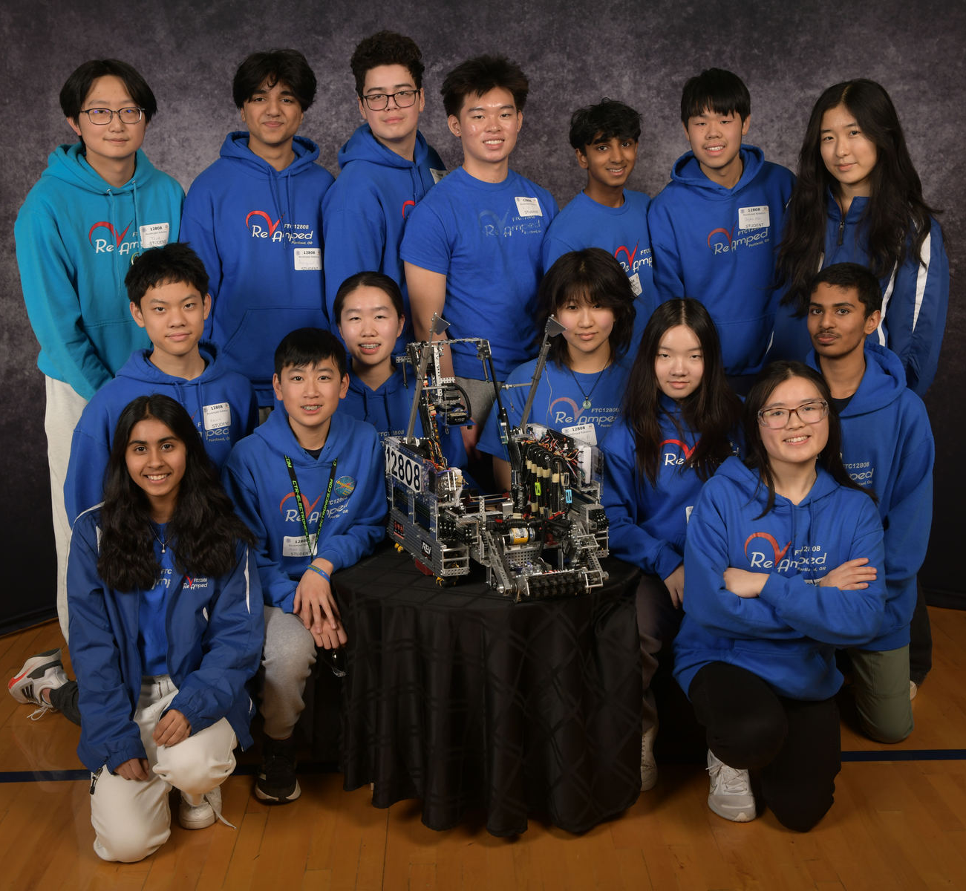

Slide 31
Who We Are
Who are the Authors?
  Monica Bao
  Sophia Lee
  Havish Sripada
  Joanna Mei
What is First® Robotics?
What is First Tech Challenge (FTC)?
Who is RevAmped Robotics?
  Our Mission

