Slide 1
QA Authority: From Zero to Hero
Anton Bolotin

Slide 2
QA Authority
Anton Bolotin
Quality Assurance Specialist
Soramitsu
A tester, a mentor, a lecturer

Slide 3
QA specialists – underrated by IT colleagues
QA Authority
Problem
Notes:
In today's world, there are opinions that testers are not 'real' IT professionals, and their profession is considered simple and accessible to anyone. These views are often based on a misunderstanding of what testers actually do and the value they bring to projects.

Slide 4
Red flags
QA Authority
“Testing is the easiest field in IT, anyone can get in”
“Testers are not programmers, they don't write code.”
“Testers don't know anything except how to push buttons and make regressions testing.”
“Monkey tester”
“Automation tests are a fake, they are not useful.”
“QA's opinion is not counted in team meetings.”
“QA has no authority in the team to push their ideas.”
Notes:
Here are a few situations and statements that many qa professionals I know have faced

Slide 5
What to do?
QA Authority

Slide 6
Let's take a look at:
QA Authority
what is the reason for such attitude
what can be done about it
and how to gain the respect of your teammates

Slide 7
Reasons
QA Authority
Notes:
What is the reasons?

Slide 8
QA Authority
Your colleagues don't see the results of your work.
That doesn't mean you're not doing a good job
It means you need visualization and transparency.
Achievements of programmers are very visible - a feature implemented, a bug fixed, a new toolkit that speeds up the work of the team.
QA has some different working artifacts that are not always visible to others.

Slide 9
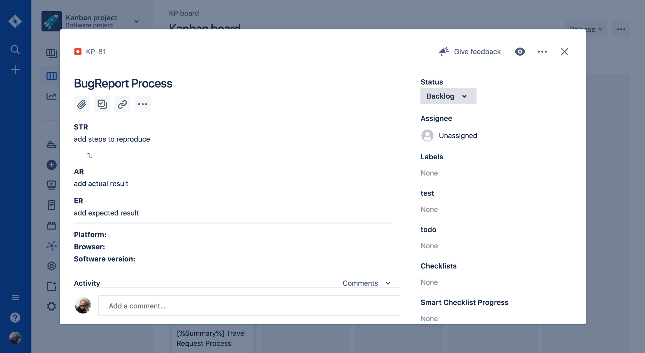
QA Authority
How do developers see a tester?

Slide 10
Solution
QA Authority
Notes:
Here are a a few advices

Slide 11
QA Authority
Visualize the results of your work
Notes:
Built-in tools for test management systems help you visualize your work

Slide 12
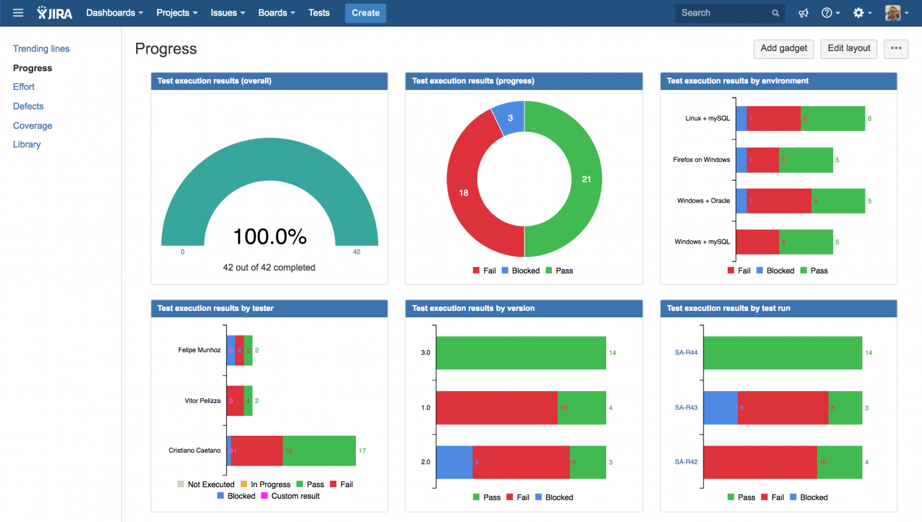
QA Authority
Dashboards
Notes:
Make release dashboards to track for example the number of active defects, test pass rate and the amount of days until release.
Make a dashboard that your colleagues can use and they will appreciate it

Slide 13
QA Authority
Test Automation
Notes:
Start writing autotests.
Once you start writing code, it increases your value as an expert. Some colleagues may start to think of you differently after that.
The secret is that it is not as hard as it seems at first sight. There are many test automation frameworks that work on the principle of Record and Play. And you can always ask ChatGPT to help you

Slide 14
QA Authority
Performance testing
Notes:
If you have already started doing test automation, you can also try to initiate load testing on the project. After all, a tester who does not only manual testing, but also automation and load testing, definitely earns respect.
But that's not the easiest way, so let's look at some other options

Slide 15
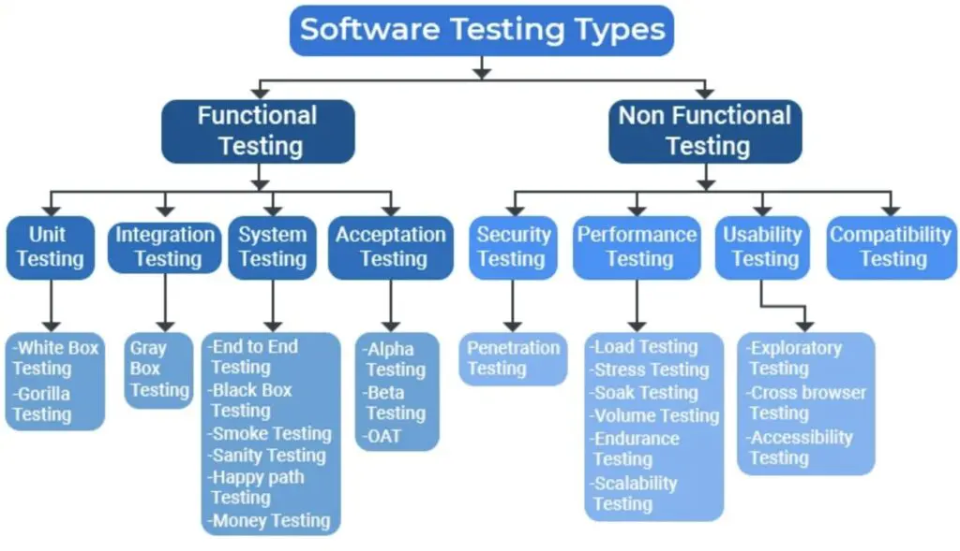
QA Authority
Other types of testing
Notes:
Start other types of testing on the project.
For example, Security testing: you can introduce security checklist checks at each release
Or testing of documentation, design, cross-browser testing.

Slide 16
QA Authority
New tools
Implement a new tool and tell your colleagues about it
For example a TMS system for writing and storing test cases, instead of a google doc or spreadsheet.
Notes:
Implement a new tool and tell your colleagues about it

Slide 17
QA Authority
Be proactive on meetings
Be proactive on work calls. If it is a discussion of task estimation, always ask if time for testing was included in the estimation.
Start sharing your achievements and innovations in testing at company meetings
Share testing reports with colleagues.

Slide 18
QA Authority
Create your own meetings
If the topics of the calls are not close to you and you don't know what to say, organize your own work meetings on a QA topic. For example, do a meeting on Defect Triage. Or a meeting on testing plans for the quarter.
Conduct a training for colleagues for example about QA basics or quality tools.
Organize a meeting on testing achievements for the quarter, with defects, scenarios and metrics.
I once saw that the team spirit of the entire department was nearing zero and suggested a department retro in a game form, in the end everyone really enjoyed it and it also unexpectedly improved my performance review score.

Slide 19
QA Authority
Conferences and meetups
Easy way: go to a conference or meetup as a listener and make a presentation/talk to the team about this experience
Cool way: go to a conference or meetup as a speaker and share this experience with your colleagues. Perhaps it will motivate them too.

Slide 20
QA Authority
Became Scrum master
A story from personal experience. At one of my jobs, we worked in Scrum. And we had a special role of Scrum Master, which could be combined by any member of the team.
So I became a Scrum Master in the team, combining the main role of QA. And somehow I got a huge authority in the team, becoming the second after the team leader and having a huge opportunity to influence the team's decisions and changes in the processes.
A little bit off the scrum way, but just know that there is such a way too and it works. And what to do with authority and the ability to influence - everyone must decide for themselves.
Notes:
A story from personal experience. At one of my jobs, we worked in Scrum. And we had a special role of Scrum Master, which could be combined by any member of the team, if they were willing and had a little study.
So I became a Scrum Master in the team, combining the main role of QA. And somehow I got a huge authority in the team, becoming the second after the team leader and having a huge opportunity to influence the team's decisions and changes in the processes.
A little bit off the scrum way, but just know that there is such a way too and it works. And what to do with authority and the ability to influence - everyone decides for himself.

Slide 21
QA Authority
Conclusion
With great authority comes great responsibility
In this talk I have given many advice on how to become a real rock star QA and gain authority among your teammates. And I wanted to show that there are a lot of different opportunities in the QA field that you can do if you are interested in it.
If you like and fit the advices - feel free to use them.
But in reality, none of these advices are necessary. Know that you are already a professional, you do not need to prove anything to anyone.
Just be yourself

Slide 22
Thank You!
Notes:
That's it from my side! If you have any questions you could write me directly. Thank you for your attention!

