Slide 1
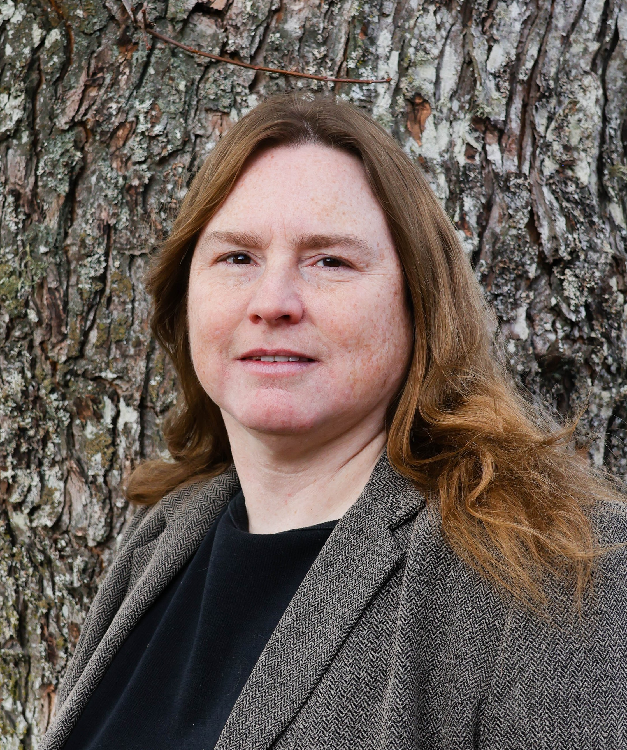
Heather
Wilcox
Leading With Quality

Slide 2
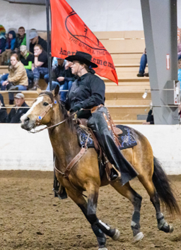
About Me…
Former Anthropologist
In 1994, I left a Master’s program to start a new life and decided that maybe technology might be fun.
29 years and 9 companies later, I’m still in the game
Current Gig: Manager of Quality and Reliability – HMH
Hobbies: Equestrian Sports, Training Donkeys (wild and domestic), hand spinning, hobby farming (pigs and goats)
Heather Wilcox
Leading With Quality

Slide 3
What is Shifting Left and Why it’s not Enough
Shifting Left: Moving Quality to an earlier place in the development process
Pair Programming QA/Dev
Solid Unit Testing
Early Automation
CI/CD build processes
Test Early and Often
Bad decisions can be made before Dev/QA get involved forcing “Quality” into a “Mission Impossible” condition.
Wrong tools
Bad design
Designed for the wrong user
Not leveraging existing work
Heather Wilcox
Leading With Quality

Slide 4
The Scenario: A Project is Born….
A need is identified:
“We need a widget that stores data from a web page!”
Marketing has done all the research to prove that the addition of this widget would be a valuable feature for the current product line.
Sales swears up and down that people have been asking for this functionality for years and they’ll be able to sell it to every customer the company has ever had and, what’s more, it will attract new clients in droves.
It is the PERFECT idea and all that is needed is a Design and a Dev Team to build it!
Heather Wilcox
Leading With Quality

Slide 5
Make it so
A Discovery Team is assembled
They lay out the solution design for the new widget- frontend and backend
They pick out a tool set for the team to use
The whole thing is packaged up and delivered to the team
Team says that they can have a Minimum Viable Product (MVP) in approximately 3 months (400 hours per person X 7 people)
WHUMP! The project is already quality-impaired and it hasn’t started yet
Heather Wilcox
Leading With Quality

Slide 6
Impairment Starts with The Wrong People
A Team is assembled to design the project
Typical “Discovery Team”
Business Analyst (BA)
UX Designer
Solution Architect - Our Token Technical Guy
Delivery Manager
Other common Participants
Product Managers (PMs)
Technical Product Managers (TPMs)
Project Managers
Heather Wilcox
Leading With Quality

Slide 7
Why are they The Wrong People?
They don’t work on the product every day
They know what the product can do
They may not know what it’s capable of doing
They may not know where problems are hidden
They don’t have daily experience with the tools that will be used
They don’t necessarily talk to the person who will use the product
They may talk to the person that buys the product. The Buyer is not always The User
Although they likely have knowledge of the company’s full range of products, they probably don’t know about skunkworks projects and extra capabilities that might be hiding in the codebase.
Heather Wilcox
Leading With Quality

Slide 8
Who are the Right People and why
(Occam’s razor) Use your Domain Experts
Lead Developers
They know where the problems will be, what easter eggs (and rotten eggs) are hidden where, and what the actual possibilities are.
They understand the code and the tools intimately
Quality Assurance
They tend to have historical knowledge about what has worked and what has failed
They know where customers will get confused or have problems (as will support)
Support
They talk to ACTUAL users every day (not just the purchasers) and will know what features customers really NEED and will use.
Heather Wilcox
Leading With Quality

Slide 9
Why the Right People don’t get included (and why those reasons are wrong)
Developers are expensive (Spoiler alert – they aren’t.)
Dev and QA are busy keeping the lights on (Not too busy to prevent a mess….)
There’s already an Architect on the team so Dev is redundant (Architects != Developers)
Developers over-design everything! (This is a solution, not a product.)
QA doesn’t need to be involved until coding starts (Yes they do. They know more than you think!)
Support doesn’t know enough about software development to be helpful. (They know more about the customer than anyone else.)
Heather Wilcox
Leading With Quality

Slide 10
The Financials*
Money is always a big reason why the “right people” don’t get in the room
The Senior Engineer isn’t so expensive after all.
*Data courtesy of Glassdoor
Title | Yearly Salary | Hourly Pay
Solution Architect | 220K | 105.77
Technical Product Manager | 164k | 78.85
Sr. Software Engineer | 149k | 71.63
Product Manager | 130k | 62.5
Sr. QA Engineer | 134K | 64.42
Delivery Manager | 124k | 59.62
Software Sales Rep | 120K | 57.69
Software Engineer | 113K | 54.33
Senior Technical Support Engineer | 106K | 50.96
Software QA Engineer | 96K | 46.15
UX Designer | 96K | 46.15
Business Analyst | 90k | 43.35
Heather Wilcox
Leading With Quality

Slide 11
The “Save the Busy People” Strategy
Title | Hourly Pay | x30 hours
Solution Architect | 105.77 | 3173.08
Delivery Manager | 59.62 | 1788.46
UX Designer | 46.15 | 1384.50
Business Analyst | 43.35 | 1300.64
Total cost per hour Included Team | 330.29 | 7646.68
Title | Hourly Pay | x30 hours
Sr. Software Engineer | 71.63 | 2148.90
Sr. QA Engineer | 64.42 | 1932.60
Senior Technical Support Engineer | 50.96 | 1528.80
Total cost per hour Excluded Team | 189.01 | 5610.30
Everyone spends 30 hours working on the project
10 - 1 hour meetings
20 hours independent research/preparation
$5610.30 was saved!!!! (Or was it….)
Heather Wilcox
Leading With Quality

Slide 12
Project Costs
Title | QTY | Hourly Pay | X400 hours
Sr. Software Engineer | 1 | 71.63 | 28,652.00
Sr. QA Engineer | 1 | 64.42 | 25,768.00
Software Engineer | 4 | 54.33 | 86,928.00
QA Engineer | 1 | 46.15 | 18,460.00
Totals | 7 | 236.53 | 159,808.00
Estimated: 400 hours for Minimum Viable Product (MVP)
Total Cost in Person Hours: $159,808.00
Heather Wilcox
Leading With Quality

Slide 13
What Could Possibly Go Wrong?
The tools didn’t work as advertised and caused the team to need extra time to complete the MVP. Add 2 weeks. Cost = $31,961.60 ($5610.30 savings turns into a $26,351.30 loss)
Bonus Problem – the implemented solution was a big kludge and is not very performant.
The tools weren’t appropriate for the job and, although an MVP was shipped, the team ended up rebuilding the widget with a different tool set after a few months of failures in the field. Spend another 400 hours rebuilding. Cost = $159,808.00 ($5610.30 savings turns into a $154,197.70 loss)
The solution, as designed and provided to the development team, wasn’t technically appropriate and required extra work to implement. Being kind, let’s only add 2 weeks. Again Cost = $31,961.60 ($5610.30 savings turns into a $26,351.30 loss)
All of the above scenarios combined into one big unhappy (and costly) mess.
Heather Wilcox
Leading With Quality

Slide 14
What Else could go wrong?
Partial implementation of the concept that already existed within current software could have been used instead of developing a whole new product.
Marketing based their work on the people who buy the product, not the ones who use it, so the final software doesn’t meet the needs of the real user.
The folks on the development team get frustrated and demoralized because nobody ever listens. They feel like they always get stuck building solutions and never get to solve problems.
Heather Wilcox
Leading With Quality

Slide 15
What If We Get a Do-Over
Get the right people in the room this time
Design a set of requirements that challenges your Dev Team and that meets the needs of the actual user, not just the purchaser.
Maybe we get to leverage code that already exists and hasn’t been turned on yet.
Potentially major problems/surprises get avoided
It may cost you a little extra upfront, but you’ll probably save at end.
You get a happy Dev Team, happy Customers, and a happier bottom line.
Heather Wilcox
Leading With Quality

Slide 16
What the Dev Team Needs to Succeed
Provide an Interesting Problem, not a completed solution:
“We need a widget that stores data from a web page!”
It needs to work with our existing website.
Stored data needs to be accessible to both customers and internal users.
Data should be always backed up in a secondary location.
Request response time should be less than 1 second.
Boundaries that need to be respected
Budget
Time to MVP
Team Size
Whatever
Heather Wilcox
Leading With Quality

Slide 17
It Can Work for Any SDLC
Waterfall
Agile
Whatever
Just get the right people in the room at the start of the project and don’t leave out the domain experts for reasons.
Heather Wilcox
Leading With Quality

Slide 18
Conclusion
Healthy company culture abhors a large meeting BUT
Don’t hamstring your project by leaving out the folks who know your ecosystem the best:
Software Engineers
QA
Support
These people have the knowledge and skills that will help your product be the best it can be from the very beginning.
The cost of getting them involved early is very likely going to be much cheaper than getting them involved too late.
Deliver an interesting challenge to your Dev Team – not just a completed solution.
Heather Wilcox
Leading With Quality

Slide 19
Questions?
Heather Wilcox
Leading With Quality

Slide 20
THANK YOU
Heather Wilcox
Leading With Quality

Slide 21
HEADING TWO
Points of the graphic
Heather Wilcox
Leading With Quality

Slide 22
HEADING TWO
Points of the speech
Heather Wilcox
Leading With Quality

Slide 23
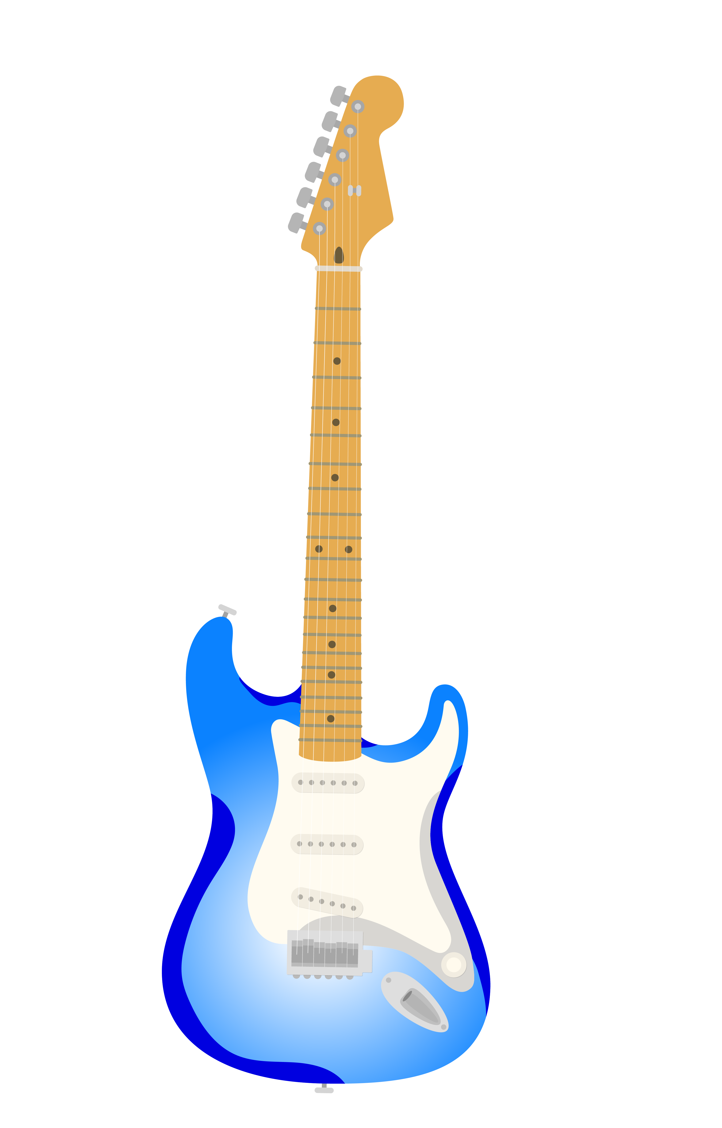
HEADING
Points of the speech
SPEAKER NAME
TOPIC

