Slide 1
QUALITY OWNERSHIP
Linda Wilkinson
wilkinsonlinda4@gmail.com

Slide 2
Who Am I?
40+ years in Software QA
Started in development (system analysis)
40+ years of test analysis and manual testing
10+ years of automated testing, including performance
14 years of management
Additional forays into compliance (SOX, other), DevOps, DBA (building databases), product ownership/BA work, certified project manager, etc.
Worked with 18 software languages and teams from 11 countries

Slide 3
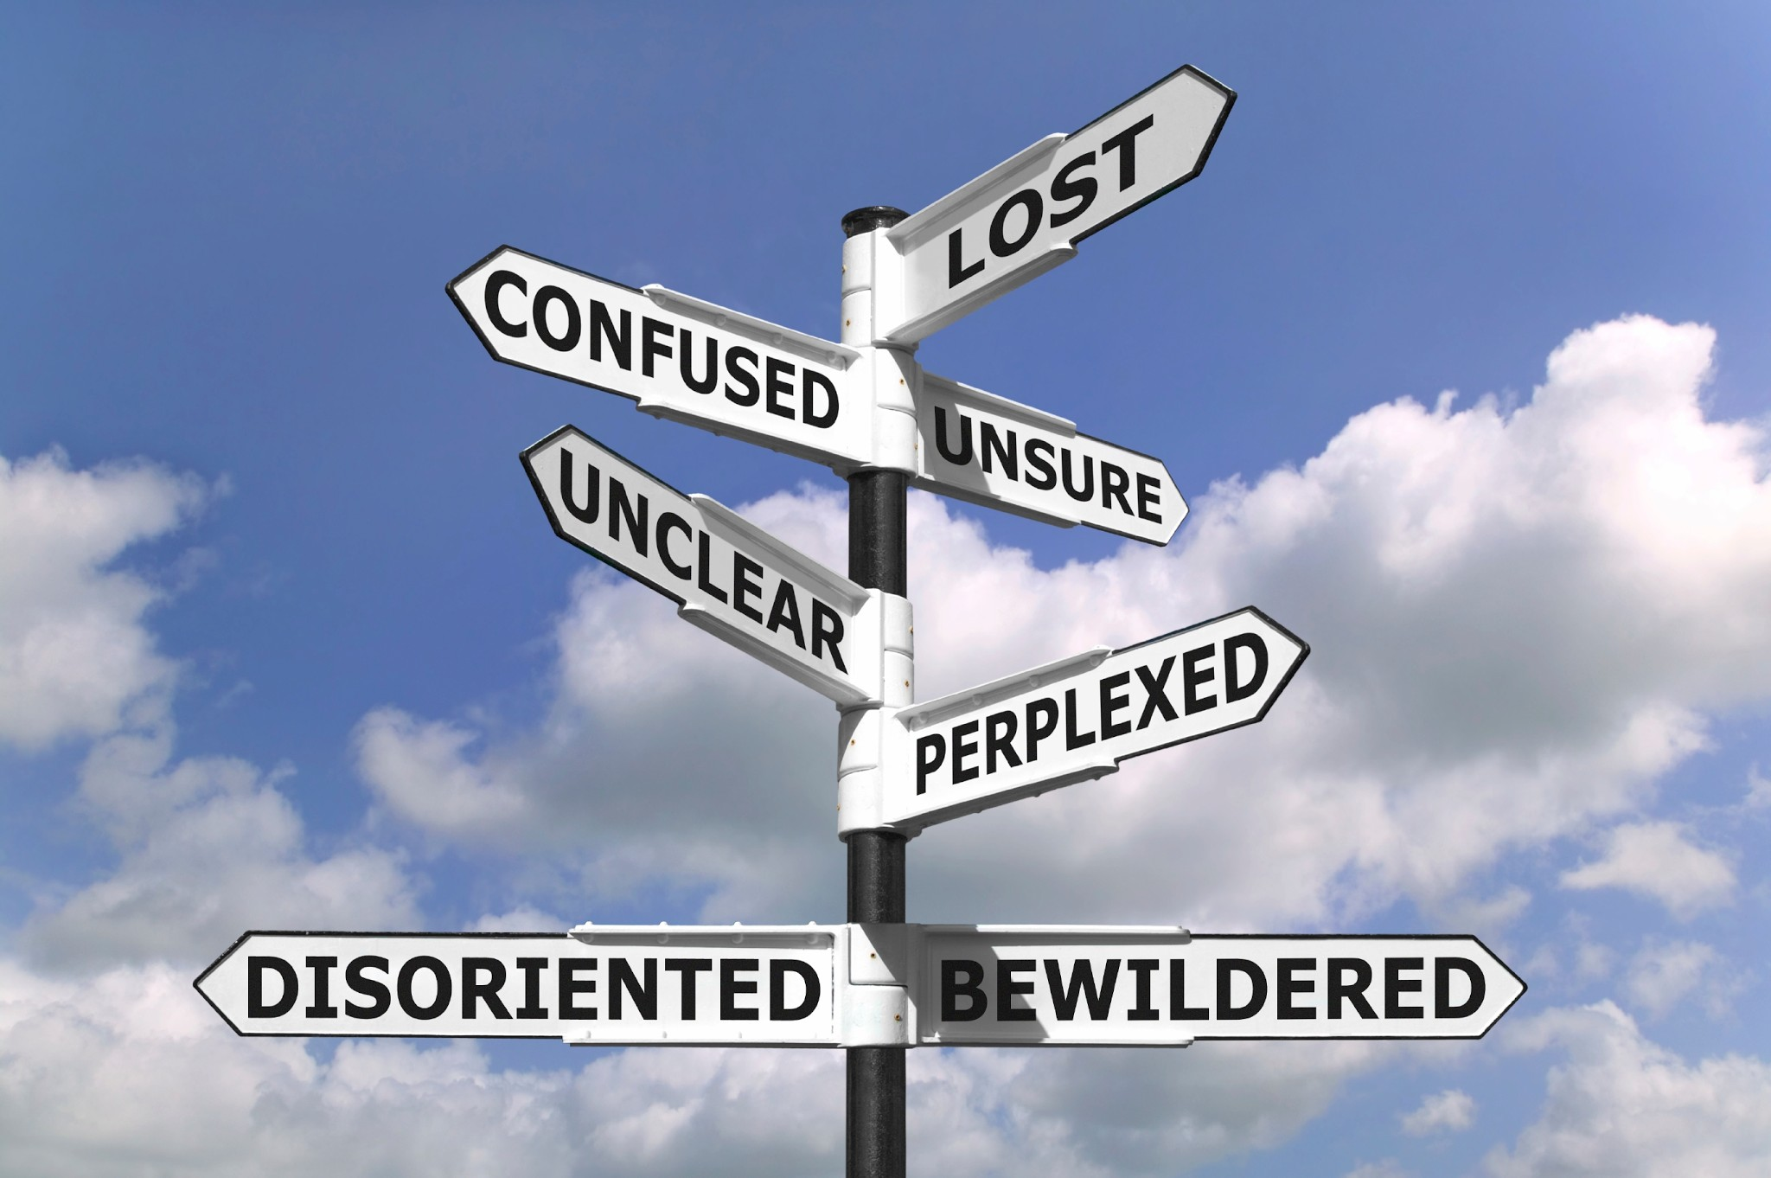
HISTORY OF QA

Slide 4
From a Practioner’s Perspective:
Waterfall
- What it was and what it wasn’t (blessings and
curses)
Shift to user-based testing
Agile
- What it was intended to be and what it is today
- What it is and what it isn’t (blessings and curses)
HOW HAS THE QA FIELD CHANGED – OR HAS IT?

Slide 5
REALITIES
IN ORDER TO TEST, (SOMETHING) MUST BE COMPLETED
THE DIFFERENCE BETWEEN EXECUTION AND A COMPARE
GOOD TESTING IS RUNNING THE RIGHT TEST AT THE RIGHT TIME IN THE RIGHT ENVIRONMENT

Slide 6
DISCONNECT
MYTHS AND LEGENDS
- “Developers are terrible testers”
- SDETS are Quality Analysts on steroids
- The testing process can be faster
- Test automation will improve quality
ANYONE, OR A MACHINE, CAN EXECUTE A TEST. TEST ANALYSIS - DETERMINING WHAT TESTS NEED TO BE RUN - IS THE KEY TO SUCCESS.

Slide 7
OPPORTUNITIES FOR CHANGE
Are you Agile?
Tossing what doesn’t work
Typical agile processes and challenges
User views of quality

Slide 8
QUALITY OWNERSHIP
What’s in a name? Why “Quality Ownership”?
Establishing the test base
Pulling in tickets as ready to work after tests are attached
Doing test automation (either a developer or an SDET) immediately
Test execution
Handling multiple teams
Using the concept for non-IT efforts

Slide 9
IMPLEMENTING CHANGE
CHANGE IS HARD
- Inertia is as strong a force as gravity
WHAT YOU CAN EXPECT:
- Pushback
- The need for random checking
- Gains and losses
STRONG MANAGEMENT AND EXECUTIVE MANAGEMENT ADVOCACY

Slide 10
CHANGE THE WORLD!!!

