Slide 1
Nancy McCormack
Mayo Clinic CDH AI Engineering
How to Design and Create Testing Data Sets for End-to-End Testing

Slide 2
HEADING
Introducing Mayo, CDH, AI Engineering and Verification and Validation (V&V)
An example of a model deployment
An Example of full stack Verification and Validation
How to design testing datasets for end-to-end testing
How to create testing datasets for end-to-end testing?
Challenges
Nancy McCormack
How to Design and Create Testing Data Sets for End-to-End Testing

Slide 3
Biography – Nancy McCormack
Sr Full Stack V&V Engineer and offshore V&V Lead for Mayo Clinic CDH AI Engineering
8 years management experiences plus 16 years testing experiences in different industries: Medical/Healthcare, Semiconductor, Networking and IT
Accomplished at managing and leading diverse quality teams using both waterfall and agile methodologies
Adept in all aspects of the SDLC but excel in test strategy, planning, process, standards, and metrics
Nancy McCormack
How to Design and Create Testing Data Sets for End-to-End Testing

Slide 4
Mayo Clinic, CDH, AI Engineering & V&V
Mayo Clinic
The No. 1 hospital overall in the nation and top-ranked in fourteen specialties by U.S News and World Report for seven consecutive years.
The Center for Digital Health (CDH)
* Creates innovative digital experiences,
aligned with Mayo Clinic’s mission to improve the health and well-being of people worldwide
* Collaborates with partners to establish innovative ways to yield greater value, agility, and effectiveness.
CDH AI Engineering
Takes responsibilities for deploying models into real production environments
Verification and Validation Engineers
* Ensure that the models that are deployed in production are safe and effective.
* Ensure that the model meets the needs of the users and the requirements of the production environment.
Nancy McCormack
How to Design and Create Testing Data Sets for End-to-End Testing
Notes:
V&V: 1. Work closely with multiple teams and organizations to ensure that the models that are deployed in production are safe and effective. 2. Work across the entire lifecycle of a model, from development to deployment to monitoring, to ensure that the model meets the needs of the users and the requirements of the production environment.

Slide 5
What does Mayo Clinic CDH AI Engineering team do?
Deployment
MLOps & IT UI Engineer
Verify used data Retraining
Ethics/Bias, Security/PHI
Validate Monitoring
Users
Model Creation
Data Scientist
Refine Data Pipeline
Structured Data
Verify UI/UX/APP
Model
Monitoring
UI/UX/App
Unstructured Data
Model
Data
preliminary data pipeline
API
External data
Verify API
Others: PO, PM, externals
Other Pipelines
Verify Pipelines
End to End V&V
Regulatory
User Acceptance
Nancy McCormack
How to Design and Create Testing Data Sets for End-to-End Testing
Notes:
The differences between data scientist’s data pipeline and environment and MLOps create and use.
what do MLOps and UI engineer do for deployment?
What does V&V do?

Slide 6
An Example of Full Stack Verification & Validation
API Testing | UI Testing | End to End (Full Stack) V&V
Functional | Functional | Data Flow
Data formatting and defaults (based on data cards) | Usability | Data bias
API Performance | PHI | Use cases
Negative/Error handling | Security | Multi-users
PHI | UI/UX standards | End to end performance
Scalability | Basic UI Performance | Differential
Stability | Negative/error handling/messages | Compliance
Simple Integration | Testable and automatable | Model retraining and monitoring
Monitoring in production
Nancy McCormack
How to Design and Create Testing Data Sets for End-to-End Testing
Notes:
Monitoring will continue in production after the deployment
Will possible back to V&V (MLOps) based on the monitoring

Slide 7
How to design Testing Datasets for End-to-End testing
* To design testing datasets that will help to ensure that the model is working correctly and that it is meeting the needs of the users
Goal
Idea Testing Datasets
* Cover all necessary combinations of data points and different data flows
* Ensure that the model can handle all possible scenarios and that it is not biased toward any particular set of data
Important Items for Designing
* How does model work? * What data does model need?
* What are data ranges? * What data can cause bias?
* What are data sources? * What are data flows?
* What are relationships between different data and all data?
* How do MLOps engineers need to do to make the model live in production
Nancy McCormack
How to Design and Create Testing Data Sets for End-to-End Testing
Notes:
The differences between data scientist test datasets: Test datasets for data scientist’s: Once your machine learning model is built (with your training data), you need unseen data to test your model. This data is called testing data, and you can use it to evaluate the performance and progress of your algorithms' training and adjust or optimize it for improved results.
How the model works: This includes understanding the model's input data, its output data, and how the model makes predictions.
Data that the model needs: This includes the type of data, the format of the data, and the amount of data that the model needs to make accurate predictions.
Data range: This includes the minimum and maximum values of the data, as well as the distribution of the data.
Data bias: This includes understanding what data can cause model bias to help with creating data that can reduce and remove those bias.
The relationship between all data: This includes understanding how the different pieces of data are related to each other, and how they affect the model's predictions.
How MLOps Engineers make the model live in production: This includes understanding the production environment, the infrastructure that the model will run on, and the monitoring tools that will be used to track the model's performance.
Data source: This includes understanding where the data comes from, how it is collected, and how it is cleaned and prepared for use in the model.
Data flow: This includes understanding how the data flows through the system, from the data source to the model to the production environment.

Slide 8
Example: MDS (Myelodysplastic Syndromes)
Data type | Data | Data values | IPSS-M R(Required)/O(Optional) | IPSS-R R(Required)/O(Optional)
Bone Marrow | Bone Marrow Blasts | 0-30% | R | R
 | Hemoglobin | 4-20 g/dL | R | R
 | Platelet count | 0-2000 1e9/L | R | R
 | Absolute Neutrophil Count | 0-15 1e9/L | O | O
 | Age | 18 to 120 years | O | O
Cytogenetics | Prescence of del(5q) | Yes/No | R | N/A
 | -7/del(7q) | Yes/No | R | N/A
 | -17/del(17p) | Yes/No | R | N/A
 | Complex Karyotype | Yes/No | R | N/A
 | Cytogenetics Category | Very good, Good, Intermediate, Poor, Very Poor | R | R
Genomic | Number of TP53 mutations | 0, 1, 2+ | R | N/A
 | Loss of heterozygosity at TP53 locus | No, Yes, N/A | R | N/A
 | FLT3 Mutations includes MLL PTD | No, Yes, Not Assessed | R | N/A
 | FLTs ITD or TKD | No, Yes, Not Assessed | R | N/A
 | 13 Genes (Individual weighs) | Non-mutated, Mutated, Not Assessed | R | N/A
 | 15 Genes (number of residual mutations) | Non-mutated, Mutated, Not Assessed | R | N/A
Clinic Documents | Notes (pdf files), Reports, Teste result | Internal & External | R | R
Background Information
MDS is referred to as a “bone marrow failure disorder” most likely for adults
Clinic requirements:
Saving clinic users’ time on reviewing patient history data
Providing IPSS-M and R risk level and score
Project features:
Calculating IPSS-M and IPSS-R risk level and risk score based on clinic data
Modifying risk levels and scores based on clinic documents
Data Information
Data used by model
Structured data
Unstructured data
Data sources
Internal database for structured data
Internal database for unstructured data
External databases
Nancy McCormack
How to Design and Create Testing Data Sets for End-to-End Testing
Notes:
Myelodysplastic Syndromes (MDS) are a group of diverse bone marrow disorders in which the bone marrow does not produce enough healthy blood cells. MDS is often referred to as a “bone marrow failure disorder”. MDS is primarily a disease of the elderly (most patients are older than age 65), but MDS can affect younger patients as well.
The model uses structured data: the patient's most recent bone marrow test data, cytogenetic test data, and genomic test data to calculate IPSS-M and IPSS-R risk scores and levels. These risk scores and levels can be used to help physicians make decisions about treatment options for patients with MDS.
Clinic users can also modify the data based on unstructured data: clinic documents and CBC (Complete Blood Count) test results. This allows for a more comprehensive assessment of the patient's condition and can help to improve the accuracy of the risk scores and levels.

Slide 9
An example – MDS Testing Datasets Designing
The Ideally testing data sets could be to:
Test how the model calculates risk scores for patients with different types of data
Test how the model handles different data flows
Test risk level categorization using the risk scores, especially using the end points
of each score ranges
Test bias by using different ages and genders that impact risk scores and levels and
possible races, locations, which should not impact risk scores and levels
Test data pipelines by having data from different data sources including internal
and external structured and unstructured data
IPSS-M Level | IPSS-M Score
VL | <= -1.5
L | >-1.5 t0 -0.5
ML | >-0.5 to 0
MH | >0 to 0.5
H | >0.5 to1.5
VH | >1.5
IPSS-R Level | IPSS-R Score
Very Low | <= 1.5
Low | >1.5 to 3
Intermediate | >3 to 4.5
High | >4.5 to 6
Very High | >6
Nancy McCormack
How to Design and Create Testing Data Sets for End-to-End Testing
Notes:
Need to mention how to decide how big or small testing datasets based on:
Testing datasets are based on project data, data source and flow … etc. to cover possible necessary combinations, different data flows and all data sources
How big and how small are perfect, good or necessary and which one is right for the project? It needs to come from the combination of quality, cost and schedule and risks that we are willing to take
The smallest necessary dataset should be a simple datasets to cover all data flows with some important data combinations

Slide 10
An example – MDS Testing Datasets
Nancy McCormack
How to Design and Create Testing Data Sets for End-to-End Testing
Notes:
Not including entries intentionally missing some data or no data that is a part of testing datasets.

Slide 11
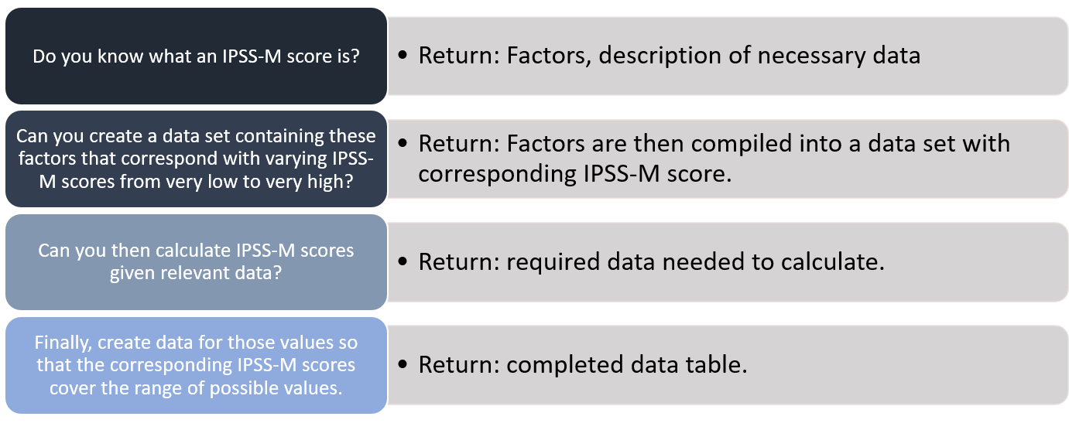
Tools that help with designing testing datasets (1)
Public Calculator
Try different data combinations by filling in fake data into the calculator to generate risk score and risk level
A Time-consuming process but can get perfect testing datasets
ChatGPT
Generated Knowledge Prompting
Findings: ChatGPT has limited knowledge of IPSS-M and R scores, and more focus on bone marrow test data
Issue: scores sometimes are not right.
For example: IPSS-M score should be -0.38. but get 1 from ChatGPT.
Nancy McCormack
How to Design and Create Testing Data Sets for End-to-End Testing
Notes:
Issue: scores sometimes are not right.
For example: IPSS-M score should be -0.38. but get 1 from ChatGPT. It probably due to aggressive rounding or a simplified score calculation method.

Slide 12
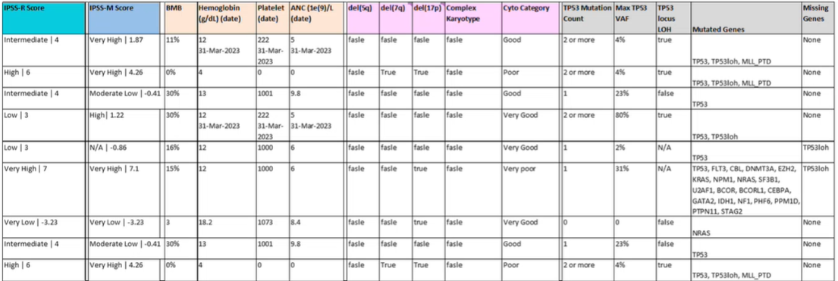
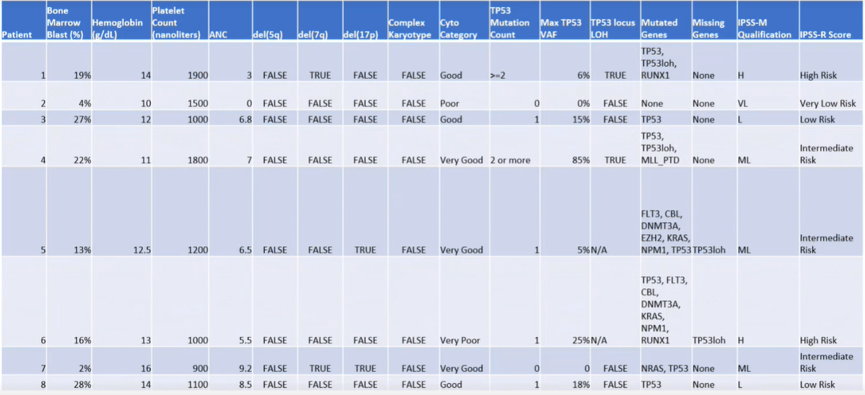
Tools that help with designing testing datasets (2)
Original datasets
ChatGPT
A few-Shot Prompting
Findings: We need to ask to generate randomized
data to avoid the exact same dataset as the
original.
Issues: Risk level data is always off by one full
qualification step.
For examples, Low should be Moderately Low
and High should be Very High.
Generated datasets
Nancy McCormack
How to Design and Create Testing Data Sets for End-to-End Testing
Notes:
Issues: Risk level data is always off by one full qualification step.
For examples, Low should be Moderately Low and High should be Very High.
It might because data is generated only based on 10 original datasets. Believe that the larger number of datasets in the original datasets will increase the accuracy.

Slide 13
How to Create Testing Datasets for End-to-End testing (1)
Method 1: Creating fake data in a local database
Advantages:
Does not require dependency on other teams.
Can be easily modified when needed.
Can be used to design and create common data sets for future similar projects.
Disadvantages:
Takes a significant amount of time to understand unstructured clinic data.
Fake data cannot be used for end-to-end testing
Overall, creating fake data in the local database can be a quick way to create testing datasets to start V&V, but not right for end-to-end testing.
Nancy McCormack
How to Design and Create Testing Data Sets for End-to-End Testing
Notes:
Disadvantages:
Takes a significant amount of time to understand the format and content of clinic notes, documents, medications, and lab results in order to create realistic fake data.
The data flows in a local database may not be the same as the data flows in the real production environment, which can impact end-to-end testing.
Overall, creating fake data in the local database can be a quick way to create testing datasets to start V&V, but the disadvantages of creating fake data in a local database should be carefully considered before using this approach.

Slide 14
How to Create Testing Data Sets for End-to-End testing(2)
Method 2: Creating test patients in Mayo systems and databases
Test patients are fake patients with fake data but created in Mayo real testing systems/databases.
Creating test patients requires following Mayo specific process and working with multiple teams
Advantages:
Protect PHI
Use real data flow.
Get accurate structured and unstructured data created by experts
Disadvantages:
Requiring the cooperation of other teams.
May be difficult to get priority for test patient creation from other teams.
Overall, creating test patients in Mayo Databases can be a valuable tool for testing models. However, it is important to be aware of the advantages and disadvantages of this approach before using it.
Nancy McCormack
How to Design and Create Testing Data Sets for End-to-End Testing
Notes:
To protect patient health information (PHI), using real patients in testing and automation is not allowed that is important for compliance with HIPAA and other regulations, so we need test patients based on the testing dataset we design and to meet verification and validation purposes.

Slide 15
Challenges during Finding Test Patients
Finding test patients before creating test patients to avoid creating duplicated test patients
Overall, finding test patients can be a challenging task, especially in large databases.
However, there are a few things that can be done to make the process easier:
Working with a data engineer to create efficient queries.
Indexing the database to improve the performance of the queries.
Using tools that can help to search through the database more efficiently.
Challenges are:
Creating queries to find data
Finding test patients takes time
Finding common test patients that have all mandatory data is time-consuming
Nancy McCormack
How to Design and Create Testing Data Sets for End-to-End Testing
Notes:
Challenges are:
Creating queries to find data is challenging for those unfamiliar with data structures and without a medical background.
Finding test patients takes time due to the large size of our database and the time it takes to run each query.
Finding common test patients that have all mandatory data is time-consuming since some of them may not have all the mandatory data.
Overall, finding test patients can be a challenging task, especially in large databases. However, there are a few things that can be done to make the process easier.
By taking these steps, it is possible to make the process of finding test patients more efficient and less time-consuming. Those steps are:

Slide 16
Challenges during Test Patient Creation
Challenges are:
Incomplete understanding of the data used by the model can lead to missing data for test patients.
Limited knowledge of multiple data sources can slow down the process of test patient creation.
Inconsistency in lab test results from multiple CIS can make test patient creation challenging.
Overall, creating test patients can be a challenging task.
However, there are a few things that can be done to make the process easier. These include:
Use a data card to document the data that is used by the model.
Learn from database experts in the organization to understand the data schema.
Develop a data mapping process to translate data from one format to another.
Nancy McCormack
How to Design and Create Testing Data Sets for End-to-End Testing
Notes:
Need to talk about how to keep testing datasets refresh when AIML code and Apps changes
Use a data card to document the data that is used by the model. This will help ensure that the test patient creation tool has access to all the necessary data.
Learn from database experts in the organization to understand the data schema. This will help you work with the right resources to create realistic and accurate patient data.
Develop a data mapping process to translate data from one format to another. This will help ensure that the data from the different data sources can be used by the test patient creation tool.
All test patients created baed on testing datasets are stored and managed by Mayo Epic testing systems and environments. To modify test patients for good reasons, we will have to submit requests to work with multiple teams to get requests completed.

Slide 17
Summary
Model Deployment
Data Scientist
MLOps
V&V
V&V
V&V + Others
CDH + IT
Monitoring
Creating pipelines, APIs and possible others
Performing Different types of tests including monitoring
Model in production
Key: Designing Testing datasets
Creating Testing datasets
Model
data sources data flows data ranges model deployment
Public Calculator
AI Tools
Fake data
Test Patient
Nancy McCormack
How to Design and Create Testing Data Sets for End-to-End Testing
Notes:
To deploy models into production, MLOps engineers need to build pipelines, APIs and possible others.
To verify and validate models can work correctly in production, V&V engineers need to perform different type of tests including monitoring, and the end-to-end testing is the most important test. End-to-end testing can ensure that the model is deployed into production correctly and ensure that the model works correctly in the real world
To make sure good coverage of V&V especially for end-to-end testing, designing proper testing datasets is the key. Designing testing datasets needs to based on model, production environment, MLOps work and use cases from end users
Designing testing datasets needs to be based on data sources, data flows, data ranges, model and MLOps engineer's work. * Use a variety of data sources to create the testing datasets to ensure that the model is not overfitting to any particular dataset.
* Use a variety of data ranges to create the testing datasets to ensure that the model is not biased towards any particular range of values.
* Use a variety of data relationships to create the testing datasets to ensure that the model is able to handle different types of relationships between the data.
* Use a variety of data flows to create the testing datasets to ensure that the model is able to handle different types of data flows.
There are different ways can be used to help with designing testing datasets, make sure to choose the proper one for your product. Based on different types of tests
To create designed testing datasets, there are two methods: creating fake data in the local database or creating test (fake) patients in Mayo real systems and databases and both of them have pros and cons. Make sure to use them properly.
There are challenges for creating testing datasets, but it can be done with the proper process and procedures. Building testing datasets correctly from the beginning of the project with appropriate resources to improve the effectiveness of the testing process and the quality of the project; Necessary help from medical experts is needed and collaboration is critical to Ensure successful creation of testing datasets.

Slide 18
Continuing to explore
AI in V&V
Standardizing deployment process
Testing datasets updating based on retraining, changes in production
Nancy McCormack
How to Design and Create Testing Data Sets for End-to-End Testing

Slide 19
References
IPSS-M Risk Calculator: https://mds-risk-model.com/
IPSS-R Basic Calculator: https://www.mds-foundation.org/ipss-r-calculator/
ChatGPT Model: GPT-4 https://openai.com/research/gpt-4
GPT-4TechnicalReport:
chrome-extension://efaidnbmnnnibpcajpcglclefindmkaj/https://cdn.openai.com/papers/gpt-4.pdf
Nancy McCormack
How to Design and Create Testing Data Sets for End-to-End Testing

Slide 20
Acknowledgements
John Skiffington
Mayo Clinic CDH
AI Engineering Director
Eric Will
Mayo Clinic CDH
AI/ML Software Architect and project technical lead
Max Comfere
Mayo Clinic CDH
AI Engineering Summer Intern (ChatGPT researcher)
Nancy McCormack
How to Design and Create Testing Data Sets for End-to-End Testing

Slide 21
Contact Information
Work email: McCormack.Wei@Mayo.edu
Personal email: nhou_wei@yahoo.com
LinkedIn: https://www.linkedin.com/in/nancy-hou-mccormack-3583781/
Nancy McCormack
How to Design and Create Testing Data Sets for End-to-End Testing

Slide 22
Q&A
Nancy McCormack
How to Design and Create Testing Data Sets for End-to-End Testing

Slide 23
THANK YOU
Nancy McCormack
How to Design and Create Testing Data Sets for End-to-End Testing

