Slide 1
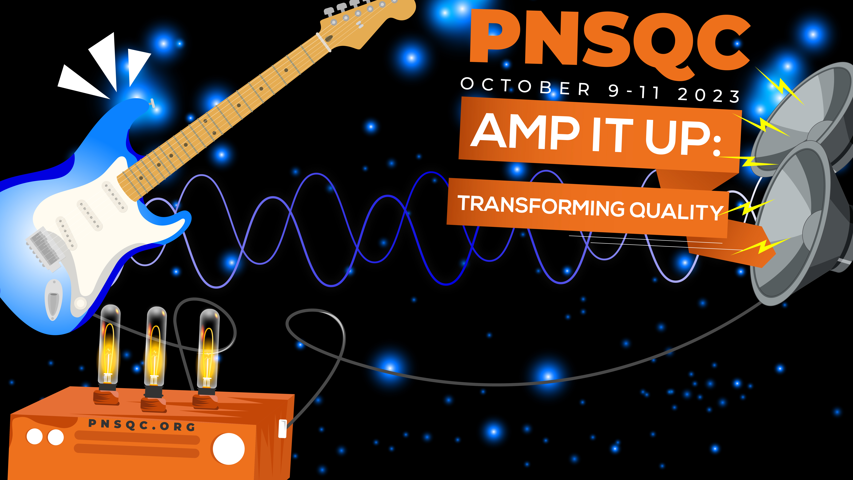


Sophia
McKeever
Art in Code
and Quality

Slide 2

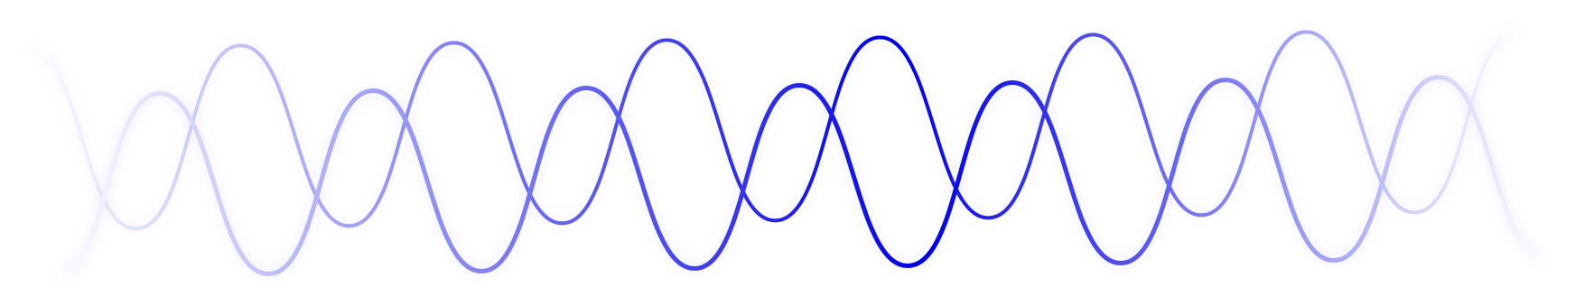
code
Sophia McKeever
Art in Code and Quality
Notes:
# TODO: Make the picture nicer
Code. What do you think of when you see or hear this word?
Maybe you think of programs or applications. Or perhaps you think of services and APIs.
Maybe you think of your current project and the many deadlines you face. Maybe you think of ML or AI.
Maybe you think of a specific programming language, or perhaps science and technology.
Code can represent many and more of these things but maybe there is something you’re not thinking of when you read code.
What if the development of code and the process of qualifying it is a creative process? What if the act of writing a piece of software, from inception to release and everything in between, is an act of creating art.
My name is Sophia McKeever and today I invite you to take a journey with me beyond the scientific and the mathematical.
A sojourn past the technical aspects of the work that you do and bring it contextually into the heart of the humanities.
I invite you to consider the very last thing on your mind when you consider code and the qualitative processes used to validate it. I invite you to think about your work as art.

Slide 3

On the Philosophy of Writing Code as a Creative Process
“There is not a particle of life which does not bear poetry within it”
― Gustave Flaubert
Sophia McKeever
Art in Code and Quality
Notes:
Before we understand how considering development and quality as art can better assist us with supporting our people, we need to muse on the philosophy of writing code as a creative process.

Slide 4
Defining Art
“Art (noun) - Skill acquired by experience, study, or observation.”
“Art (noun) - The conscious use of skill and creative imagination especially in the production of aesthetic objects”
Sophia McKeever
Art in Code and Quality
Notes:
When used as a noun, Merriam Webster recognizes six different definitions.
“Art (noun) - Skill acquired by experience, study, or observation.”
Whether you are self-taught, taught through an educational institution, or learnt by watching or reading the work of others you have acquired a skill. That skill grants you the ability to make a computer do a specific set of tasks. Line by line you create an application, service, automated test and so on, drawing on that knowledge and your previous experiences to write that application. It takes knowledge of writing in your preferred programming language, knowledge of the ecosystem you’re building for, and knowledge of the type of program you’re building. You’ve gained that skill through a mix of either study or observation and through experience. You have acquired the art of writing code, however there is more nuance to this philosophy, so we need to now look at the next important definition of art.
--
“Art (noun) - The conscious use of skill and creative imagination especially in the production of aesthetic objects”
The first definition allows us to the define our work as art because it is an acquired skill while this second definition expands that concept by taking the concept of that skill and using it with creative imagination to produce aesthetic objects. Let’s break down the process of developing. Whether you are assigned a task or just wanting to build a new application on your own, you are starting with a blank canvas. Since the solution doesn’t exist, you begin to really think about how to build it, drawing on your skill and experience, engaging your imagination on how to build it. Of course, you’re using the principles of mathematics and logic to think through how the code of the application will work, however, in addition your imagination is powering the dream to bring that application to life and to bring it into the real world.

Slide 5
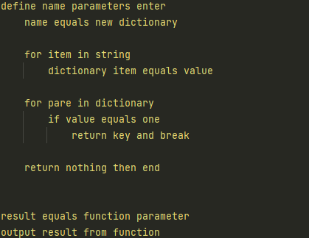
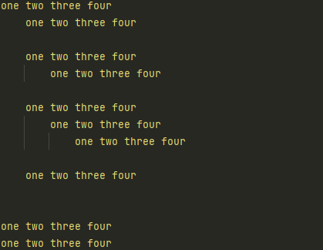
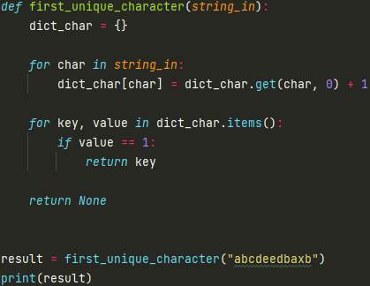
Meter, Rhythm, Poetry - The Aesthetic Object of Code
Sophia McKeever
Art in Code and Quality
Notes:
TODO – Make images the same dimensions

Slide 6
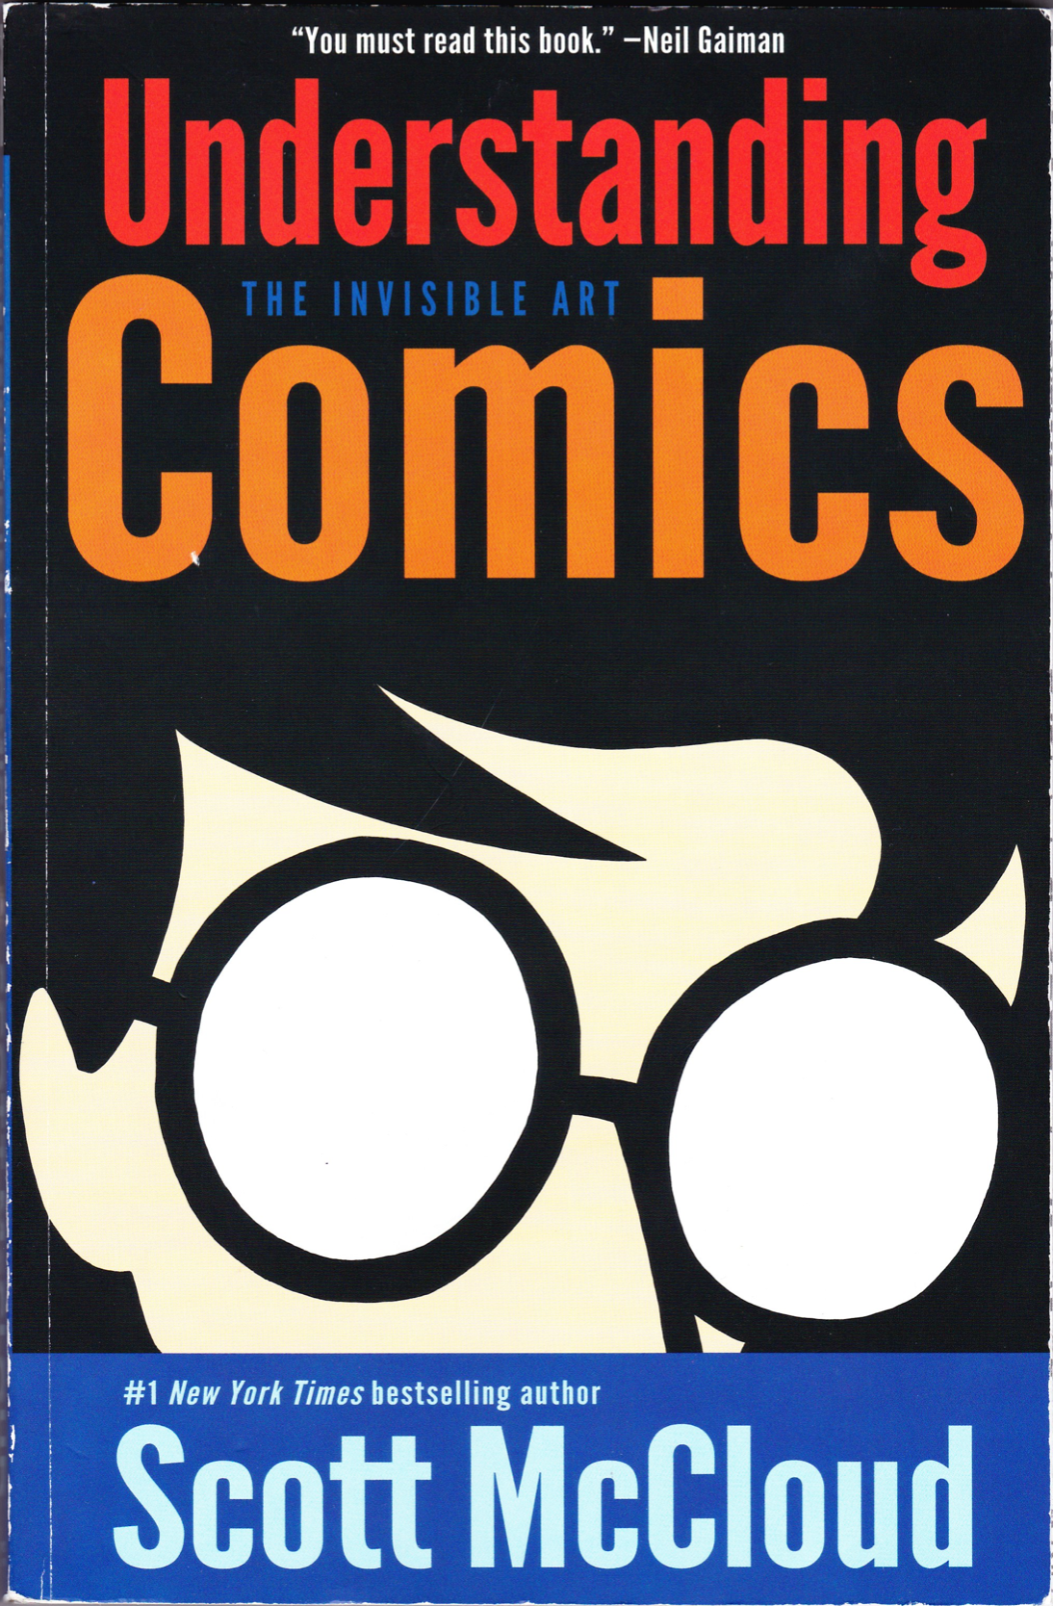
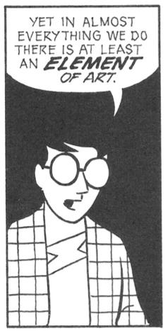
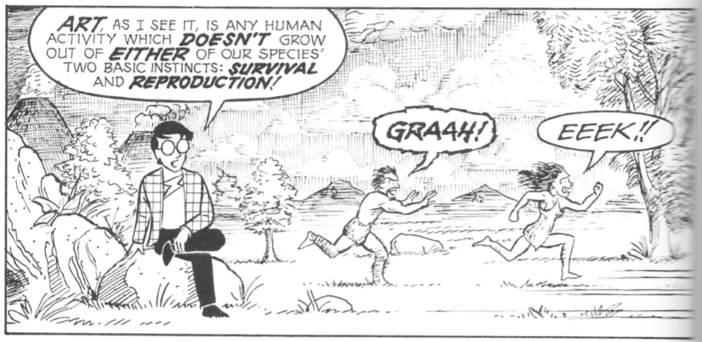
Art in Almost Everything We Do
Sophia McKeever
Art in Code and Quality
Notes:
When used as a noun, Merriam Webster recognizes six different definitions.
“Art (noun) - Skill acquired by experience, study, or observation.”
Whether you are self-taught, taught through an educational institution, or learnt by watching or reading the work of others you have acquired a skill. That skill grants you the ability to make a computer do a specific set of tasks. Line by line you create an application, service, automated test and so on, drawing on that knowledge and your previous experiences to write that application. It takes knowledge of writing in your preferred programming language, knowledge of the ecosystem you’re building for, and knowledge of the type of program you’re building. You’ve gained that skill through a mix of either study or observation and through experience. You have acquired the art of writing code, however there is more nuance to this philosophy, so we need to now look at the next important definition of art.
--
“Art (noun) - The conscious use of skill and creative imagination especially in the production of aesthetic objects”
The first definition allows us to the define our work as art because it is an acquired skill while this second definition expands that concept by taking the concept of that skill and using it with creative imagination to produce aesthetic objects. Let’s break down the process of developing. Whether you are assigned a task or just wanting to build a new application on your own, you are starting with a blank canvas. Since the solution doesn’t exist, you begin to really think about how to build it, drawing on your skill and experience, engaging your imagination on how to build it. Of course, you’re using the principles of mathematics and logic to think through how the code of the application will work, however, in addition your imagination is powering the dream to bring that application to life and to bring it into the real world.

Slide 7
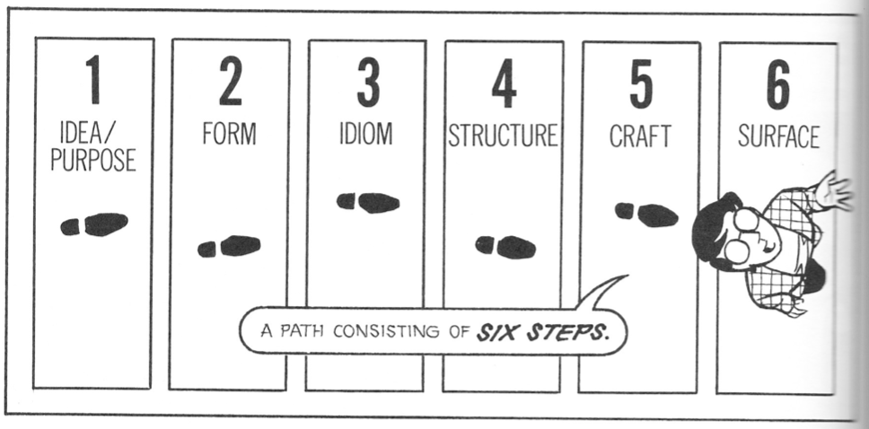
Art in Almost Everything We Do
Sophia McKeever
Art in Code and Quality
Notes:
When used as a noun, Merriam Webster recognizes six different definitions.
“Art (noun) - Skill acquired by experience, study, or observation.”
Whether you are self-taught, taught through an educational institution, or learnt by watching or reading the work of others you have acquired a skill. That skill grants you the ability to make a computer do a specific set of tasks. Line by line you create an application, service, automated test and so on, drawing on that knowledge and your previous experiences to write that application. It takes knowledge of writing in your preferred programming language, knowledge of the ecosystem you’re building for, and knowledge of the type of program you’re building. You’ve gained that skill through a mix of either study or observation and through experience. You have acquired the art of writing code, however there is more nuance to this philosophy, so we need to now look at the next important definition of art.
--
“Art (noun) - The conscious use of skill and creative imagination especially in the production of aesthetic objects”
The first definition allows us to the define our work as art because it is an acquired skill while this second definition expands that concept by taking the concept of that skill and using it with creative imagination to produce aesthetic objects. Let’s break down the process of developing. Whether you are assigned a task or just wanting to build a new application on your own, you are starting with a blank canvas. Since the solution doesn’t exist, you begin to really think about how to build it, drawing on your skill and experience, engaging your imagination on how to build it. Of course, you’re using the principles of mathematics and logic to think through how the code of the application will work, however, in addition your imagination is powering the dream to bring that application to life and to bring it into the real world.

Slide 8
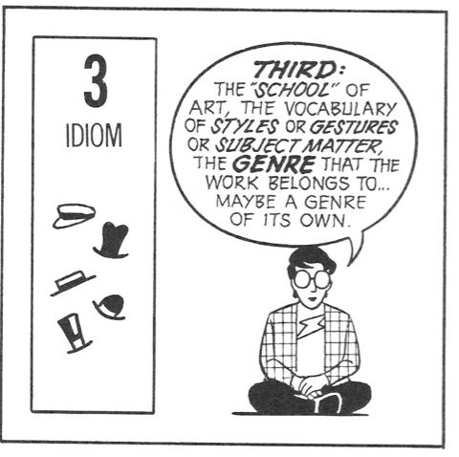
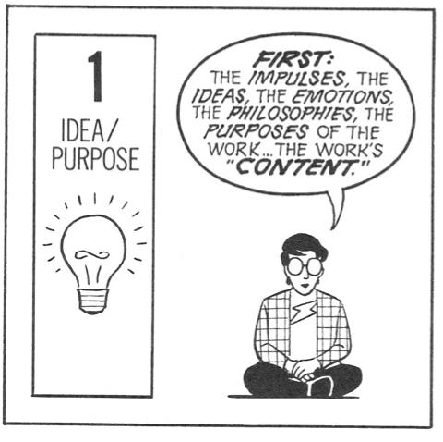
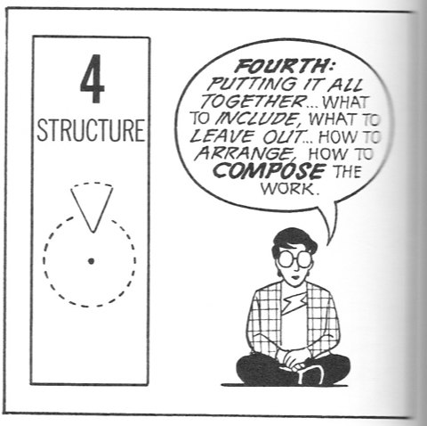
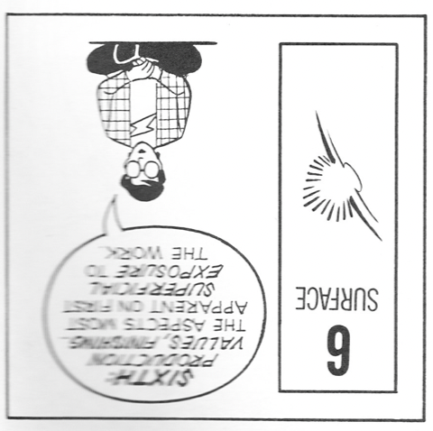
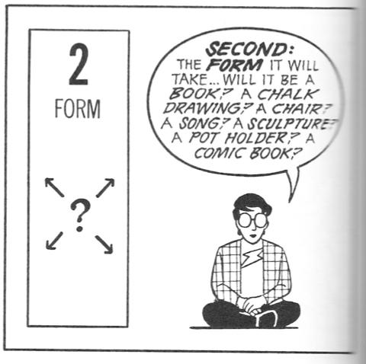
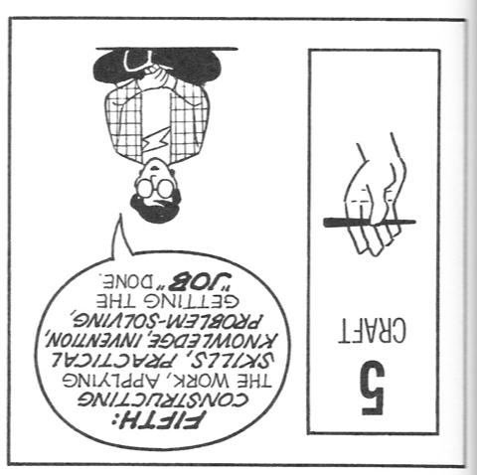
The Creative Process as it Applies to Development
Sophia McKeever
Art in Code and Quality
Notes:
Idea/Purpose: Upon being assigned a task you begin to react to impulses and ideas on how to do the work. The task you receive or app you imagine may defines the context of your work and then you apply your knowledge to generate ideas for the solution.
Form: You decide the form the task or app will take. Maybe it’s a command line app, maybe a Lambda in AWS, maybe a service or a script, or perhaps a mobile app.
Idiom: In this case, idiom defines a lot about the process of writing the code. What programming language to use, the coding paradigms you align to, how are you going to unit test it?
Structure: Putting the coding project together, creating the directory structure, defining the namespaces, perhaps adding your tests if you subscribe to Test Driven Development (TDD).
Craft: Writing the code. Applying your knowledge and skills to solve the problem and bring the code to life.
Surface: Building and running the code. Handing off to your test team for validation, building test automation against it. Delivering the solution to your customers or stakeholders.

Slide 9
Emotions and Their Effect on the Creative Process
“The aim of art is to represent not the outward appearance of things, but their inward significance.”
― Aristotle
Sophia McKeever
Art in Code and Quality
Notes:
Before we understand how

Slide 10
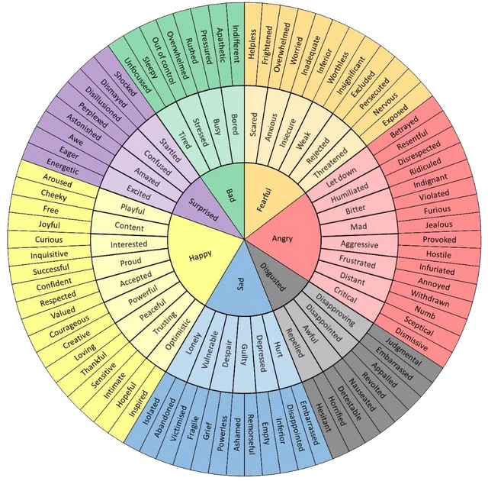
Defining Our Feelings and Emotions
Sophia McKeever
Art in Code and Quality

Slide 11
Sophia McKeever
Art in Code and Quality

Slide 12
Our Artist’s Model for Today
Meet The Poet
  They are an SDET who writes Python
  Volunteered to help identify when emotions affected their code
  Will remain anonymous and be referred to with They/Them pronouns
Meet Their Code
  Snippets specifically are unit tests for testing libraries and frameworks
  Some code snippets modified
    To protect identity
    Prevent leaks of confidential code or information
  Despite modifications - confirmed that the emotional effects remained
Sophia McKeever
Art in Code and Quality
Notes:
When used as a noun, Merriam Webster recognizes six different definitions.
“Art (noun) - Skill acquired by experience, study, or observation.”
Whether you are self-taught, taught through an educational institution, or learnt by watching or reading the work of others you have acquired a skill. That skill grants you the ability to make a computer do a specific set of tasks. Line by line you create an application, service, automated test and so on, drawing on that knowledge and your previous experiences to write that application. It takes knowledge of writing in your preferred programming language, knowledge of the ecosystem you’re building for, and knowledge of the type of program you’re building. You’ve gained that skill through a mix of either study or observation and through experience. You have acquired the art of writing code, however there is more nuance to this philosophy, so we need to now look at the next important definition of art.
--
“Art (noun) - The conscious use of skill and creative imagination especially in the production of aesthetic objects”
The first definition allows us to the define our work as art because it is an acquired skill while this second definition expands that concept by taking the concept of that skill and using it with creative imagination to produce aesthetic objects. Let’s break down the process of developing. Whether you are assigned a task or just wanting to build a new application on your own, you are starting with a blank canvas. Since the solution doesn’t exist, you begin to really think about how to build it, drawing on your skill and experience, engaging your imagination on how to build it. Of course, you’re using the principles of mathematics and logic to think through how the code of the application will work, however, in addition your imagination is powering the dream to bring that application to life and to bring it into the real world.

Slide 13
How Emotions Can Affect the Code You Build
Consider the following:
What do you notice about the code?
What problems can you see?
Most importantly – How does the code make you feel?
Sophia McKeever
Art in Code and Quality
Notes:
Before we understand how considering development and quality as art can better assist us with supporting our people, we need to muse on the philosophy of writing code as a creative process.

Slide 14
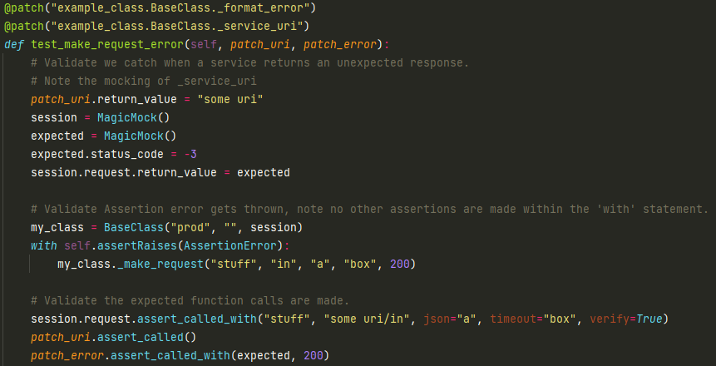
Sophia McKeever
Art in Code and Quality

Slide 15
A Sterile Base Line
Created with education intent
Clean, well organized
Descriptive naming
Comments
Logistical whitespace
No major flaws or issues
Invokes: Calm, collectedness, patience.
Sophia McKeever
Art in Code and Quality

Slide 16
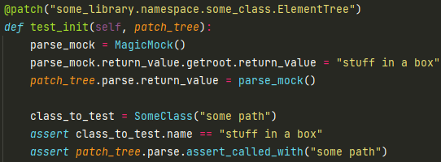
Sophia McKeever
Art in Code and Quality

Slide 17
Feeling Unfocused
Impossible assert the last line
Unnecessary instantiation
No documentation
Invokes: Boredom, apathy, indifference.
Sophia McKeever
Art in Code and Quality
Notes:
Resolve whatever is taking your focus.
Engage in simple mental exercises to free up your thought process.
Self-Care/Handle basic needs

Slide 18
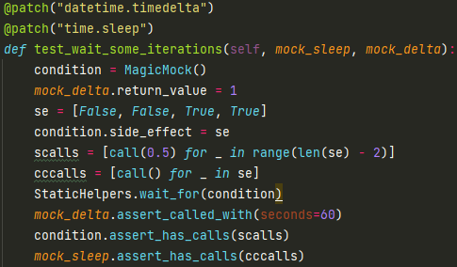
Sophia McKeever
Art in Code and Quality

Slide 19
Feeling Infuriated
No logistical white spacing
Unclear naming conventions
Incoherent code, impossible to understand
Invokes: Frantic Anxiety, Frustration.
Sophia McKeever
Art in Code and Quality
Notes:
Step away - let yourself calm down.
Engage in grounding exercises to restore calm, rational thinking.
Learn to let go of solutions that won't work or that need refactoring.
Reach out to friends or colleagues to vent your frustration.

Slide 20
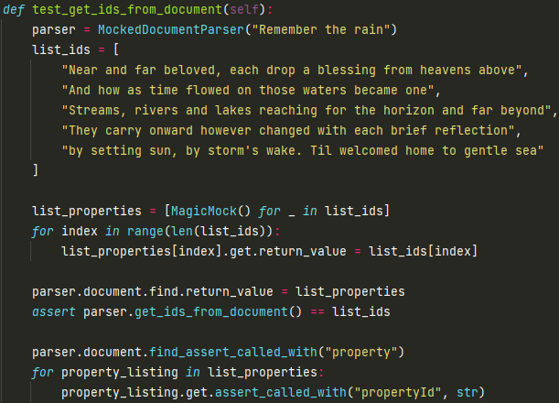
Sophia McKeever
Art in Code and Quality

Slide 21
Feeling Hopeful
Clean, well written code
Logistical whitespace
Song lyrics in code
  Maybe over did it on the IDs
Invokes: Joy, Hope, Inspiration.
Sophia McKeever
Art in Code and Quality
Notes:
Continue as you are. Shine on.

Slide 22
Summarizing The Emotional Effects
Emotion | Effects | Recommendations
Unfocused | Syntactical Errors Lapses in Critical Thinking Decline in Debugging Skills Lack of enthusiasm | Resolve whatever is taking your focus. Engage in simple mental exercises to free up your thought process. Self-Care/Handle basic needs
Infuriated | Lapses in critical thinking Difficult to understand or inappropriate variable names. Creation of difficult to read code. Compounding frustration when trying to "force it to work" | Step away - let yourself calm down. Engage in grounding exercises to restore calm, rational thinking. Learn to let go of solutions that won't work or that need refactoring. Reach out to friends or colleagues to vent your frustration.
Inspired | Playfulness in code or comments Fluidity in solutions Easier to read and parse code | Continue as you are. Shine on.
Sophia McKeever
Art in Code and Quality

Slide 23
Artistic Appreciation, Emotional Intelligence, and the Quality Mindset
“Art appreciation, like love, cannot be done by proxy: It is a very personal affair and is necessary to each individual.”
― Robert Henri
Sophia McKeever
Art in Code and Quality
Notes:
Before we understand how

Slide 24
Why This Matters?
The humanity and creative aspects of development are often overlooked.
There is a human, an artist behind every single line of code.
Humans express their emotions through creative outlets.
According to Forbes, top reasons developers leave jobs:
  Reason 4: “They feel creatively stifled”
  Reason 5: “They don’t feel recognized or appreciated”
  Reason 10: “They’ve lost passion for their work”
  Reason 11: “They feel like a cog in the machine”
Sophia McKeever
Art in Code and Quality
Notes:
Forbe’s Council Post: 13 Reasons Devs Leave Companies (And How To Turn Them Around), entry posted Sept 4th, 2020
Reason 4 translates to “My code is my art!”
Reason 5 translates to “I am not recognized for my creative work, my art is not appreciated.”
Reason 10 translates to “I cannot feel passion if others do not appreciate the creative I do”
Reason 11 translates to “Lack of appreciation in my art makes me feel like I don’t matter”

Slide 25
Quality Through The Lens of Art
We excel at find flaws, but this can alienate us from partners.
By acknowledging the humanity of their art we can help partners shine on.
By being educative instead of prescriptive we can tear down walls.
Opens the doors for mentorships, knowledge sharing, improved quality of work.
Sophia McKeever
Art in Code and Quality
Notes:
When the code you read invokes feelings, it connects you better to the person who wrote the code.
Additionally, you can begin to pick out patterns in their code, ways that communicate their feelings in the context of their work.
You can begin to identify when the person was feeling sad, frustrated, or any other host of emotions simply by reading the code and connecting with the human behind it.
This is an incredible opportunity to help build a relationship with that individual and reach out to check in on them.
The more you connect with the people on your team, the more it’ll foster integrity and respect within the team and partners that you work with.

Slide 26
How Does This Make a Difference?
Code reviews can transcend the mere functional analysis of code
Emotional intelligence can help build relationships with partner teams
Build those relationships through artistic appreciation can delight your customers
Increased awareness of your partners fosters integrity and respect
Appreciating creative of work from partner teams ensures dedication to quality
Artistic appreciation in a code review challenges the expected
Sophia McKeever
Art in Code and Quality
Notes:
When the code you read invokes feelings, it connects you better to the person who wrote the code.
Additionally, you can begin to pick out patterns in their code, ways that communicate their feelings in the context of their work.
You can begin to identify when the person was feeling sad, frustrated, or any other host of emotions simply by reading the code and connecting with the human behind it.
This is an incredible opportunity to help build a relationship with that individual and reach out to check in on them.
The more you connect with the people on your team, the more it’ll foster integrity and respect within the team and partners that you work with.

Slide 27

code
Sophia McKeever
Art in Code and Quality
Notes:
# TODO: Make the picture nicer
Code. What do you think of when you see or hear this word?
I hope now you have a new synonym for it: art.
Whether as a quality engineer or a software engineer, our artistic ability grants us an ability no other artist has. The ability to bring life to the inanimate. The ability to conjure something from nothing as we paint across the canvas of a code sheet. Our art sets alight the fire of creation within lifeless circuits and pixels. An art that is so profound that not only does it influence the way that human and machine interact together bit it inspires the very fabric of our universe to come alive and dance in harmony. Our poetry inspires electrons to flow from atom to atom as bits and bytes flowing along traces within the computer and help it understand, calculate, store and recall data. A beauty that transcends its mathematical and scientific roots, piercing right into the heart of the humanities. As computer programmers that is the power we wield.
As we are artists, it is our duty to see the beauty and humanity in our partners’ work. We should take an opportunity to realize that even though we might think we have “the right answers” when we’re developing our code or giving feedback on other’s code, that others developing code are artists as well. The way they write their code may be influenced by the emotions they feel at the time, and we should be conscious of those emotions and how they define them as a person. By changing the perspective on how we think about code, realizing the artistic nature of code, we can reframe how we give feedback and nurture the relationships between us and our peers and partners. In nurturing those relationships and approaching our feedback from the lens of artistic appreciation, we can begin to foster a new level of integrity and respect in those we work with which will ultimately help improve the acceptance of our qualitative feedback.

Slide 28
Citations
Merriam-Webster.com Dictionary. n.d. art. Accessed June 1st, 2023. https://www.merriam-webster.com/dictionary/art
McCloud, Scott. 1993. Understanding Comics: The Invisible Art. New York: Kitchen Sink Press.
Roberts, Geoffrey. 2015. Emotions Wheel, Imgur, entry posted March 15th, 2015, https://imgur.com/a/CkxQC (accessed June 1st, 2023).
Forbe’s Council Post: 13 Reasons Devs Leave Companies (And How To Turn Them Around), entry posted Sept 4th, 2020 https://www.forbes.com/sites/forbestechcouncil/2020/09/04/13-reasons-devs-leave-companies-and-how-to-turn-them-around/ (access September 19th, 2023)
Sophia McKeever
Art in Code and Quality

Slide 29
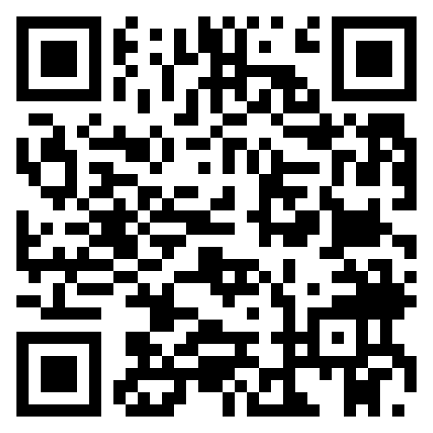
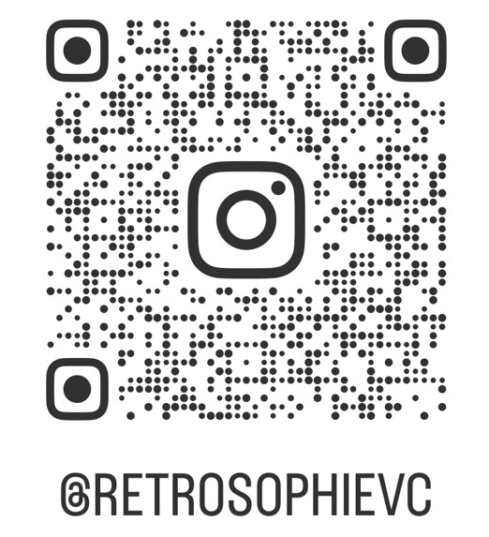
Meet the Artist
Sophia McKeever (She/Her)
10+ years as an SDET
Employers Include:
  The Pokémon Company International
  Apple Inc.
  Microsoft Azure
  DataSphere Technologies Inc.
Artist
Vintage Computing Enthusiast
Autistic
LinkedIn
Instagram
Sophia McKeever
Art in Code and Quality

Slide 30
THANK YOU
Sophia McKeever
Art in Code and Quality

