Slide 1
Quality Engineering Considered As A Helix of Semi-precious Quadrants -Vivek Mathur

Slide 2
Topics/ Flow
Software Development and growing simplicity & complexity
Application Deployment and its impact
Accountability shifts

Slide 3
Requirements elicitation and documentation
Should Not Should
Happy Path in detail
Most Positive flows
Known Exception handling
Regulatory requirements
Foreseeable exceptions
Past defects/ known gaps

Slide 4
Code, as delivered
Should Not Should
4: Missed Coding
1: Good Coding
Does not Does
3: Opportunistic Coding
2: Lax Coding

Slide 5
Business Logic, Intended and Implemented
Should Not Should
Functional Defects
As per Requirements
Functional Defects
As per Design
Does Not Do Does
Some Prevented Defects
Security Vulnerabilities, Non-Functional Defects

Slide 6
How did we get here?
Increasing:
Data, Compute Power, User Base, App Centrality
What is “Testing”?
Clever Spaghetti Code
Few Centralized Users
V & V – MECE cases
Structured flowing code
Monolithic
Centralized Users
Automation Frameworks
MBT
Web & Native Apps
Centralized Users
Scrum Roles
Pairing up
Agile Development Pods
MVP/ Frequent Releases
Distributed Userbase
Shift Left & Right
Experiential coverage
Continuous Deployment
Constant Upgrades

Slide 7
In the Brave New World
Should Not Do Should Do
Functional Defects
As per requirements
Does Not Do Does
Some Prevented Defects
Security Vulnerabilities, Non- Functional Defects

Slide 8
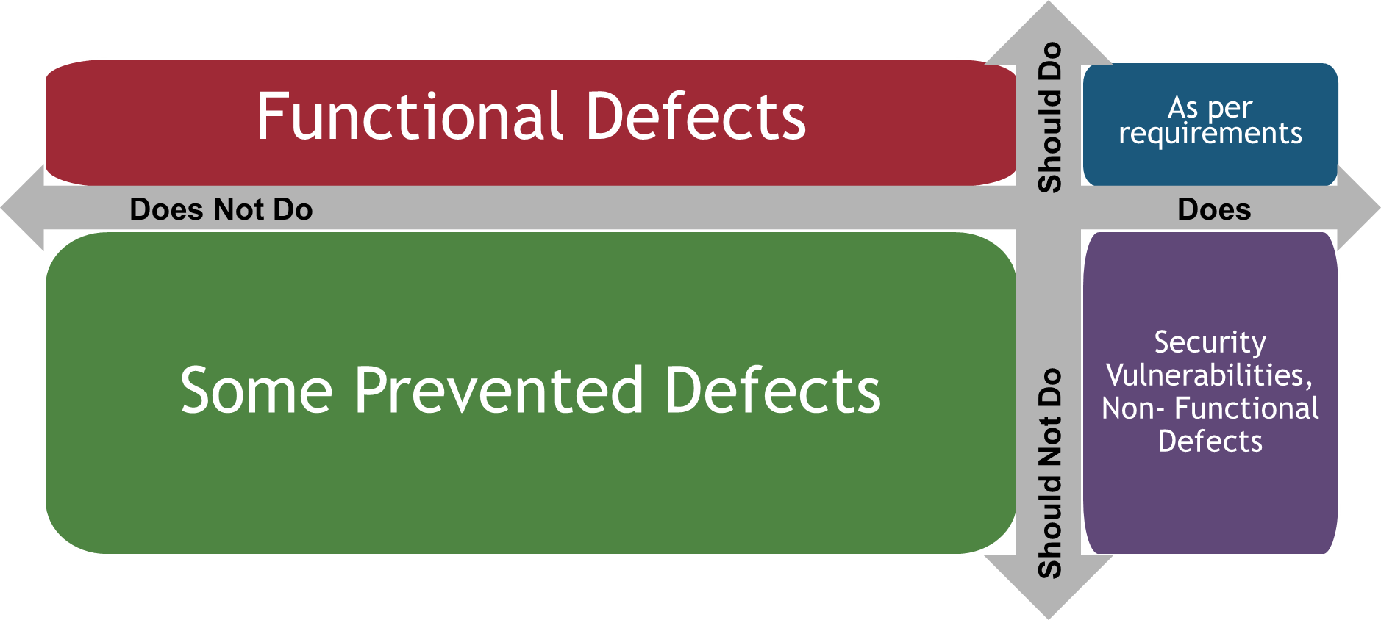
Zoom Out …
Negative
Testing
Control
“Flow”
Modular
Code
Device
Connectivity
Defect
Compounding
Application
Deployment Environments
Geo-Location
Enhanced
Risk Surface
Data Volume
Notes:
Modular Code could be open sourced
Event based applications, means that the control could jump anywhere. Retaining context and scope of parameters is a challenge
Corner cases for defects abound
Implementation environment changes constantly

Slide 9
Evolution in Relationships
"Time Considered as a Helix of Semi-Precious Stones" is a science fiction short story by American writer Samuel R. Delany, published in the December 1968 issue of New Worlds. It won the Hugo Award for Best Short Story 1970, and the Nebula Award for Best Novelette in 1969
“Later HCE finds Arty the Hawk on his doorstep. Arty explains that he sought him out because their relationship was about to undergo a change. HCE is puzzled, but eventually realizes that Arty and he are about to become rivals. Arty will try to buy him out, then to kill him, because that is the way the world works. If he survives and prospers, he and Arty will eventually become friends because there will be more profit in cooperating than in competing. He tells Arty this, and Arty wholeheartedly agrees. He responds that HCE is starting to think holographically, just like Maud and Special Services. He departs, leaving HCE to contemplate his future.” - wikipedia
The story of Coding and Testing has a similar intertwining, connection, and evolution

Slide 10
So?
Where is the Helix?
Back to Mr. Delany:
Necessity creates the spawn
Nature abhors a vacuum
Emergent Evolution hides the origins
Govern code, validate functionality

Slide 11
Where Next?
Supply Chain/ ecosystem – Outsourced components
Constant upgrade churn – OSes/ Browsers/ Dev Frameworks
“My Name is Vuca”
“Would you like some more PII?”
Built to sell
Edge Computing
Gen AI & its impact on the work that we do.
Evolution follows
“First they ignore you”
“Then they laugh at you”
“Then they fight you”
“Then you win” – attributed to MK Gandhi

Slide 12
References
“Time Considered as a Helix of Semi-Precious stones”
Mahatma Gandhi quotes
Suzanne Vega

