Slide 1
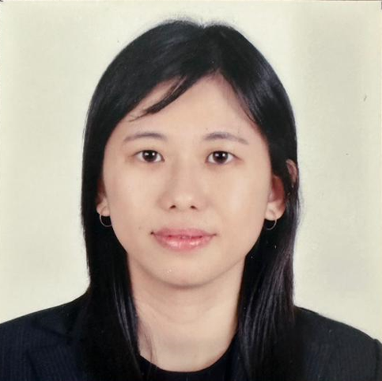
SPEAKER
Ooi, Mei Chen
AI Software Bugs Segregation System DSF

Slide 2
Speaker : Ooi, Mei Chen
12 years+ in software engineering and has held many roles spanning code development, design and project management.
Currently serves as a senior System Software Quality Engineer at Intel Corporation based in Penang, Malaysia.
Holds a Degree in Computer Science from University Tunku Abdul Rahman, Malaysia.
Co-author : Liu, Keping
SPEAKER : Ooi, Mei Chen
Topic : AI Software Bugs Segregation System DSF

Slide 3
Terms Used
DSF - Data-Search-Fix
POC - Proof of Concept
RCA - Root Cause Analysis
SPEAKER : Ooi, Mei Chen
Topic : AI Software Bugs Segregation System DSF

Slide 4
Agenda
What is the problem?
Why is this difficult?
What is Data-Search-Fix (DSF)?
Learning and challenges
Key takeaways
SPEAKER : Ooi, Mei Chen
Topic : AI Software Bugs Segregation System DSF

Slide 5
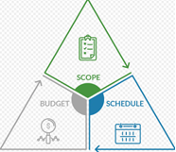
What is the problem? (General)
Fixing bugs is incredibly costly and time consuming
Unpredictable outcome or inconsistent behavior on a critical software
Need to ensure the debugging work is quick and manageable
SPEAKER : Ooi, Mei Chen
Topic : AI Software Bugs Segregation System DSF

Slide 6
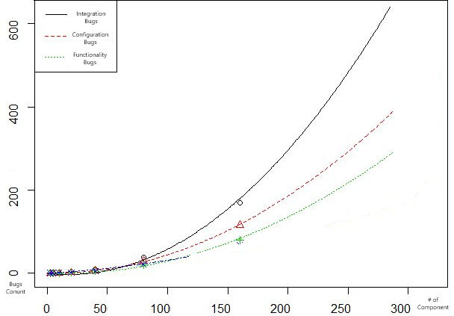
What is the problem? (Complex Software)
A complex software solution usually consists of multiple sub-components or combinations of multiple software solutions
The more software sub-components integrated; the higher possibility bugs will occur
Most of the time, it is difficult to identify which sub-component that broke the end-to-end functionality
SPEAKER : Ooi, Mei Chen
Topic : AI Software Bugs Segregation System DSF

Slide 7
Why is this difficult? (Complex Software)
Consists of multiple sub-components and hard to identify which component caused the problem
Sub-components passed the component level unit test but failed in the end-to-end integration test
Complex dependency between sub-components
SPEAKER : Ooi, Mei Chen
Topic : AI Software Bugs Segregation System DSF

Slide 8
Why is this difficult? (cont.)
Multiple check-in requests submitted at the same time or within a short duration
Sub-component development team does not have the end-to-end knowledge to debug the issue
Lack of clear software architecture design with module coupling and decoupling and an incremental build system
SPEAKER : Ooi, Mei Chen
Topic : AI Software Bugs Segregation System DSF

Slide 9
What is Data-Search-Fix (DSF)?
Incremental Build/Integration System
Data
Search
Fix
Bugs Tracking system
The Data-Search-Fix (DSF) is an AI software bugs segregation concept that arranges, searches and analyze the historical data then recommend a solution to narrow down the debugging scope and reduce the debugging cost
SPEAKER : Ooi, Mei Chen
Topic : AI Software Bugs Segregation System DSF

Slide 10
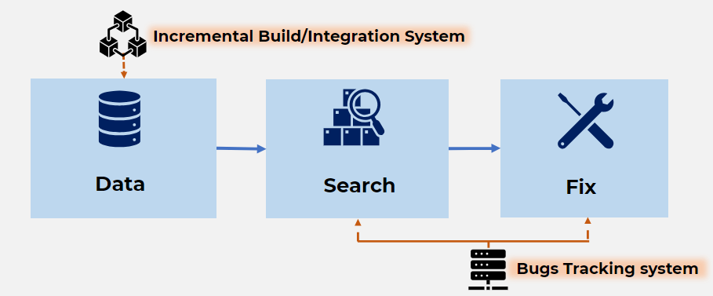
Data
Collecting high quality data base on integrated software behaviors is the foundation of building effective data searching and analysis
The “Data Collection” block of the DSF determines what types of data need to be collected and use for Search and Fix recommendation. Below are the recommended data that can be used for analysis and segregation.
Data
Storing & Sorting
SPEAKER : Ooi, Mei Chen
Topic : AI Software Bugs Segregation System DSF

Slide 11
Data (cont.)
Data for "Search"
How many sub-components or solutions have been integrated into the software
Which sub-components have more code change or new functionality
Data
Storing & Sorting
Clear software architecture design, incremental build sequence and dependency of each of the sub-components
Group the component that have the strong dependency
SPEAKER : Ooi, Mei Chen
Topic : AI Software Bugs Segregation System DSF

Slide 12
Data (cont.)
Data for “Fix Recommendation"
Historical data “issue log” “debugging log” and “bugs description” and other bugs information captured in bugs tracking system
Data
Storing & Sorting
RCA data “root cause,” “injection phase”, “found phase”, “what was wrong” and other RCA (Root Cause Analysis) captured in bugs tracking system
SPEAKER : Ooi, Mei Chen
Topic : AI Software Bugs Segregation System DSF

Slide 13
Search
There are many search algorithms that can be used for bug segregation in DFS, such as binary search, linear search, interval search, interpolation search etc.
Considering the data structure being searched and prior knowledge about the data, DSF decided to use the binary recursive search algorithm to narrow down the sub-components that have the failure test case.
Search &
Narrow Down
SPEAKER : Ooi, Mei Chen
Topic : AI Software Bugs Segregation System DSF

Slide 14
Search (cont.)
Arrange and find the Mid
Search &
Narrow Down
Pinpoint the bug via integration test
SPEAKER : Ooi, Mei Chen
Topic : AI Software Bugs Segregation System DSF

Slide 15
Search (cont.)
Move to the next half component if no bugs detected
Search &
Narrow Down
Identify N most possibly went-wrong sub-component
SPEAKER : Ooi, Mei Chen
Topic : AI Software Bugs Segregation System DSF

Slide 16
Fix Recommendation
To construct the accurate fixing or debugging direction, analysis and filtering needs to be done before the recommendation can be made.
Continuing with the example above, DSF will use the decision tree machine learning algorithm to further process based on historical data like “similar keyword,” “root cause,” and “injection phase.”
Recommend
& Fix
SPEAKER : Ooi, Mei Chen
Topic : AI Software Bugs Segregation System DSF

Slide 17
Fix Recommendation (cont.)
Check if the bug happened before
Recommend
& Fix
Check if there was any similar keyword
SPEAKER : Ooi, Mei Chen
Topic : AI Software Bugs Segregation System DSF

Slide 18
Fix Recommendation (cont.)
Check if there was any similar keyword
Recommend
& Fix
Check the sub-component injection phase
SPEAKER : Ooi, Mei Chen
Topic : AI Software Bugs Segregation System DSF

Slide 19
Learning and Challenges
Learning and solving challenges are the continuous effort to improve the maturity of a system
Some key elements that need to be considered to make DSF successful:
Easier coupling and decoupling
Standardized issue description
Scalable and flexible criteria
Sufficient training data
SPEAKER : Ooi, Mei Chen
Topic : AI Software Bugs Segregation System DSF

Slide 20
Key takeaways
DSF software bugs segregation system detail end-to-end flow with a deep dive example
From the data that need to be collected and arranged. Then analyze the data by using one of the algorithms, binary search. And finally report the fixes recommendations with decision tree machine learning algorithm
DSF software bugs segregation system goal is to improve the productivity by narrow down the debugging scope and lead to quick turnaround time for bugs fixing
Lastly but not least, the learning and challenges has been captured for future improvement
SPEAKER : Ooi, Mei Chen
Topic : AI Software Bugs Segregation System DSF

Slide 21
Author:
Ooi, Mei Chen
Co-Author :
Liu, Keping
THANK YOU
SPEAKER Ooi Mei Chen
AI Software Bugs Segregation System DSF

