Slide 1
DevOps
Test Automation

Slide 2
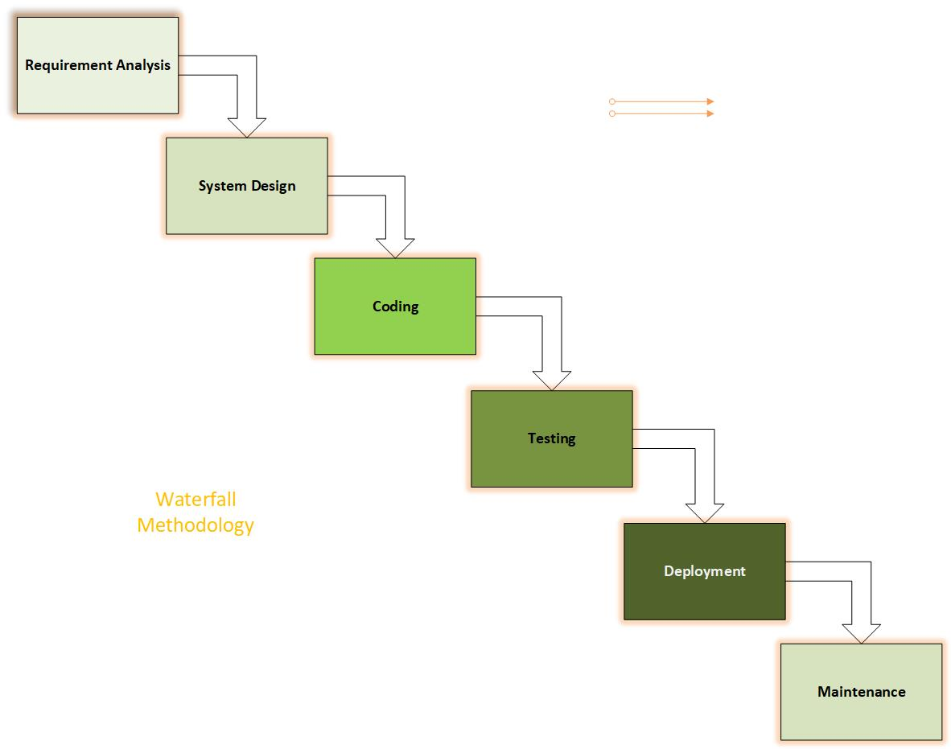
Waterfall Development Method

Slide 3
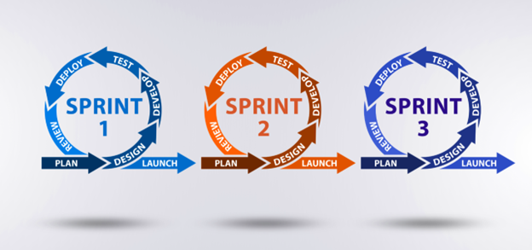
Agile Development Method
Source: Krusche & Company

Slide 4
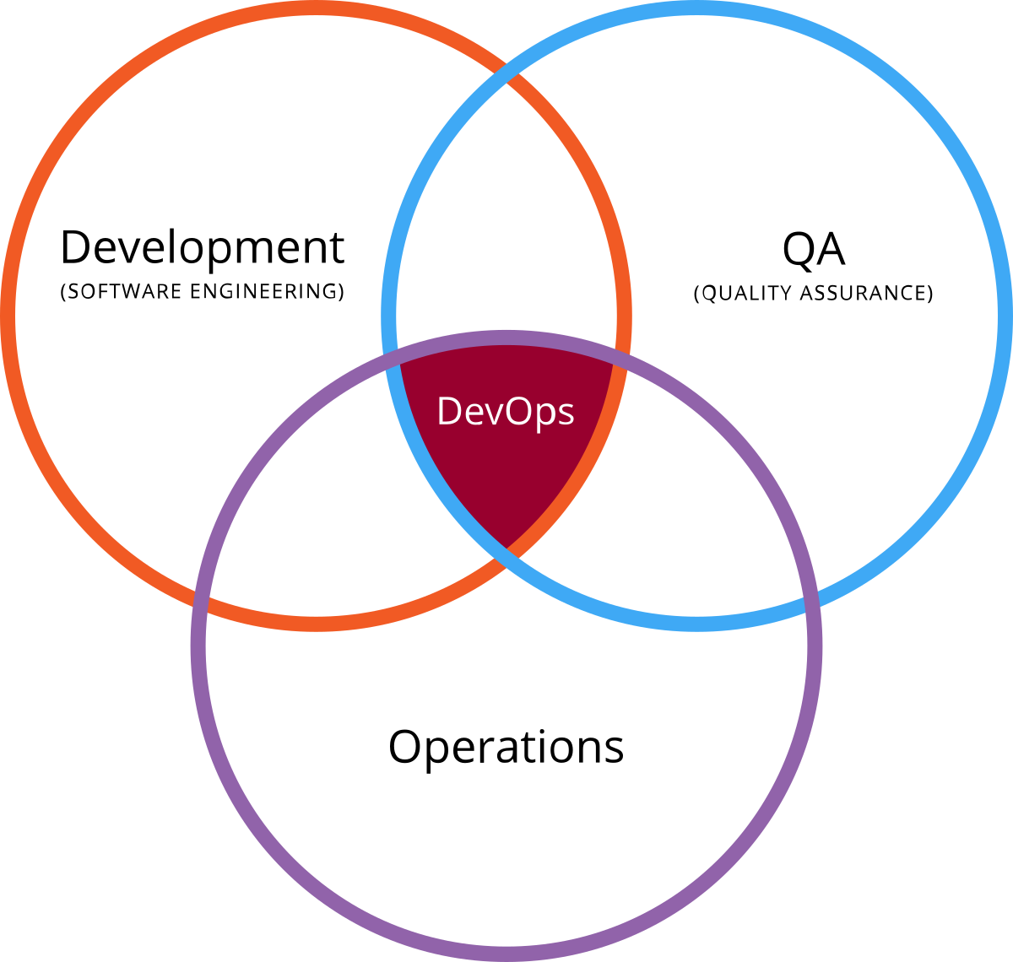
The Need for DevOps
The conflict of Dev and Ops gives rise to DevOps
Source: Smartsheet

Slide 5
DevOps Goals
More frequent deployment
Shorter lead time for a new release
Significant improvement in product quality
Automation in repetitive tasks

Slide 6
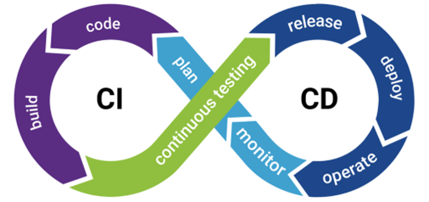
DevOps Tool – CI/CD Pipeline
Source: Synopsys

Slide 7
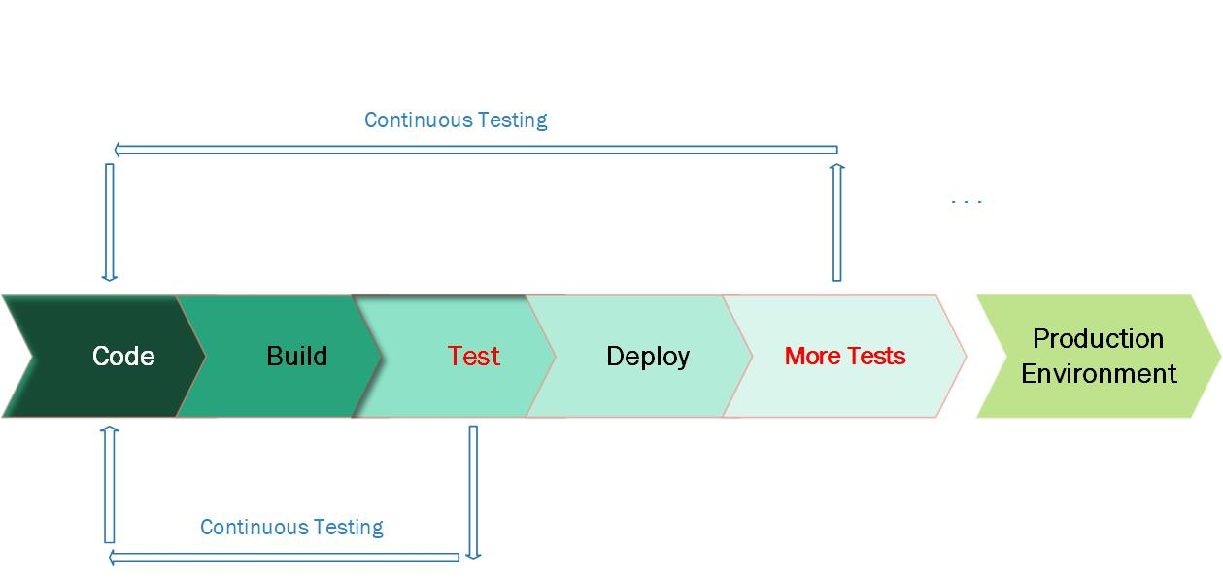
Continuous Testing
-- Agile’s approach to testing

Slide 8
The Benefit of Continuous Testing
Expose defects early
Be able to improve the test process
Immediate feedback

Slide 9
z
Example Test Integration
-- Supra Organization, Carrier
Types of Tests to be automated
Unit Test
Integration Test
Functional Test (API)
Regression Test (UI/Selenium)
Acceptance Test

Slide 10
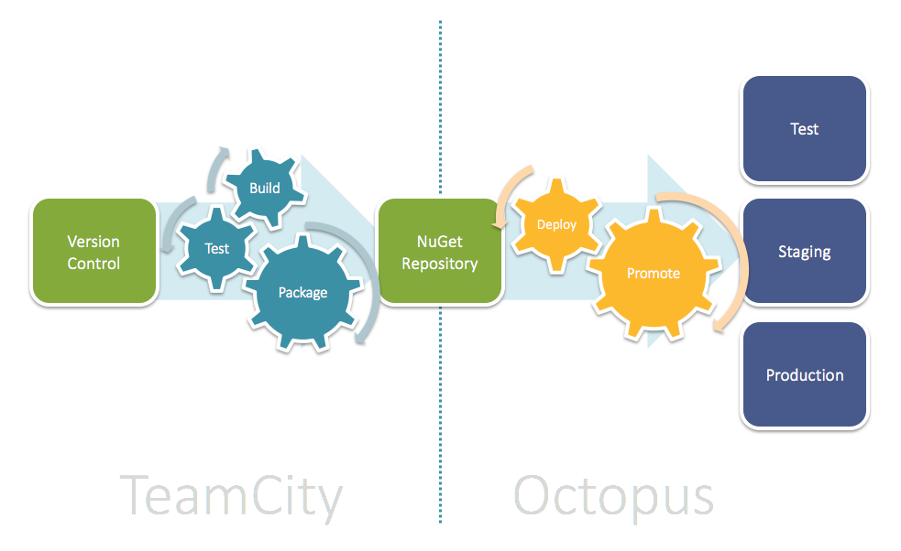
CI/CD Pipeline Example
z
Source: Jetbrains

Slide 11
Integration Test Automation
On Premise Deployment
Integration Test
Cloud Deployment
WebJobs
Parameter passing
Test Report Download
Sychronization with WebJobs

Slide 12
Parameter passing
Deploy code
Deploy WebJobs
Teamcity
Octopus
Deploy
Azure
Test Report
Integration Test in Azure

Slide 13
z
Functional Test Integration
CI Tool Plugin
Plugin script modification
Test invocation from the CD Tool
Test Report Upload

Slide 14
Test Invocation
ReadyApi
Teamcity
Octopus Deploy
Test Report
ReadyApi Test Integration

Slide 15
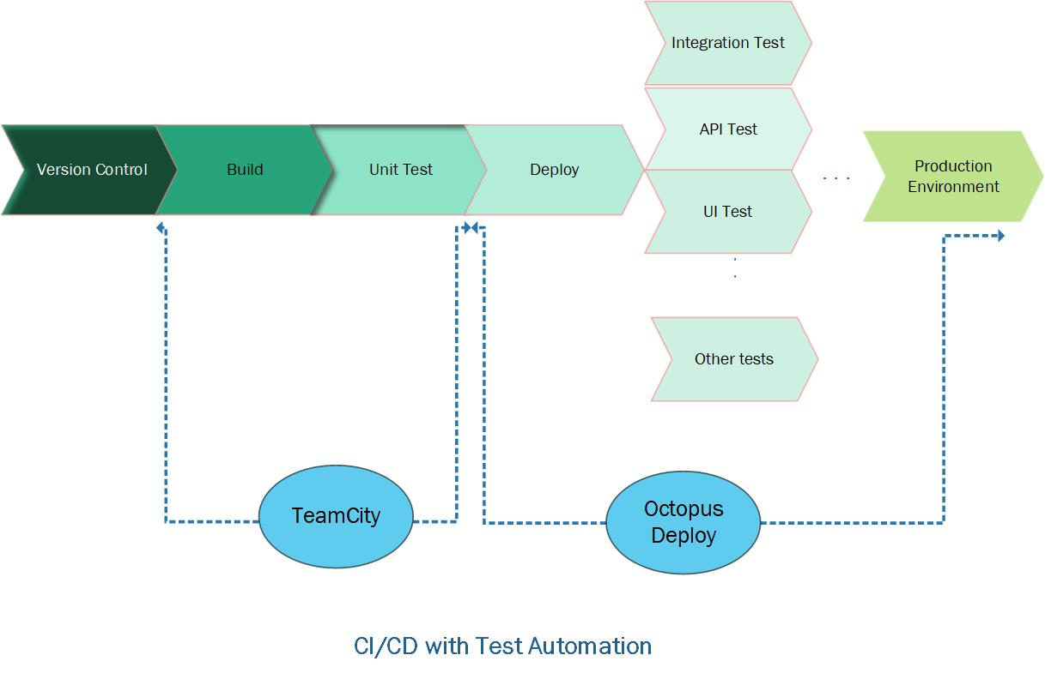
CI/CD with Test Automation

Slide 16
z
Question?

