Slide 1


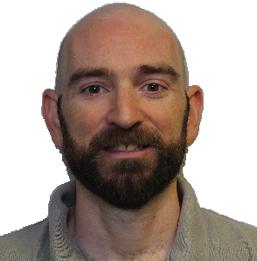
Brent
Clausner
Software Continuous Integration with Hardware

Slide 2

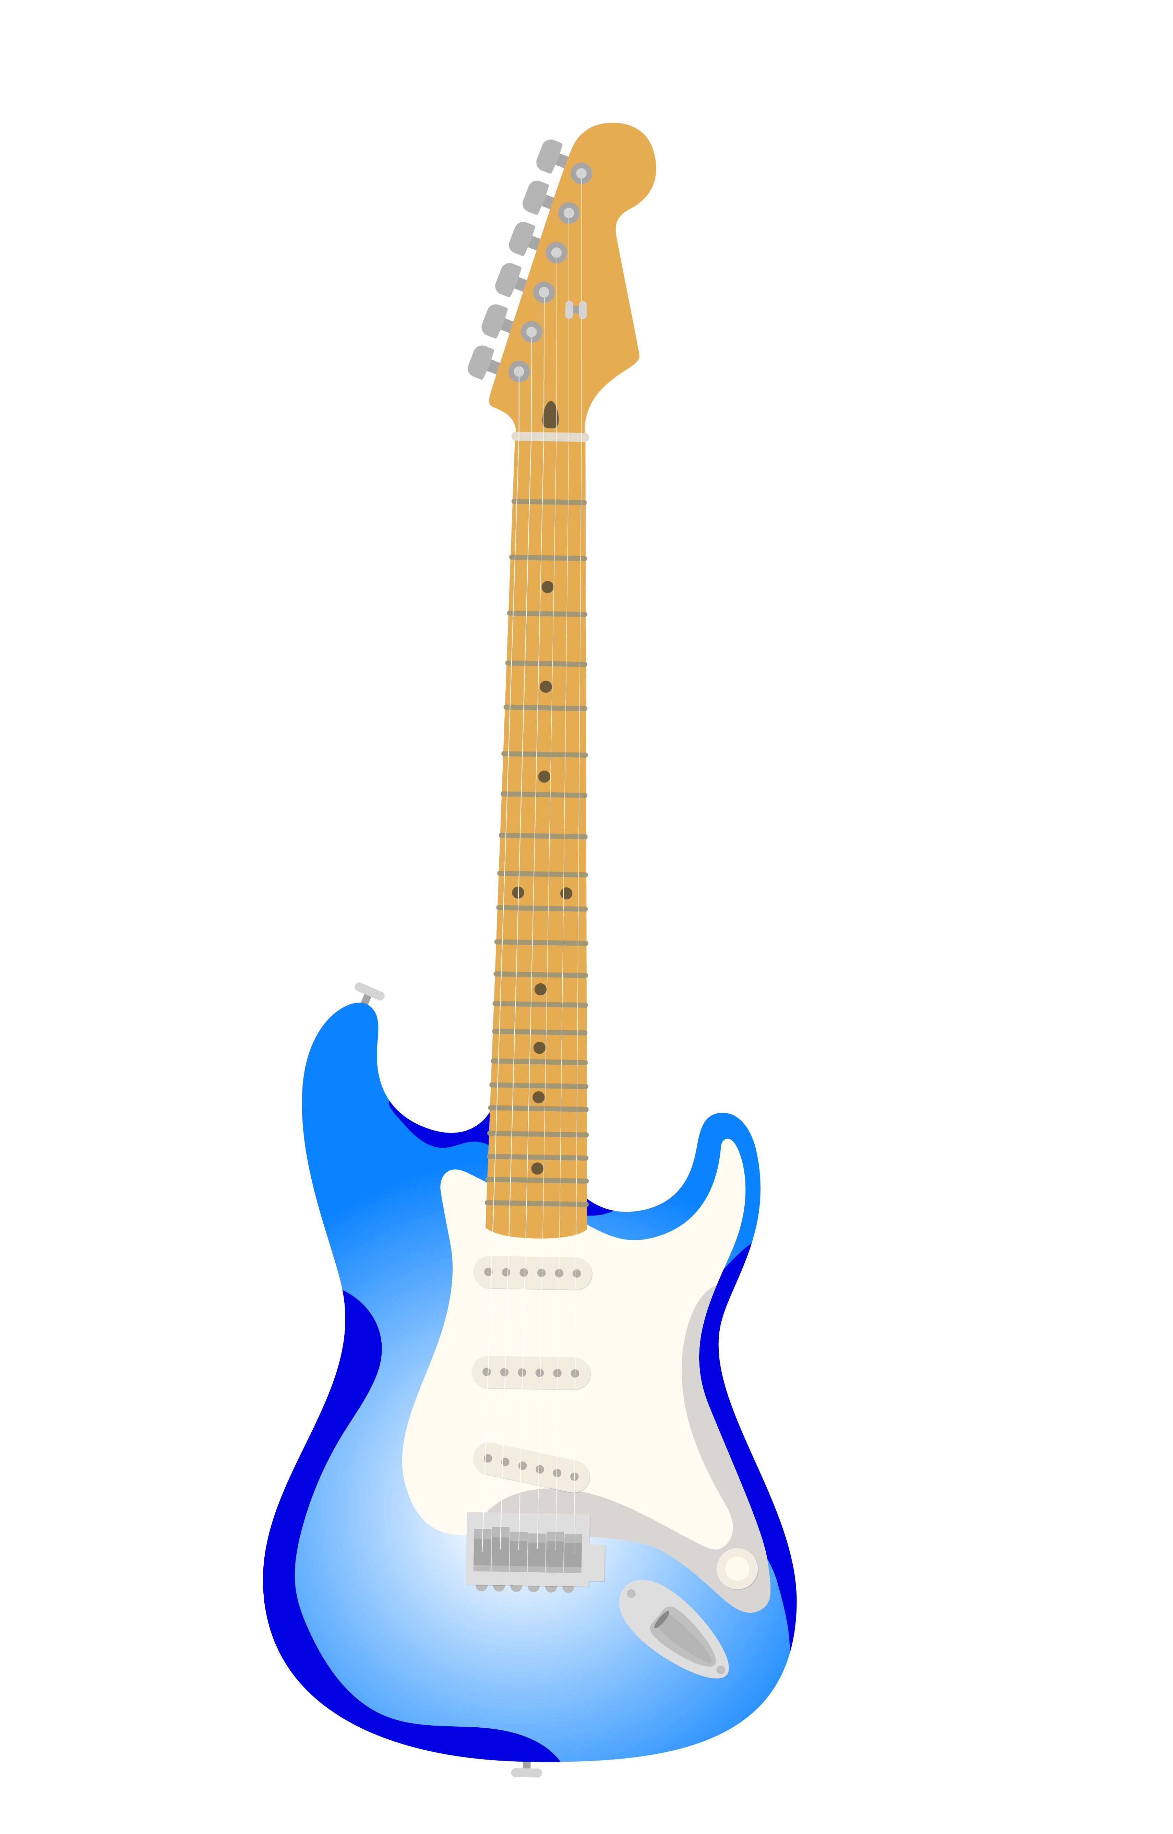


Copyright 2023 Carnegie Mellon University.
This material is based upon work funded and supported by the Department of Defense under Contract No. FA8702-15-D-0002 with Carnegie Mellon University for the operation of the Software Engineering Institute, a federally funded research and development center.
The view, opinions, and/or findings contained in this material are those of the author(s) and should not be construed as an official Government position, policy, or decision, unless designated by other documentation.
NO WARRANTY. THIS CARNEGIE MELLON UNIVERSITY AND SOFTWARE ENGINEERING INSTITUTE MATERIAL IS FURNISHED ON AN "AS-IS" BASIS. CARNEGIE MELLON UNIVERSITY MAKES NO WARRANTIES OF ANY KIND, EITHER EXPRESSED OR IMPLIED, AS TO ANY MATTER INCLUDING, BUT NOT LIMITED TO, WARRANTY OF FITNESS FOR PURPOSE OR MERCHANTABILITY, EXCLUSIVITY, OR RESULTS OBTAINED FROM USE OF THE MATERIAL. CARNEGIE MELLON UNIVERSITY DOES NOT MAKE ANY WARRANTY OF ANY KIND WITH RESPECT TO FREEDOM FROM PATENT, TRADEMARK, OR COPYRIGHT INFRINGEMENT.
[DISTRIBUTION STATEMENT A] This material has been approved for public release and unlimited distribution. Please see Copyright notice for non-US Government use and distribution.
This material may be reproduced in its entirety, without modification, and freely distributed in written or electronic form without requesting formal permission. Permission is required for any other use. Requests for permission should be directed to the Software Engineering Institute at permission@sei.cmu.edu.
Carnegie Mellon® is registered in the U.S. Patent and Trademark Office by Carnegie Mellon University.
DM23-0885
Brent Clausner
[Distribution Statement A] Approved for public release and unlimited distribution.
Software Continuous Integration with Hardware

Slide 3
Hello
Who I am
Introduction
DevOps Current Practices
Software for Hardware
Emulation
Code Branches
Drawbacks
Wrap up
Brent Clausner
[Distribution Statement A] Approved for public release and unlimited distribution.
Software Continuous Integration with Hardware

Slide 4


Myself
Education
  PTI
  Point Park University
Work
  DevOps Engineer
Hobbies
  Video Games
  Jogging
  Technology
Brent Clausner
Software Continuous Integration with Hardware
[Distribution Statement A] Approved for public release and unlimited distribution.

Slide 5
Introduction
Testing is important
  Regular basis
  Every code submission
Hardware
  Equipment Costs
  Contention for use
  Downtime for hardware refresh
Functional Dependencies
  Test all areas
  Use all current changes
Brent Clausner
Software Continuous Integration with Hardware
[Distribution Statement A] Approved for public release and unlimited distribution.

Slide 6
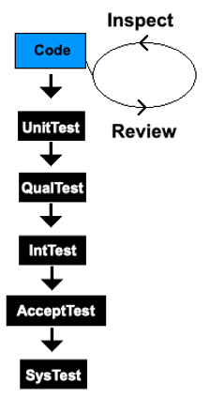
Current DevOps
Develop Code
  Build
  Pipeline for Static Analysis
Inspect/Review
Test
  Unit Testing
    Language based frameworks
  Integration Testing
  System Testing
Brent Clausner
Software Continuous Integration with Hardware
[Distribution Statement A] Approved for public release and unlimited distribution.
Notes:
REST Api example for work, necessary but not…
First step is building
Unit test during build
Quality testing normally by another team
Integration testing with other functional areas

Slide 7
Current DevOps Cont’d
Architecture(s)
  x86_64 or arm64 (Examples)
  Cross platform builds
  Parallel building
Functional Areas
  Most features touch several areas
Example
  REST API
    Authentication (Every endpoint)
    Database update
    Bring service up
    Responses
Brent Clausner
Software Continuous Integration with Hardware
[Distribution Statement A] Approved for public release and unlimited distribution.

Slide 8
Software for Hardware
Connecting
  rconsole
Loading Image onto the Hardware
Timing
  Initialization Time
  Asynchronous Commands
Capturing output
Errors
  Console only errors
Hardware inside pipeline
Brent Clausner
Software Continuous Integration with Hardware
[Distribution Statement A] Approved for public release and unlimited distribution.

Slide 9
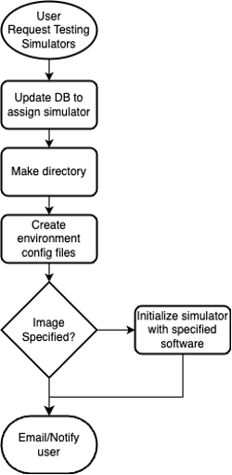
Emulation
Cost savings
  Hardware
  Time savings
  Team sharing
Scale
Sample Testbed Creation
Templates
  Benefit multiple teams
  Expand to test suites
  Changes benefit all suites
  Test in parallel threads
Brent Clausner
Software Continuous Integration with Hardware
[Distribution Statement A] Approved for public release and unlimited distribution.

Slide 10
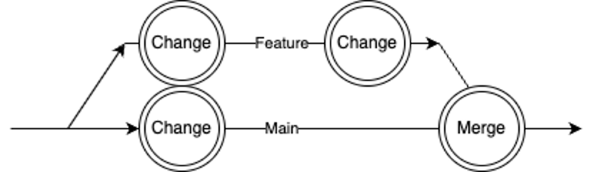
Code Branches
Single Main
  Simple
  Easy of use
  Most small projects
  Backing out changes
  Merges
  Testing on each submission
  Sync from main
Requires tagged version branches
  Long term support
Brent Clausner
Software Continuous Integration with Hardware
[Distribution Statement A] Approved for public release and unlimited distribution.
Notes:
REST Api example for work, necessary but not…
First step is building
Unit test during build
Quality testing normally by another team
Integration testing with other functional areas

Slide 11
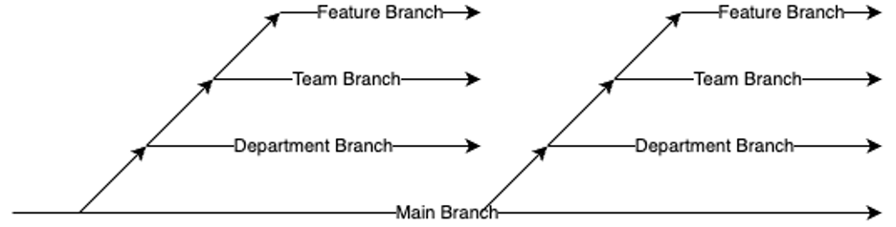
Code Branches Cont’d
Complex branching
  More teams more problems
  Slow to merge up
  Cherry picking changes
  Problem changes impact
  Testing takes longer
More teams
Testing every Change
  Large workload for concurrent changes
  Sequential Queue
Brent Clausner
Software Continuous Integration with Hardware
[Distribution Statement A] Approved for public release and unlimited distribution.
Notes:
REST Api example for work, necessary but not…
First step is building
Unit test during build
Quality testing normally by another team
Integration testing with other functional areas

Slide 12
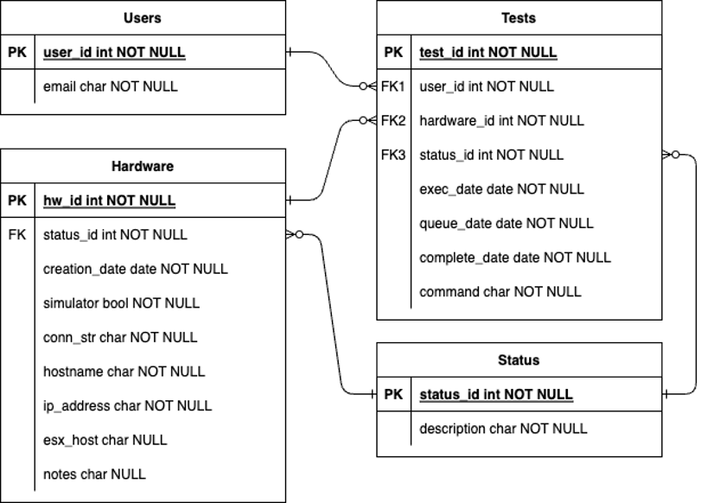
Code Branches Cont’d
Single main branch
  Smaller feature branches
Testing Periodically
  Time based cron
  Find bad changes via sorting algorithms
  Bulk good changes validated quicker
Handle large amounts of changes
Better picture of quality
Use Emulators for scaling testing
Sample DB Schema
Brent Clausner
Software Continuous Integration with Hardware
[Distribution Statement A] Approved for public release and unlimited distribution.
Notes:
REST Api example for work, necessary but not…
First step is building
Unit test during build
Quality testing normally by another team
Integration testing with other functional areas

Slide 13
Drawbacks
Delays
  Intermittent failures
  Infrastructure failures
  Multiple bad changes
    Prevent any changes during the find phase
Don’t wait to submit before vacation
Custom Infrastructure
  Team to support
  Time investment
Time to be approved
  Can be shortened as Developers learn the system
Brent Clausner
Software Continuous Integration with Hardware
[Distribution Statement A] Approved for public release and unlimited distribution.

Slide 14
Wrap up
Write tests for areas you care about
Reduce costs
  Emulators
  Test more frequently
Prevent bad changes quicker
Brent Clausner
Software Continuous Integration with Hardware
[Distribution Statement A] Approved for public release and unlimited distribution.

Slide 15
Questions?
???
Brent Clausner
Software Continuous Integration with Hardware
[Distribution Statement A] Approved for public release and unlimited distribution.

Slide 16
References
Tim Menzies, William Nichols, Forrest Shull, & Lucas Layman (Retrieved on 2023, May 29) Are delayed issues harder to resolve? Revisiting cost-to-fix of defects throughout the lifecycle. Retrieved from: https://link.springer.com/article/10.1007/s10664-016-9469-x
David Davis (Retrieved on 2023, May 30) What is VMware ESXi Server and Why do I Need It? Retrieved from: https://www.pluralsight.com/blog/it-ops/what-is-vmware-esx-server-and-why-you-need-it
Install GitLab Runner (Retrieved on 2023, May 30) Retrieved from: https://docs.gitlab.com/runner/install/index.html
Stable Diffusion web UI: https://github.com/AUTOMATIC1111/stable-diffusion-webui
Brent Clausner
Software Continuous Integration with Hardware
[Distribution Statement A] Approved for public release and unlimited distribution.

Slide 17
THANK YOU
Brent Clausner
Software Continuous Integration with Hardware
[Distribution Statement A] Approved for public release and unlimited distribution.

