Slide 1

Q: Intelligent Server Configuration Test Selection Tool
Virender Sharma, Vishnu Karrotu, Ramakanth K, Saheli Saha

Slide 2

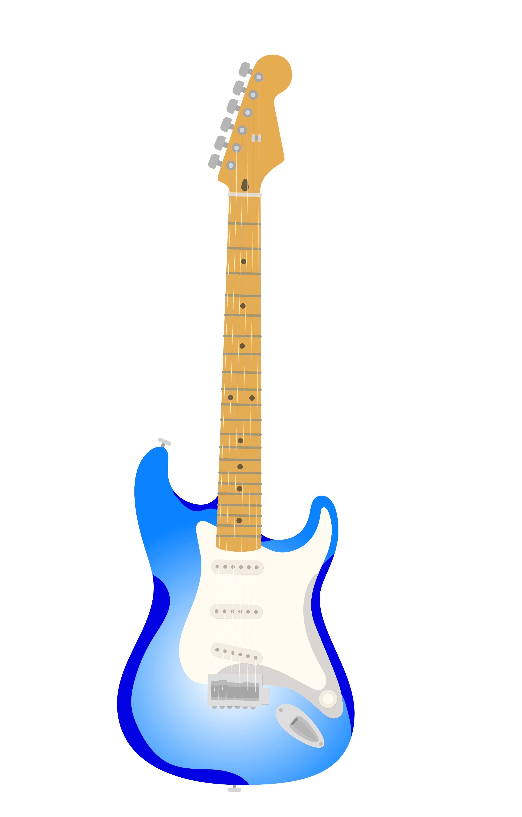


Intelligent Server Configuration Test Selection Tool
“Q” – The Smart Assistant for Server Validation
Server Validation Org: This team is responsible for all the server hardware and software testing that takes place prior to the launch of a New generation server series
What are the priority use cases where predictive analytics can a play a role in Server Validation?
What are our most under-utilized systems
What Test Cases have generated the most critical defects?
What is the release risk given the testing that’s been completed?
How many defects can we expect to find?
Virender Sharma, Vishnu Karrotu, Ramakanth K, Saheli Saha
Q: Intelligent Server Configuration Test Selection Tool

Slide 3











Intelligent Server Configuration Test Selection Tool
“Q” – The Smart Assistant for Server Validation
Q
How do we prioritize High Value SUT Configs?
Quickly predict “best-available” SUT configurations during planning and test execution
Ensure Optimal Configs Coverage
Prioritizes High-Value Configs
Objectives
Challenges
465 Trillion possible server configs!!!
Which are the High Value Configs?
How to ensure Optimal Configs Coverage?
Virender Sharma, Vishnu Karrotu, Ramakanth K, Saheli Saha
Q: Intelligent Server Configuration Test Selection Tool

Slide 4
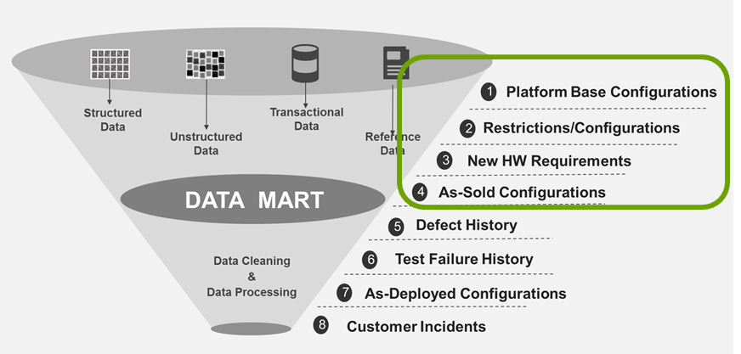
What data does Q use?
Virender Sharma, Vishnu Karrotu, Ramakanth K, Saheli Saha
Q: Intelligent Server Configuration Test Selection Tool

Slide 5
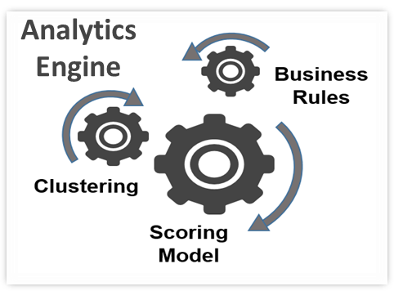
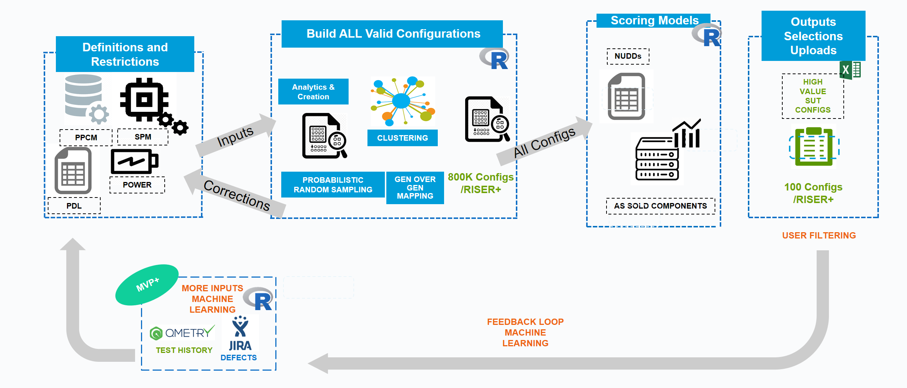

Q Process Flow
Step 1
Step 2
Step 3
Step 4
Virender Sharma, Vishnu Karrotu, Ramakanth K, Saheli Saha
Q: Intelligent Server Configuration Test Selection Tool

Slide 6



Detailed View of Clustering Algorithms
TECHNIQUE 1 : K-MEANS CLUSTERING USING SINGULAR VALUE DECOMPOSITION
111 terms reduced to 28 dimensions (retains 90% information)
~500K Configs/Rows
21 Commodities/Columns
1
DTM Matrix
111 Terms/Columns
2
100 clusters
Each config tagged to a cluster
3
25
Variance between groups – 70%
K-Means on Singular Value Decomposition
Kohenon SOM Neural Network based
Ensemble
Virender Sharma, Vishnu Karrotu, Ramakanth K, Saheli Saha
Q: Intelligent Server Configuration Test Selection Tool

Slide 7
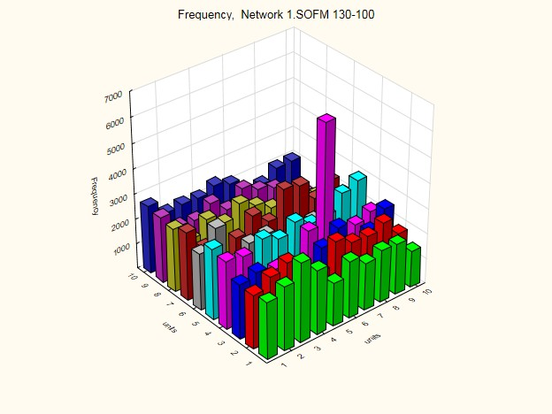
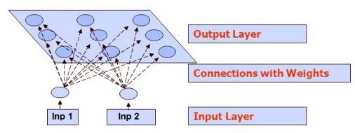

Detailed View of Clustering Algorithms
TECHNIQUE 2 : KOHONEN SOM CLUSTERING (NEURAL NETWORKS)
Neural Network Clustering Technique - Based on Competitive
Variance between groups – 60%
ENSEMBLE: Results from two techniques are combined to arrive at a total of 100 recommended configs from a list of 0.5 million configs
75 Common Configs from both methods– 1st Priority Recommendation
25
A total of 100(P1 & P2) unique Configs.
25 K-Means SVD Configs – 2nd Priority Recommendation
K-Means on Singular Value Decomposition
Kohenon SOM Neural Network based
Ensemble
Virender Sharma, Vishnu Karrotu, Ramakanth K, Saheli Saha
Q: Intelligent Server Configuration Test Selection Tool

Slide 8


Q Value
Value
  Risk Analysis and Cost Savings - Business insight. Priorities, scenarios, gaps, and reactions
  Avoiding Errors and Save Time - Quickly & thoroughly create all valid possible configurations
  Focus on Specific and New Views - Prioritize & highlight configurations given a growing and configurable set of dimensions
  One Size Doesn’t Fit All - Individualized configurations for personal, team, & related processes.
  Structural Base Config (SBC) Configs to ensure factory coverage
  BONUS: Provides rapid insight when planned components are delayed
Providing Rapid Configuration Planning From Weeks to Mins
What makes Q unique?
Builds Valid Configs - Q creates ALL the configurations
Consistent, Data-driven, Scientific Approach
Virender Sharma, Vishnu Karrotu, Ramakanth K, Saheli Saha
Q: Intelligent Server Configuration Test Selection Tool

Slide 9
Q Patent
Invention Title: "Cognitive Quality Assurance – Smart Assistant for Dell Server Validation – Determining High Value System Under Test Configurations“
Novelty: Ensuring Optimal Component Coverage using probabilistic sampling and resampling technique: Q builds as many numbers of riser configurations as possible by an innovative way of assigning probabilities to components. The problem Q solves here by assigning probabilities to each DPN based on factors like # of DPNs for a given vendor, # of slots a DPN is permitted to be placed in, # of DPNs for a given commodity type, is ensuring optimal components coverage. The selected components then populated following the rules & restrictions defined by SPM data source.
Unique Architecture – Ensemble SVD K Means & SVD Kohenon SOM coupled with High Value determining data driven factors-based Scoring Model. This is ensuring to narrow down to server configs from millions to about 50 or 100 of high value.
Data driven definition of high value SUT configs using weighted scoring model.
Ensuring Optimal config coverage using the ensemble clustering techniques
Virender Sharma, Vishnu Karrotu, Ramakanth K, Saheli Saha
Q: Intelligent Server Configuration Test Selection Tool

Slide 10
THANK YOU
Virender Sharma, Vishnu Karrotu, Ramakanth K, Saheli Saha
Q: Intelligent Server Configuration Test Selection Tool

