Slide 1
Vittalkumar Mirajkar
Topic:
Real time failure point detection and operational health monitoring of Cloud Infra

Slide 2
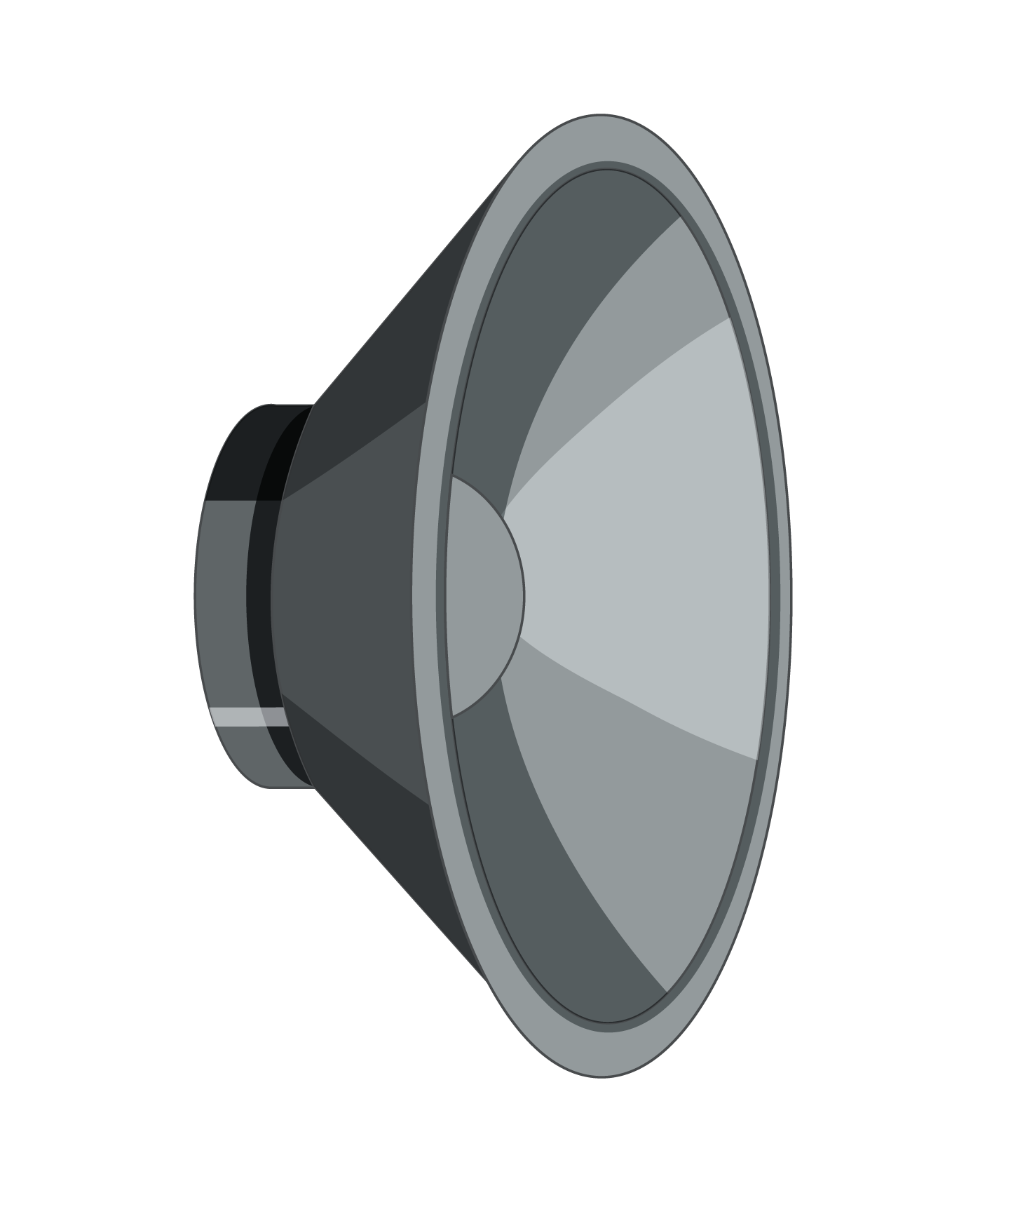
Cloud Infra
Cloud Infra uptime challenges
The reality of 99.999 availability
Under standing external and internal dependencies
How do we answer “Is it THEM or US”
Visibility into all aspects of infrastructure management
Proposed solution
Vittalkumar Mirajkar
Failure detection & health monitoring of Cloud Infra

Slide 3
Why do cloud infra have outages
Average cloud relies on 137 different services.
This is 137 failure points.
TWO Broader categories of cloud infra failures
External outage categories | Internal outages categories
Cascading failure of dependencies | Product issues
Outage caused by service providers. | Deployment related failures
Cloud infrastructure failure due to resource starvation | Resource starvation of nodes due to resource consumption due to prolonged running time
Network infrastructure issues | Interdependencies failure
Vittalkumar Mirajkar
Failure detection & health monitoring of Cloud Infra

Slide 4
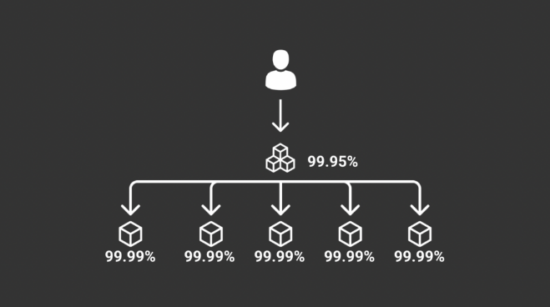
Understanding 99.999% availability
Understanding 99.999% availability
Composite SLA
Availability Level | Uptime | Downtime per Year | Downtime per Day
1 Nine | 90% | 36.5 days | 2.4 hours
2 Nines | 99% | 3.65 days | 14 minutes
3 Nines | 99.90% | 8.76 hours | 86 seconds
4 Nines | 99.99% | 52.6 minutes | 8.6 seconds
5 Nines | 100.00% | 5.25 minutes | 0.86 seconds
(System) Uptime != (Service) Availability
Defining Service uptime in multiple dependencies:
Composite SLA = No Of Dependencies * 0.9999 (assuming 99.99% availability)
Average 137 external dependencies.
I use external services which is 99.999 availability, do I need to worry ?
Vittalkumar Mirajkar
Failure detection & health monitoring of Cloud Infra

Slide 5
Composite SLA
(System) Uptime != (Service) Availability
Defining Service uptime in multiple dependencies:
Composite SLA = No Of Dependencies * 0.9999 (assuming 99.99% availability)
For example, an app with 5 dependencies, all with four nines of availability, can only offer a 99.95% SLA itself.
Composite SLA = 5* 0.9999 = 0.9995, this is 99.95 % availability.
Vittalkumar Mirajkar
Failure detection & health monitoring of Cloud Infra

Slide 6
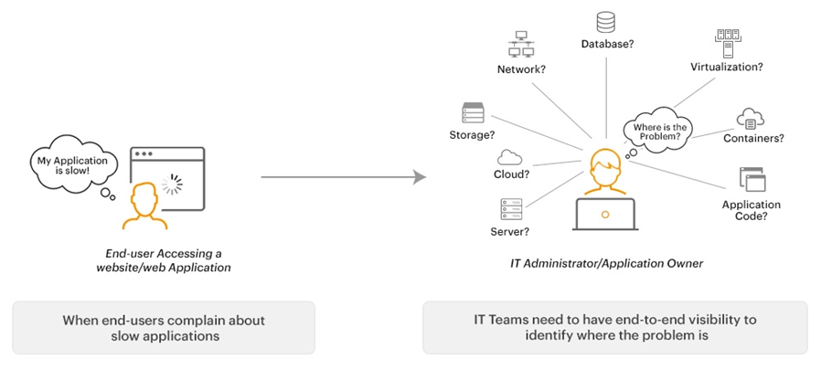
Ideal visibility landscape
What we expect from current infra visibility
Reality of Infra visibility
Multiple tools used in monitoring.
1/3rd issues detected manually.
1/4th SaaS solution provider don’t have full visibility
There are just too many tools to be monitored and any real time correlation needs to be done by the engineer,
SPEAKER NAME
TOPIC

Slide 7
What we address
During surgical procedure, entire health of patient is monitored before operating on the patient, irrespective of which area is being operated. This is done to maintain stability of the patient.
Musing on similar approach, we propose solution
During upgrade / maintenance window how to ensure there are no unforeseen failures leading to outages
Proactively detect failure of node based on its node health (resource consumption)
SPEAKER NAME
TOPIC

Slide 8
Stability during deployment / upgrade window
Maintenance window turning in to Outage window
Before upgrade, is / are the system ready for upgrade
Ideal state is decided based.
Current CPU consummation.
Current Memory usage vs available memory.
Current event in processing queue
Are the upstream dependencies fully functional and nodes in healthy condition
How do we achieve Infra visibility
Service Dependency Tree
Deployment Logs
Health Check API’s
Db queries
Cloud Services resources status (Ex: AWS status)
Compute node logs (Ex: EC2 logs)
Queue Health
Harness logs
Jenkins logs
Network connectivity
Vittalkumar Mirajkar
Failure detection & health monitoring of Cloud Infra

Slide 9
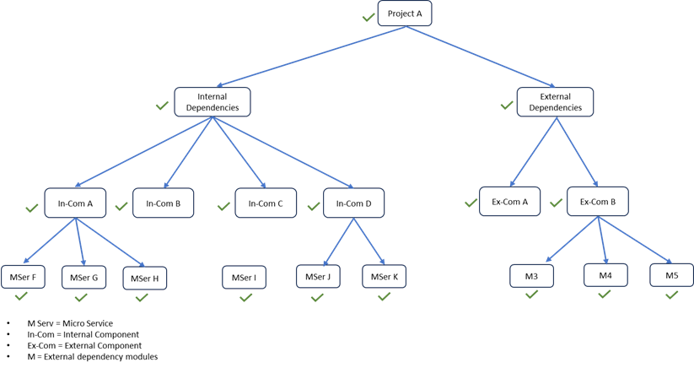
Guidelines for to start upgrade - 1
When all internal and external dependencies are Operational
Infra patching or upgrading, ensure
Current state of services running condition.
CPU consumption < 60 %
Memory consumption < 60 % of overall capacity
Network availability < 50 %
Have a clear internal and external dependencies mapped and tracked
Vittalkumar Mirajkar
Failure detection & health monitoring of Cloud Infra

Slide 10
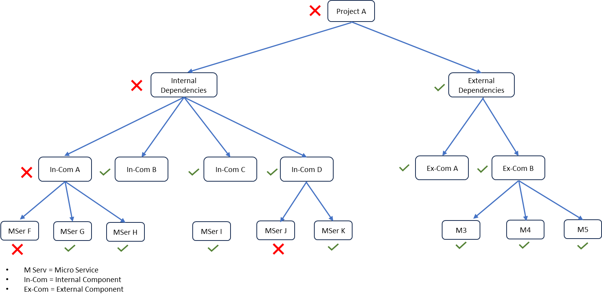
Guidelines for to start upgrade - 2
Internal and external dependencies are Non-Operational (internal dependency is down)
Vittalkumar Mirajkar
Failure detection & health monitoring of Cloud Infra

Slide 11
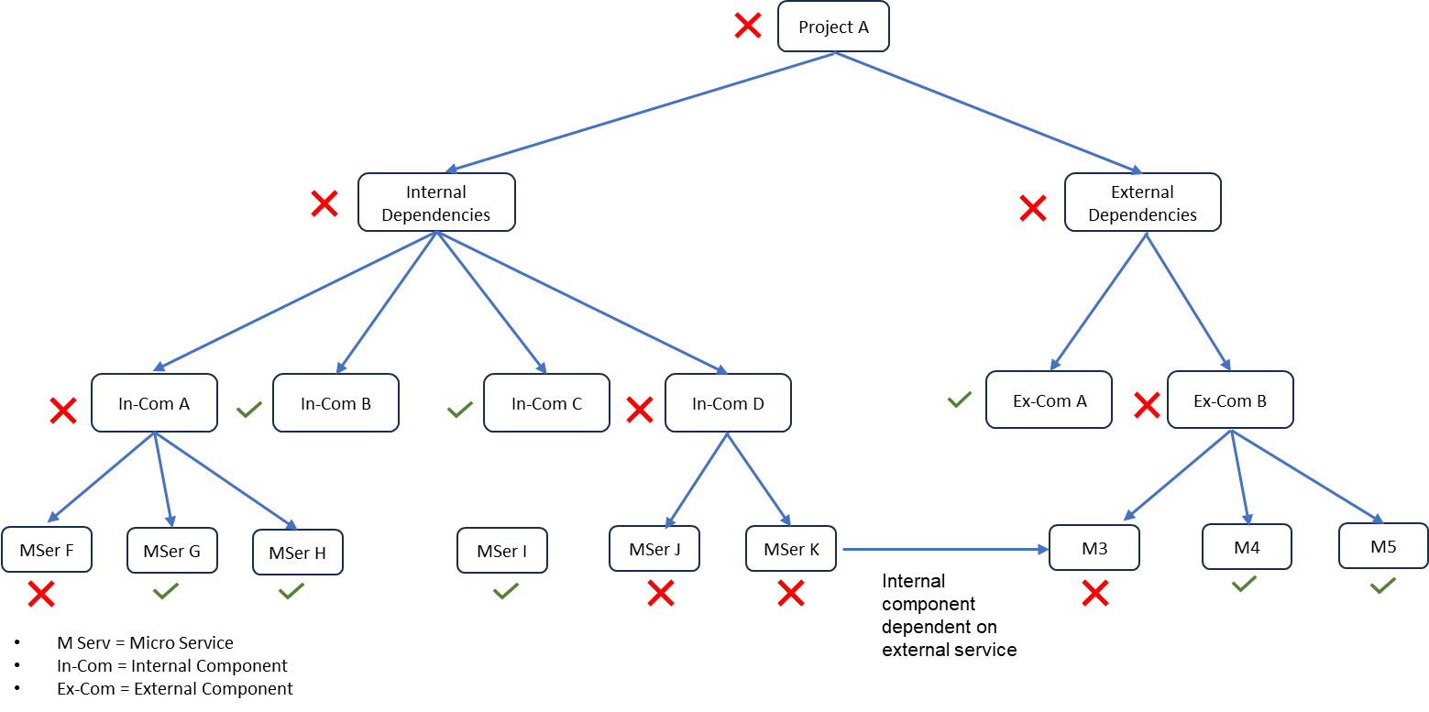
Guidelines for to start upgrade - 3
Internal and external dependencies are Non-Operational (External dependency is down)
Rule to be followed:
Before upgrade: Shutdown Downstream dependencies 1st
Upgrade
After upgrade: Restart Downstream dependencies.
Vittalkumar Mirajkar
Failure detection & health monitoring of Cloud Infra

Slide 12
Proactive failure detection
A service failure could be because of following two issues.
Software failure
A node could be in running condition, however nonfunctional.
A periodic smoke test running across all critical paths covered helps
Infra Node failure can be detected using
Node Health (using CSP api’s and custom client agent)
Process hung state
CPU and Memory consumption
Network spikes
Vittalkumar Mirajkar
Failure detection & health monitoring of Cloud Infra

Slide 13
Custom infra monitoring
We have built a custom monitoring setup using:
Using CSP API’s
Customer agents
Network monitoring
Co-relating existing status monitoring tools
Implementation:
QA cloud infrastructures having more than 400+ nodes and running 140+ microservices.
We monitored,
Infrastructure node level resource consumption
140+ micro service functional status
Vittalkumar Mirajkar
Failure detection & health monitoring of Cloud Infra

Slide 14
Results of new monitoring -1
Data parameters were measured across 2 quarters.
Total Outage Incident Count
Post deployment failure
Internal Service dependency related failures
External Dependency failures
Resource starvation related failures
Time taken for debugging service failures (in hrs)
Q1 (Jan – Feb – March) : Before applying NEW monitoring framework.
Q2 (April – May – June) : New monitoring system was implemented.
We have recorded:
Functional up time increased from 90% to 95%.
Eliminated resource starvation-based outage by >95%
Vittalkumar Mirajkar
Failure detection & health monitoring of Cloud Infra

Slide 15
Results of new monitoring - 2
Vittalkumar Mirajkar
Failure detection & health monitoring of Cloud Infra

Slide 16
Take aways
There is no one tool for monitoring everything.
Correlation between tools need to be automated.
Service status visibility is a must
service dependencies should be mapped.
Proactive hardware infra monitoring will help identify nodes which are leading towards failures,
You will not be able to avoid all failures.
During service failures quickly isolating the root cause is equally important.
Periodic smoke tests on production environments helps us proactively check functional working of all the services.
Vittalkumar Mirajkar
Failure detection & health monitoring of Cloud Infra

Slide 17
THANK YOU
Vittalkumar Mirajkar
Topic:
Real time failure point detection and operational health monitoring of Cloud Infra

