Slide 1
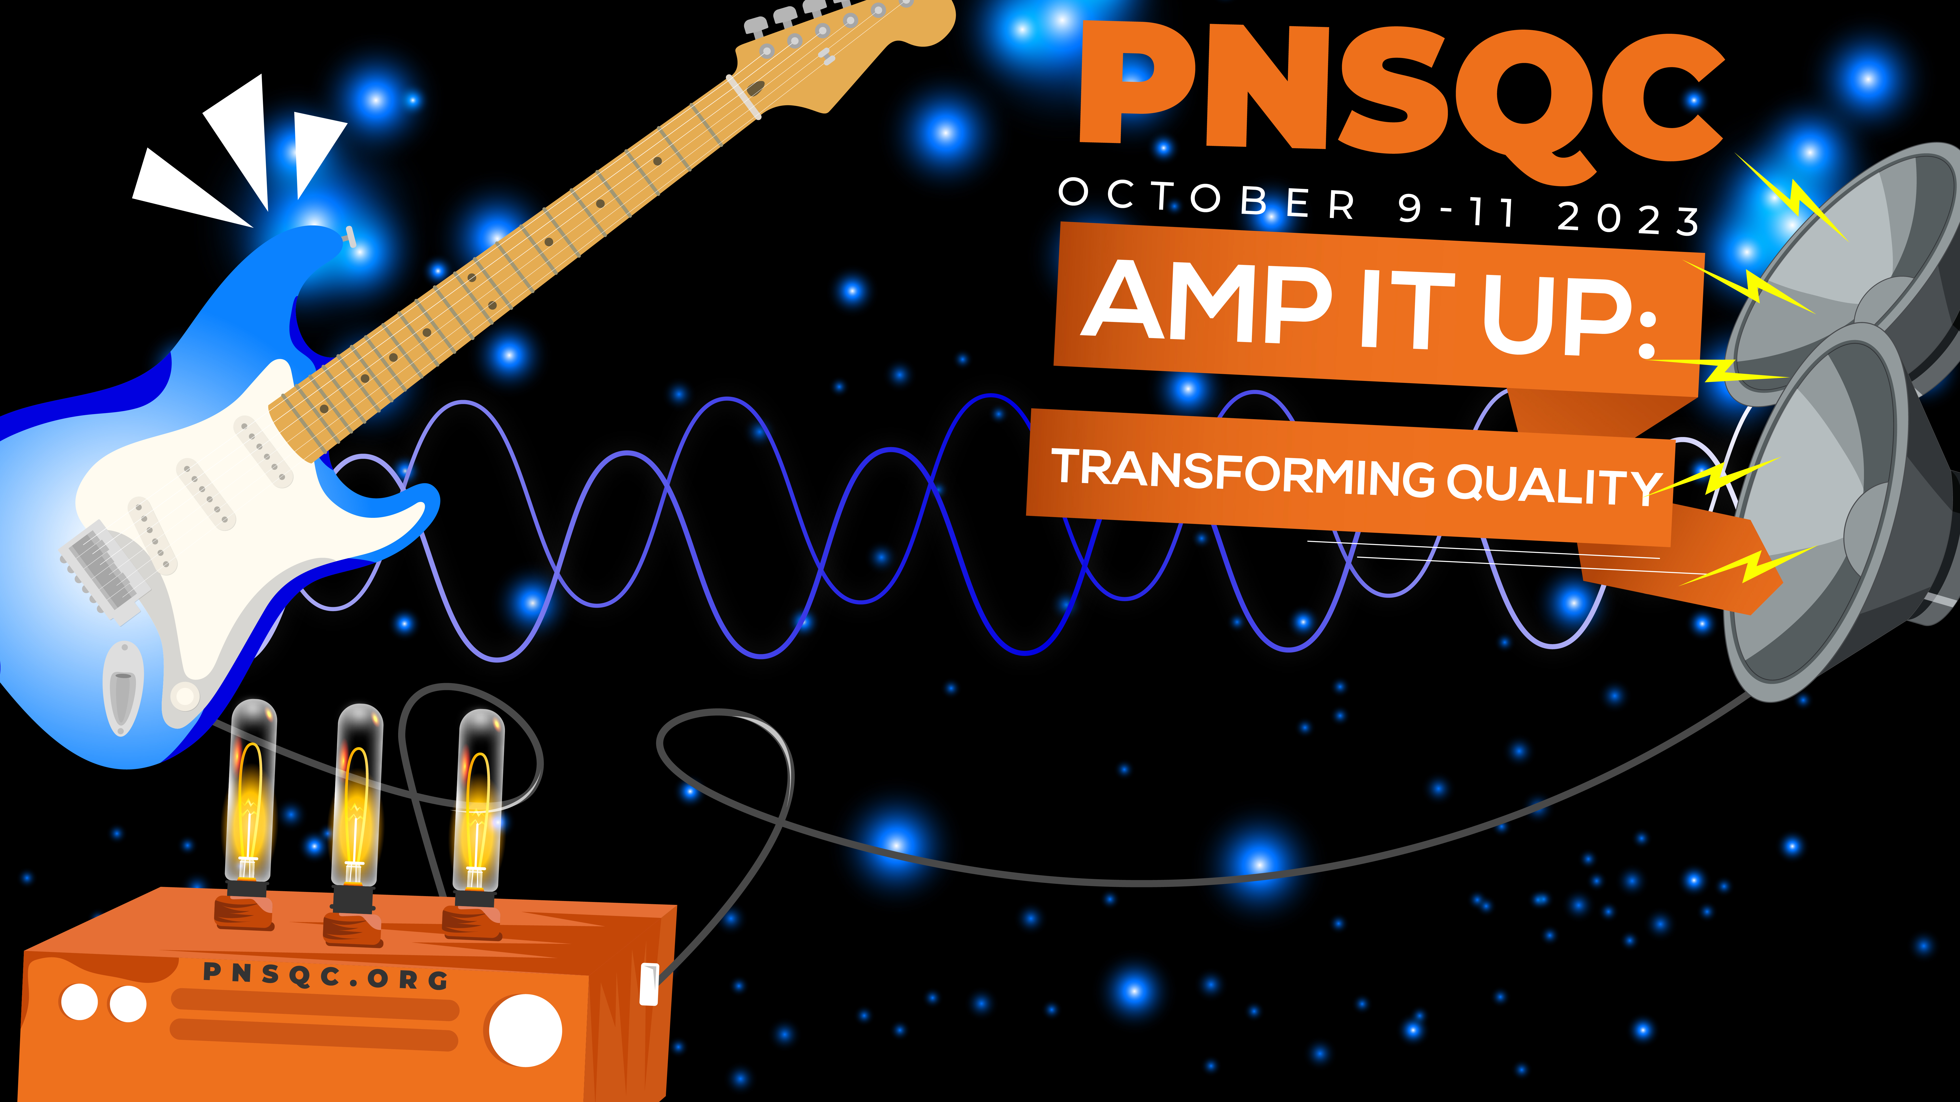


KAVITHA NAVEEN
Chatbots As Meeting Stand-In: Enhancing Remote Work Productivity

Slide 2

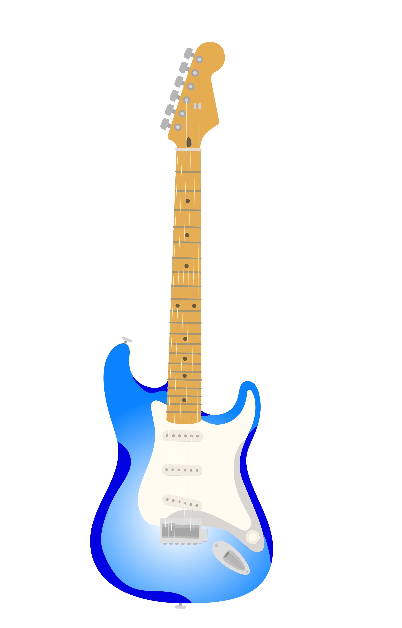


Agenda
Introduction - Overview of the Meeting Stand-In Bot
Features and Capabilities –
  Key Functions and Integration with Meeting Platforms
How the Bot Works –
  Automation of Routine Meeting Tasks
Benefits and Advantages –
  Time and Efficiency Savings
Use Cases –
  Scenarios Where the Bot Can Be Utilized
Security and Privacy –
  Data Handling and Protection
Conclusion - Encouragement for Adoption
SPEAKER KAVITHA NAVEEN
TOPIC

Slide 3

Introduction – Meeting Stand-In Chatbot
Modern Meeting Dilemma
Common challenges in today's meetings - scheduling conflicts, time wastage, and lack of organization.
.
Power of Artificial Intelligence
Organizations can save time, enhance productivity, and make data-informed decisions,
Benefits of Using AI-Powered Meeting Stand-In Bots
Enhanced Collaboration
Consistency and Quality
Need for innovative solutions to address the above issues
Transforming traditional processes adaptive to the demands of the modern world.
Improved Time Management:
Enhanced Collaboration:
Reduced Meeting Fatigue
SPEAKER KAVITHA NAVEEN

Slide 4
What is Meeting Stand-In Chatbot ?
SOFTWARE – Assist and Optimize Meetings
Virtual Assistant – Seamlessly Integrating
Zoom, Microsoft Teams, Communication channel etc
SPEAKER KAVITHA NAVEEN
TOPIC

Slide 5
Benefits and Advantages
Join as Meeting Stand-In
Subject Matter Expert
24/7 Availability
Meeting Stand-In Chatbot
KAVITHA NAVEEN

Slide 6
Features and Capabilities
Meeting Stand-In Chatbot
Efficiency
Engagement
Productivity
SPEAKER NAME
TOPIC

Slide 7
Features and Capabilities
Intelligent Scheduling: The chatbot can efficiently schedule meetings, consider participants' availability, and send calendar invitations, reducing the need for manual scheduling.
Natural Language Processing (NLP): It employs advanced NLP algorithms to understand and respond to user queries and requests in a conversational manner.
Customizable Responses: Users can customize the chatbot's responses to align with their communication style and preferences, ensuring a personalized experience.
AI-Powered Search: The chatbot can quickly search through vast amounts of data, documents, and information to provide relevant answers and resources during meeting
5. Availability: The chatbot is available round-the-clock, accommodating different time zones and helping users schedule meetings at their convenience.
6. A Meeting Stand-In Chatbot aims to simplify the process of organizing and conducting meetings, enhance collaboration, and save users time and effort in managing their meeting-related tasks.
SPEAKER NAME
TOPIC

Slide 8
How it works?
Users can interact with the chatbot through various channels, such as a website chat window, messaging apps (e.g., Slack, Microsoft Teams), or voice assistants.
Interaction can be initiated by sending messages or voice commands to the chatbot.
The chatbot employs Natural Language Processing (NLP) techniques to understand user queries and requests in natural language.
It uses machine learning models to parse and extract information from user inpu
Meeting Assistance:
User Intercation
Natural Language Understanding (NLU):
Meeting Assistance
Customizable Responses: Users can customize the chatbot's responses to align with their communication style and preferences, ensuring a personalized experience.
Multi-Platform Support: The chatbot can be accessed and interacted with across multiple communication platforms, such as Slack, Microsoft Teams, email, and web interfaces.
SPEAKER NAME
TOPIC

Slide 9
How it works?
Plugin
Can often be added as plugins or apps within these platforms. This means you can access their features directly from your preferred meeting software.
Real Time
These chatbots operate in real time, so as soon as you start a meeting, they begin transcribing and providing assistance, ensuring a smooth and uninterrupted experience.
Cloud based
Many Meeting Stand-In Chatbots operate in the cloud, which means they are easily accessible from any device with an internet connection, making them suitable for both remote and in-person meetings.
SPEAKER KAVITHA NAVEEN

Slide 10
Example – Daily Standup
Example: In this scenario, the chatbot steps in to represent Ann and ensure that her perspective and contributions are not missed.
Pre-Defined Responses:
Before the meeting, Ann can pre-configure the chatbot with key updates, action items, and responses to anticipated questions. This information is based on her insights and knowledge.
Real-Time Interaction:
During the meeting, when Ann’s turn to speak arises, the chatbot provides her pre-defined responses, ensuring that her perspective is represented accurately.
Clarifications:
If there are follow-up questions or a need for further clarification, the chatbot can either provide pre-configured answers or, in more advanced setups, request real-time input from Ann via text message or another communication channel.
SPEAKER KAVITHA NAVEEN

Slide 11
Limitations
Data Privacy and Security::
Pre-Configured Responses:
Consideration: Relying solely on pre-configured responses may limit the chatbot's ability to adapt to unexpected questions or nuances in the discussion.
Absence of Context:
Consideration: Chatbots may not possess the same level of context as a human team member, especially if the conversation delves into nuanced or context-dependent matters.
Consideration: Chatbots capture and transcribe meeting conversations. It's essential to ensure that sensitive or confidential information is handled securely and that the chatbot complies with data privacy regulations.
Mitigation: Implement robust security measures, including encryption and access controls, to protect sensitive data. Choose chatbot solutions that prioritize data privacy and compliance.
Mitigation: Balance pre-configuration with the chatbot's capacity to seek clarification or provide customizable responses in real time, where appropriate
Mitigation: When using chatbots in this manner, ensure they have access to relevant project documentation and contextual information to provide more accurate responses.
SPEAKER NAME

Slide 12
Key Takeaways
Meeting Stand-In Chatbots are Virtual Assistants:
Seemlkess Intgeration
They seamlessly integrate with common meeting platforms, ensuring a smooth user experience for both hosts and participants.
Practical Use Cases:
Meeting Stand-In Chatbots find applications in various scenarios, from simplifying scheduling to enhancing multilingual communication.
These chatbots function as virtual assistants during meetings, automating tasks such as scheduling, real-time transcription, note-taking, and more.
ize data privacy and compliance.
SPEAKER KAVITHA NAVEEN

Slide 13
THANK YOU
SPEAKER KAVITHA NAVEEN
Meeting Stand-In Chatbot

