Slide 1
Your picture
Jeff Sing
Building a Modern QA Program From the Ground Up

Slide 2
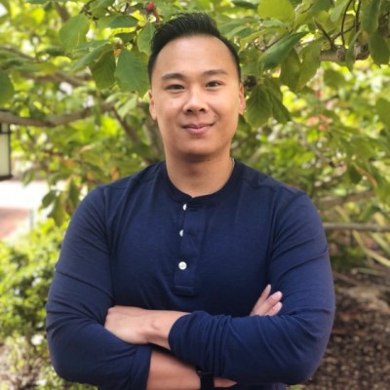
Learning
Sr Engineering Manager Iterable
Building
Skylight Healthcare
Optimizely
Medical Devices for Hospitals. 2 Person QA Org.
A/B Testing Platform.
Built QA Org (6+)
iovation
Iterable
Device based auth service. Automation engineer, 10+ QA Org.
Cross Channel Marketing Platform.
Built QA Org (6+) and Eng Ops (2+)
SPEAKER: Jeff Sing
TOPIC: BUILDING A MODERN QA PROGRAM FROM THE GROUND UP

Slide 3
Building a Modern QA Program from the Ground Up…

Slide 4
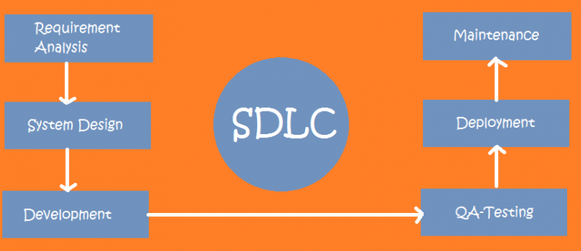
TRADITIONAL QA IN THE SDLC
Test Plan
Defect Support
Test Case
Support Release
Automation
Execute Tests
: JEFF SING
TOPIC: BUILDING A MODERN QA PROGRAM FROM THE GROUND UP

Slide 5
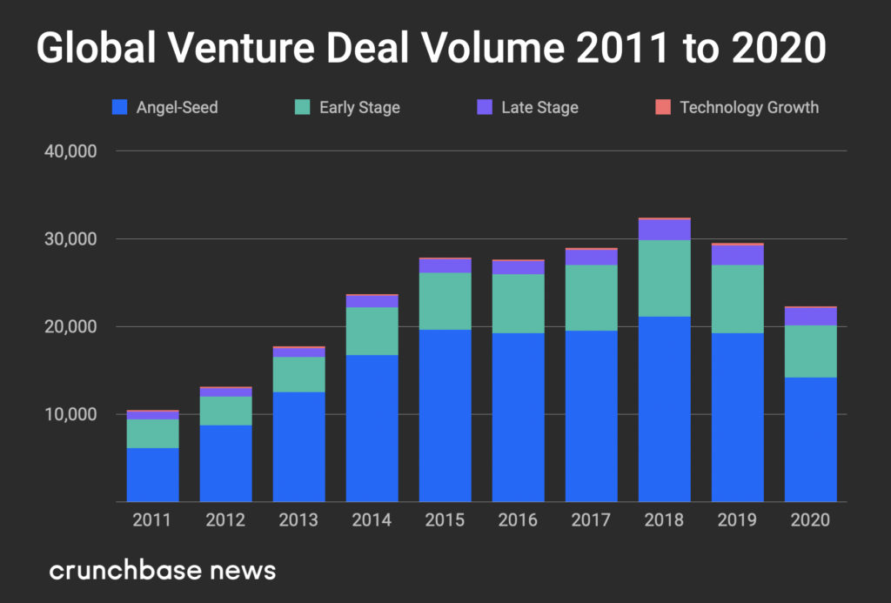
WHAT’S CHANGED
Velocity
Tooling
Speed to market is king until company matures.
Modern DevOps stresses importance of Shift Left and Shift Right
Risk
Job Fit
Code can be deployed frequently, shipping a defect is less significant.
Traditional QA Process doesn’t quite fit in this newer environment.
: JEFF SING
TOPIC: BUILDING A MODERN QA PROGRAM FROM THE GROUND UP

Slide 6
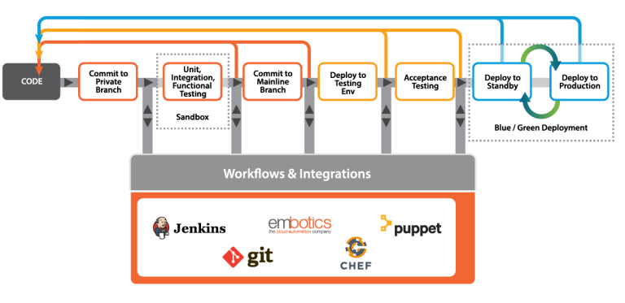
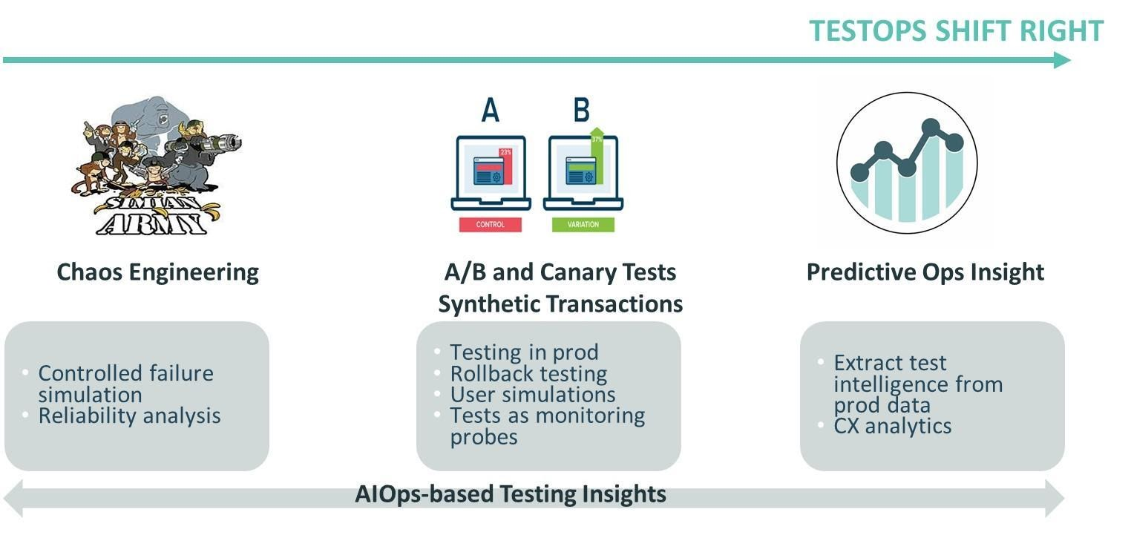
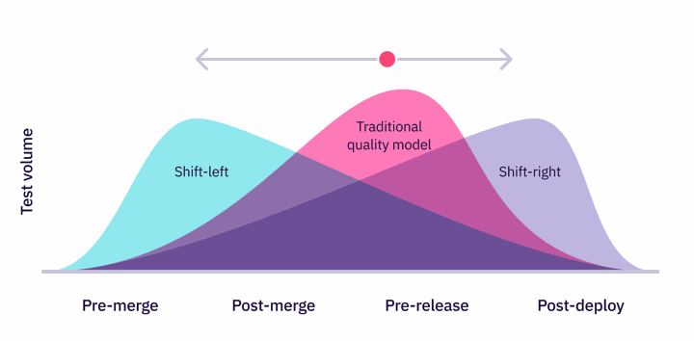
DO WE NEED TRADITIONAL QA?
: JEFF SING
TOPIC: BUILDING A MODERN QA PROGRAM FROM THE GROUND UP

Slide 7
HOW DOES THIS TRANSLATE TO HAPPY CUSTOMERS?
Defects Filed?
Deployment Velocity?
Less defects means happier customers right?
Move fast break things!
Number of E2E Tests Run?
Unit Testing Coverage?
We run 700 Cypress tests, parallized, only takes us 1 hr. Mission Accomplished!
Over 90% Unit Test Coverage, nothing to see here!
Number of A/B Tests?
NPS Score?
It’s over 95!
Test in Production, customers know best!
: JEFF SING
TOPIC: BUILDING A MODERN QA PROGRAM FROM THE GROUND UP

Slide 8
The main strategic challenge QA teams are facing in agile and DevOps adoption is ‘operational and business priorities’ now more than ever, teams need to ensure the development projects on which they are embarked are aligned closely to the needs of the business, and also to the customers they serve.
This means that new ways of working are required, in the form of a smart, connected, and business-driven ecosystem.
World Quality Report 2019-20
: JEFF SING
TOPIC: BUILDING A MODERN QA PROGRAM FROM THE GROUND UP

Slide 9
“New ways of working are required…”
The Modern Quality Program

Slide 10
RESPONSIBILITIES AS A MODERN QUALITY PROGRAM LEADER
Quality Program Manager
Technical Architect
Quality Operations
Engineering Leader
Implement the Quality SDLC Program, driving the engineering org towards its Quality North Star.
Identify what KPI/Metrics represent Quality, and review if organization is achieving its goals.
Visionary of the technical roadmap of tools, frameworks, and QAOPS needed for engineering to move with high velocity.
Work crossfuctionaly across partner organizations to champion the customer experience. Manage the resources to accomplish this mission.
: JEFF SING
TOPIC: BUILDING A MODERN QA PROGRAM FROM THE GROUND UP

Slide 11
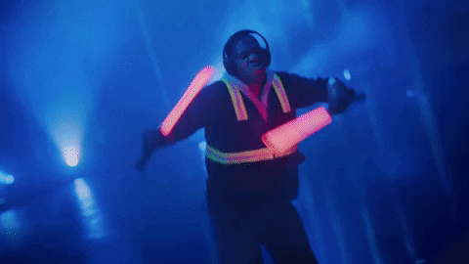
TRADITIONAL QA IN THE SDLC
QUALITY PROGRAM
MANAGER
: JEFF SING
TOPIC: BUILDING A MODERN QA PROGRAM FROM THE GROUND UP

Slide 12
QUALITY PROGRAM MANAGER
Program Vision
What Quality Program & Process does my company need now, and what will it need in the future?
Quality Coaching
Implement the Quality SDLC + justify ROI of Program
Customer Advocate
How do we ensure that the customer experience is baked into how we build features?
: JEFF SING
TOPIC: BUILDING A MODERN QA PROGRAM FROM THE GROUND UP

Slide 13
TRADITIONAL QA IN THE SDLC
TECHNICAL ARCHITECT
: JEFF SING
TOPIC: BUILDING A MODERN QA PROGRAM FROM THE GROUND UP

Slide 14
TECHNICAL ARCHITECT
Technical Leadership
Automation Mentorship
What should the best practices be here and how do we execute them?
Building the program to uplevel my engineers to write good automation.
: JEFF SING
TOPIC: BUILDING A MODERN QA PROGRAM FROM THE GROUND UP

Slide 15
TRADITIONAL QA IN THE SDLC
QUALITY OPERATIONS
: JEFF SING
TOPIC: BUILDING A MODERN QA PROGRAM FROM THE GROUND UP

Slide 16
QUALITY OPERATION CYCLE
Data Collection
What indicators do we want to monitor to determine our system quality and customer satisfaction?
How do we collect this data?
Visibility
How do we share out data to the right parties and do they understand what it all means?
1
2
Implementation
Drive discussion and identify stakeholders to execute changes.
Reflection & Analytics
Understand if our initiatives actually made a difference?
How should we iterate to perfection?
3
5
Governance
Review and Enact systems that hold stakeholders accountable for change.
4
: JEFF SING
TOPIC: BUILDING A MODERN QA PROGRAM FROM THE GROUND UP

Slide 17
KPI/METRICS THAT LINK QUALITY WITH BUSINESS SUCCESS
Number of incoming customer reported bugs vs number of outgoing pull requests
Normalized Bug Ratio
Amount of High/Medium Sev post production bugs + SLO/SLA status
High Sev Bugs
NPS Score or any data that shows customer usage rates or happiness index.
Customer Satisfaction
: JEFF SING
TOPIC: BUILDING A MODERN QA PROGRAM FROM THE GROUND UP

Slide 18
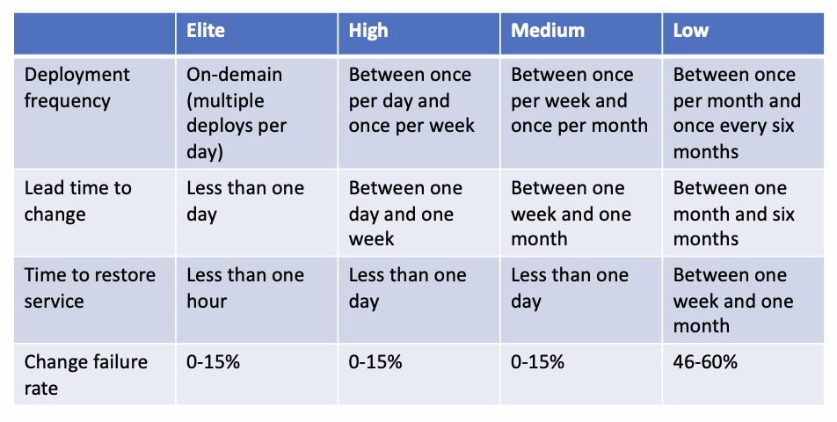
NON TRADITIONAL QUALITY METRICS
Benchmarkable Metrics - can compare us vs other companies
: JEFF SING
TOPIC: BUILDING A MODERN QA PROGRAM FROM THE GROUND UP

Slide 19
TRADITIONAL QA IN THE SDLC
ENGINEERING LEADER
: JEFF SING
TOPIC: BUILDING A MODERN QA PROGRAM FROM THE GROUND UP

Slide 20
ENGINEERING LEADERSHIP
01
Involve Security Early and Often
02
Utilize Soft Power
03
Swiss Army Knife Job Roles
04
Thoughtful Team Building
05
People Manager To Scale
: JEFF SING
TOPIC: BUILDING A MODERN QA PROGRAM FROM THE GROUND UP

Slide 21
Now you know the roles, how do you navigate the start?

Slide 22
TIPS THAT HELPED ME BUILD FROM SCRATCH
1
2
3
4
North Star
Judge Value
Quick Win
Don’t Go Alone
Establish a mission statement which will guide you on which projects you should engage on.
Does current initiatives makes sense at this point in time? If not, why are you pursuing them?
Small quick wins will create a lot of value and help build momentum for bigger wins later.
Find your champions that will be your stakeholders in quality. They will help you steer your program.
: JEFF SING
TOPIC: BUILDING A MODERN QA PROGRAM FROM THE GROUND UP

Slide 23
THANK YOU
Stay In Touch!
Your picture
or talk title
linkedin.com/in/jeffsing
jeff.sing@iterable.com

